Slide 1

Cognitive Computing
Dr. Piyush Joshi
Assistant Professor
IIIT Sri City

Slide 2
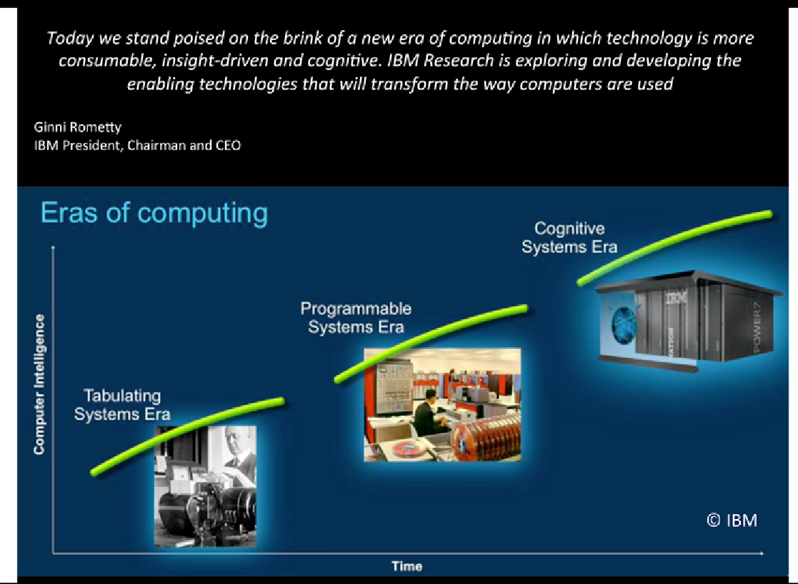
The eras of computing

Slide 3
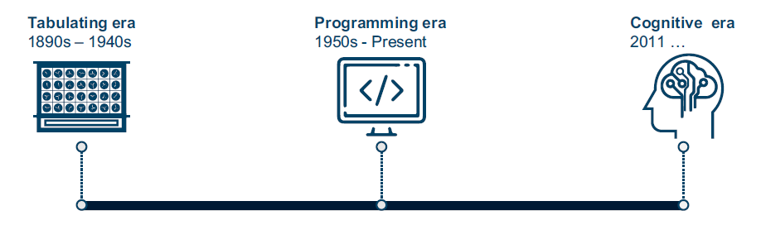
The eras of computing
Till now, two distinct eras of computing have occurred: the tabulating era and the programming era.
We are entering the third and most transformational era in computing’s evolution, the cognitive computing era (cognitive era).

Slide 4
The eras of computing
Tabulating era (1890s - 1940s)
The first era of computing consisted of single-purpose electromechanical systems that counted, using punched cards to input and store data, and to eventually instruct the machine what to do.
These tabulation machines were essentially calculators designed to count and summarize information and they did it really well but were ultimately limited to a single task.

Slide 5
The eras of computing
Programming era (1950s - present)
This era started with the shift from mechanical tabulators to electronic systems
The introduction of general purpose computing systems that are programmable
They can be reprogrammed to perform different tasks and solve multiple problems in business and society.
But ultimately, they must be programmed and are still somewhat constrained in the interaction with human beings.

Slide 6
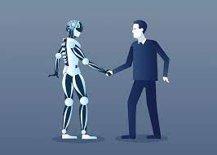
The eras of computing
Cognitive era (2011 - future)
As J.C.R Licklider predicted (“Man-Computer Symbiosis”), cognitive computing is a necessary and natural evolution of programmable computing.
Cognitive computing systems are meant to extend the boundaries of human cognition.
Cognitive computing technologies are not about replacing or necessarily even replicating the way that the human brain works; they are about extending the capabilities of the human brain.

Slide 7
The eras of computing
Humans excel at reasoning, deep thinking, and solving complex problems.
But the human ability to read, analyze, and process huge volumes of data, both structured and unstructured, is quite poor.
That, of course, is the strength of the computer system.
The first role of a cognitive computing system is to combine strengths of human and machine into a collaborative situation.
Another key element of cognitive systems is a more natural interaction between human and machine, combined with the capability to learn and adapt over time.

Slide 8
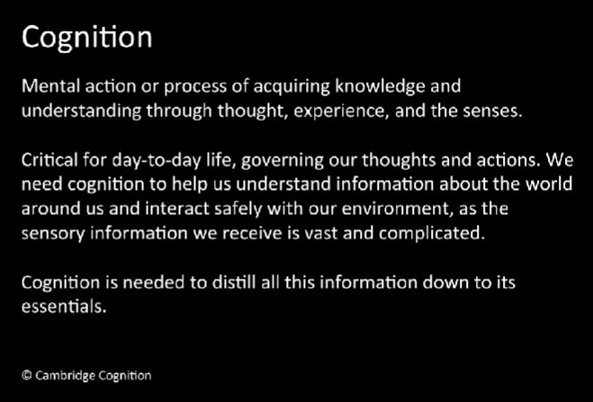

Slide 9
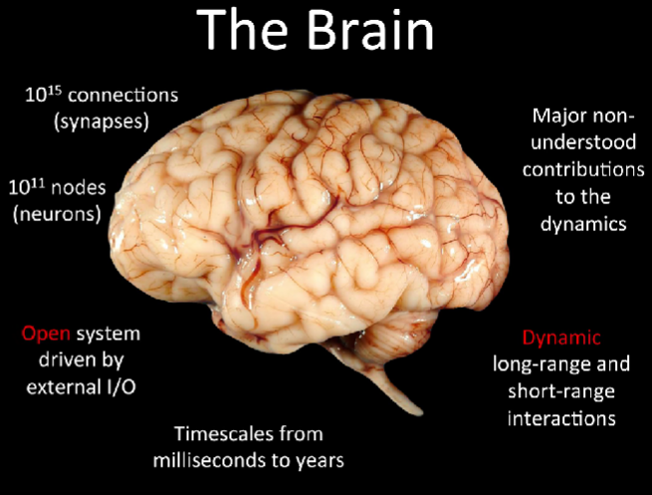

Slide 10
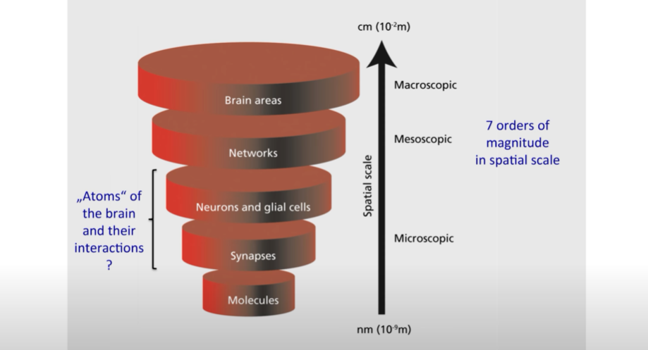

Slide 11
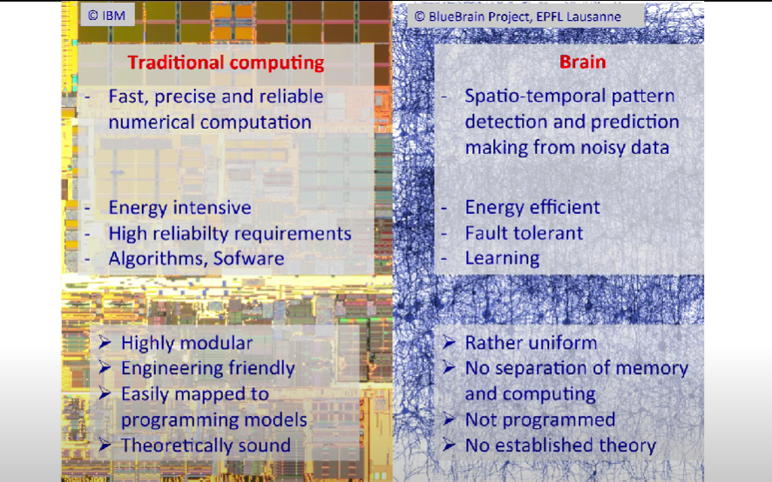

Slide 12
CC: The future computing
“Those of us engaged in serious information science and in its application in the real world of business and society understand the enormous potential of intelligent systems. The future of such technology — which we believe will be cognitive, not “artificial”— has very different characteristics from those generally attributed to AI, spawning different kinds of technological, scientific and societal challenges and opportunities, with different requirements for governance, policy and management.”
Computing, cognition and the future of knowing: How humans and machines are forging a new age of understanding, Dr. John E. Kelly
“Cognitive computing refers to systems that learn at scale, reason with purpose and interact with humans naturally. Rather than being explicitly programmed, they learn and reason from their interactions with us and from their experiences with their environment.”

Slide 13
Cognitive Processes
Learning and Memory
Thinking and Reasoning (Planning, Decision Making, Problem Solving ...)
Language
Vision-Perception
Social Cognition
Dreaming and Consciousness
Notes:
Learning
Memory
Thinking and Reasoning (Planning, Decision Making, Problem Solving ...)
Language
Vision-Perception
Social Cognition
Metacognition
Emotions
Dreaming
Consciousness

Slide 14
Cognitive steps in human
When we as humans seek to understand something and to make a decision, we go through four key steps:
1. Observe visible phenomena and bodies of evidence.
2. Interpret what we see by drawing on what we know in order to generate hypotheses about it means.
3. Evaluate which hypotheses are right or wrong.
4. Decide (choose) the option that seems best and act accordingly.
Just as humans become experts by going through the process of observation, evaluation and decision-making, cognitive systems use similar processes to reason about the information they absorb.

Slide 15
Cognitive Science
“The interdisciplinary study of mind and intelligence”
“Study of cognitive processes involved in the acquisition, representation and use of human knowledge”

Slide 16
Impact of cognitive computing to our lives
Whether you realize this or not, cognitive computing is already having an impact on our lives.
Often when you talk to a call center, your interaction is likely with a computer.
Articles that you read might have been written by a machine. In many cases, such as online shopping, cognitive computing understands your behavior and activities and makes recommendations based on that understanding.
Chatbots that are powered by cognitive computing have been built to successfully support complaint-resolution services.

Slide 17
Some basic concepts

Slide 18
Basic concept (Cognition)
Cognition, the “act of thinking,” is the mental process of acquiring understanding through thought and personal or shared experiences.
Brain-based skills are part of every human action and are essential in carrying out any task, from the simplest to the most difficult.
Tasks include human senses (hearing, touch, smell, sight, taste, and even extra-sensory perception), learning, remembering, motor skills, language, empathy, social skills, and problem solving capabilities.

Slide 19
Basic concept (Cognition)
As stated, cognition is the process of acquiring knowledge through thoughts, experiences, and senses.
Cognitive processing helps us understand and interact with the world around us from the basic to the complex.

Slide 20
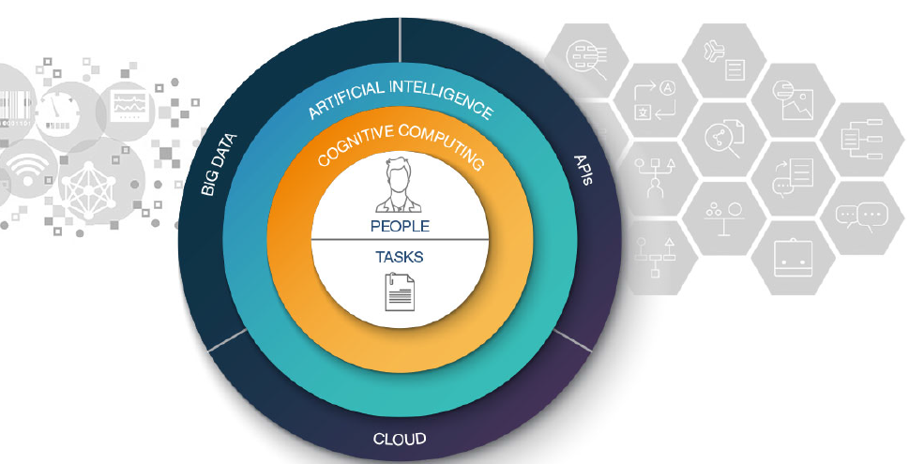
Cognitive System: Integration of basic concepts

Slide 21
Basic concept (AI)
The study and development of AI systems aim at building computer systems able to perform tasks that normally require human intelligence.
AI-based machines are intended to perceive their environment and take actions that optimize their level of success.
Today’s AI can be considered weak, in that it is designed to perform narrow and specific tasks.
The goal of many researchers is to create strong AI that learns like a human and can solve human-type problems.
AI research uses techniques from many fields, such as computer science, philosophy, linguistics, economics, speech recognition, and psychology, which are manifested in applications, such as control systems, natural language processing, facial recognition, speech recognition, analytics, pattern matching, data mining, and logistics.

Slide 22
Basic concept (Cognition computing)
Humans are inherently capable of a set of skills that help us learn, discover, and make decisions:
Humans can apply common sense, morals, and reason through dilemmas.
Humans can think of new ideas and make generalizations when essential clues and pieces of information are missing.
But humans are restricted by the amount of time spent to learn, process, and absorb new information, and limited by the unconscious biases we all possess that influence the decisions we make.

Slide 23
Basic concept (Cognition computing)
Cognitive computing is among the subdisciplines that shape AI.
It is about putting together a system that combines the best of human and machine capabilities.
Consider capabilities that humans naturally have, such as imagination and emotions, combined with capabilities that computers excel at, such as number crunching, identifying patterns, and processing huge amounts of information.
Cognitive computing uses machine strengths to “simulate” the human thought processes in a computerized model.

Slide 24
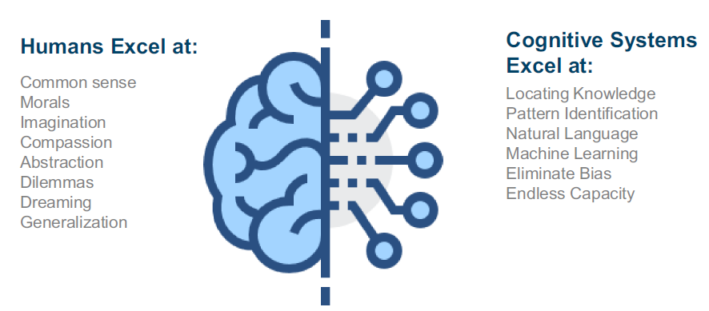
Basic concept (CC)

Slide 25
Basic concept (Big data)
Often big data characteristics are defined by the five V’s: variety, volume, velocity, veracity, and value.
Big data requires innovative forms of information processing to draw insights, automate processes, and assist in decision making.
Big data can be structured data that corresponds to a formal pattern, such as traditional data sets and databases.
Also big data includes semi-structured and unstructured formats, such as word processing documents, videos, images, audio, presentations, social media interactions, streams, web pages, and many other kinds of content.
Unstructured data is not contained in a regular database and is growing exponentially, making up the majority of all the data in the world.

Slide 26
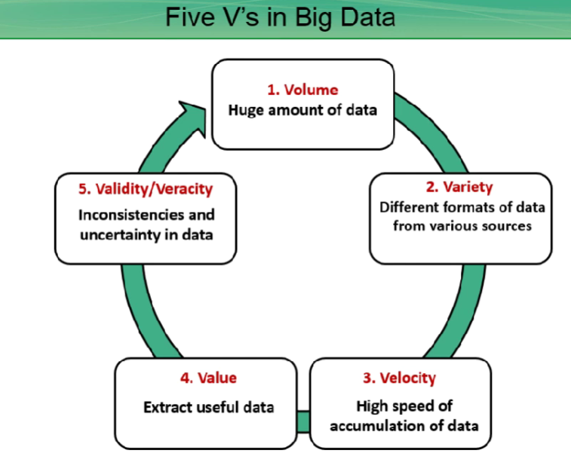

Slide 27
Basic concept (QA technology)
Cognitive systems can ingest millions of pages of text and apply question-answering technology to respond to questions posed by humans in natural language.
This approach allows people to “ask” and get almost instantaneous answers to complex questions.
Combined with other application programming interfaces (APIs) and advanced analytics, QA technology distinguishes itself from the conventional search (that is triggered by keywords) by providing a more conversational discussion.

Slide 28
Basic concept (ML)
Machine learning is a type of AI that gives computers the ability to learn and act without being explicitly programmed.
This means that the computer model gets better over time by learning from its mistakes and new experiences (being exposed to new data), increasing its intelligence.
If a computer program can improve how it performs certain tasks that are based on past experiences, then it has learned.
This differs from performing the task always the same way because it has been programmed to do so.

Slide 29
Basic concept (NLP)
NLP is the ability of computer software to understand human speech.
By using NLP capabilities, computers can analyze text that is written in human language and identify concepts, entities, keywords, relations, emotions, sentiment, and other characteristics, allowing users to draw insights from content.
Any system that takes natural language as input and is capable of processing it is a natural language processing system (for example, spam-detection software).
A spam classifier is a system that looks at the content of the email subject line to assess whether the received email is or is not spam.

Slide 30
Basic concept (cloud computing)
Cloud computing is a general term that describes delivery of on-demand services, usually through the Internet, on a pay-per-use basis.
Companies worldwide offer their services to customers.
Services might be data analysis, social media, video storage, e-commerce, and cognitive computing in a way that is available through the Internet and supported by cloud computing.

Slide 31
Basic concept (APIs)
In general, APIs expose capabilities and services.
APIs enable software components to communicate with each other easily.
Making the task easier to connect and interface with other applications or services.
APIs abstract the underlying workings of a service, application, or tool, and expose only what a developer needs, so programming becomes easier and faster.

Slide 32
Cognitive System: Integration of basic concepts

