Slide 1

AUTHENTICATION & AUTHORIZATION

Slide 2
Identity and access management -- provides control over user validation and resource access.
-- ensures right people access the right
Resource
Identity
Authentication
Authorization
Authentication and authorization are two vital information security processes that administrators use to protect systems and information

Slide 3
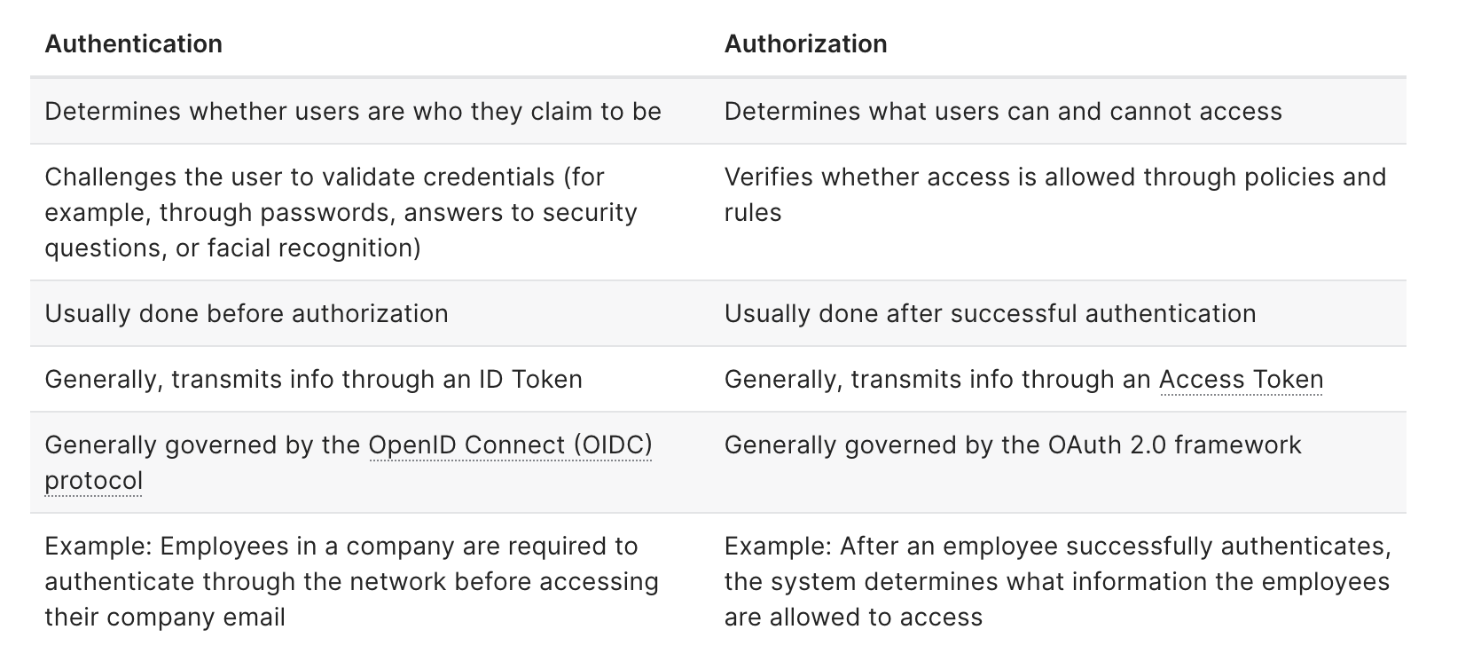
Authentication vs. Authorization

Slide 4
Authentication –
Identity of users are checked for providing the access to the system.
Users or persons are verified.
The authentication credentials can be changed in part as and when required by the user.
Authentication is visible at user end.
The user authentication is identified with username, password, face recognition, retina scan, fingerprints, etc.
Popular Authentication Techniques-
-- Password-Based Authentication -- Passwordless Authentication -- 2FA/MFA (Two-Factor Authentication / Multi-Factor Authentication) -- Single sign-on (SSO) -- Social authentication
Authorization –
The person’s or user’s authorities are checked for accessing the resources
Users or persons are validated.
Authorization permissions cannot be changed by user as these are granted by the owner of the system and
only he/she has the access to change it
Not visible at user end.
The user authorization is carried out through the access rights to resources by using roles that have been pre-defined.
Popular Authentication Techniques-
Role-Based Access Controls (RBAC)
JSON web token (JWT) Authorization
SAML Authorization
OpenID Authorization
OAuth 2.0 Authorization

Slide 5
Authentication TYPES
Password Based :
Most commonly utilized regular login authentication system Input a combination of your username/mobile number and a password - Individual is considered valid if both match and is verified To reduce risk, users need to choose secure passwords and even asked to reset it frequently.
Multi-Factor Authentication :
Individual must pass multiple factors in order to gain access to a service or network Extra layer of security on top of the standard password-based login Examples - OTP/TOTP via SMS, OTP/TOTP over Email, Push notification, Hardware Token, and Mobile Authenticator For improved security, password-based traditional authentication and Multi-Factor Authentication methods are usually used simultaneously

Slide 6
Biometric Authentication : Individual physical attributes such as fingerprints, palms, retinas, voice, face, and voice recognition are used in biometric authentication Biometric authentication works in the following way: -- first, the physical characteristics of individuals are saved in a database. -- Individuals’ physical features are checked against the data contained in the database whenever a user wants to access Creates a high level of security and a user-friendly frictionless flow Fingerprint: - fingerprint authentication matches the unique pattern of an individual’s print - most user-friendly and accurate biometric systems, fingerprint authentication is currently the most common biometric technology
Retina & Iris : Scanners shine a strong light into the eye and look for distinctive patterns in the colourful ring around the pupil of the eye in this biometric. After that, the scanned pattern is compared to data recorded in a database.

Slide 7
Facial: In facial authentication, multiple aspects of an individual’s face are scanned while they try to get access to a certain resource. When comparing faces from different angles or persons that look similar, such as family members, face recognition results can be inconsistent. Voice Recognition: Your voice tone is stored with a standardized secret code in the same way that the above-mentioned approach does. A check occurs because you must speak off each time you want access.
Certificate-based authentication: Certificate authentication uses digital certificates issued by a certificate authority and public key cryptography to verify user identity. The certificate stores identification information and the public key, while the user has the private key stored virtually. Certificate-based authentication can be costly and time-consuming to deploy.

Slide 8
Token-Based Authentication: Allows users to enter their credentials only once and obtain a one-of-a-kind encrypted string exchange in return. After that, you won’t have to input your credentials every time you want to log in or acquire access. With token-based authentication, users verify credentials once for a predetermined time period to reduce constant logins. Tokens make it difficult for attackers to gain access to user accounts.
Single Sign-On Authentication (SSO) : Enables an user to use a single set of credentials to access multiple applications or websites. The user has an account with an identity provider (IdP) that is a trusted source for the application (service provider). The service provider doesn't save the password. The IdP tells the site or application via cookies or tokens that the user verified through it. SSO reduces how many credentials a user needs to remember, strengthening security. But if an IdP suffers a data breach, attackers could gain access to multiple accounts with a single set of credentials

Slide 9
Adaptive Authentication – authenticate users depending on their “IP, Device, Location, Device, and Time of Access When IP and Location-based authentication are enabled, after entering the username and password, Adaptive Authentication will check if the user’s IP is the same as the one used by the administrator and whether he is in the location to which he has been assigned.
API Authentication --
HTTP Basic Authentication API Passwords Oauth
CAPTCHAs

Slide 10
Authentication method protocols
Lightweight Directory Access Protocol (LDAP) – process of verifying usernames and passwords stored in a directory service, Administrators can create user accounts and grant them permissions. When a user tries to access a resource, a request is sent to the LDAP authentication server. The LDAP server validates the entered username-password against the data in the directory.
Password Authentication Protocol (PAP) - used if servers cannot handle stronger protocols. PAP sends usernames and passwords in plaintext
Challenge-Handshake Authentication Protocol (CHAP) - uses a challenge/response mechanism to authenticate instead of transmitting a secret
Kerberos - used to authenticate over insecure networks relies on temporary security certificates known as tickets uses a trusted third party to maintain security
SSL / TLS - uses public key cryptography and digital certificates to authenticate between user and server Client certificates and server certificates are exchanged to verify each party’s identity in a process known as mutual identification A web browser checks the validity of the certificate before connecting to the server.

Slide 11
Authorization STRATEGIES
Role-based access controls (RBAC):
Treats authorization as permissions associated with roles and not directly with users
Role - collection of permissions managing authorization privileges becomes easier
Attribute-Based Access Control (ABAC) Sufficient access privileges to execute an action is checked based on a trait (attribute or claim) associated with that user ABAC grants users permissions on a more granular level than RBAC using a series of specific attributes. ABAC is a more complex authorization process than RBAC designed to further limit access
Relationship-Based Access Control (ReBAC)
Relationship Based Access Control examines the relationship to the object or action with the user The relationship can come via a user attribute or having a direct relationship Sometimes a traversal of a graph of groups, roles, organizations, and objects requires exploring many nodes to establish a relationship

Slide 12
THANK YOU…

