Slide 1

OBJECT RELATIONAL MAPPING [ORM]

Slide 2
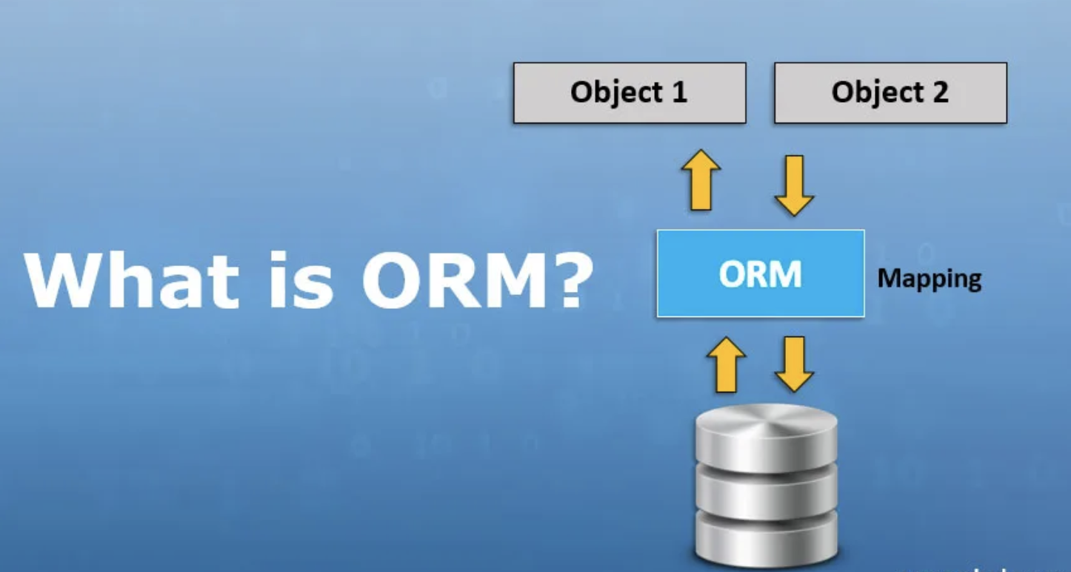
ORM
Creates a object-oriented layer between the object-oriented programming language and the relational database, helping programmers work with data without the OOP paradigm.
Makes it possible to address, access and manipulate objects without having to consider how those objects relate to their data sources
ORM and ORM tools help simplify the interaction between relational databases and different OOP languages

Slide 3
How does ORM work?
Generates objects which map to tables in the database virtually
ORM uses libraries to comprehend the code in the form of objects and then maps it to database
This “plumbing” type of code does not have to be rewritten, saving the developer a tremendous amount of time
Choose the right database you want to use.
Decide on Object Relational Mapper that would work efficiently with the database, and install it.
Create a database model - represents the structure of our database.

Slide 4

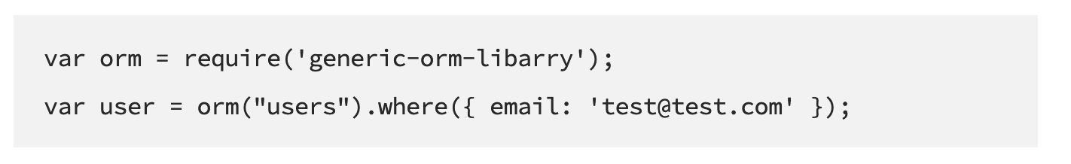
ORM Example
"SELECT id, name, email, country, phone_number FROM users WHERE id = 20"
Include ORM Library and use it
users.GetById(20)

Slide 5
features
Makes the application independent of the database management system being used in the backend, and so you can write a generic query
Migrating to another database, it becomes fairly a good deal to have ORM
Hassles of coders are reduced to learn SQL syntaxes separately for whichever database being used
Coders can shift their focus on optimizing the code and improving performance rather than dealing with connectivity issues
All small or big changes can be carried out via ORM, so there are no such restrictions when we deal with data
The connection becomes robust, secure as there will be less intervention in code
There is a fairly large deal of ORMs present in the market as per the application language used - One can choose easily as per business requirements.
Disadvantage - database is in legacy file systems and disarranged, need to arrange data first and then map this with ORM

Slide 6
advantages
Harmonization of data types between the OO language and the SQL database. All relational databases use data types for each of the fields, sometimes you have to convert the data types on the fly to properly add a record to the database. A good ORM will take care of these details for you.
Using an ORM will create a consistent code base for your application - makes it easier to write and debug your application
ORM frameworks will shield your application from SQL injection attacks since the framework will be filtering the data for you.
Switching of databases is easy

Slide 7
TYPES of ORM
As the name suggests, Object Relational Mapping are designed for relational databases. Below are some of the known ORMs that support Nodejs:
Node-ORM, Bookshelf, Objection.js. These types of ORMs work perfectly with MySQL, SQLite, and PostgreSQL databases.
Caminte is a powerful ORM that supports a large number of database formats such as MySQL Sqlite3, Riak, Postgres, Couchdb, Mongodb, Redis, Neo4j, Firebird, Rethinkdb, Tingodb.
Sequelize ORM fully supports PostgreSQL, MySQL, MariaDB, SQLite, and Microsoft SQL Server database formats.

Slide 8
SEQUELIZE

Slide 9
Sequelize
Sequelization is the process of connecting a Node.js application to an Object Relational Mapper for better database synchronization.
Sequelize is a promise-based ORM (Object Relational Mapping) that deals with the management versions of the database primarily SQL database.
It can also support other databases like PostgreSQL , MySQL , SQLite and MSSQL.
It is also popularly known as Object-Relation Mapper because it maps object syntax into a database schema.
Well supported ORM for Node js
Sequelize supports various types of actions, be it solid transaction support, reading and writing applications, the relationship among transactions, and much more.

Slide 10
Benefits of sequelize
Sequelize allow us to write less code.
Enable us to write more consistent code.
You can mostly avoid SQL queries.
Sequelize abstracts the database engine.
Good tooling for migrations.

Slide 11
MODEL
A model is an abstraction that represents a table in your database.
Models are the essence of Sequelize
The model tells Sequelize several things about the entity it represents, such as the name of the table in the database and which columns it has (and their data types).
A model in Sequelize has a name. [name does not have to be the same name of the table it represents in the database ]
Models can be defined in two equivalent ways in Sequelize:
Calling sequelize.define(modelName, attributes, options)
Extending Model and calling init(attributes, options)
After a model is defined, it is available within sequelize.models by its model name.

Slide 12
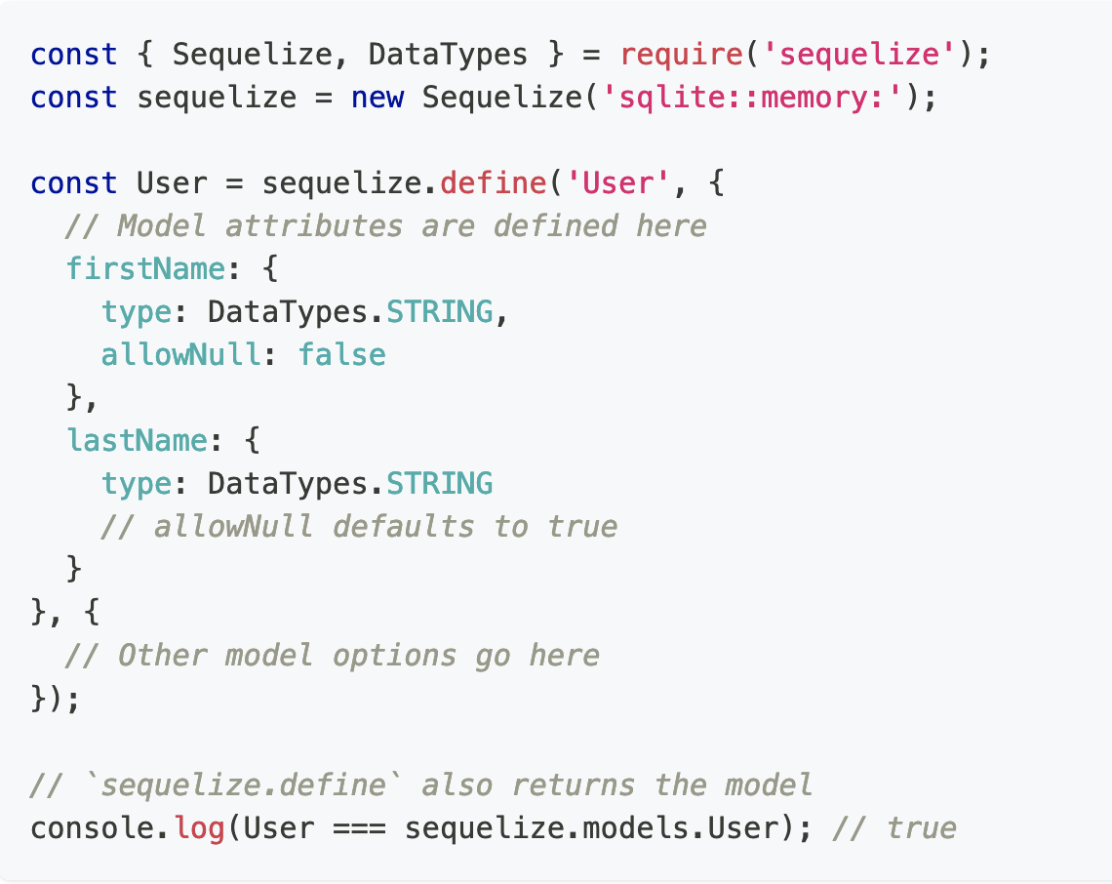
Using sequelize.define(modelName, attributes, options)

Slide 13
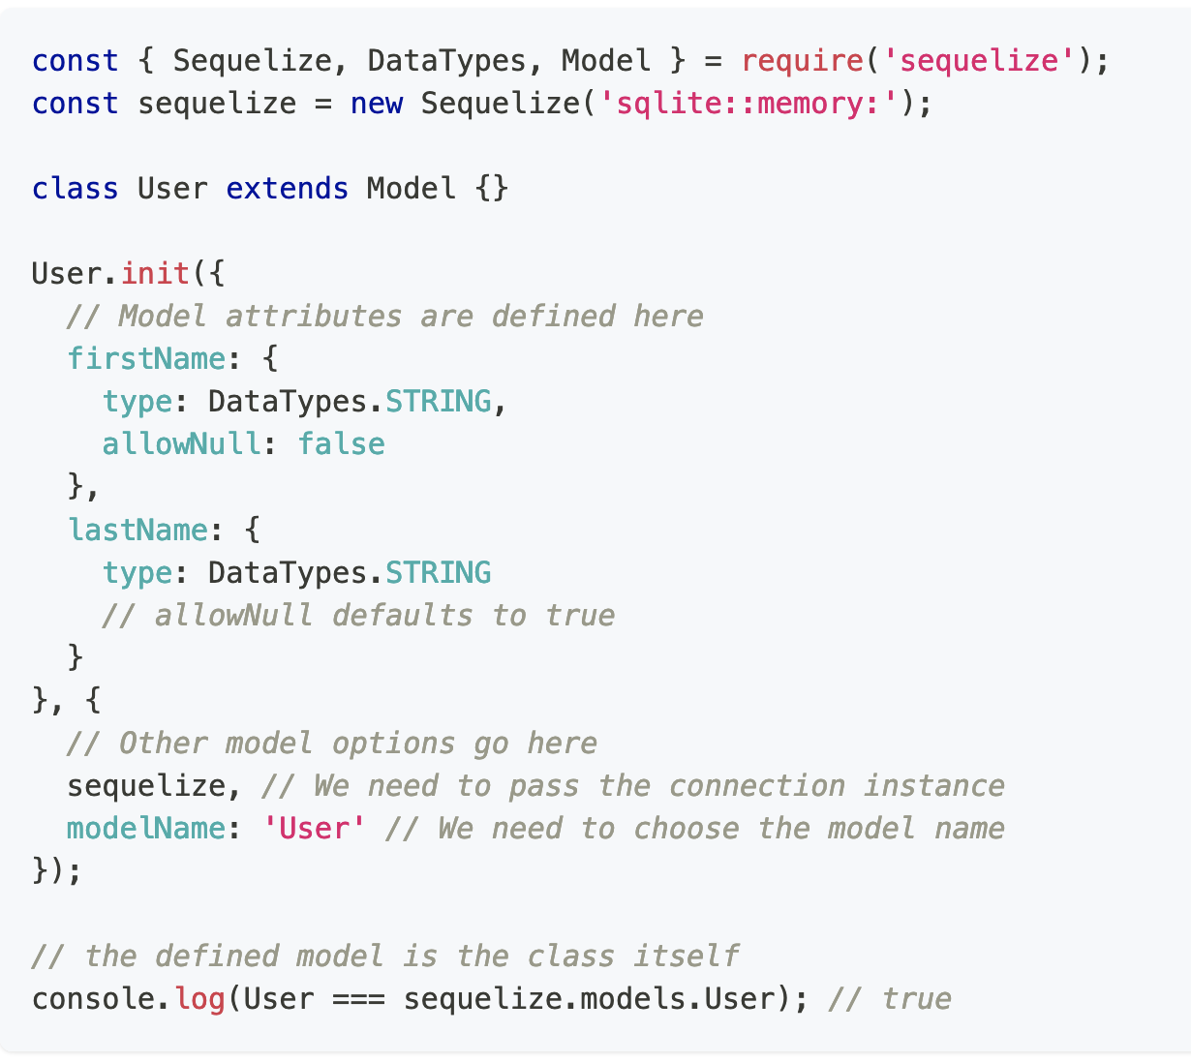
Extending Model and calling init(attributes, options)

Slide 14
Table name inference
In both methods above, the table name (Users) was never explicitly defined. However, the model name was given (User).
By default, when the table name is not given, Sequelize automatically pluralizes the model name and uses that as the table name. This pluralization is done under the hood by a library called inflection
Irregular plurals (such as person -> people) are computed correctly.

Slide 15
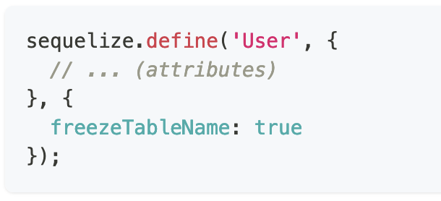
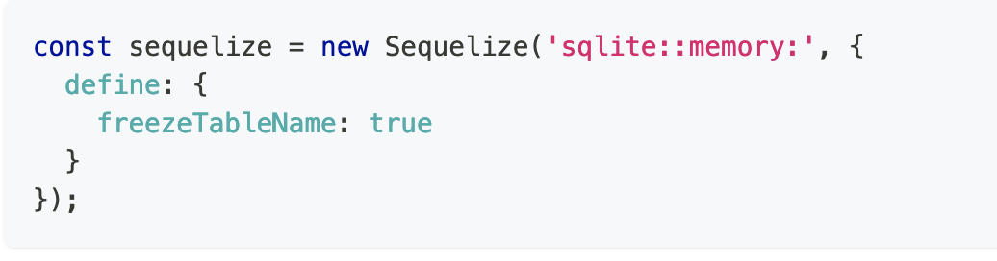
Enforcing the table name to be equal to the model name
Auto-pluralization performed by Sequelize using the freezeTableName: true option. Sequelize will infer the table name to be equal to the model name
At Modal level : At Global Level :

Slide 16
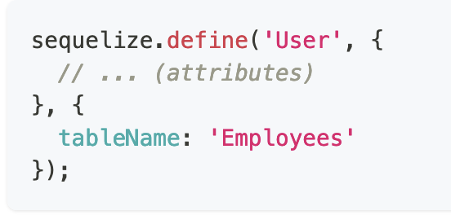
Providing the table name directly
Simply tell Sequelize the name of the table directly

Slide 17
Model synchronization
A model can be synchronized with the database by calling model.sync(options), an asynchronous function (that returns a Promise). With this call, Sequelize will automatically perform an SQL query to the database. User.sync() - This creates the table if it doesn't exist (and does nothing if it already exists),
User.sync({ force: true }) - This creates the table, dropping it first if it already existed
User.sync({ alter: true }) - This checks what is the current state of the table in the database (which columns it has, what are their data types, etc), and then performs the necessary changes in the table to make it match the model. Synchronizing all models at once - sequelize.sync()

Slide 18
Raw Queries
Use the sequelize.query method to execute raw / already prepared SQL queries
By default the function will return two arguments - a results array, and an object containing metadata

Slide 19
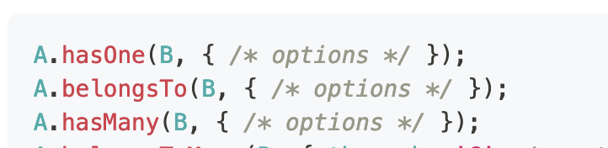
Associations
Sequelize supports the standard associations: One-To-One, One-To-Many and Many-To-Many.
The A.hasOne(B) association means that a One-To-One relationship exists between A and B, with the foreign key being defined in the target model (B).
The A.belongsTo(B) association means that a One-To-One relationship exists between A and B, with the foreign key being defined in the source model (A).
The A.hasMany(B) association means that a One-To-Many relationship exists between A and B, with the foreign key being defined in the target model (B).

Slide 20
HANDS ON..

