Slide 1
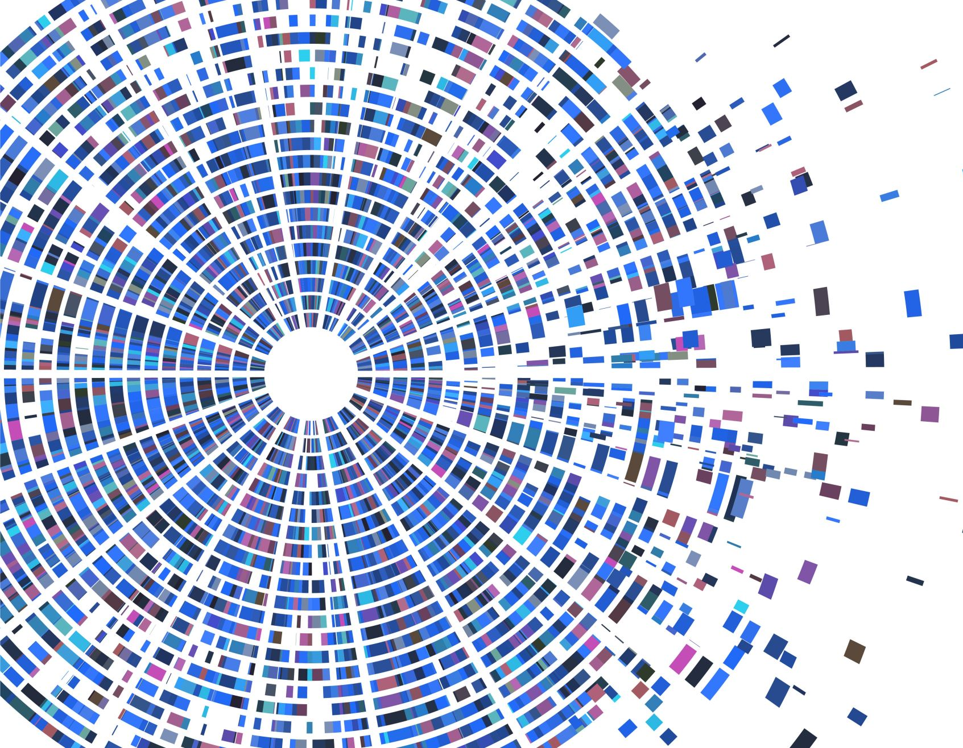
KUBERNETES

Slide 2
container orchestration
Container orchestration is the process of managing containers using automation.
It allows organizations to automatically deploy, manage, scale and network containers and hosts, freeing engineers from having to complete these processes manually.
The more containers an organization has, the more time and resources it must spend managing them.
You could conceivably upgrade 25 containers manually, but it would take a considerable amount of time.
Container orchestration can perform this and other critical life cycle management tasks in a fraction of the time and with little human intervention.
Container orchestration tools provide a framework for managing containers and microservices architecture at scale.
Some popular options are Kubernetes, Docker Swarm, and Apache Mesos.

Slide 3
KUBERNETES
Kubernetes (sometimes referred to as K8s) is a popular open source platform that orchestrates container runtime systems across a cluster of networked resources.
Kubernetes orchestration allows you to build application services that span multiple containers, schedule containers across a cluster, scale those containers, and manage their health over time
Kubernetes gives you the platform to easily and efficiently manage those clusters.
Eliminates many of the manual processes involved in deploying and scaling containerized applications.
Bundles a set of containers into a group that it manages on the same machine to reduce network overhead and increase resource usage efficiency.
Kubernetes is a critical tool for building robust DevOps CI/CD pipelines.

Slide 4
Kubernetes benefits
Automated operations Kubernetes comes with a powerful API and command line tool, called kubectl, which handles a bulk of the heavy lifting that goes into container management by allowing you to automate your operations.
Infrastructure abstraction Kubernetes manages the resources made available to it on your behalf.
Service health monitoring Kubernetes monitors the running environment and compares it against the desired state. It performs automated health checks on services and restarts containers that have failed or stopped.
Schedules and automates container-related tasks throughout the application lifecycle -- Deployment , Rollouts, Service discovery, Storage provisioning, Load balancing, Autoscaling, Self-healing for high availability

Slide 5
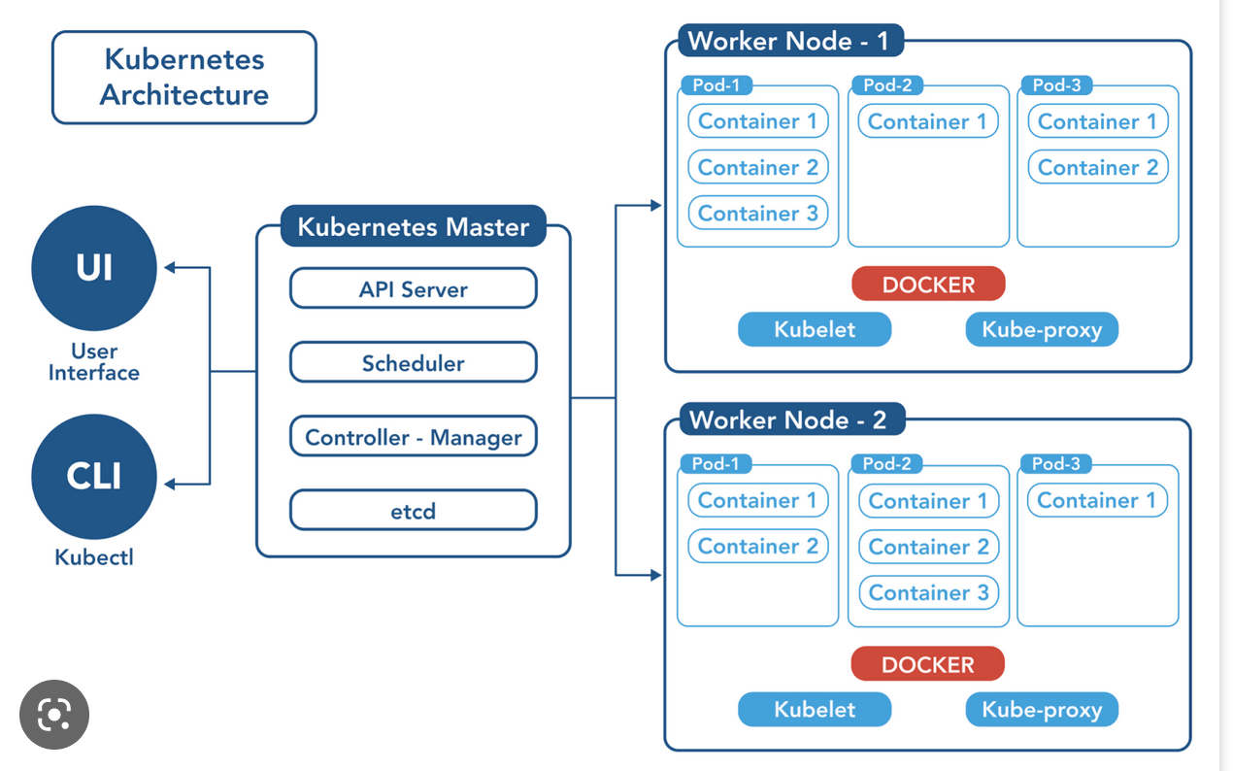
Kubernetes architecture

Slide 6
Kubernetes - Master Components
Etcd The distributed key-value store that maintains details about how Kubernetes needs to be configured.
API Server The front end of the cluster and the bridge between various components, delivering commands and maintaining cluster health
Controller Manager This ensures the cluster is operating as expected, tracks available capacity and oversees the various controllers that determine how pods are spun up/down and rolled out.
Scheduler This component assigns newly formed pods to a node and assigns workloads to specific nodes in the cluster.

Slide 7
Kubernetes - NODE Components
Docker Helps in running the encapsulated application containers in a relatively isolated but lightweight operating environment.
Pods Groups of one or more containers and the smallest objects in Kubernetes architecture. Each pod represents a single instance of an application in Kubernetes
Kubelet Service This software agent executes orders from the master node and ensures the containers are running and healthy
Kubernetes Proxy Service This service maintains network rules on nodes.

Slide 8
ADD ONS
Web UI (Dashboard)
Dashboard is a general purpose, web-based UI for Kubernetes clusters. It allows users to manage and troubleshoot applications running in the cluster, as well as the cluster itself.
Container Resource Monitoring
Container Resource Monitoring records generic time-series metrics about containers in a central database, and provides a UI for browsing that data.
Cluster-level Logging
A cluster-level logging mechanism is responsible for saving container logs to a central log store with search/browsing interface.

Slide 9
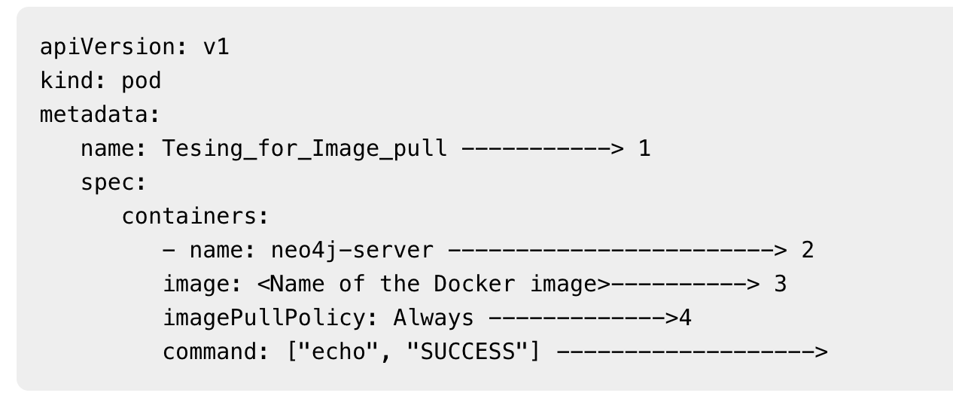
IMages
Images are the key building blocks of Containerized Infrastructure.
Each container in a pod has its Docker image running inside it.
Create a container image of your application and push it to a registry before referring to it in a Pod
The configuration file has a field to define the image name, which we are planning to pull from the registry.

Slide 10
Pod Lifecycle
Pods follow a defined lifecycle, starting in the Pending phase, moving through Running if at least one of its primary containers starts OK, and then through either the Succeeded or Failed phases depending on whether any container in the Pod terminated in failure.
Whilst a Pod is running, the kubelet is able to restart containers to handle some kind of faults.
Within a Pod, Kubernetes tracks different container states and determines what action to take to make the Pod healthy again.
Once a Pod is scheduled (assigned) to a Node, the Pod runs on that Node until it stops or is terminated.
Pods do not, by themselves, self-heal. If a Pod is scheduled to a node that then fails, the Pod is deleted
Pod Phase : Pending - The Pod has been accepted by the Kubernetes cluster, but one or more of the containers has not been set up and made ready to run. Running - The Pod has been bound to a node, and all of the containers have been created. At least one container is still running, or is in the process of starting or restarting. Succeeded - All containers in the Pod have terminated in success, and will not be restarted. Failed - All containers in the Pod have terminated, and at least one container has terminated in failure. Unknown - For some reason the state of the Pod could not be obtained.

Slide 11
ConfigMaps -
ConfigMap is an API object used to store non-confidential data in key-value pairs. Pods can consume ConfigMaps as environment variables, command-line arguments, or as configuration files in a volume.
Secrets – A Secret is an object that contains a small amount of sensitive data such as a password, a token, or a key. Secrets are similar to ConfigMaps but are specifically intended to hold confidential data.
Resource Management for Pods and Containers – When you specify the resource request for containers in a Pod, the kube-scheduler uses this information to decide which node to place the Pod on. When you specify a resource limit for a container, the kubelet enforces those limits so that the running container is not allowed to use more of that resource than the limit you set.
Ingress – manages external access to the services in a cluster, typically HTTP. Ingress may provide load balancing, SSL termination and name-based virtual hosting An Ingress controller is responsible for fulfilling the Ingress, usually with a load balancer

Slide 12
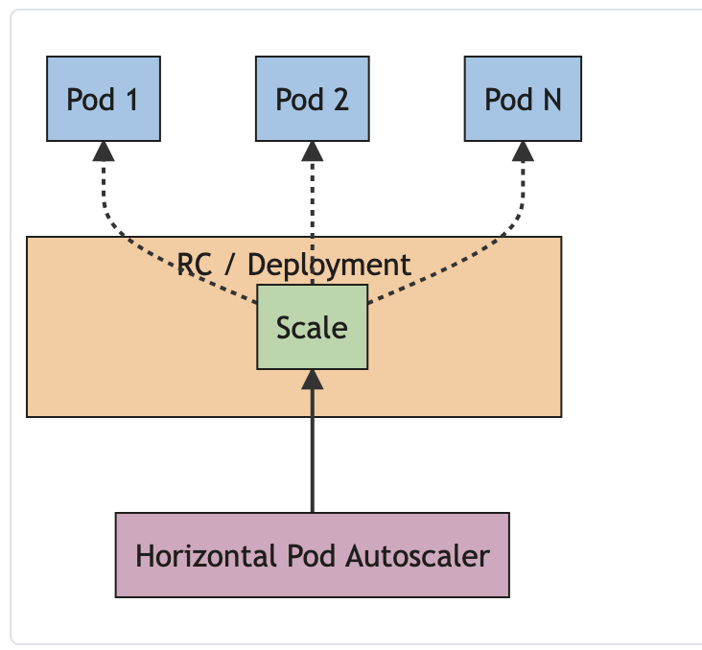
Horizontal Pod Autoscaling
Kubernetes would assign more resources (for example: memory or CPU) to the Pods that are already running for the workload.
If the load decreases, and the number of Pods is above the configured minimum, the HorizontalPodAutoscaler instructs the workload resource to scale back down.
The horizontal pod autoscaling controller, running within the Kubernetes control plane, periodically adjusts the desired scale of its target

Slide 13
HANDSON

