Slide 1
OBJECT DATA MAPPER

Slide 2
Object NoSql Data Mappers (ONDM), also known as Object Data Mappers (ODM), serve the same purpose of mapping data objects into a database structure, particularly for NoSQL databases.
WHAT IS NO SQL DATABASE
“NoSQL database,” refers to any non-relational database. Some say the term “NoSQL” stands for “non SQL” while others say it stands for “not only SQL.” Either way, most agree that NoSQL databases are databases that store data in a format other than relational tables.

Slide 3
benefits of NOSQL database
Flexible data models NoSQL databases typically have very flexible schemas. A flexible schema allows you to easily make changes to your database as requirements change.
Horizontal scaling Most SQL databases require you to scale-up vertically (migrate to a larger, more expensive server) when you exceed the capacity requirements of your current server. Conversely, most NoSQL databases allow you to scale-out horizontally
Fast queries Queries in NoSQL databases can be faster than SQL databases. Data in NoSQL databases is typically stored in a way that is optimized for queries
Easy for developers Some NoSQL databases like MongoDB map their data structures to those of popular programming languages. This mapping allows developers to store their data in the same way that they use it in their application code.

Slide 4
Types of ODMs
Multiple ODMs are designed to support different NoSQL databases
Typesaurus is an ODM for Firebase database designed for Typescript developers.
Express-Cassandra is also an ODM, designed to work with Node.js for a NoSQL database like Cassandra.
Powerful NoSQL databases such as DynamoDB, have a helper Dynamo data mapper, an ODM that allows structured data to interact with the database easily.
Mongoose is an ODM for MongoDB database. MongoDB is one of the most commonly used NoSQL databases, we will use Mongoose to build a data model for MongoDB in a Nodejs application.

Slide 5
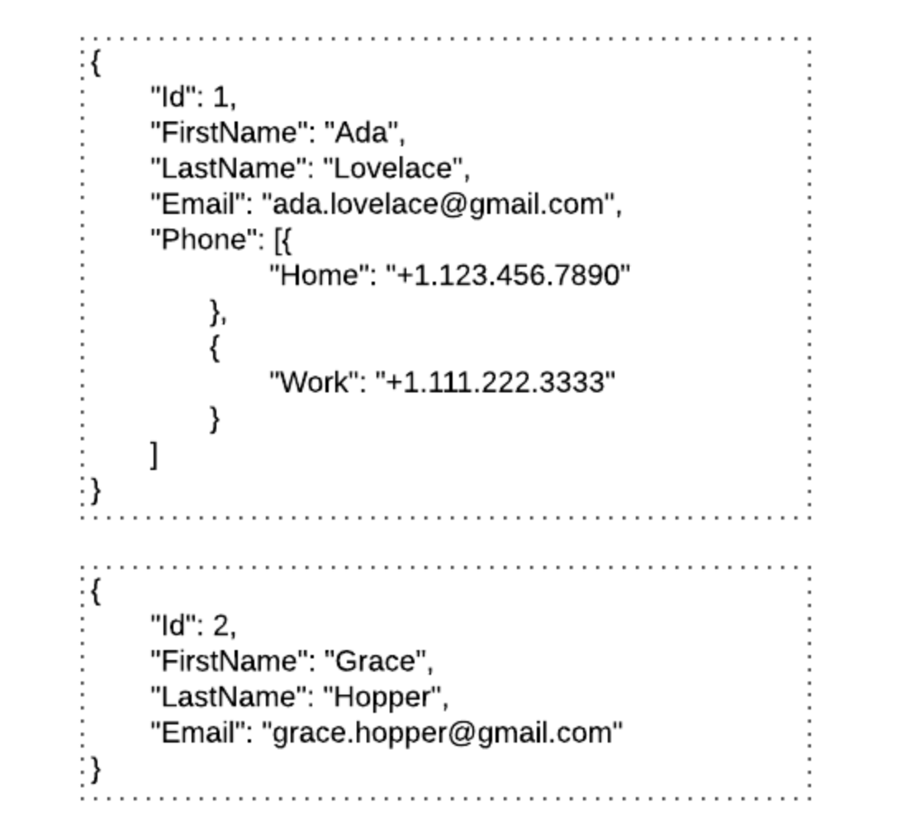
MONGOOSE
Mongoose is an Object Data Modeling (ODM) library for MongoDB and Node.js.
MongoDB is a schema-less NoSQL document database.
Data can be stored in form of JSON documents and the structure of these documents can vary as it is not enforced like SQL databases

Slide 6
Terminologies
Collections - Equivalent to tables in relational databases. They can hold multiple JSON documents.
Documents - ‘Equivalent to records or rows of data in SQL. While a SQL row can reference data in other tables, Mongo documents usually combine that in a document.
Fields - Similar to columns in a SQL table.
Schema - While Mongo is schema-less, SQL defines a schema via the table definition. A Mongoose ‘schema’ is a document data structure (or shape of the document) that is enforced via the application layer.
Models - ‘Models’ are higher-order constructors that take a schema and create an instance of a document equivalent to records in a relational database.

Slide 7
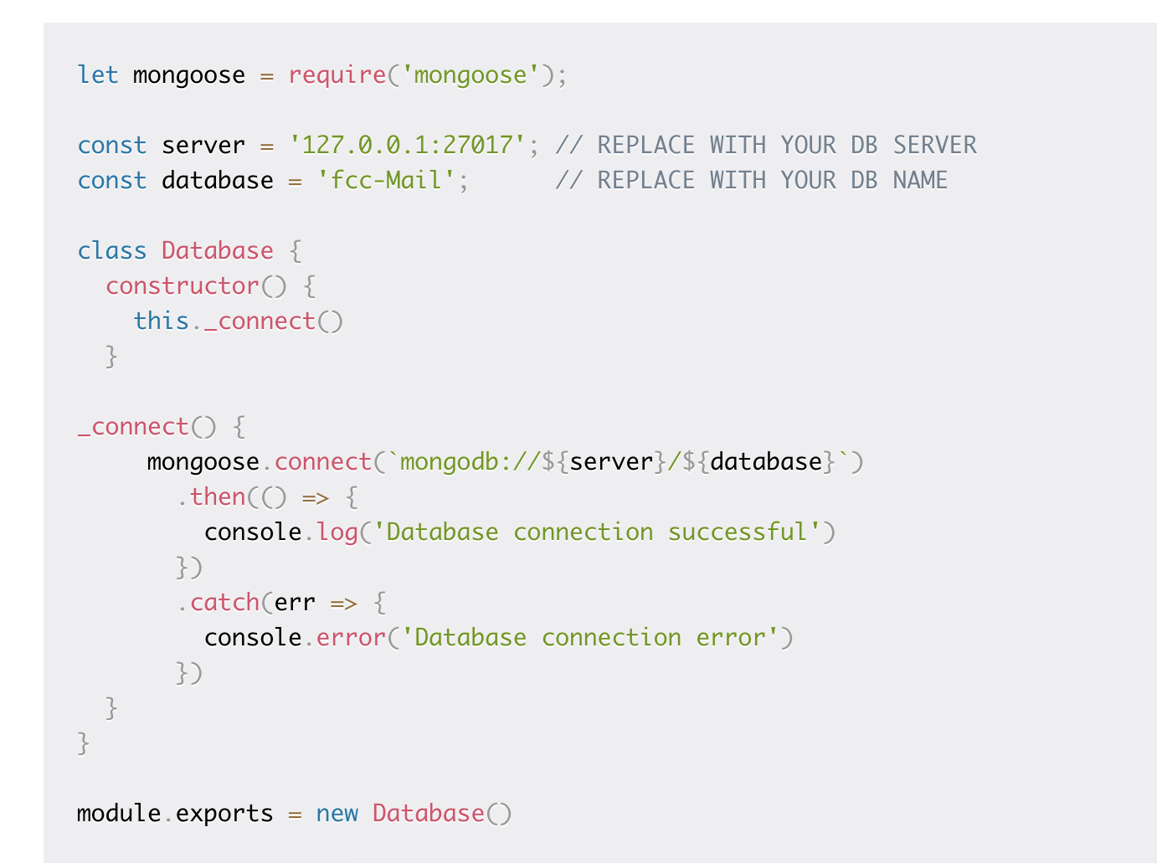
DB Connection from mongoose
require(‘mongoose’) This reference will be the same as the one that was returned when we connected to the database, which means the schema and model definitions will not need to explicitly connect to the database.connect to the database.

Slide 8
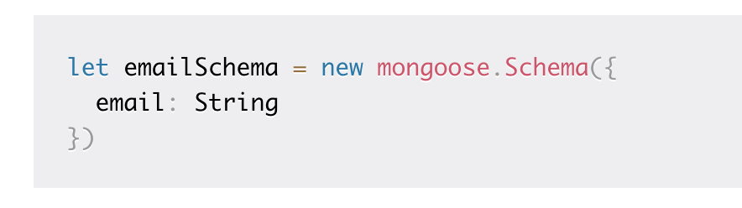
Mongoose Schema
A Mongoose schema defines the structure of the document, default values, validators, etc.,
Schema defines document properties through an object where the key name corresponds to the property name in the collection
Each schema maps to a MongoDB collection and defines the shape of the documents within that collection.
Here we define a property called email with a schema type String which maps to an internal validator that will be triggered when the model is saved to the database. It will fail if the data type of the value is not a string type.

Slide 9
The following Schema Types are permitted:
Array
Boolean
Buffer
Date
Mixed (A generic / flexible data type)
Number
ObjectId
String

Slide 10
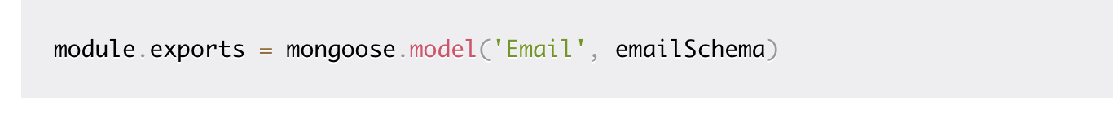
MONGOOSE MODEL
A Mongoose model is a wrapper on the Mongoose schema
Derive a custom schema from Mongoose’s Schema and compile the schema to a model.
Mongoose model provides an interface to the database for creating, querying, updating, deleting records, etc.
Models are responsible for creating and reading documents from the underlying MongoDB database. We need to call the model constructor on the Mongoose instance and pass it the name of the collection and a reference to the schema definition.
An instance of a model is called a document. Creating them and saving to the database is easy.

Slide 11
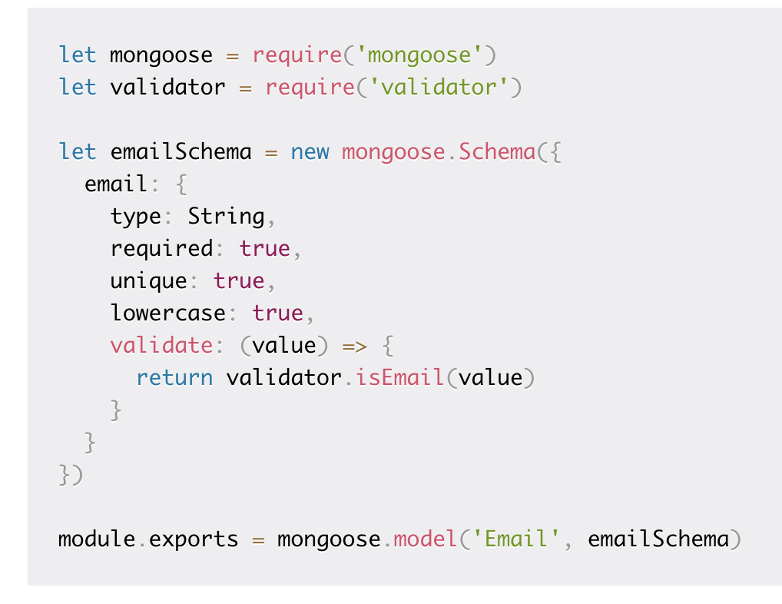
COMBINING .. validation function that will ensure that the value is a valid email address

Slide 12
Basic Operations
Mongoose has a flexible API and provides many ways to accomplish a task
Create Record
Fetch Record
Update Record
Delete Record

Slide 13
HANDS ON…

