Slide 1
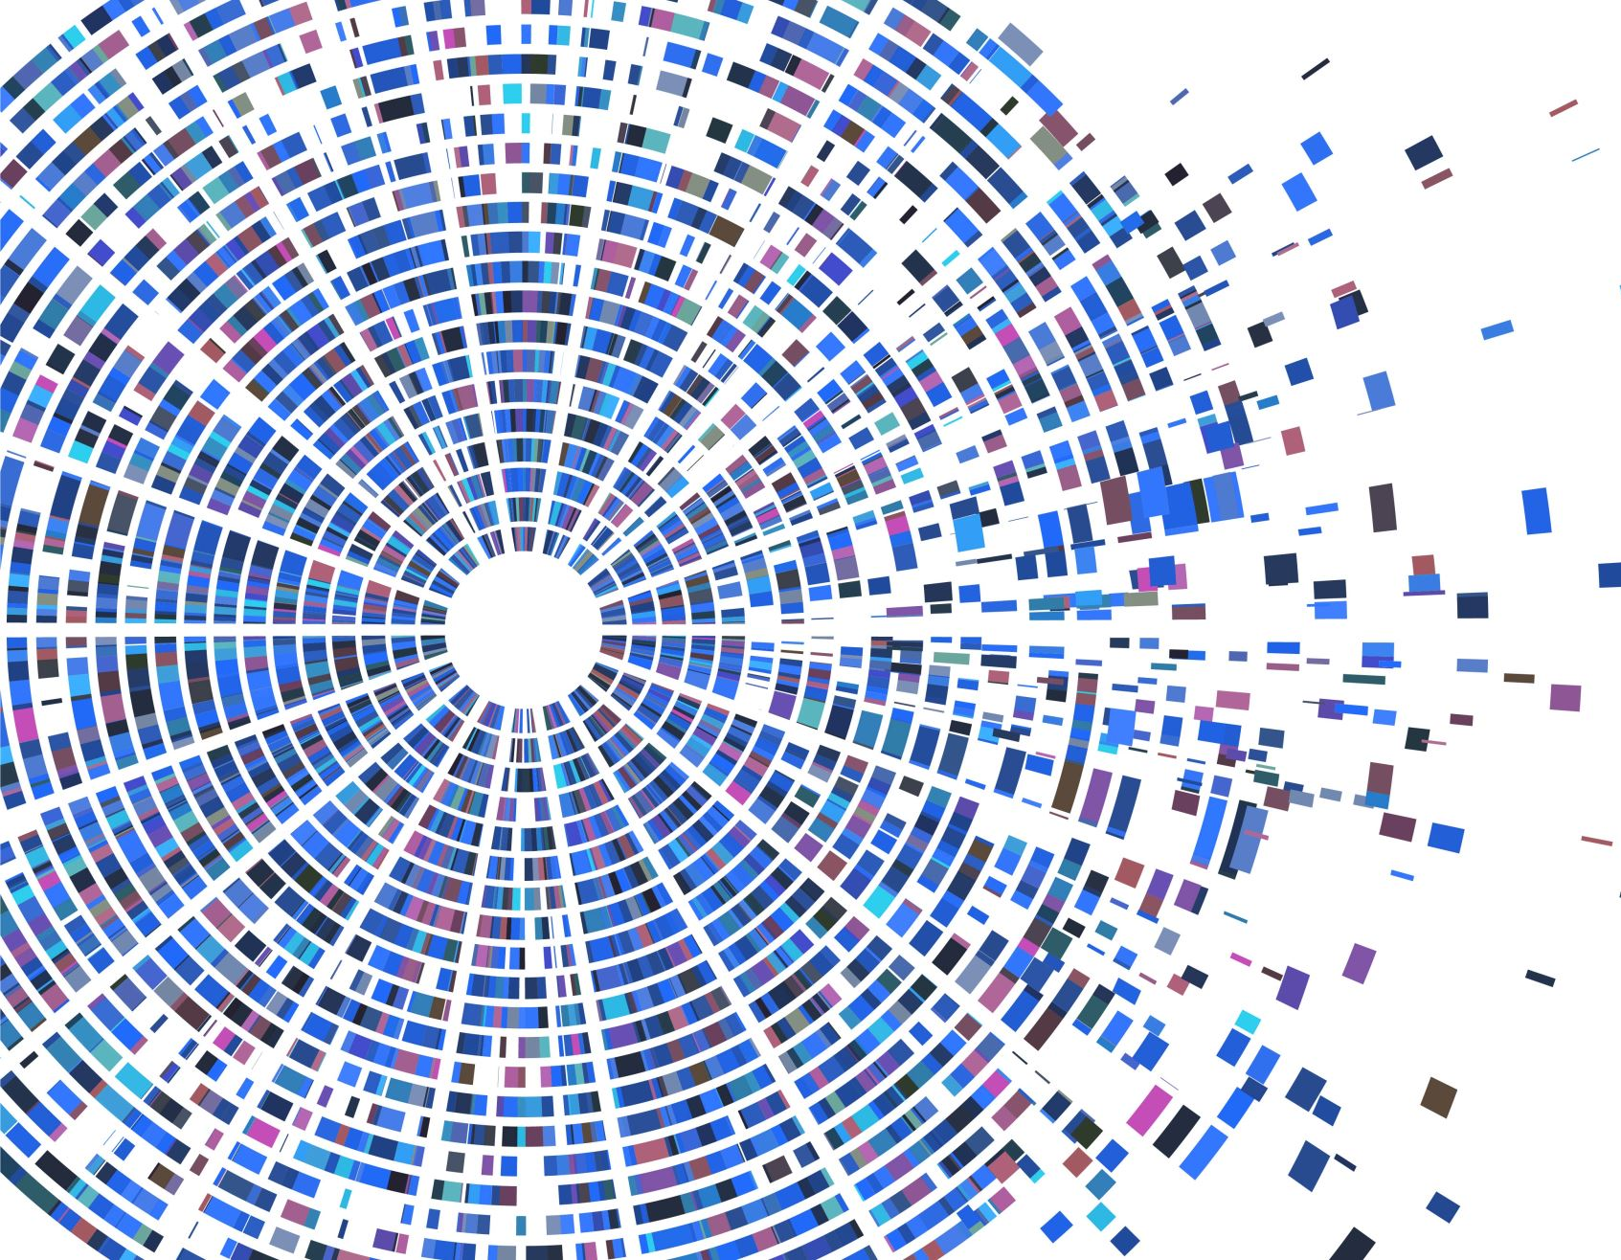
Web Applications Web Services Security

Slide 2
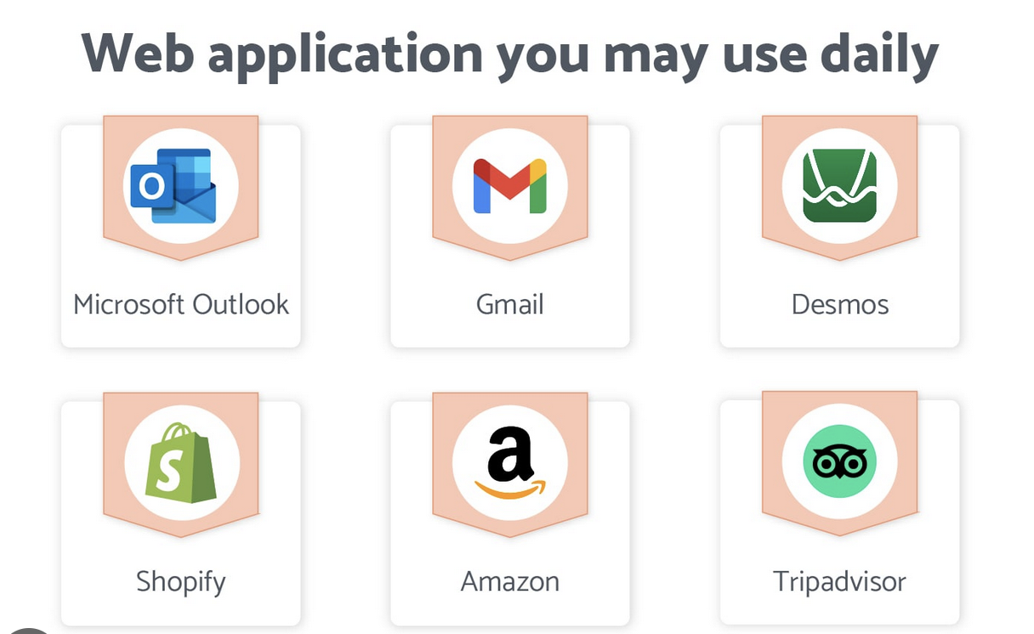
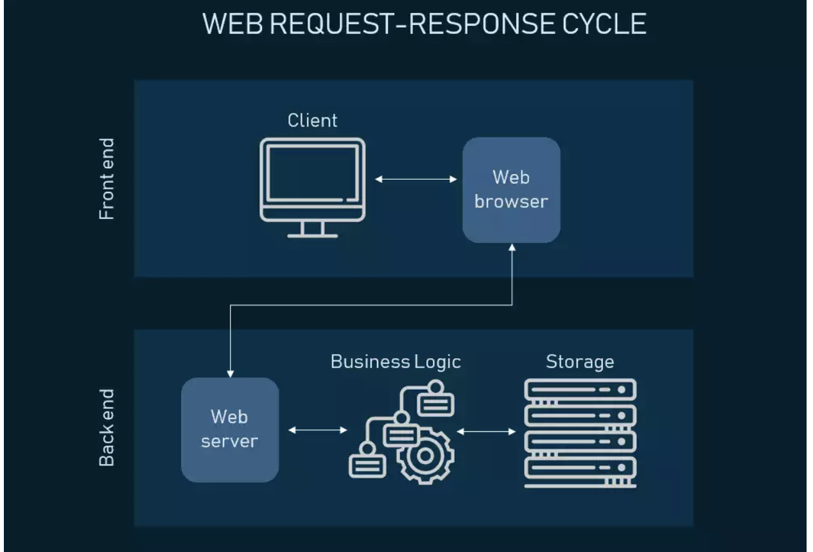
Web APPLICATION
Application software that is accessed using a web browser allowing manipulation of data
Works on “client-server model” - Stored on a remote server and delivered over the Internet through a browser interface - Any requests from you ( client ) is responded
Architecture - Web server, application server, and a database

Slide 3
Web Application Vs Website
Website Website is a group of interlinked web pages that are globally accessible and tied to a single domain name Use markup languages like HTML, CSS, and JavaScript to create the user interface and increase its functionality Host on a single server or multiple servers Websites can be accessed via a public network or via a private local network with an IP address Main purpose of websites is to inform users of information
Web Application Web application is a program or software that users can access via a web browser Create the appearance of web applications by using markup languages like HTML, CSS and JavaScript Web applications can provide users with information, but their primary function is for users to interact with the software or program and perform specific functions The interaction between a user and a web application is called a dialogue

Slide 4
Differences between WebApplication and Websites
Authentication
Most websites do not use authentication systems for end-users. By contrast, web applications often require a user to confirm their identity before gaining access to the system.
Audience Websites seen by potentially anyone. In comparison, web applications usually have a more narrow audience
Integration Web applications integrate more programs than websites do. Web applications have more complex processes, and for web apps to function properly, they need interaction with more systems
Deployment Websites rarely undergo deployments whereas web app usually requires coders to re-compile and deploy the application.
User Details On a web application, businesses can easily view all of a customer's data related to that app and handle any feedback / concerns. While on website businesses are not able to view data about individual users accumulated through their site

Slide 5
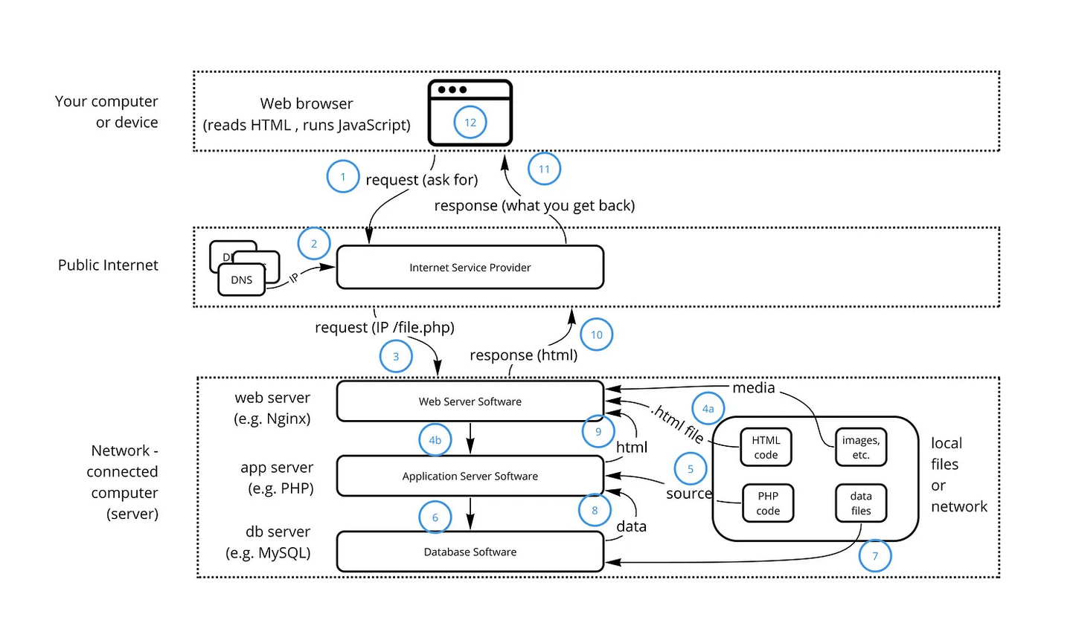
How Web Applications Work

Slide 6
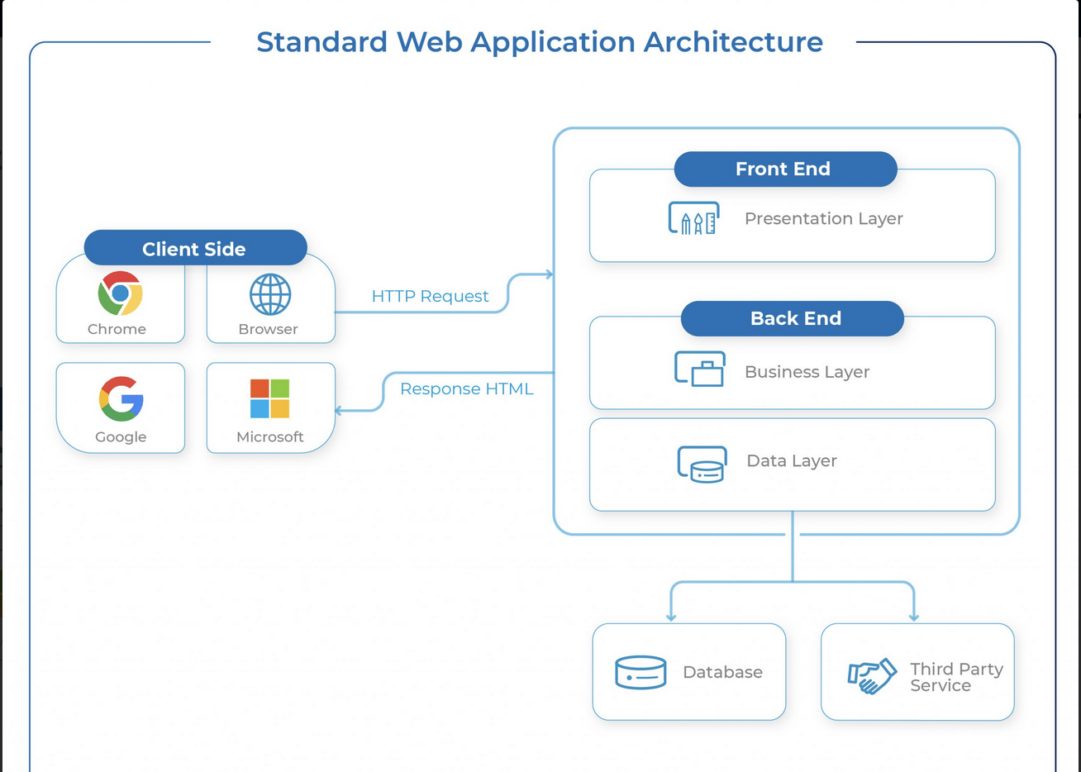
Web Application Architecture

Slide 7
Presentation Layer (Front-end)
Accessible to the client via a browser and it includes user interface components and UI process components.
Enables users to interact with the server and the backend service via a browser.
The code resides in the browser, receives requests and presents the user with the required information.
This is where UI/UX design, dashboards, notifications, configurational settings, layout and interactive elements come into the picture.
Front End Technologies : HTML CSS JavaScript React Angular

Slide 8
Application Layer: Is the key component of the web application architecture that receives user requests, performs business logic and delivers the required data to the front-end systems. It contains servers, databases, web services etc. Web server uses HyperText Transfer Protocol (HTTP) along with other protocols to listen to user requests via a browser. It processes them by applying business logic and delivering the requested content to the end-user. APIs enables developers to access certain data and functions of a software Commonly used Server-side technologies: Node.js , Java, Python, Ruby
Data Layer: Database A database is a key component of a web application that stores and manages information for a web app. Using a function, you can search, filter and sort information based on user request and present the required info to the end user. They allow role-based access to maintain data integrity.

Slide 9
Why WEBSERVICE ??
Variety of programming platforms to develop web-based applications in modern day business applications
Applications need some sort of communication to happen between them.
Different development languages, it becomes really difficult to ensure accurate communication between applications.
Use web services to integrate your applications into the Web.
Web services can help your business in these ways
Reducing the cost of doing business
Making it possible to deploy solutions more rapidly
Opening up new opportunities
Notes:
A Web Application is meant for humans to read, while a Web Service is meant for computers to read. Web Application is a complete Application with a Graphical User Interface (GUI), however, web services do not necessarily have a user interface since it is used as a component in an application

Slide 10
Web SERVICE
Interoperability - “One Code Different Applications”. - Uses interface described in a machine-processable format [ WSDL ] - Interface hides the implementation details - Allows applications to be loosely coupled, component oriented, cross-technology implementations.
Not tied to any one operating system or programming language
Built on existing and emerging standards - HTTP, XML, SOAP, and WSDL.
Types of Web Services : SOAP Web Services REST Web Services
Notes:
Interoperability - “One Code Different Applications”. Provides a common platform that allows multiple applications built on various programming languages to have the ability to communicate with each other. - Uses interface described in a machine-processable format [ WSDL ] - Interface hides the implementation details of the service so that it can be used independently of the hardware or software - Allows and encourages web service based applications to be loosely coupled, component oriented, cross-technology implementations.
Not tied to any one operating system or programming language - applications can be written in various languages and are still able to communicate by exchanging data with one another via a web service between clients and servers Example : The client would invoke a series of web service calls via requests to a server which would host the actual web service.
These requests are made through what is known as remote procedure calls. Remote Procedure Calls(RPC) are calls made to methods which are hosted by the relevant web service.
As an example, Amazon provides a web service that provides prices for products sold online via amazon.com. The front end or presentation layer can be in .Net or Java but either programming language would have the ability to communicate with the web service.
The main component of a web service design is the data which is transferred between the client and the server, and that is XML. XML (Extensible markup language) is a counterpart to HTML and easy to understand the intermediate language that is understood by many programming languages.
So when applications talk to each other, they actually talk in XML. This provides a common platform for application developed in various programming languages to talk to each other.
Web services use something known as SOAP (Simple Object Access Protocol) for sending the XML data between applications. The data is sent over normal HTTP. The data which is sent from the web service to the application is called a SOAP message. The SOAP message is nothing but an XML document. Since the document is written in XML, the client application calling the web service can be written in any programming language.
XML tags the data, SOAP transfers the message, and WSDL describes the service’s accessibility.
XML - A standard for document markup, which uses a generic syntax to mark up data with simple, human-readable tags. The standard is endorsed by the World Wide Web Consortium (W3C). Formerly an acronym for Simple Object Access Protocol. A lightweight protocol for exchange of information in a decentralized, distributed environment. It is an XML-based protocol that consists of three parts:An envelope that defines a framework for describing what is in a message and how to process it
A set of encoding rules for expressing instances of application-defined data types
A convention for representing remote procedure calls and responses WSDL (Web Services Description Language)
- Defines where the Web Service actually resides - Which type of Web Service to be picked up for a specific request. This makes use of an XML file that describes the Web Service functionality. Web Service Description Language An XML application for describing web services. It is designed to separate the descriptions of the abstract functions offered by a service and the concrete details of a service, such as how and where that function is offered.The specification is published at Web Services Description Language (WSDL).
UDDI (Universal Description, Discovery and Integration) - Given Service Provider, UDDI used for describing, discovering, and publishing those Web Services. - Helps client find out where WSDL’s XML is located UDDI is also a publicly accessible set of implementations of the specification that allow businesses to register information about the web services that they offer, so that other businesses can find them. The specification is published by OASIS.
XML-RPC (Extensible Markup Language – Remote Procedure ) - Responsible for sending messages across systems. - Requests and responses are in the form of XML and are sent/received through the HTTP POST.

Slide 11
WEBSERVICE SECURITY
Personal Information of Customers and Data Security is the need of the hour
WS Security is a standard that addresses security when data is exchanged as part of a Web service
Service-oriented architecture (SOA) security is a security model that addresses complex combination services as opposed to only one software program or platform.
Standards Implemented by SOA - Authentication ( verification for the user ) - Authorization ( who can access what ) - Confidentiality (practice of securing data from others ) - Integrity (preventing the alteration of a message )
Web Service Interaction Levels - > Transport Level, Application level
Notes:
Talk about hacking and stealing of PI Authentication
Authentication refers to a means of verification for the user.
Using credentials, a password, or biometrics, or a combo of these methods, a service can verify that the user is who they claim to be.
Authorization
As a form of access control, authorization, grants users certain entitlements.
An employee in your tech company, for example, might have access to some directories and programming but not to the same degree as a higher level employee.
Related reading: Work From Home Cybersecurity: 10 Steps to Avoid Risks
Confidentiality
Confidentiality, or privacy, is the practice of securing data from others.
Personal contact information, for one, should not be shared with those who can compromise the information.
Integrity
Integrity has to do with preventing the alteration of a message. Generally, a sender’s digital signature can certify its validity on one end.
This is closely related to non repudiation which ensures that the author of a statement cannot deny its authenticity.
These components of web service security are considered industry standard.

Slide 12

JSON WEB TOKEN [ JWT ]

Slide 13
Overview
JWTs are used to identify an authenticated user. Issued by an authentication server and are consumed by the client-server (to secure its APIs).
JSON Web Token (JWT) is an open standard (RFC 7519) that defines a compact and self-contained way for securely transmitting information between parties as a JSON object. This information can be verified and trusted because it is digitally signed.
JWTs can be signed using a secret (with the HMAC algorithm) or a public/private key pair using RSA or ECDSA. When tokens are signed using public/private key pairs, the signature also certifies that only the party holding the private key is the one that signed it. Also ensures JSON contents (also known as JWT claims) cannot be altered by the client or a malicious party.
Compact: Because of its size, it can be sent through an URL, POST parameter, or inside an HTTP header. Additionally, due to its size its transmission is fast.
Self-contained: The payload contains all the required information about the user, to avoid querying the database more than once

Slide 14
Use CASES of JWT
Here are some scenarios where JSON Web Tokens are useful:
Authorization: This is the most common scenario for using JWT. Once the user is logged in, each subsequent request will include the JWT, allowing the user to access routes, services, and resources that are permitted with that token. Single Sign On is a feature that widely uses JWT nowadays, because of its small overhead and its ability to be easily used across different domains.
Information Exchange: JSON Web Tokens are a good way of securely transmitting information between parties. Because JWTs can be signed—for example, using public/private key pairs—you can be sure the senders are who they say they are. Additionally, as the signature is calculated using the header and the payload, you can also verify that the content hasn't been tampered with.

Slide 15
HOW JWT WORKS
User successfully logs in using their credentials - a JSON Web Token will be returned. Since tokens are credentials, great care must be taken to prevent security issues. In general, you should not keep tokens longer than required and should have an expiry time .
Whenever the user wants to access a protected route, it should send the JWT, typically in the Authorization header using the Bearer schema
Authorization: Bearer <token>
This is a stateless authentication mechanism - user state is never saved in the server memory. Just checks for a valid JWT in the Authorization header, and if there is, the user will be allowed.
As JWTs are self-contained, all the necessary information is there, reducing the need of going back and forward to the database.
This allows to fully rely on data APIs that are stateless and even make requests to downstream services. It doesn’t matter which domains are serving your APIs, as Cross-Origin Resource Sharing (CORS) won’t be an issue as it doesn’t use cookies.
Notes:
In authentication, when the user successfully logs in using their credentials, a JSON Web Token will be returned. Since tokens are credentials, great care must be taken to prevent security issues. In general, you should not keep tokens longer than required. Whenever the user wants to access a protected route, it should send the JWT, typically in the Authorization header using the Bearer schema. Therefore the content of the header should look like the following.
Authorization: Bearer <token>
This is a stateless authentication mechanism as the user state is never saved in the server memory. The server’s protected routes will check for a valid JWT in the Authorization header, and if there is, the user will be allowed. As JWTs are self-contained, all the necessary information is there, reducing the need of going back and forward to the database.
This allows to fully rely on data APIs that are stateless and even make requests to downstream services. It doesn’t matter which domains are serving your APIs, as Cross-Origin Resource Sharing (CORS) won’t be an issue as it doesn’t use cookies.

Slide 16
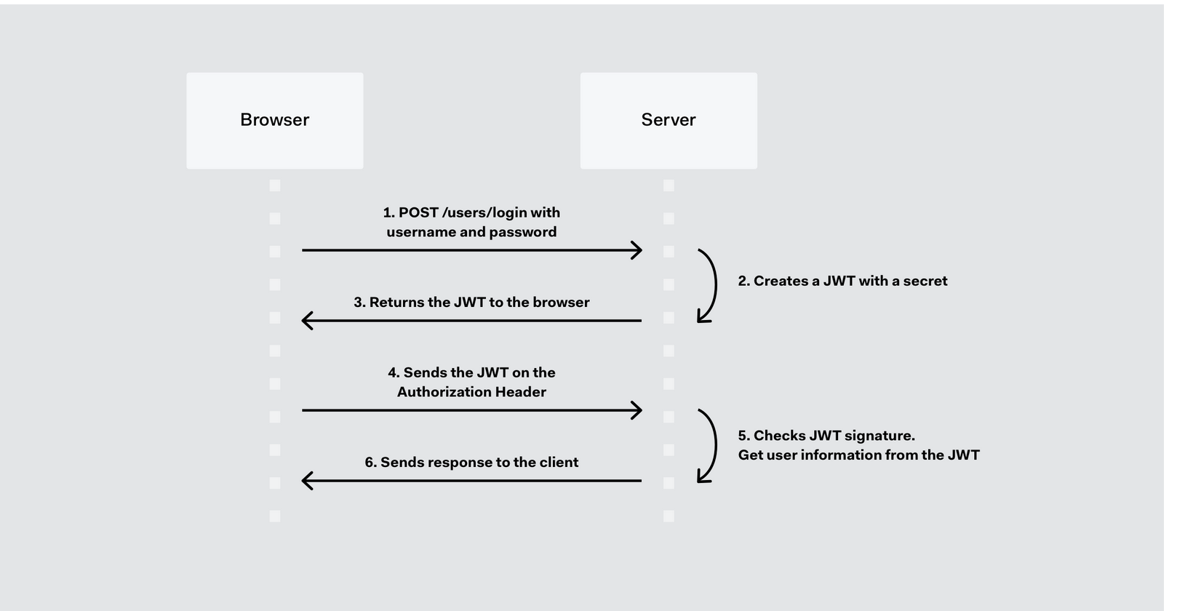
HOW JWT WORKS
Notes:
Authorization Server – Auth0

Slide 17
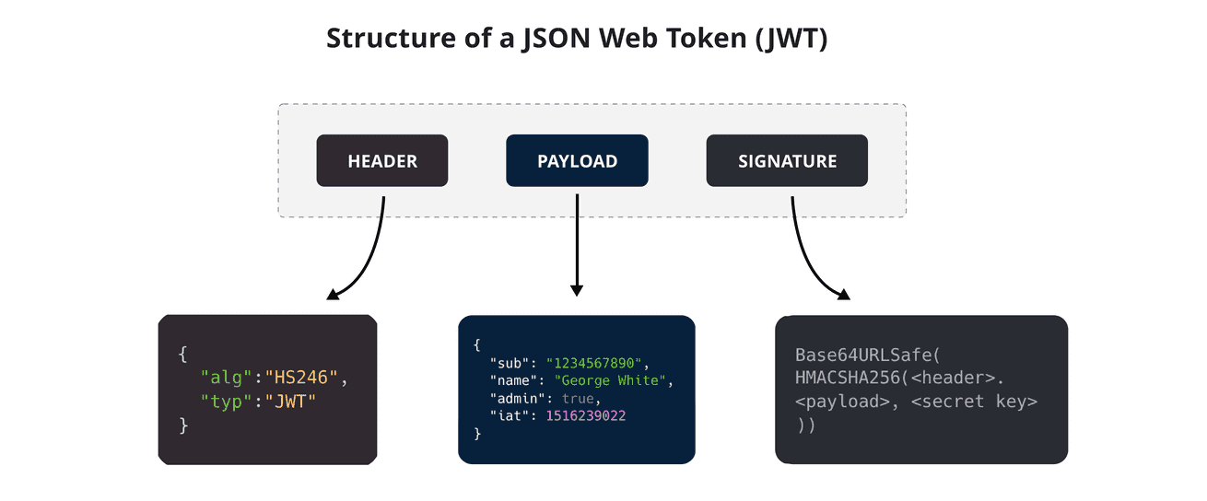
JWT STRUCTURE
JWTs consist of three parts separated by dots (.), which are: Header Payload Signature Therefore, a JWT typically looks like the following. xxxxx.yyyyy.zzzzz

Slide 18
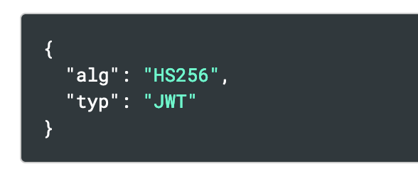
JWT STRUCTURE - HEADER
The header typically consists of two parts: the type of the token, which is JWT, and the signing algorithm being used, such as HMAC SHA256 or RSA. The header will contain data related to the type of token we’re dealing with and the algorithm used for its generation. There are several compatible algorithms that you can specify here, but the most common ones are HS256 and RS256. The right choice will depend on what security standards and measures you’re looking for. Then, this JSON is Base64Url encoded to form the first part of the JWT.

Slide 19
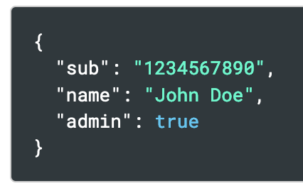
JWT STRUCTURE : PAYLOAD
The second part of the token is the payload, which contains the claims. Claims are statements about an entity (typically, the user) and additional data.
The payload will contain data pertaining to the request and the user making it. There are a set of standard key/value pairs that are defined as part of JWT, which you can use on your implementation: Sub (Subject): Identifies the user making the request and being authenticated
Iss (Issuer): The server that issued the token.
Aud (Audience): Provides some form of identification of the recipient of this token
Exp (Expiration date): Tokens usually don’t last forever. Exp ensures that whoever is using the token provides a recently generated token
You can use them or just define your own as long as both the client and server are in agreement about the implementation. The payload is then Base64Url encoded to form the second part of the JSON Web Token.

Slide 20
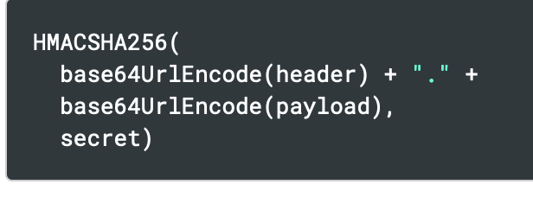
JWT STRUCTURE - SIGNATURE
To create the signature part you have to take the encoded header, the encoded payload, a secret, the algorithm specified in the header, and sign that.
For example if you want to use the HMAC SHA256 algorithm, the signature will be created in the following way:
The signature is used to verify the message wasn't changed along the way, and, in the case of tokens signed with a private key, it can also verify that the sender of the JWT is who it says it is.

Slide 21
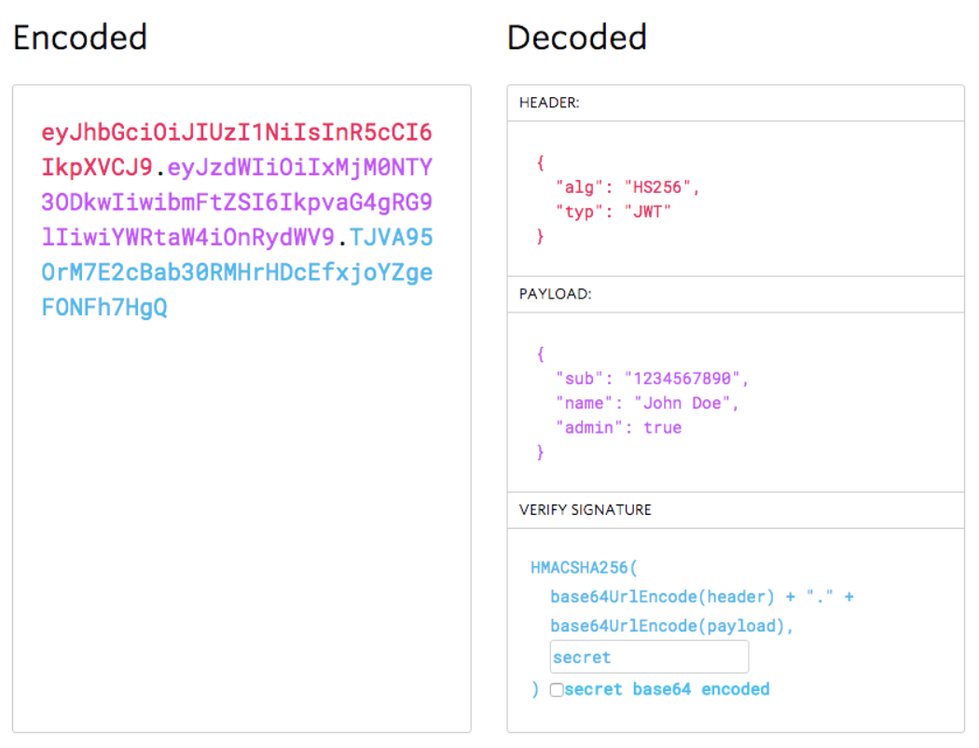
SAMPLE JWT
https://jwt.io/

Slide 22
Pros and CONS
PROS
Secure: JWTs are digitally signed using either a secret (HMAC) or a public/private key pair (RSA or ECDSA) which safeguards them from being modified by the client or an attacker.
Stored only on the client: You generate JWTs on the server and send them to the client. The client then submits the JWT with every request. This saves database space.
Efficient / Stateless: It’s quick to verify a JWT since it doesn’t require a database lookup. This is especially useful in large distributed systems.
CONS
Non-revocable: Due to their self-contained nature and stateless verification process, it can be difficult to revoke a JWT before it expires naturally.
Dependent on one secret key: The creation of a JWT depends on one secret key. If that key is compromised, the attacker can fabricate their own JWT which the API layer will accept. We can reduce this risk by changing the secret key from time to time.

Slide 23
QUESTIONS …. ?

