Slide 1

CONTInious integration

Slide 2
Multiple developers work on a piece of software and merge their code changes into a shared codebase multiple times a day
Traditionally, development and integration were different phases in the development cycle.
Continuous integration (CI) is the practice of automating the integration of code changes from multiple contributors into a single software project - allowing developers to frequently merge code changes into a central repository where builds and tests then run. - automated tools are used to assert the new code’s correctness before integration.
Overall, continuous integration helps streamline the build process, resulting in higher-quality software and more predictable delivery schedules.

Slide 3
Importance of Continuous Integration
Continuous Integration enables better transparency and farsightedness in the process of software development and delivery.
1. Reduces Risk
2. Better Communication
3. Higher Product Quality
4. Reduced Waiting Time

Slide 4
First step – automated tests
Automate tests to be able to run them for every change that is made to the main repository Helps to capture issues early and minimise disruptions
Determine the type of test to be run
Run tests automatically
Use code coverage to find untested code
Refactoring is an opportunity to add tests

Slide 5
Critical Success Factors with ci
Integrate early and often
Keep the build green at all times
Write tests as part of your stories
Write tests when fixing bugs

Slide 6
Benefits of continuous integration
Commonly cited benefit of continuous integration include:
Early and improved error detection and metrics that let you address errors early—sometimes within minutes of check-in
Continuous and demonstrated progress for improved feedback
Improved team collaboration; everyone on the team can change the code, integrate the system and quickly determine conflicts with other parts of the software
Improved system integration, which reduces surprises at the end of the software development lifecycle
Fewer parallel changes for merging and testing
Reduced number of errors during system testing
Constantly updated systems to test against

Slide 7
Continuous integration and DevOps In the DevOps framework, continuous integration sits at the beginning of the software development process Keeps a check on merge conflicts that could "break" the build and take the team hours or days to resolve. Continuous integration serves as a prerequisite for the testing, deployment and release stages of continuous delivery.
Continuous integration and agile Agile organizes development into smaller groups of work or sprints.
In the context of continuous integration, agile software development is about delivering software iterations based on how you prioritize the value of the features as you continuously integrate.

Slide 8
Continuous Integration vs Continuous Deployment vs Continuous Delivery
Continuous integration
Developers practicing continuous integration merge their changes back to the main branch as often as possible. Emphasis is on testing automation to check that the application is not broken whenever new commits are integrated into the main branch.
Continuous delivery Continuous delivery is an extension of continuous integration since it automatically deploys all code changes to a testing and/or production environment after the build stage. On top of automated testing, you have an automated release process and you can deploy your application any time by clicking a button.
Continuous deployment
With this practice, every change that passes all stages of your production pipeline is released to your customers. There's no human intervention, and only a failed test will prevent a new change to be deployed to production.

Slide 9
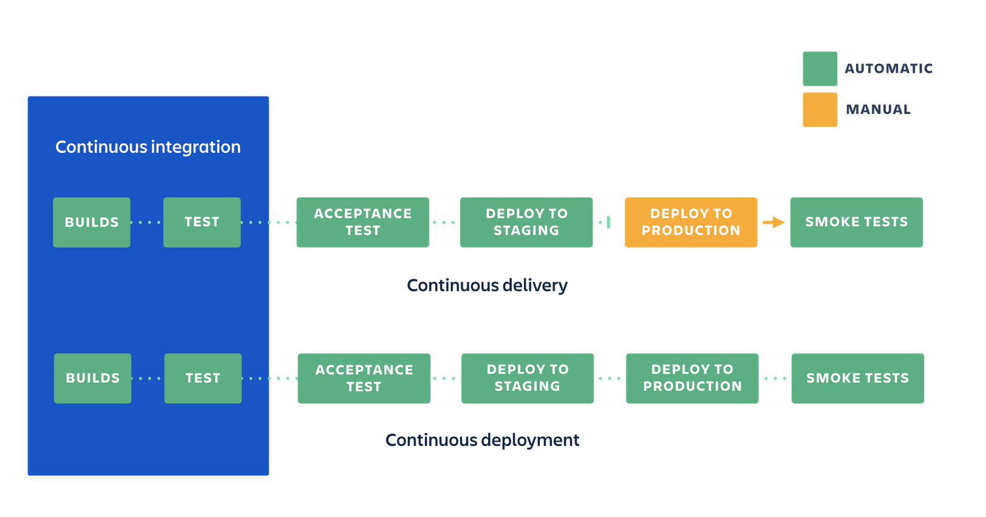

Slide 10
continuous integration tools
Jenkins: A widely used open source continuous integration tool, Jenkins allows developers to automatically build, integrate and test code as soon as they commit it to the source repository, making it easier for developers to catch bugs early and deploy software faster. The Docker plug-in is available on Jenkins
Buildbot: Buildbot can automate all aspects of the software development cycle. As a job scheduling system, it queues and executes jobs, and reports results.
Go: What makes Go stand out from the crowd is the concept of pipelines, which makes the modeling of complex build workflows easy.
Travis CI: One of the oldest and most-trusted hosted solutions, it is also available in an on-premises version for the enterprise.
GitLab CI: An integral part of the open source Rails project, GitLab CI is a free hosted service that provides detailed git repository management with features like access control, issue tracking, code reviews and more.

Slide 11
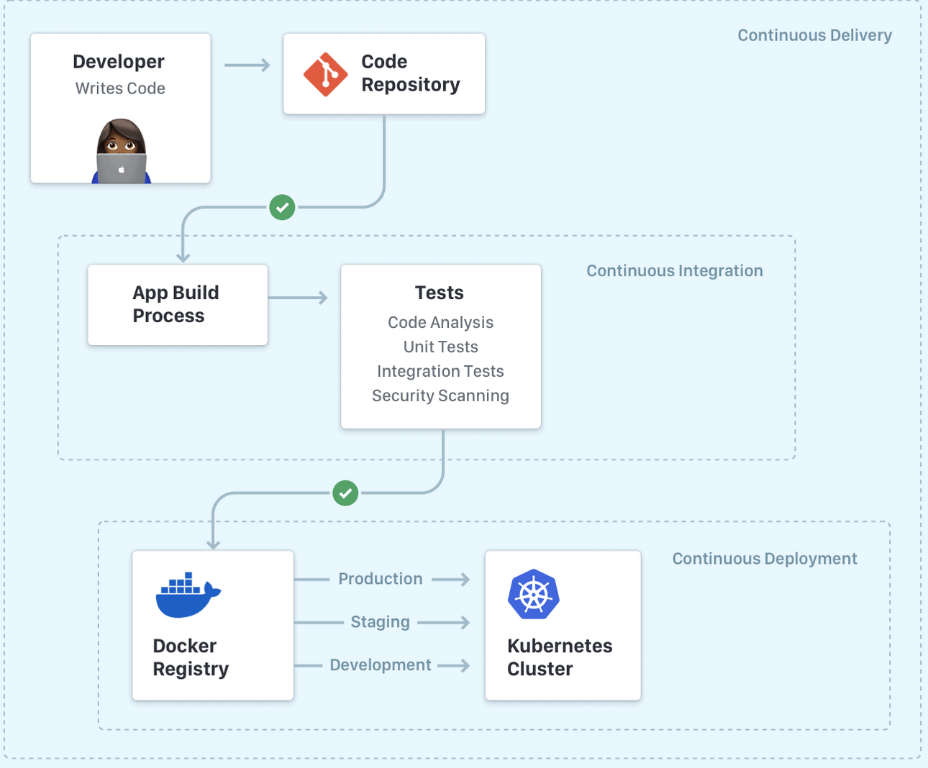
CI and CD pipeline

Slide 12
JENKINS

Slide 13
Jenkins is a platform for creating a Continuous Integration/Continuous Delivery (CI/CD) environment.
Offers many different tools, languages, and automation tasks to aid in pipeline creation when developing and deploying programs.
Jenkins doesn’t eliminate the need to create scripts for individual steps
Although Jenkins requires scripting some automation steps, the program provides a fast and robust way to systematize the software development lifecycle.
Jenkins provides support for:
Various version control tools such as Git.
Building Ant and Apache Maven-based projects.
Running Bash scripts and Windows batch files.

Slide 14
Jenkins Pipeline
The Jenkins Pipeline is a user-made model for the continuous delivery pipeline. The Pipeline incorporates various plugins that help define procedure steps from version control to the users.
All software changes and commits go through a complex process before the release. The method includes three steps:
Automated building.
Multi-step testing.
Deploying procedures.
Two ways to create a pipeline:
Define the Pipeline through the user interface directly.
Use the Pipeline as Code methodology and create a Jenkinsfile. The text file uses Groovy-compatible syntax to define the pipeline process.

Slide 15
Creating a Jenkinsfile and committing it to source control provides a number of immediate benefits: Automatically creates a Pipeline build process for all branches and pull requests. Code review/iteration on the Pipeline (along with the remaining source code). Audit trail for the Pipeline. Single source of truth for the Pipeline, which can be viewed and edited by multiple members of the project.
Features of Pipeline: Code: Pipelines are implemented in code and typically checked into source control, giving teams the ability to edit, review, and iterate upon their delivery pipeline.
Durable: Pipelines can survive both planned and unplanned restarts of the Jenkins controller.
Pausable: Pipelines can optionally stop and wait for human input or approval before continuing the Pipeline run.
Versatile: Pipelines support complex real-world CD requirements, including the ability to fork/join, loop, and perform work in parallel.
Extensible: The Pipeline plugin supports custom extensions and multiple options for integration with other plugins.

Slide 16
Steps to install Jenkins:
• Goto this URL --- https://www.jenkins.io/download/
• Current Jenkins version can support java 8 and java 11 only. So before installing please check your java version.
• Pickup always a stable version(LTS) of Generic java package(.war) file, installation will be same for mac ,windows or any other. click on windows for download jenkins war file.
• once download is finished you will see that file is in downloads on your system.
• open the command prompt in the downloads location.
• Run the command java -jar jenkins.war –httpPort=8080
• Whenever you have installed Jenkins first time in your system you will see Jenkins password in the location C:\Users\admin\.jenkins\secrets\initialAdminPassword then copy that password.
• Browse to http://localhost:8080 and wait until the Unlock Jenkins page appears then paste the password and then click continue.

Slide 17
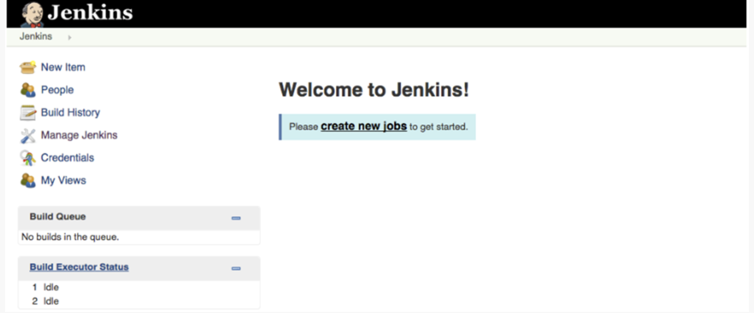

Slide 18
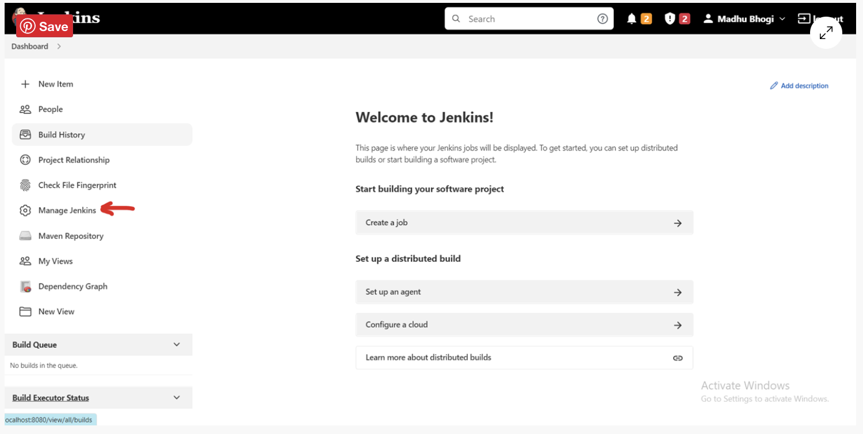

Slide 19
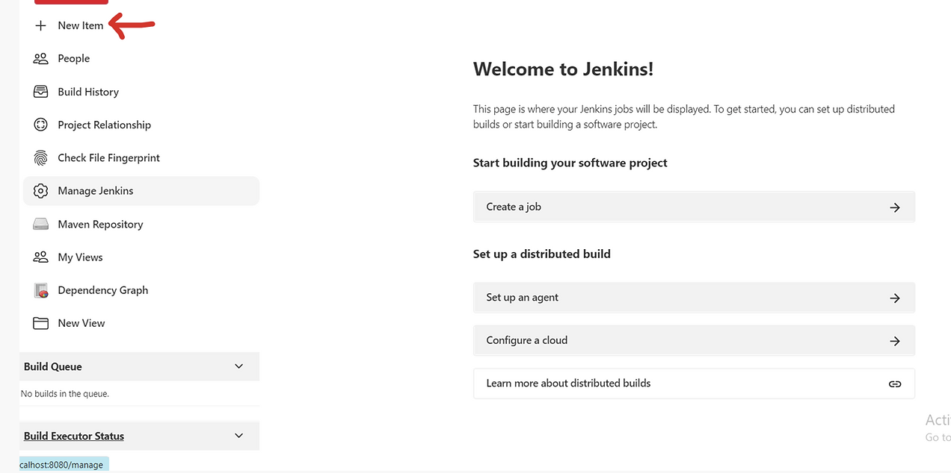

Slide 20
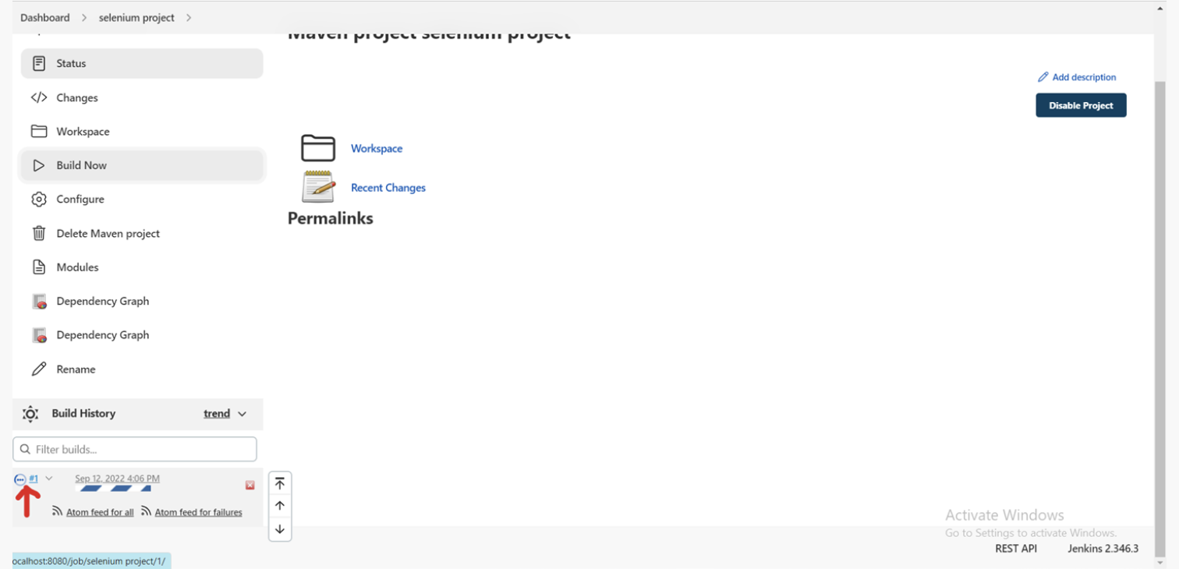

Slide 21
