Slide 1

OAUTH2

Slide 2
What is OAUTH 2
OAuth, or open authorization - authorization framework that allows you to consent to an application interacting with another on your behalf without having to reveal your password.
Provide client applications with “secure delegated access”. Works over HTTPS and authorizes devices, APIs, servers, and applications with access tokens rather than credentials.
Provides applications with secure designated access so that users can engage with the secure portions of a website without the need to create a new account with new credentials.
OAuth doesn’t share password data but instead uses authorization tokens to prove an identity between consumers and service providers.
The tokens are typically used short term, but some can grant recurring access.
There are two versions of OAuth: OAuth 1.0a and OAuth 2.0.

Slide 3
Oauth 1.0 Vs Oauth 2.0
OAuth 2.0 is a completely rewritten framework of OAuth 1.0, and the 1.0 version is regarded as a protocol that uses different terminology and terms.
The main difference in function is how both versions categorize duties and end-user experience.
OAuth 1.0 has a consumer, service provider, and user, and it doesn’t explicitly separate the roles of the resource server and authorization server.
On the other hand, OAuth 2.0 has a client, authorization server, resource server, and resource owner. That’s why these versions don’t have backward compatibility.
OAuth 2.0 offers specific authorization flows for web applications, desktop applications, mobile phones, smart devices, and non-browser-based applications such as API-based services.

Slide 4
OAuth ROLES
1. Resource Owner
The user, or the owner of the protected resources (e.g., credentials, account info, contact lists, sensitive data),
and this entity has the power to grant an application access to their protected resources or credentials.
2. Client
The application that sends an access request to the resource owner’s protected resources.
To attain access, the client attempts to obtain an access token from the authorization server. When requesting
an access token, a client has to acquire its own credentials, a client ID, and a client secret from the
authorization server for identification and authentication.
The client can be a web application, mobile app, TV app, or other application.

Slide 5
OAuth ROLES
3. Authorization Server
The Authorization server accepts credentials from the resource owner, checks to see if they’re authorized to access the resource.
After successful authentication, an authorization server gives away the tokens via the resource owner’s consent.
The authorization server has an authorization endpoint that manages the resource owner’s consent user and a token endpoint that deals with M2M (machine-to-machine communication).
4. Resource Server
Also called the API server in OAuth 2.0, the Resource Server is the external server that a user integrates with.
Hosts the protected user accounts and safeguards the user’s credentials and resources.
A client may request access from the resource server. The resource server is in charge of handling authenticated requests once the app receives an access token.

Slide 6
How 0AUTH works
The Client requests authorization (authorization request) from the Authorization server, supplying the client id and secret to as identification; it also provides the scopes and an endpoint URI (redirect URI) to send the Access Token or the Authorization Code to.
The Authorization server authenticates the Client and verifies that the requested scopes are permitted.
The Resource owner interacts with the Authorization server to grant access.
The Authorization server redirects back to the Client with either an Authorization Code or Access Token, depending on the grant type, as it will be explained in the next section. A Refresh Token may also be returned.
With the Access Token, the Client requests access to the resource from the Resource server.
Notes:
Scopes are an important concept in OAuth 2.0. They are used to specify exactly the reason for which access to resources may be granted. Acceptable scope values, and which resources they relate to, are dependent on the Resource Server.

Slide 7
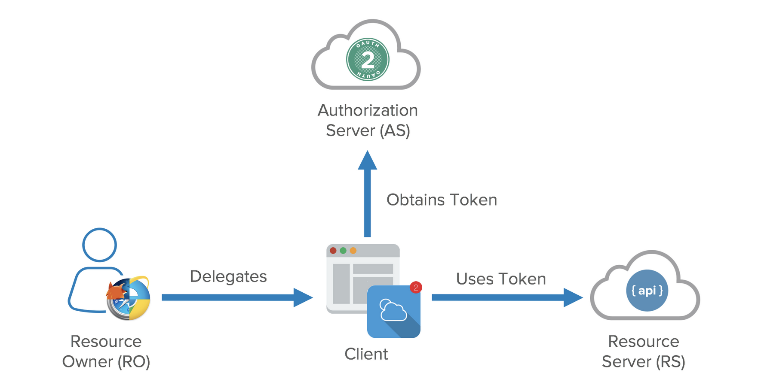

Slide 8
Application Registration
Before using OAuth with your application, you must register your application with the service. This is done through a registration form in the developer or API portion of the service’s website, where you will provide the following information (and probably details about your application):
Application Name
Application Website
Redirect URI or Callback URL
The redirect URI is where the service will redirect the user after they authorize (or deny) your application, and therefore the part of your application that will handle authorization codes or access tokens.

Slide 9
Client ID and Client Secret
Once your application is registered, the service will issue client credentials in the form of a client identifier and a client secret. The Client ID is a publicly exposed string that is used by the service API to identify the application, and is also used to build authorization URLs that are presented to users. The Client Secret is used to authenticate the identity of the application to the service API when the application requests to access a user’s account, and must be kept private between the application and the API.

Slide 10
GRANT TYPES
Authorization Code grant: The Authorization server returns a single-use Authorization Code to the Client, which is then exchanged for an Access Token. This is the best option for traditional web apps where the exchange can securely happen on the server side. The Authorization Code flow might be used by Single Page Apps (SPA) and mobile/native apps. However, here, the client secret cannot be stored securely, and so authentication, during the exchange, is limited to the use of client id alone. A better alternative is the Authorization Code with PKCE grant, below.
Implicit Grant: A simplified flow where the Access Token is returned directly to the Client. In the Implicit flow, the authorization server may return the Access Token as a parameter in the callback URI or as a response to a form post.
Authorization Code Grant with Proof Key for Code Exchange (PKCE): This authorization flow is similar to the Authorization Code grant, but with additional steps that make it more secure for mobile/native apps and SPAs.

Slide 11
GRANT TYPES
Resource Owner Credentials Grant Type: This grant requires the Client first to acquire the resource owner’s credentials, which are passed to the Authorization server. It is, therefore, limited to Clients that are completely trusted. It has the advantage that no redirect to the Authorization server is involved, so it is applicable in the use cases where a redirect is infeasible.
Client Credentials Grant Type: Used for non-interactive applications e.g., automated processes, microservices, etc. In this case, the application is authenticated per se by using its client id and secret.
Device Authorization Flow: A grant that enables use by apps on input-constrained devices, such as smart TVs.
Refresh Token Grant: The flow that involves the exchange of a Refresh Token for a new Access Token.

Slide 12
Authorization Code grant
The authorization code grant type is the most commonly used because it is optimized for server-side applications, where source code is not publicly exposed, and Client Secret confidentiality can be maintained.
This is a redirection-based flow, which means that the application must be capable of interacting with the user-agent (i.e. the user’s web browser) and receiving API authorization codes that are routed through the user-agent.
Step 1 — Authorization Code Link Shared with User
Step 2 — User Authorizes Application
Step 3 — Application Receives Authorization Code
Step 4 — Application Requests Access Token
Step 5 — Application Receives Access Token
{"access_token":"ACCESS_TOKEN","token_type":"bearer","expires_in":2592000,"refresh_token":"REFRESH_TOKEN","scope":"read","uid":100101,"info":{"name":"Mark E. Mark","email":"mark@thefunkybunch.com"}

Slide 13
Client Credentials GRANT
The client credentials grant type provides an application a way to access its own service account.
The application requests an access token by sending its credentials, its client ID and client secret, to the authorization server. An example POST request might look like the following:
https://oauth.example.com/token?grant_type=client_credentials&client_id=CLIENT_ID&client_secret=CLIENT_SECRET
If the application credentials check out, the authorization server returns an access token to the application. Now the application is authorized to use its own account.

Slide 14
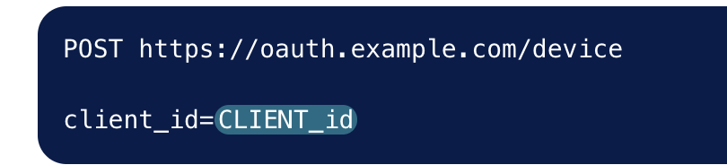
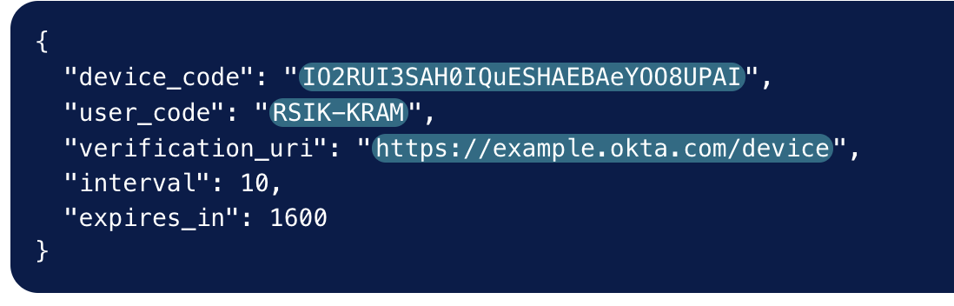
Device Code GRANT
The user starts an application on their browser-less or input-limited device, such as a television or a set-top box. The application submits a POST request to a device authorization endpoint.
The device authorization endpoint is different from the authentication server, as the device authorization endpoint doesn’t actually authenticate the device. Instead, it returns a unique device code, which is used to identify the device; a user code, which the user can enter on a machine on which it’s easier to authenticate, such as a laptop or mobile device; and the URL the user should visit to enter the user code and authenticate their device.

Slide 15
AOUTH Tokens
OAuth Access Token is a string that the OAuth client uses to make requests to the resource server. Access tokens do not have to be in any particular format, and in practice, various OAuth servers have chosen many different formats for their access tokens.
Proves an identity between consumers and service providers
OAuth 2.0’s access tokens are valid for a short period of time. Depending on the permissions granted, they can last from five minutes to a week.
With the resource owner’s approval, OAuth allows the issuing of access tokens to third-party clients via authorization servers.
However, refresh tokens can be utilized in order to get a new access token without repeating the authorization process.

Slide 16
AOUTH TOKENS
These tokens contain information about:
the authentication session;
the user identifier;
an identifier for the identity provider who issued the token;
length of time they'll be valid;
the length of time that has passed since the authorization process began;
and an identifier for the client for which the token was created.

Slide 17
Pros
It’s the accepted industry standard. This means that most authentication services will understand and use OAuth 2.0.
There’s many plug-and-play OAuth options. Including services like “Sign in with Google” and “Sign in with Facebook” that are already set up to be consumed within your application.
OAuth has well tested client libraries in almost all languages and web frameworks. This means that your language of choice can be used with OAuth
It allows for decoupling of code. Your client application code is not affected by the authentication code.
OAuth is very secure and battle tested. Due to its widespread nature, you can be rest assured that all security edge cases have been thought about by industry experts.

Slide 18
CONS
OAuth can be complicated to understand if you are unfamiliar. There are several different OAuth flows and deciding which is right for you can be a challenge. Sometimes, you may even need to use multiple flows.
It has lower end user privacy. The auth server knows all the sites that the end user has logged in into. For example, when a site uses Sign in with Google, Google would be able to keep track of when that site’s users are signing in or are active.
It’s overkill in certain situations. If you are building a simple webapp that has one frontend and backend, then you don’t need the OAuth protocol. However, a lot of online tutorials and ready made auth solutions force you to implement this.
No session management solution. Once the user is authenticated, the auth server simply returns a JWT which can be consumed by your application (as well will see later). However, after that step, the OAuth protocol doesn’t provide any support for specifying how to maintain the authenticated session between your app’s frontend and backend - this is totally up to the developer.

Slide 19
Question.. ???

