Slide 1

SQL QUERY optimization

Slide 2
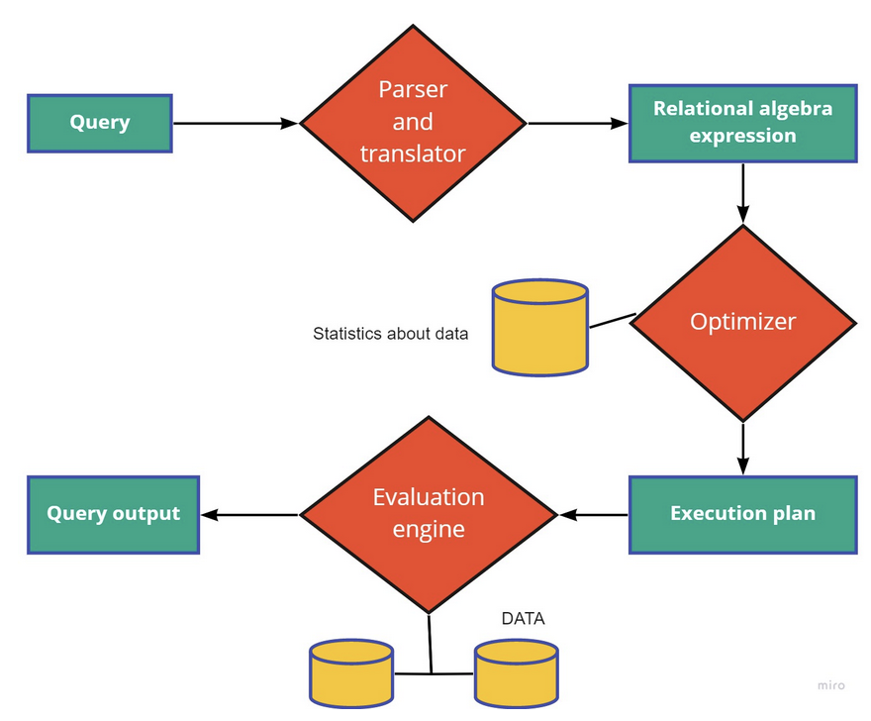
Query Processing
Group of phases associated with the extraction of data from the database. It includes conversion of queries written in a high-level language such as SQL into a form that can be understood by the physical level implementation of the database, SQL query optimization techniques, and the original evaluation of the query. Three major steps involved in query processing: 1. Parser and translator 2. Optimization
3. Execution plan

Slide 3
Purpose of SQL Query Optimization
The major purposes of SQL Query optimization are:
1. Reduce Response Time: The major goal is to enhance performance by reducing the response time. The time difference between users requesting data and getting responses should be minimized for a better user experience.
2. Reduced CPU execution time: The CPU execution time of a query must be reduced so that faster results can be obtained.
3. Improved Throughput: The number of resources to be accessed to fetch all necessary data should be minimized. The number of rows to be fetched in a particular query should be in the most efficient manner such that the least number of resources are used.

Slide 4
Metrics for analyzing query performance
Several metrics are available for calculating the cost of the query in terms of space, time, CPU utilization, and other resources
Execution Time - time taken by the query to return the rows from the database SET STATISTICS TIME ON SELECT * FROM <Table Name >
Statistics IO - IO is the major time spend accessing the memory buffers for reading operations in case of query. It provides insights into the latency and other bottlenecks for executing the query SET STATISTICS IO ON SELECT * FROM <Table Name >
Execution Plan - helps to analyze the major phases in the execution of a query
Buffer cache - Used to reduce memory usage on the server
Latency: Used to analyze the duration of queries or operations.
Indexes: Used to accelerate reading operations on the SQL Server.
Memory-optimized tables: Used to store table data in memory to make reading and writing operations run faster.

Slide 5
Querys runtime depends on :
Table size: If your query hits one or more tables with millions of rows or more, it could affect performance.
Joins: If your query joins two tables in a way that substantially increases the row count of the result set, your query is likely to be slow.
Aggregations: Combining multiple rows to produce a result requires more computation than simply retrieving those rows.
Other users running queries: The more queries running concurrently on a database, the more the database must process at a given time and the slower everything will run. It can be especially bad if others are running particularly resource-intensive queries that fulfill some of the above criteria.
Database software and optimization: This is something you probably can't control, but if you know the system you're using, you can work within its bounds to make your queries more efficient.

Slide 6
Select Which Queries to Optimize?
Consistently Slow Queries If you have a consistently slow query, it may be time to optimize it. When executed frequently, queries with high latency can cause performance issues, so it’s crucial to monitor and optimize them
Occasionally Slow Queries If you notice an occasionally slow query—whether you decide to optimize it or not—it’s a good idea to monitor it carefully
Queries With Red Flags Queries that have returned warnings and errors Query doesn’t use indexes
Queries That Majorly Contribute to Total Execution Time If more than five percent of total execution time can be attributed to a single query, optimize it

Slide 7
Best Practices for Optimizing SQL Query Performance
Define Your Requirements - clearly define your requirements before writing the query, enabling you to receive only the information you need, potentially reduce runtime, and optimize SQL queries.
Reduce Table Size - Filtering data will reduce table size and optimize SQL queries’ runtime.
-- Providing a limited range of dates for time series data
-- Limiting the dataset in a subquery
-- Avoiding duplicate data
Simplify Joins - When joining two tables, start with the one that will return the fewest results after filtering.
Use SELECT Fields FROM Instead of SELECT * FROM -- SELECT * will fetch all the data from your table, whereas specifying fields can reduce query runtime by ensuring you only receive the necessary data
SELECT ID instead of SELECT DISTINCT can reduce the processing power required to perform the query while still returning unduplicated records

Slide 8
Use EXISTS() Instead of COUNT()
Use WHERE Instead of HAVING
Add EXPLAIN to the Beginning of a Query
Create SQL Server Indexes
Avoid Running Queries in a Loop
Indexing
Inner joins vs WHERE clause - use inner join for merging two or more tables rather than using the WHERE clause
LIMIT command - control the number of rows to be displayed from the result set
IN versus EXISTS - use EXISTS rather than using IN for fetching results with a subquery
Avoid using multiple OR in the FILTER predicate
Use wildcards at the end of a phrase only
Use TOP to sample query results
Run the query during off-peak hours
Minimize large write operations

Slide 9
Commands that help you automatically optimize query performance.
ANALYZE
Run on your databases and tables to measure some statistics about the tables. These calculated statistics are then stored in a PostgreSQL maintained table, which will then be used by the query planner to better plan query execution.
Analyze command when run, the command recalculates the stats for the given table and updates them in the database. This will then be used for planning the execution.
EXPLAIN Next logical step after the analyze command. This outputs the plan that the database forms after using the stats calculated by the analyze command. This should give us a clear idea as to how the query is going to perform, if it’s going to use an index scan or a table scan, etc. Based on this, we can either alter the query for better performance, or update the stats by running analyze again

Slide 10
QUERY MONITOR
Query Monitor tracks the query and displays it inside the logs so that you as a user can see which queries were executed successfully and which were not
The monitor's dashboard is structured to give you an overview of the important metrics of the monitor
DB query monitor, get information about the availability and the performance of the database as well as the execution time of the database queries
Helps to identify probable causes of performance degradation of your business applications
Compare query execution times and understand the database performance better
Query monitoring tool provides various options to manage your query -- enable/disable data collection of the query results by selecting particular rows according to your requirement -- allows you to delete rows of query results

Slide 11
QUERY MONITORING TOOLS / OPTIMIZATION TOOLS : -- Datadog SQL Server Monitoring -- Solar Winds Database Performance Analyzer -- Site 24*7 SQL Server Monitoring -- Red-Gate SQL Monitor -- SQL Power Tools -- dbForge Monitor

Slide 12
THANK YOU…

