Slide 1

CACHING

Slide 2
Database caching is a buffering technique that stores frequently-queried data in temporary memory.
A cache is a high-speed data storage layer which stores a subset of data that is often read requested
Rerouting of queries for frequently read data to the cache itself, rather than the primary database easing the burden on the primary database
The cache itself, resides in either the database, application, or even as a standalone access layer.
Caching significantly improves response time for client applications by serving data more quickly

Slide 3
BENEFITS
Significantly improve response times for client applications which results in improvement of performance, availability and scalability of a system
Performance - caching minimize the workload of the database, keeping it from spending inefficient amounts of time doing repetitive tasks
Availability - Cache can still provide a place for the application to call upon for data in the case of the primary database server becoming unavailable for any reason.
Scalability – Caching helps in distributing backend queries across entities

Slide 4
When to cache
Huge data that you have and the larger the number of users that need to access this data
Database supports limited number of concurrent connections
Data that has a higher proportion of read operations than write operations
Recommended not to make cache authoritative store of critical information
-- If the cache is unavailable, your application can still continue to operate

Slide 5
different database caching strategies
Caching strategy depends on the data and data access patterns. In other words, how the data is written and read. Choosing right strategy can reduce response times, decrease load on database, and save costs
cache-aside
read-through
write-through
write-back
write-around

Slide 6
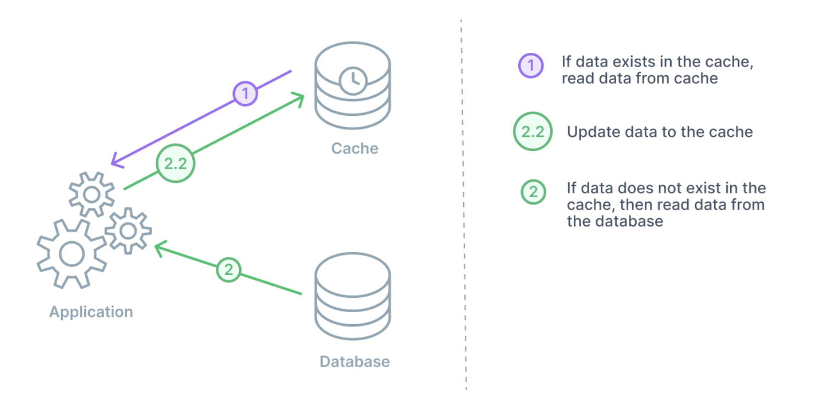
Cache-aside
Cache sits next to the database
Useful for applications with read-heavy workloads
In the instance of a cache failure, the system relying on cache data can still go directly to the database
Cache being separated, it can employ a different data model than that of the database.
Application is responsible for fetching the data and populating the cache
Main drawback - cache may have a period of inconsistency with the primary database

Slide 7
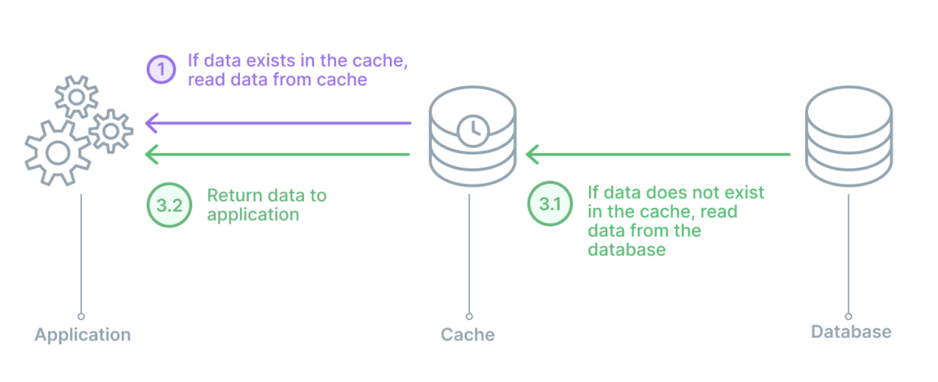
Read-through
Cache sits between the application and the database
Useful for applications with read-heavy workloads
For any data writes, the application will still go directly to the database
A Library or some separate cache provider fetches the data and populating the cache
Disadvantage - needing to go to the database to get the data anytime a new read request comes through
Developers to mitigate this delay by ‘warming’ the cache by issuing likely to happen queries manually

Slide 8
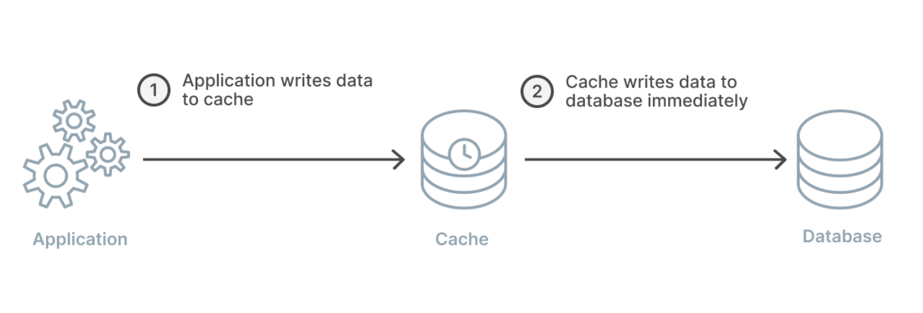
Write-through
Write to the cache first and the cache immediately writes to the database.
Benefit - cache is ensured to have any written data and no new read will experience delay
Disadvantage - extra write latency because the action must go to the cache and then to the database
The real benefit comes from pairing a write-through with a read-through cache.

Slide 9
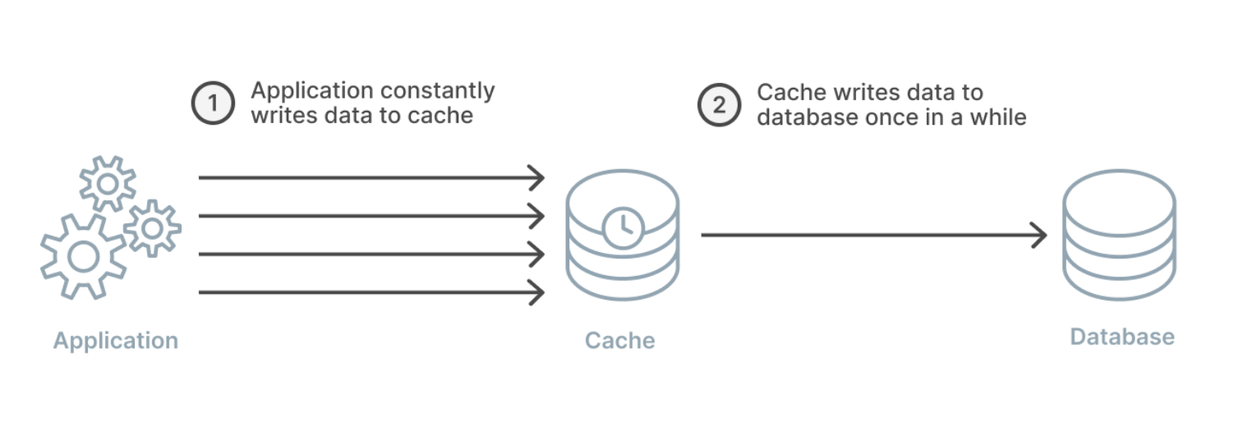
Write-BACk
Same as write-through strategy except cache does not immediately write to the database, and it instead writes after a delay.
Strain on the cache is reduced in a write-heavy workload
Improves overall performance, cost savings and overall workload reduction if batches is supported
write-back, read-through combination good for mixed workloads - most recently written data and accessed data is always available in cache
possible data loss if the batch or delayed write to the database has not yet occurred.

Slide 10
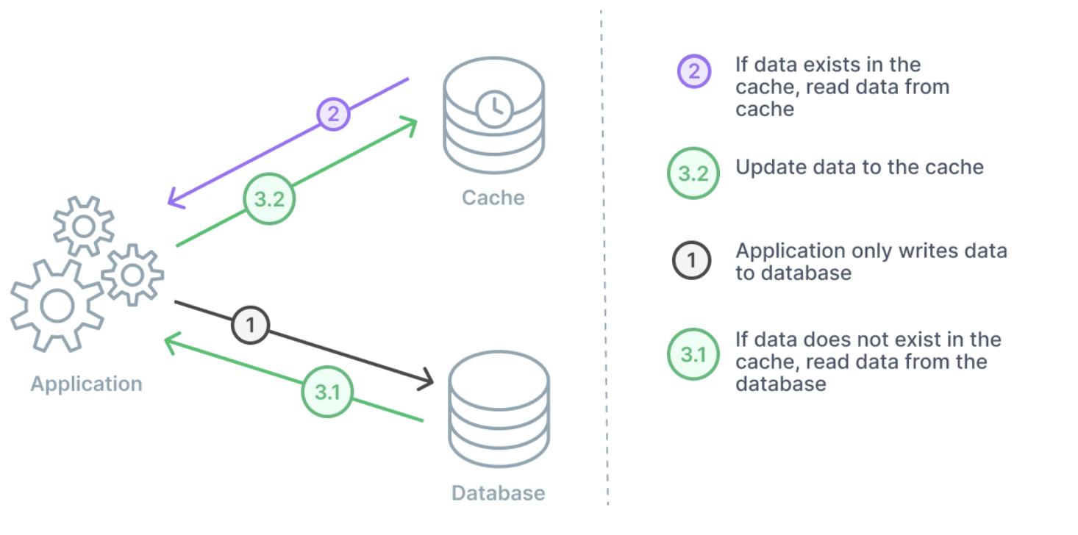
Write-around
Data is always written to DB
Data read is from cache – If cache miss, application will read to the database and then update the cache for next time
Combined with either a cache-aside or a read-through.

Slide 11
types of caches
Cache itself can live in several areas, including in your database, in the application, or as a standalone layer
Types of caches
-- Database-integrated caches - cache that is managed within the database engine and has built-in write-through capabilities. The database updates its cache automatically when the underlying data changes
-- Local caches - frequently-used data is stored within your application – Data retrieval is faster. But with multiple application servers, coordinating the values across them becomes a major challenge if each server has its own cache
-- Remote caches - dedicated servers and are typically built on key/value NoSQL stores, such as Redis and Memcached. With remote caches, the orchestration between caching the data and managing the validity of the data is managed by your applications and/or processes that use it. The cache itself is not directly connected to the database but is used adjacently to it.

Slide 12
CACHE validity
Freshness of your cached data can be controlled by applying a time to live (TTL) or expiration to your cached keys
After the set time has passed, the key is deleted from the cache
Make sense to keep static or reference data (that is, data that is seldom updated) valid for longer periods of time with write-throughs to the cache when the underlying data gets updated.
With dynamic data that changes often, you might want to apply lower TTLs that expire the data at a rate of change that matches that of the primary database. This lowers the risk of returning outdated data while still providing a buffer to offload database requests.
Appropriately applying TTLs to your cached keys can result in a huge performance boost and an overall better user experience with your application
Another best practice when applying TTLs to your cache keys is to add some time jitter to your TTLs

Slide 13
Evictions
Eviction is intended to control the total size of the cache. This is to prevent each cluster member from an OutOfMemory issue
Cache eviction is a feature where file data blocks in the cache are released when usage exceeds the soft quota, and space is created for new files.
Use automatic cache eviction or define your own policy to decide which file data is evicted.
To automatically enable cache eviction, define a fileset soft quota on the cache fileset. Eviction starts when fileset usage reaches the soft quota limit.
Policies can be configured based on which eviction occurs

Slide 14
REDIS
[Remote Dictionary Server]

Slide 15
INTRO..
Redis is an open source, in-memory, NoSQL key/value store that is used primarily as an application cache or quick-response database
Because it stores data in memory, rather than on a disk, Redis delivers unparalleled speed, reliability, and performance.
Redis is an actual data structure server that supports multiple data types and structures - like strings, hashes, lists, sets, sorted sets, bitmaps,
Redis can replicate data to any number of slaves.

Slide 16
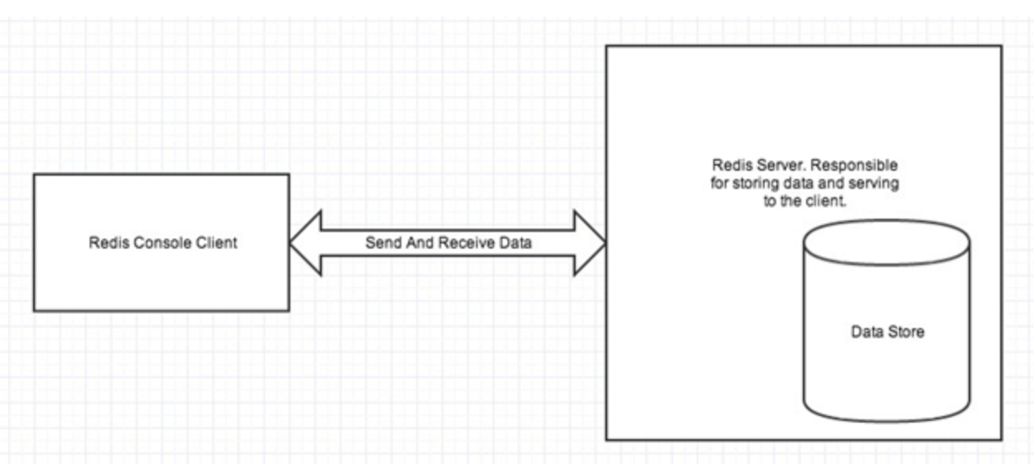
Redis Architecture
There are two main processes in Redis architecture:
Redis Client
Redis Server
Redis server is used to store data in memory . It controls all type of management and forms the main part of the architecture. You can create a Redis client or Redis console client to retrieve data

Slide 17
Features of Redis
Redis as an in-memory database
Redis supports both read and write operations. In Redis, writes can be protected from system failure either by being stored periodically in a local snapshot file or in an append-only log file.
All writes are asynchronous and don't block clients from reading and writing data. When Redis starts running, it reads the data from the snapshot or log file and uses it to construct the in-memory cache.
Redis data types
Redis is a key-value store, where values can contain simple types or complex data structures It supports a set of atomic operations on these data types. Keys can be permanent or tagged with a limited time-to-live, at which point the key and its corresponding value are automatically removed from the cache.

Slide 18
Features of Redis
Redis replication and clustering
Redis supports primary/subordinate replication to help ensure availability and maintain throughput. Write operations to a Redis primary node are replicated to one or more subordinate nodes. Read operations can be served by the primary or any of the subordinates. This ensures availability across each node in the cluster.
Redis also provides clustering, which enables you to transparently partition data into shards across servers and spread the load. This feature improves scalability, because new Redis servers can be added and the data repartitioned as the size of the cache increases.

Slide 19
Redis memory use Redis server, you can specify the maximum amount of memory it can use As memory fills up, Redis can automatically evict keys and their values by following a number of policies. Configure a key in a Redis cache to have an expiration time, after which it's automatically removed from the cache. Prevents the in-memory cache from filling with old or stale data.
Redis transactions and batches
Transaction processing consists of two stages— the first is when the commands are queued, and the second is when the commands are run command queuing stage - error occurs at this point then Redis refuses to process the entire transaction and discards it.
run phase, Redis performs each queued command in sequence. – failure occurs Redis continues with the next queued command and doesn't roll back Redis also supports nontransactional batching of requests.

Slide 20
Redis security
Redis is focused purely on providing fast access to data, and is designed to run inside a trusted environment that can be accessed only by trusted clients. Redis supports a limited security model based on password authentication. All authenticated clients share the same global password and have access to the same resources. Need more comprehensive sign-in security, you must implement your own security layer in front of the Redis server Redis doesn't directly support any form of data encryption Redis doesn't provide any form of transport security

Slide 21
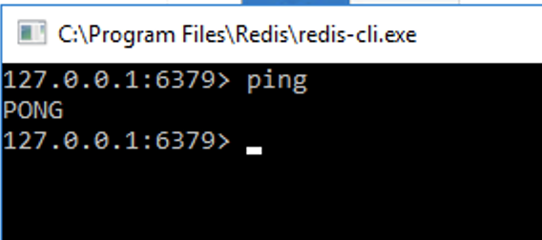
REDIS INSTALL
Officially, Redis is not supported on Windows. There is, however, version 3 of Redis that can be ported to Windows. Download installable from : https://github.com/microsoftarchive/redis/releases
Start the server from <installation_folder>: redis-server.exe
Run the client and issue commands.

Slide 22
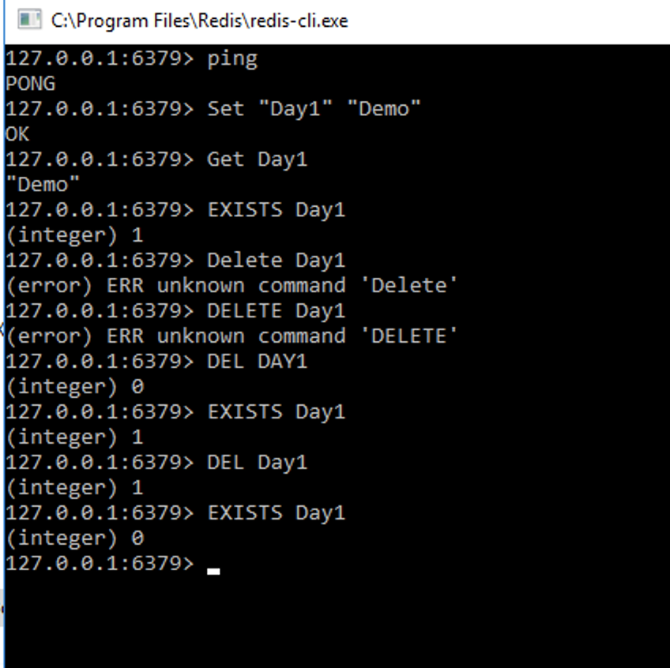
REDIS COMMANDS :

Slide 23
Redis Data Types
There are five types of data types supported by Redis database.
Strings
Hashes
Lists
Sets
Sorted Sets
Strings:
String is a set of bytes. In Redis database, strings are binary safe.
It means they have a known length and not determined by any special terminating characters.
So it is possible to store anything up to 512 megabytes in one string.

Slide 24
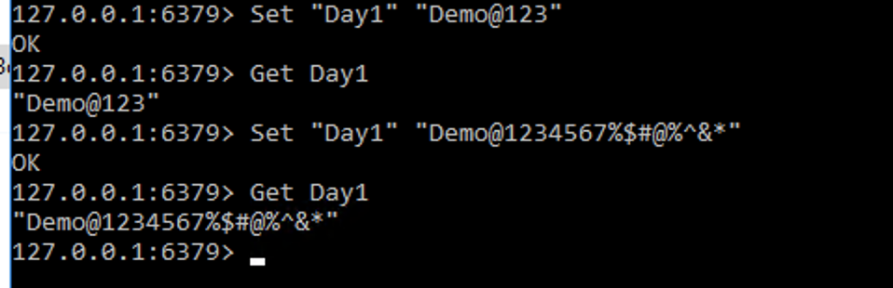
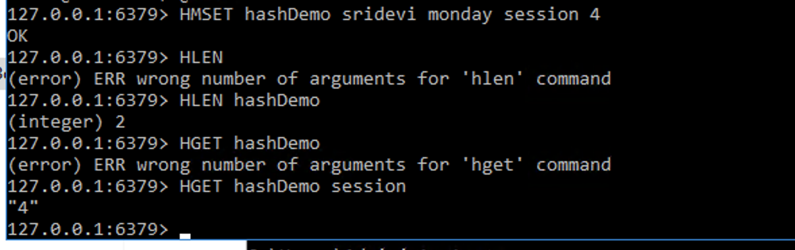
Hashes:
Hash is a collection of key-value pairs.
In Redis, hashes are maps between string fields and string values. So, they are used to represent objects.
Every hash can store up to more than 4 billion field-value pairs.

Slide 25
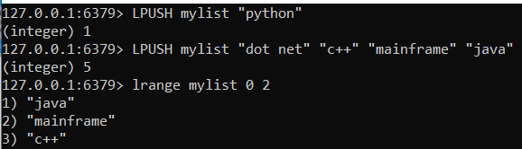
Lists:
inserts all the specified values at the head of the list stored at the key.
If the key does not exist, it is created as an empty list before performing the push operations.
When the key holds a value that is not a list, an error is returned.
Maximum length of a list is more than 4 billion of elements

Slide 26
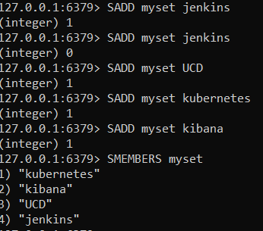
Sets:
Redis Sets are an unordered collection of unique strings.
Unique means sets does not allow repetition of data in a key.
In Redis set add, remove, and test for the existence of members in O(1) (constant time regardless of the number of elements contained inside the Set).
The maximum length of a list is more than 4 billion of elements.

Slide 27
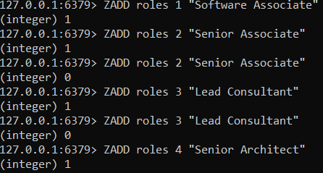
Sorted Sets:
Redis Sorted Sets are similar to Redis Sets with the unique feature of values stored in a set.
The difference is, every member of a Sorted Set is associated with a score, that is used in order to take the sorted set ordered, from the smallest to the greatest score.
Maximum length of a list is more than 4 billion of elements.

Slide 28
HANDS ON ..
https://redis.io/commands/

