Slide 1

INDEXING

Slide 2
WHAt is indexing
Indexes are a powerful tool used in the background of a database to speed up querying
Power queries by providing a method to quickly lookup the requested data.
Optimizes the performance of a database by minimizing the number of disk accesses required when a query is processed.
Data structure technique which is used to quickly locate and access the data in a database
It is the way to get an unordered table into an order that will maximize the query’s efficiency while searching
A database table can have one or more indexes associated with it

Slide 3
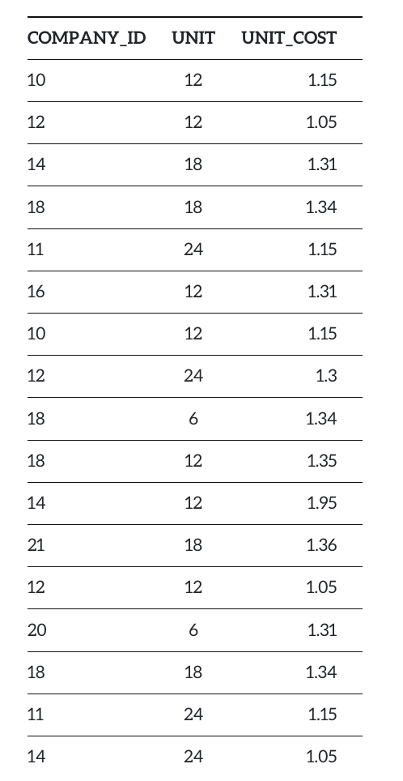
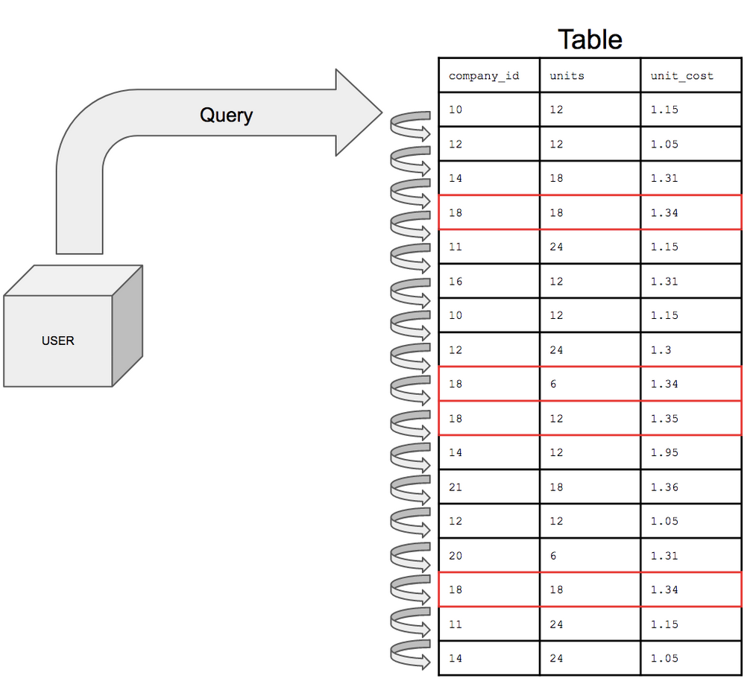
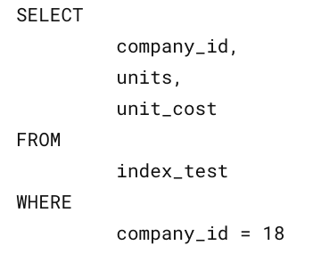
Fictional Table

Slide 4
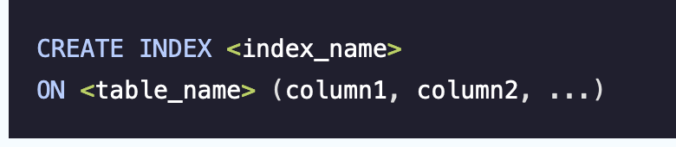
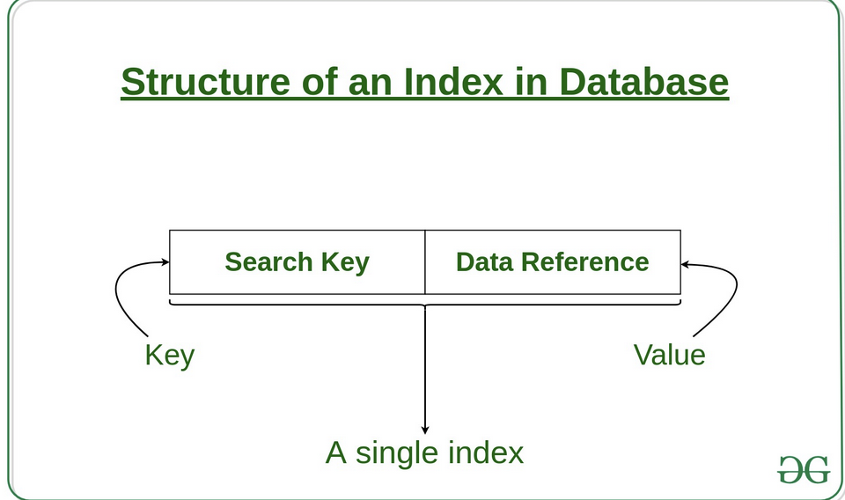
CREATE INDEX
Index causes the database to create a data structure on a specific column. No other column is stored in the data structure
Database indexes will also store pointers which are simply reference information for the location of the additional information in memory.

Slide 5
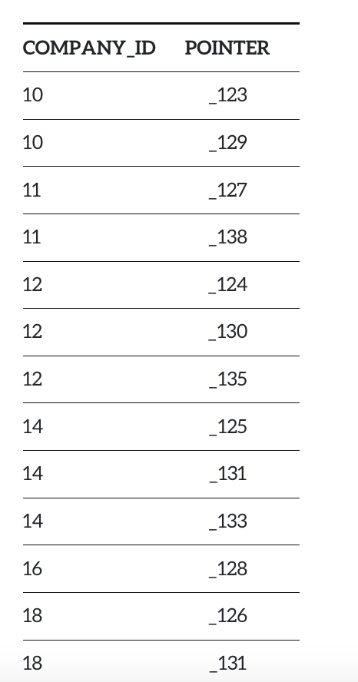
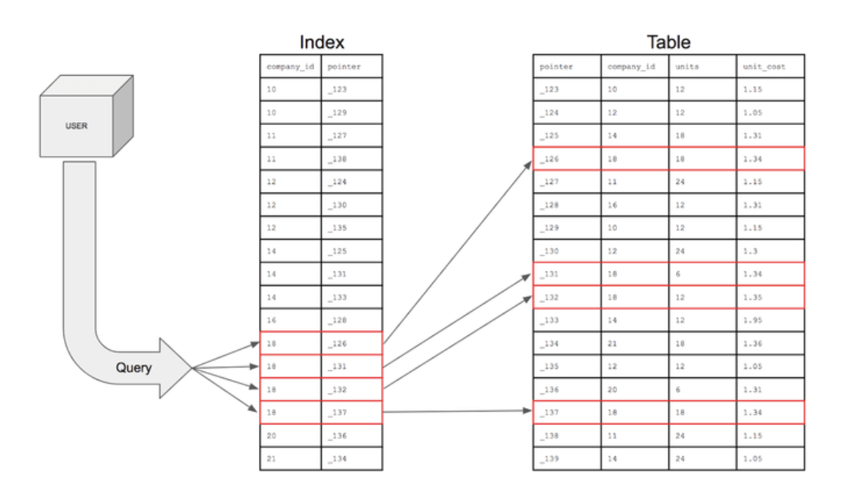

Slide 6
File Organization Methods for Database Indexes
1. Ordered Index File: This is the traditional method of storing index data. In this method, the key values are sorted in a particular order.
2. Hash File organization: In this file organization method, a hash function determines the location or disk block where a record is stored.

Slide 7
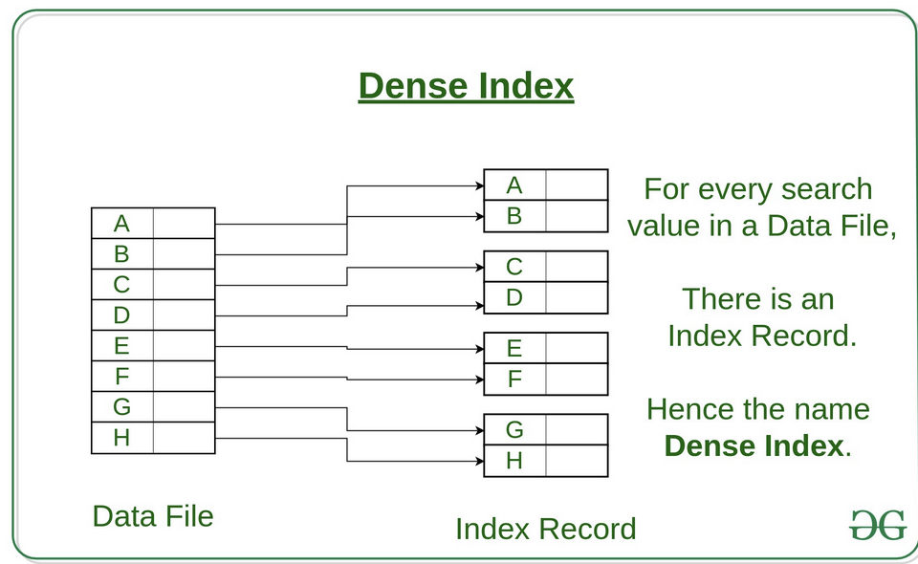
Dense Index: For every search key value in the data file, there is an index record. This record contains the search key and also a reference to the first data record with that search key value.

Slide 8
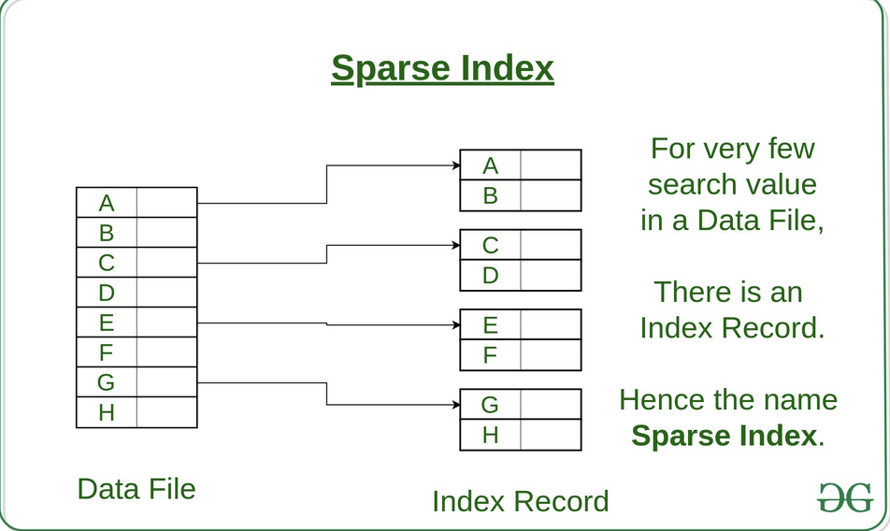
Sparse Index: The index record appears only for a few items in the data file Each item points to a block To locate a record, we find the index record with the largest search key value less than or equal to the search key value we are looking for. We start at that record pointed to by the index record, and proceed along with the pointers in the file (that is, sequentially) until we find the desired record.

Slide 9
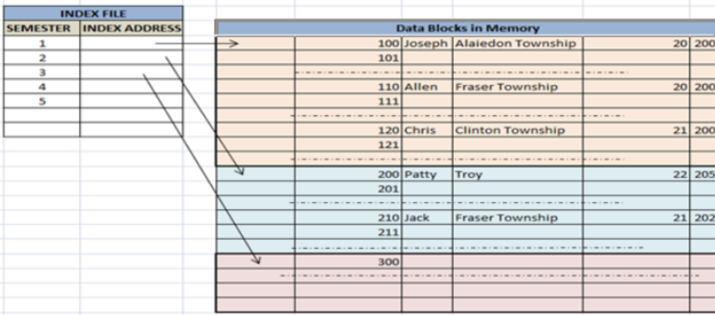
Clustered Indexing Similar data types are grouped [ Clusters] and indices are created for them Data pointers in indices will refer to the cluster as a whole entity. Only one clustered index can exist in any table. A clustering index uses ordered data files to define itself Order of the rows in the data pages corresponds to the order of the rows in the index Database manager attempts to insert rows with similar keys onto the same pages

Slide 10
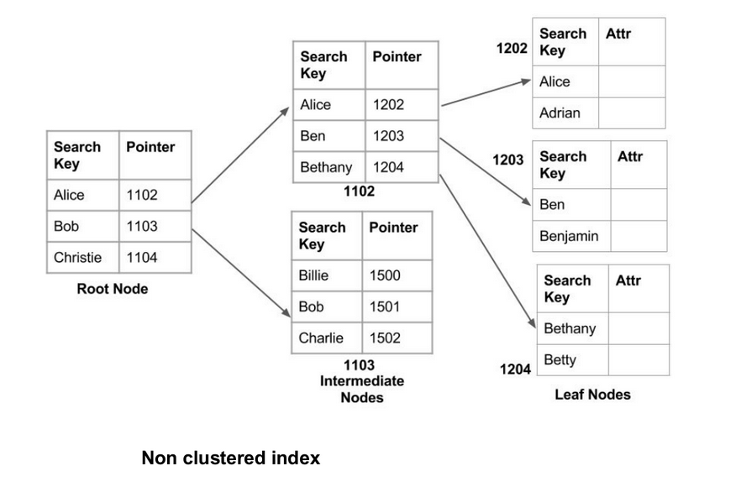
Non-clustered Indexing Just tells us where the data lies Data is not physically stored in the order of the index Instead, data is present in leaf nodes Can have only dense ordering in the non-clustered index Requires more time as compared to the clustered index

Slide 11
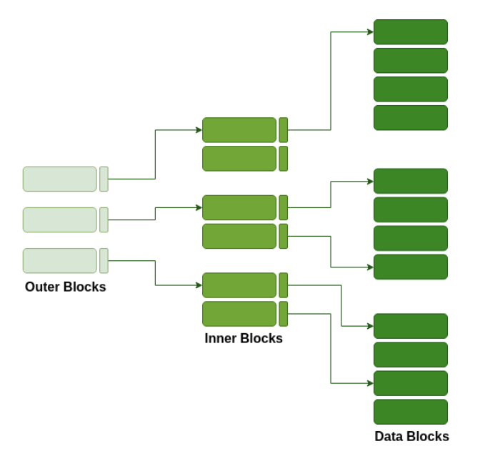
Multilevel Indexing Multi-level indexing is used when the number of indices is very high, and it can't store the primary index in the main memory With the growth of the size of the database, indices also grow As the index is stored in the main memory, a single-level index might become too large a size to store with multiple disk accesses. The multilevel indexing segregates the main block into various smaller blocks so that the same can stored in a single block. The outer blocks are divided into inner blocks which in turn are pointed to the data blocks. This can be easily stored in the main memory with fewer overheads.

Slide 12

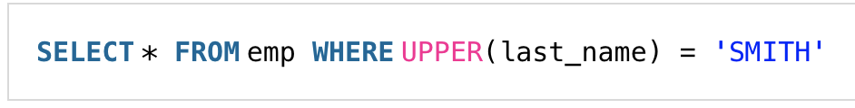
Improving Record Selection Performance
To improve the performance of selections, the index expression must match the selection condition exactly Index : last_name
Uses Index :
Doesn’t use index :

Slide 13
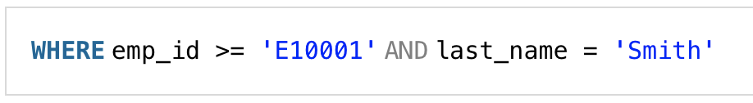
Indexing Multiple Fields
Often use Where clauses that involve more than one field, build an index containing multiple fields Optimal index field expression is LAST_NAME, FIRST_NAME --- concatenated index Concatenated indexes can also be used for Where clauses that contain only the first of two concatenated fields index on the EMP_ID field as well as the LAST_NAME field. Driver selects the index on the LAST_NAME field.

Slide 14
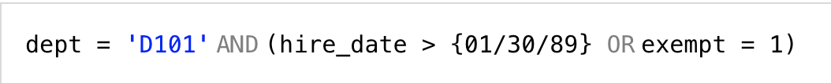
Deciding Which Indexes to Create
Insert, update, and delete records ---- > fewer indexes, better the performance
Retrieve records --- > define the criteria for retrieving records, create indexes to improve the performance of these retrievals Few Tips → Record retrievals are based on one field at a time - create an index on these fields Record retrievals are based on a combination of fields – Identify the combination and create Indicies Comparison operator for the conditions is AND -- build concatenated indicies Comparison operator is OR -- index does not help performance Comparison operator is OR is grouped – index improves performance [ dept column ]
AND conditions are grouped, an index does not improve performance

Slide 15
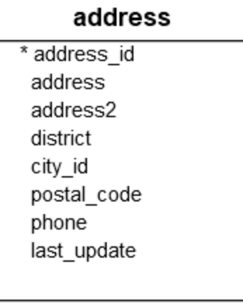
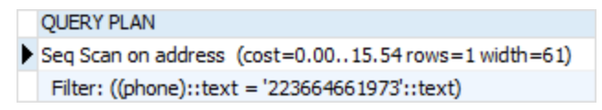
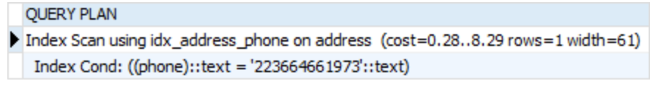
POST GRE SQL EXAMPLE
SELECT * FROM address WHERE phone = '223664661973’; EXPLAIN SELECT * FROM address WHERE phone = '223664661973’;
CREATE INDEX idx_address_phone ON address(phone); EXPLAIN SELECT * FROM address WHERE phone = '223664661973';

Slide 16
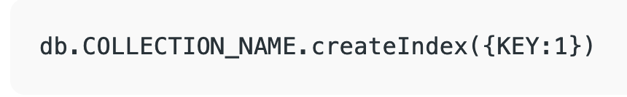
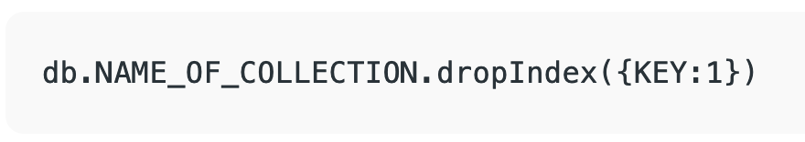
MONGO INDEX EXAMPLE
Create Index : key determines the field on the basis of which you want to create an index 1 (or -1) determines the order in which these indexes will be arranged(ascending or descending).
Drop Index:

Slide 17
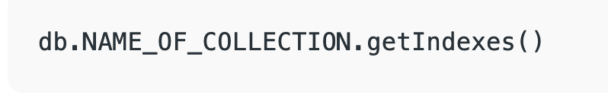
description of all the indexes that exists in the given collection.

Slide 18
THANK YOU

