Slide 1

APACHE SOLR

Slide 2
Apache Solr is an Open-source REST-API based Enterprise Real-time Search and Analytics Engine Server
SOLR stands for Searching On Lucene w/Replication. It’s main functionalities are indexing and searching
Search Functionality is built using Apache Lucene Framework and with some extra and useful features.
It is written in Java Language.
Solr has RESTful XML/HTTP and JSON APIs and client libraries for many programming languages such as Java, Phyton, Ruby, C#, PHP
Solr is a scalable, ready-to-deploy enterprise search engine that was developed to search a large volume of text-centric data
Often used as a document-based NoSQL database with transactional support that can be used for storage purposes and even a key-value store.
Solr takes in structured, semi-structured, and unstructured data from various sources, stores and indexes it, and makes it available for search
Solr can work with large amounts of data in what has traditionally been called master-slave mode

Slide 3
Benefits of solr
Scalable: It scales by distributing indexing and query processing to multiple servers in a cluster.
Flexibility: Its easy to scale Solr up or down
Ready to deploy: It is open-source, easy to install and configure, and provides a preconfigured example to help you get started.
Optimized for search: It is fast and can execute complex queries in a fraction of second speed, often only tens of milliseconds.
Large volumes of documents: It is designed to deal with indexes containing many millions of documents.
Text-centric: It is optimized for searching natural-language text, like emails, web pages, resumes, PDF documents, and social messages such as tweets or blogs.
Results sorted by relevance: It returns documents in ranked order based on how relevant each document is to the user's query.

Slide 4
Powerful Full-Text Search Capabilities – Solr provides advanced near real-time searching capabilities such as fielded search, Boolean queries, phrase queries, fuzzy queries, spell check, wildcards, joins, grouping, auto-complete and many more across different types of data
Comprehensive Administration Interfaces - Solr provides a built-in responsive user interface that enables you to perform administrative tasks, such as managing logging, adding, deleting, updating or searching documents.
High Scalability and Flexibility - With tools such as Apache ZooKeeper, it’s easy to scale Solr up or down, as it relies heavily on automated index replication, distribution, load-balancing, and automated failover and recovery.
Extensible Plugin Architecture - Solr publishes extension points that make it easy to plugin both index and query time plugins.
Built-in Security: SSL for encryption of HTTP traffic , Basic and Kerberos-based authentication, Authorization APIs for defining users, roles, and permissions
Easy Monitoring: Solr exposes its metrics via JMX MBeans, so you can do some ad-hoc monitoring. Recently started exposing its metrics via an HTTP API, too.
Powerful Analytical Capabilities

Slide 5
Solr Terminology
Document - Basic unit of information in Solr that can be stored and indexed. Stored in collections.
Field - Stores the data in a document holding a key-value pair, where key states the field name and value the actual field data.
Core - Core is an Index of texts and fields available in all documents. One Solr Instance can contain one or more Solr Cores.
Collection - Group of shards/cores that form a single logical index.
Shard - Shards allow you to split and store your index into one or more pieces
Node - single Java Virtual Machine instance running Solr, also known as a Solr server.
Replica - replica is a physical copy of a shard that runs as a core in a node.
Leaders - Leader is a replica of the shard that sends requests of the SolrCloud to the rest of the replicas in the shard whenever there’s an index update, such as document additions or deletions
Cluster - cluster is made up of one or more nodes that store all the data, providing distributed indexing and search capabilities across all nodes

Slide 6
Solr’s Schema File - Where you specify how Solr should build indexes from input documents. - Named either managed-schema.xml or schema.xml - Schema is Solr concept and actual data in your index is stored in Lucene, and Lucene does not have the concept of a schema
Document Analysis in Solr Solr breaks down and works with textual data Field analyzers - analyzer examines the text of fields and generates a token stream Tokenizers - break field data into lexical units, or tokens Filters - examine a stream of tokens and keep them, transform or discard them, or create new ones

Slide 7
How Does Solr Work?
Step 1: Indexing -- Solr uses Lucene to create an inverted index - it inverts a page-centric data structure (documents ⇒ words) to a keyword-centric structure (word ⇒ documents).
-- Solr index is a list that holds the mapping of words, terms or phrases and their corresponding places in the documents stored.
-- Searches for keywords in the index instead of scanning the text directly – achieves faster response
-- Solr uses fields to index a document - before being added to the index, data goes through a field analyzer, where Solr uses char filters, tokenizers, and token filters to make data searchable
-- need to set up rules for processing content found in fields as documents are indexed -- fields and the rules are defined in the managed-schema file

Slide 8
Step 2: Querying
When you send a query, Solr processes it with a query request handles (or simply query handler) that works similarly to the index handler, only that is used to return documents from the Solr index.
To process a search query, a request handler calls a query parser, which interprets the terms and parameters of a query.
Step 3: Ranking the Results
As it matches indexed documents to a query, Solr ranks the results by their relevance score – the most relevant hits appear at the top of the matched documents
Relevance is the degree to which a query response satisfies a user who is searching for information.
Precision is the percentage of documents in the returned results that are relevant.

Slide 9
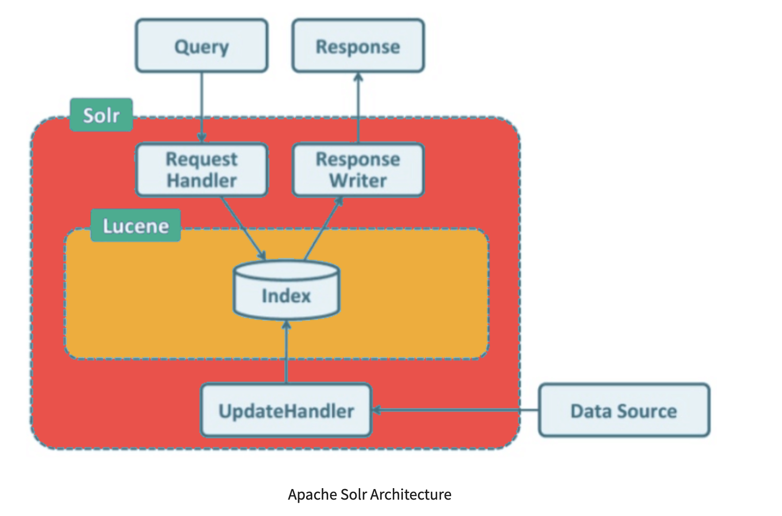

Slide 10
Install APACHE solr
Windows Environment
Download latest version of Apache Solr
Use this https://solr.apache.org/downloads.html to download Apache V. 9.1.1. You will get solr- 9.1.1.zip for Windows environments.
Extract zip file to Local Filesystem
Extracted solr- 9.1.1.zip file to F:\solr-9.1.1
Set Environment Variables
Let us assume SOLR_HOME=F:\solr-9.1.1
Set the PATH

Slide 11
COMMANDS
Start Apache Solr $ ./solr start Started Solr server on port 8983 $ ./solr start –p 9000 -- > To start on a different port number
Check Status of Apache Solr $ ./solr status Found 1 Solr nodes
Stop Solr $ ./solr stop
Restart Solr $ ./solr restart

Slide 12
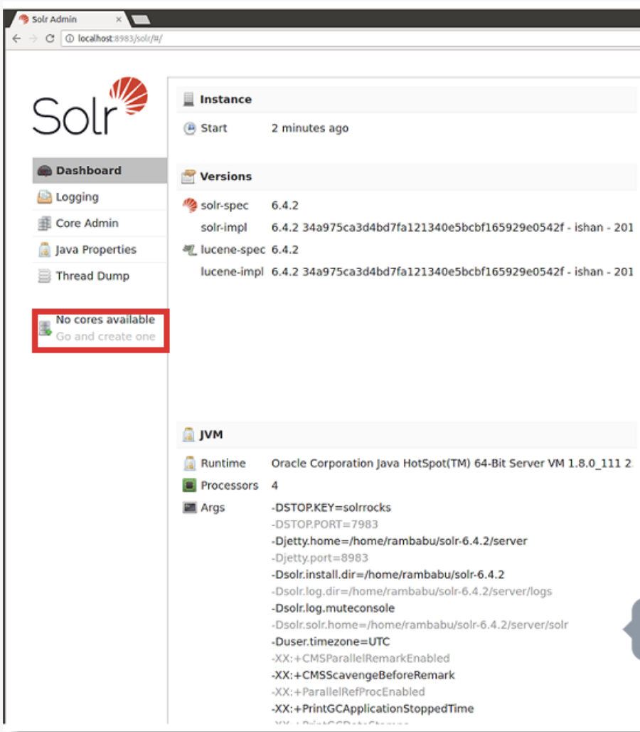
Apache Solr Admin Console
Apache Solr has a Web interface or Admin console view Solr configuration details, run queries and analyze document fields in order to fine-tune a Solr configuration etc Accessible on - http://localhost:8983/solr/ We can use this Admin console:
Create, Update, Delete (Unload) and View Cores
Create, Update, Delete and View Documents
Apache Solr Configurations
Logging information
Monitoring information

Slide 13
HANDS ON …

