Slide 1
E-CAMPUS
College Management
Mobile Application
RAHUL VEGDANI — 56
VISHWAJIT WAGHDHARE — 57
SOHAM TAMBADE — 52
PARIDHI SUREKA — 51
ASHUTOSH PANDEY — 36
A connected campus experience for students, teachers and administrators
Flutter • Firebase • Role-based access
MCA PROJECT PRESENTATION
E-CAMPUS • PROJECT PRESENTATION
01

Slide 2
01 • OVERVIEW
Project at a glance
E-Campus is a Flutter-based college management app designed to bring everyday campus information and communication into one mobile experience.
01
One campus hub
02
Role-aware experience
03
Cloud-connected
Core student services and academic information in one place.
Student, teacher and administrator workflows.
Firebase services support authentication and app data.
Focus: usability • access • communication • maintainability
E-CAMPUS • PROJECT PRESENTATION
02

Slide 3
02 • WHY THIS PROJECT
Problem statement
Campus information is often spread across different channels, making it harder for students and staff to find the right information quickly.
Fragmented information
Communication gaps
Different responsibilities
Timetables, attendance and library details may live in separate places.
Students need a clear channel to contact teachers or administrators.
Each campus role needs relevant screens and permissions.
E-CAMPUS • PROJECT PRESENTATION
03

Slide 4
03 • GOALS
Project objectives
• Provide a mobile-first interface for common campus tasks.
• Support OTP-based authentication and role-based navigation.
• Bring attendance, timetable, library and profile access into one app.
• Enable campus communication between students, teachers and administrators.
• Use Firebase services to support app data and notifications.
DESIGN PRINCIPLE
Make the right campus action easy to find.
Clear navigation • focused screens • role-aware access
E-CAMPUS • PROJECT PRESENTATION
04

Slide 5
04 • USER ROLES
Users and role-based experience
S
Student
T
Teacher
A
Administrator
View relevant academic information, attendance, timetable and library features; contact teachers or admins as appropriate.
Access teacher-facing screens and communicate with students or administrators.
Support app administration and respond to app-related issues.
The intended experience changes according to the signed-in user's role.
E-CAMPUS • PROJECT PRESENTATION
05

Slide 6
05 • APP CAPABILITIES
Core features
Authentication
Dashboard & profile
Attendance
OTP login and account-aware entry
Personal starting point and profile details
Attendance views and chart component
Timetable
Library
Campus chat & notifications
Academic schedule and admin timetable screen
Access to library-related functionality
Communication flows and notification service
E-CAMPUS • PROJECT PRESENTATION
06

Slide 7
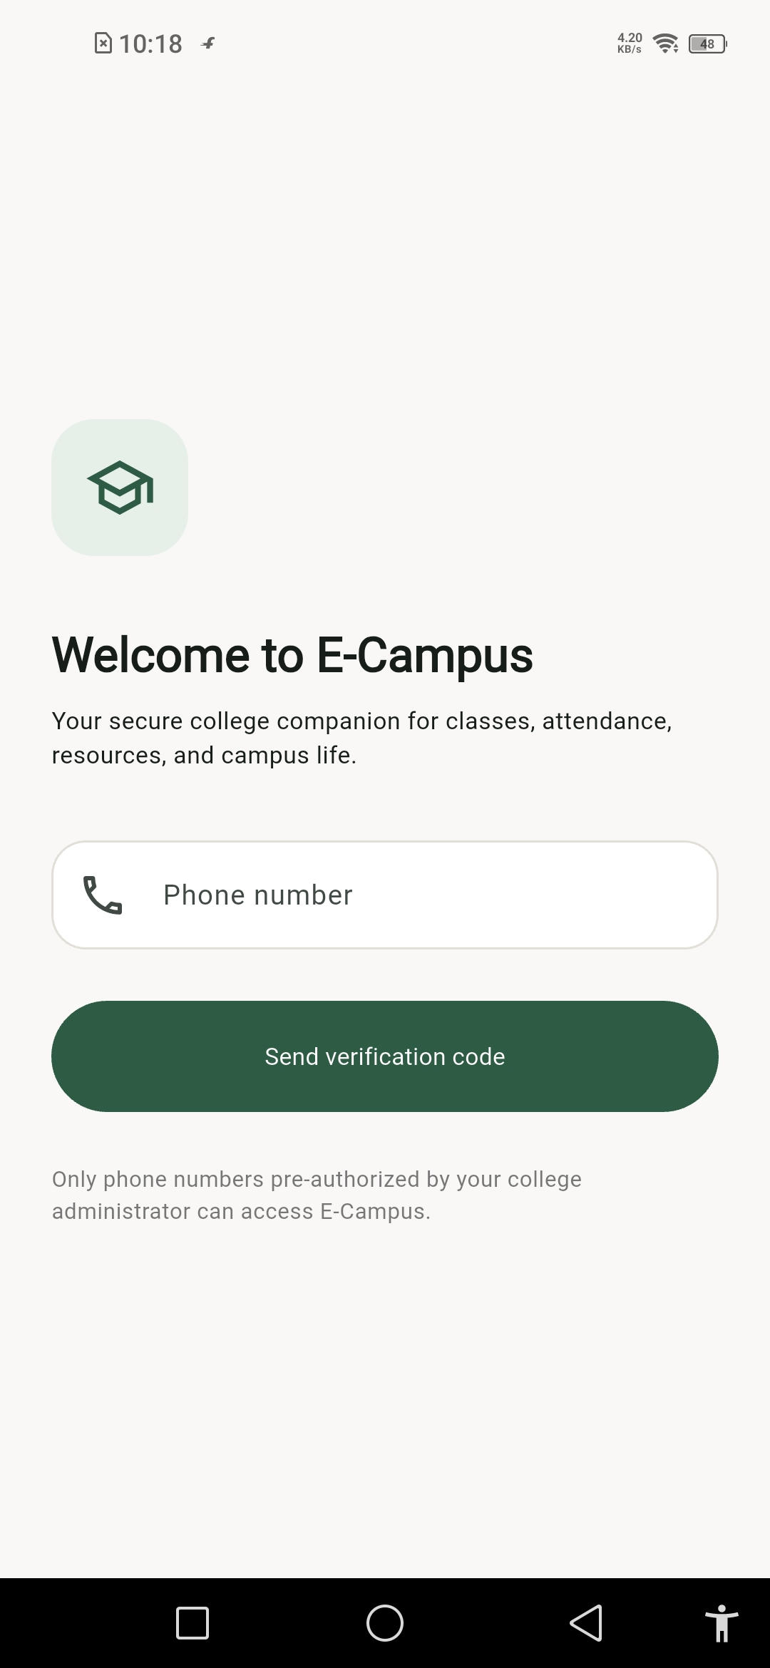
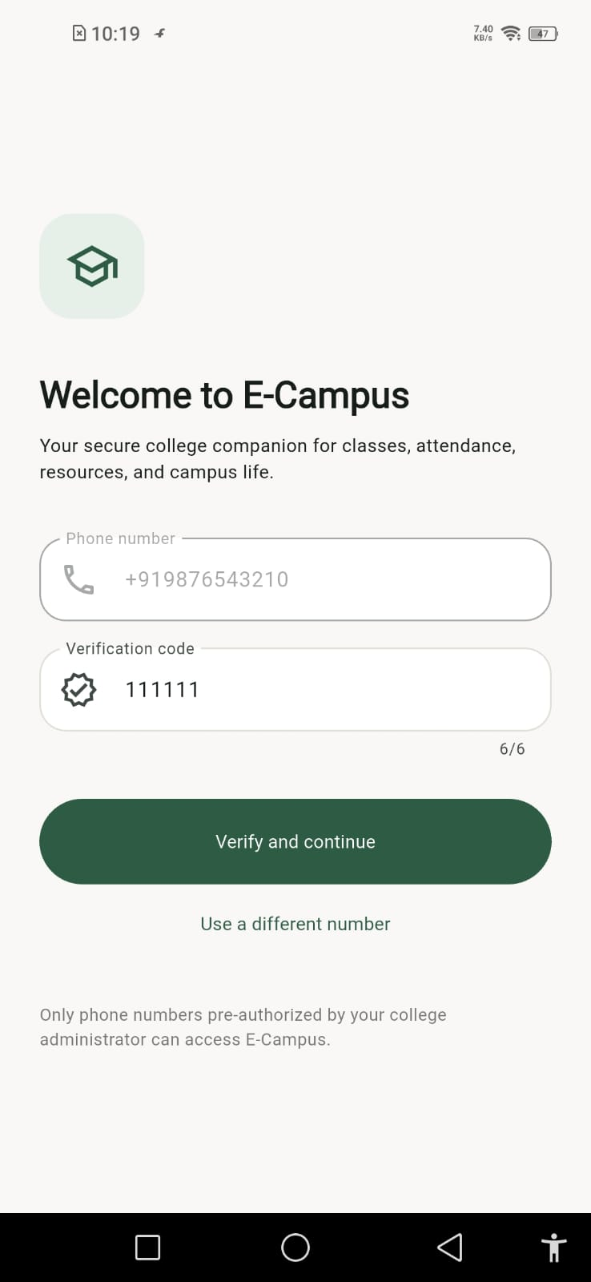
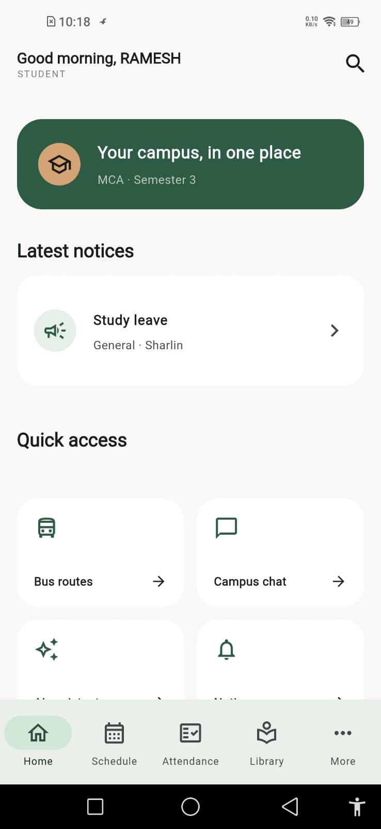
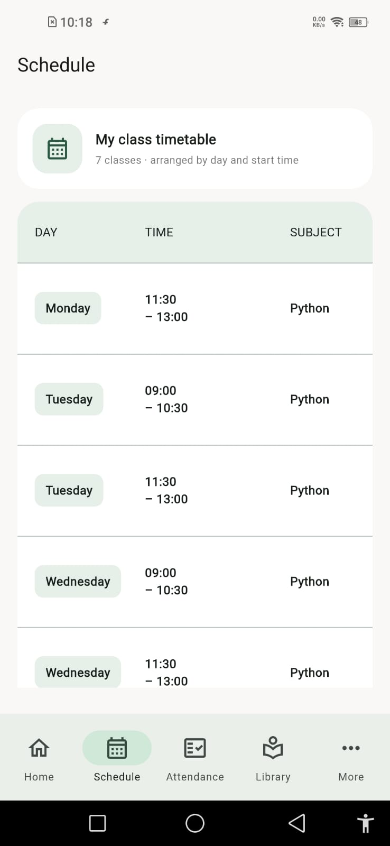
06 • VISUAL WALKTHROUGH
App screens
SCREEN 01
SCREEN 02
SCREEN 03
SCREEN 04
E-CAMPUS • PROJECT PRESENTATION
07

Slide 8
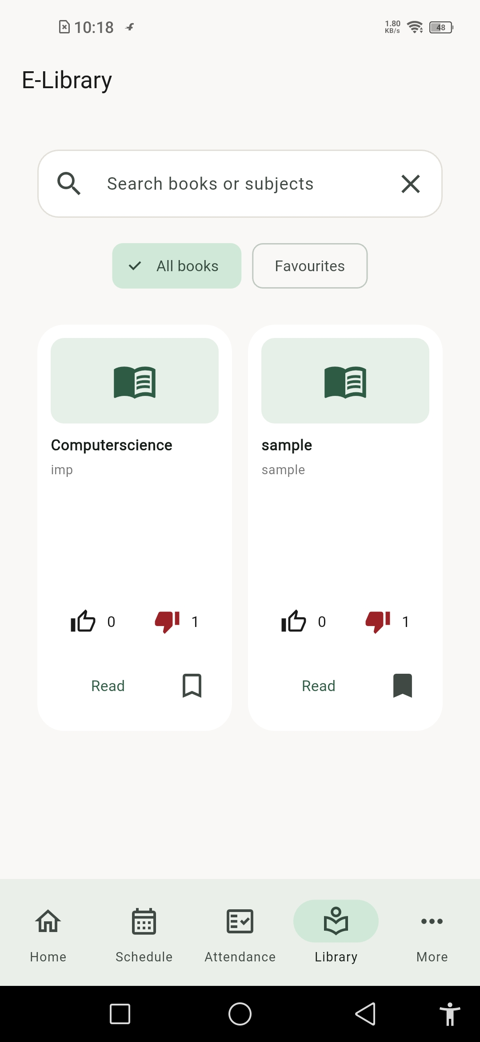
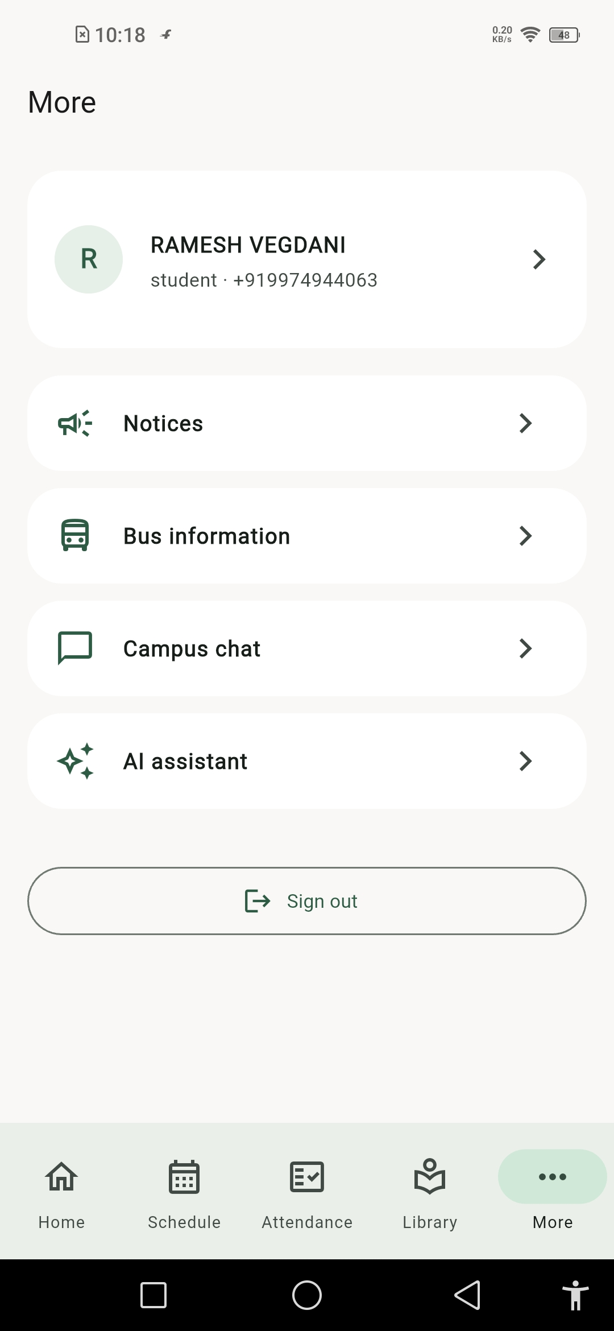
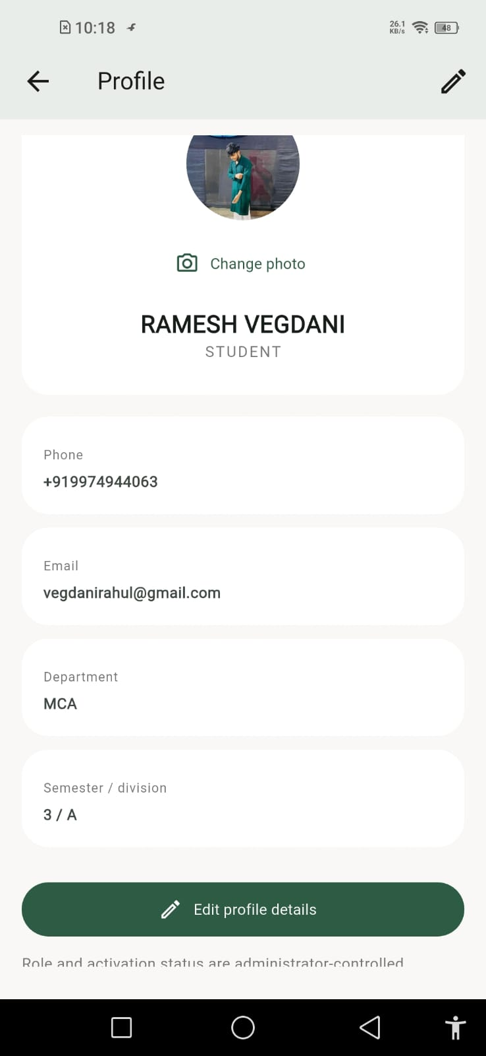
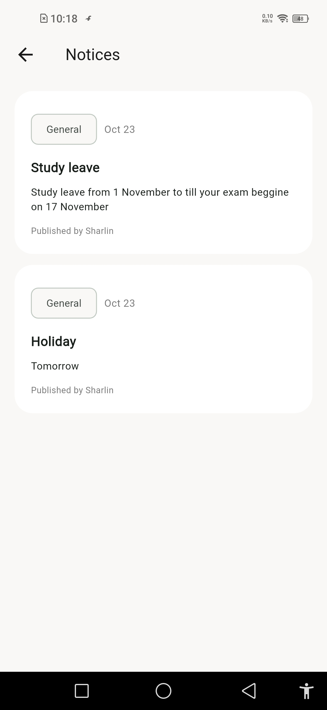
06 • VISUAL WALKTHROUGH
More app screens
SCREEN 05
SCREEN 06
SCREEN 07
SCREEN 08
E-CAMPUS • PROJECT PRESENTATION
08

Slide 9
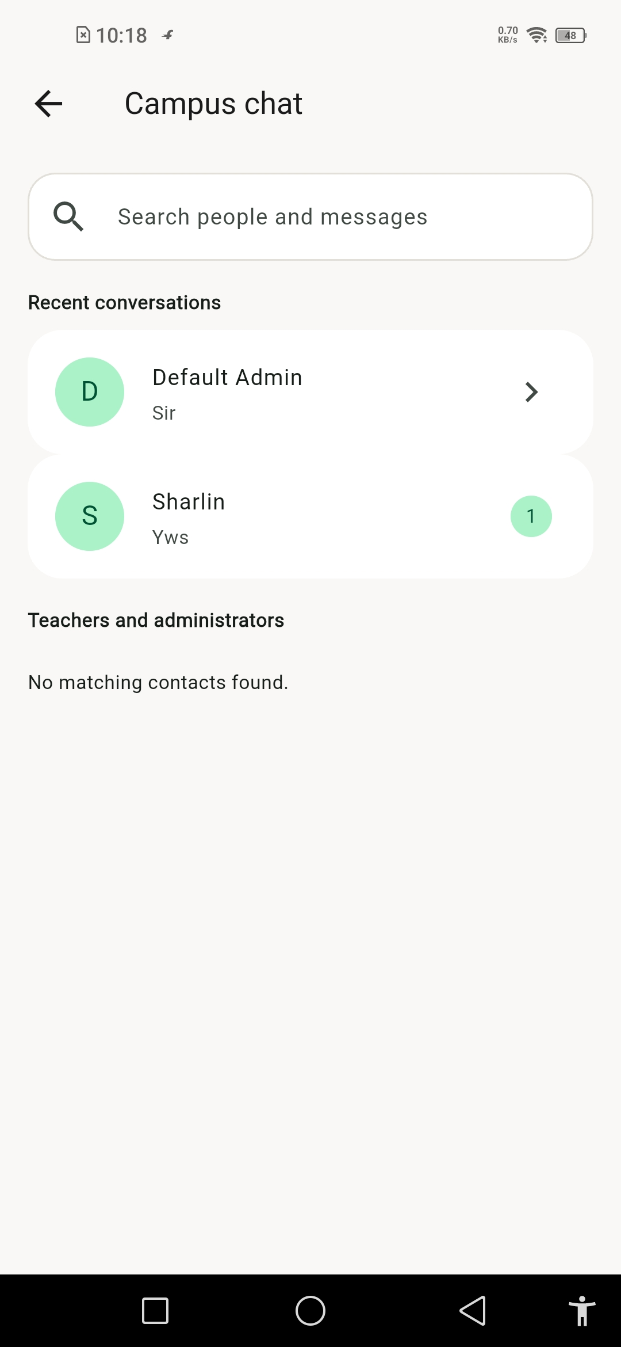
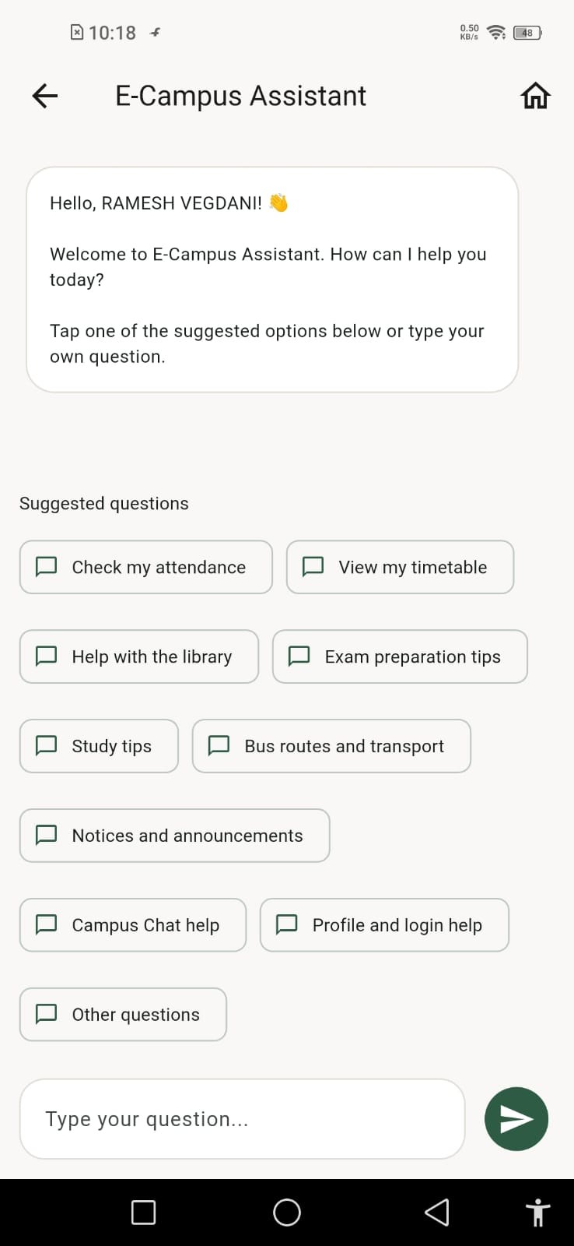
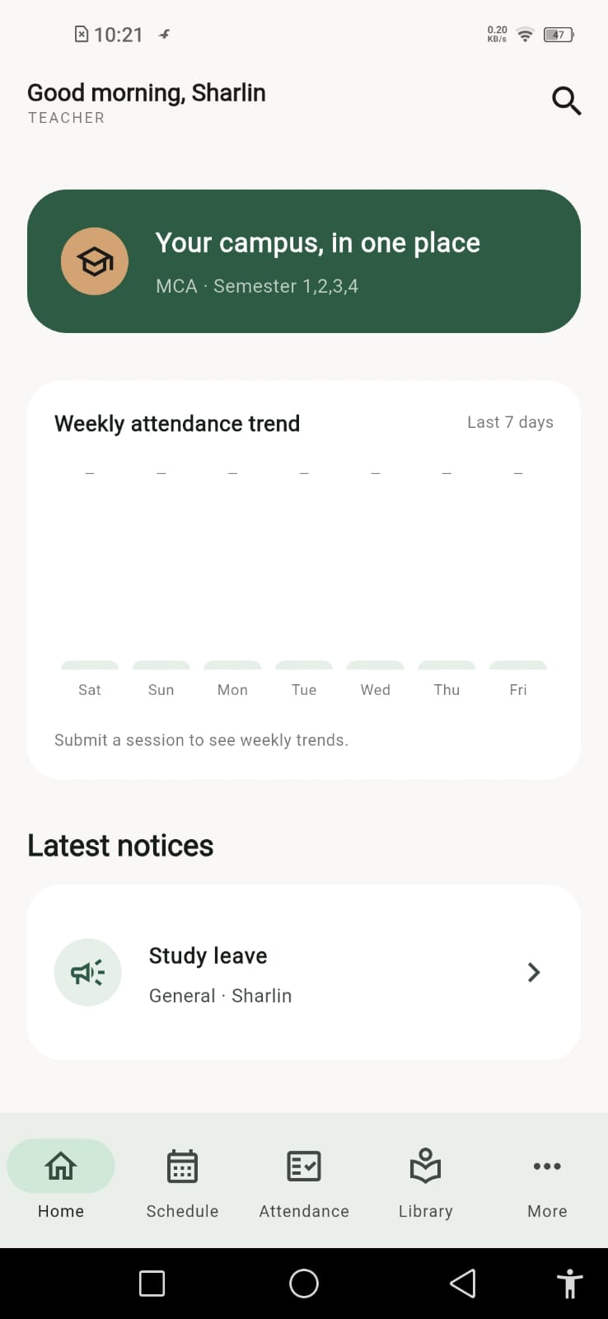
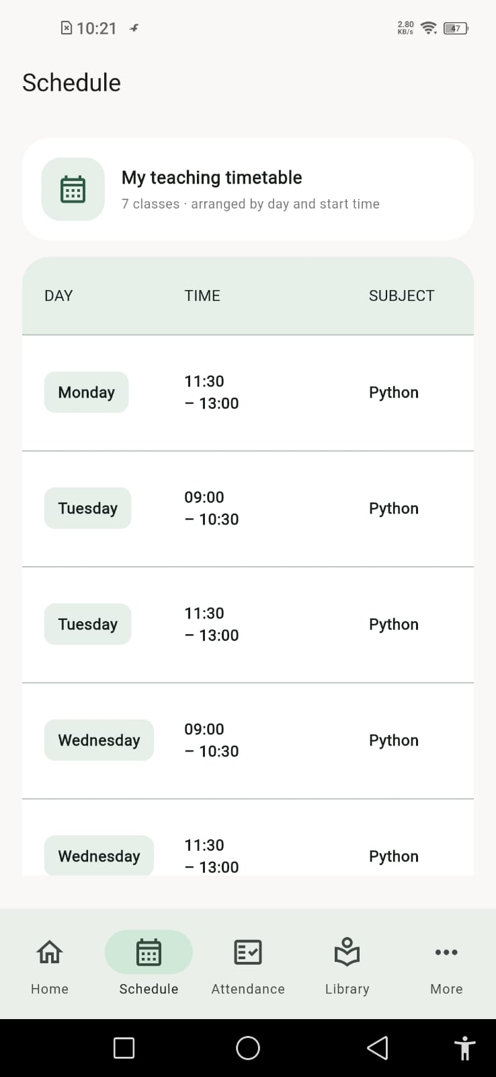
06 • VISUAL WALKTHROUGH
Additional screens
SCREEN 09
SCREEN 10
SCREEN 11
SCREEN 12
E-CAMPUS • PROJECT PRESENTATION
09

Slide 10
07 • HOW IT FITS TOGETHER
Technical architecture
FLUTTER APP
FIREBASE
CAMPUS USERS
Screens & navigation
Role-based flows
Riverpod state management
Authentication
Cloud Firestore
Cloud Messaging
Storage / App Check
Students
Teachers
Admins
Conceptual architecture based on the project stack; exact runtime flows may vary by feature.
E-CAMPUS • PROJECT PRESENTATION
10

Slide 11
08 • IMPLEMENTATION
Technology stack
Flutter + Dart
Firebase Authentication
Cloud Firestore
Cross-platform mobile application UI.
Authentication and signed-in user identity.
Cloud-hosted app data and conversation records.
Firebase Messaging
Riverpod + GoRouter
Firebase Storage & App Check
Push notification infrastructure.
State management and navigation support.
File storage and app-integrity support.
E-CAMPUS • PROJECT PRESENTATION
11

Slide 12
09 • QUALITY
Security and reliability considerations
• Use role-aware navigation to present the relevant experience for each user.
• Enforce authorization in Firebase Security Rules—not only in the UI.
• Keep service-account credentials and private secrets out of the repository.
• Test authentication, Firestore permissions, notifications and role-specific flows.
• Validate the app on a physical Android device before release.
QUALITY CHECK
Correct access
Reliable data
Clear feedback
E-CAMPUS • PROJECT PRESENTATION
12

Slide 13
10 • NEXT STEPS
Future enhancements
Campus transport
AI assistant
Richer analytics
Explore live bus tracking and route information.
Offer guided help for common campus questions.
Improve attendance insights and administrative reporting.
More integrations
Release hardening
Connect additional campus systems where available.
Expand testing, monitoring and accessibility checks.
E-CAMPUS • PROJECT PRESENTATION
13

Slide 14
11 • SUMMARY
Conclusion
E-Campus brings essential campus services into one mobile experience.
• A role-aware Flutter application for students, teachers and administrators.
• Firebase-backed authentication and app-service foundations.
• A foundation that can grow with more campus workflows and integrations.
THANK
YOU
E-CAMPUS • PROJECT PRESENTATION
14

Slide 15
E - CAMPUS
Questions & Discussion
College Management Mobile Application
Thank you
E-CAMPUS • PROJECT PRESENTATION
15

