Slide 1
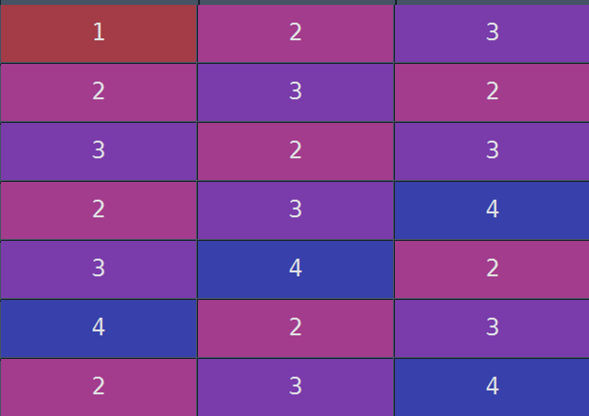
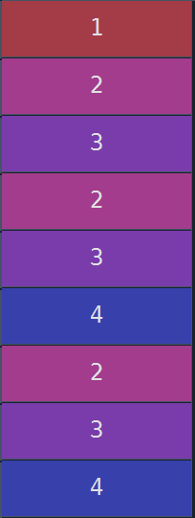
How many sequences match with this sequence
1
Delay = 1
1
1
2
1
1
2

