Slide 1
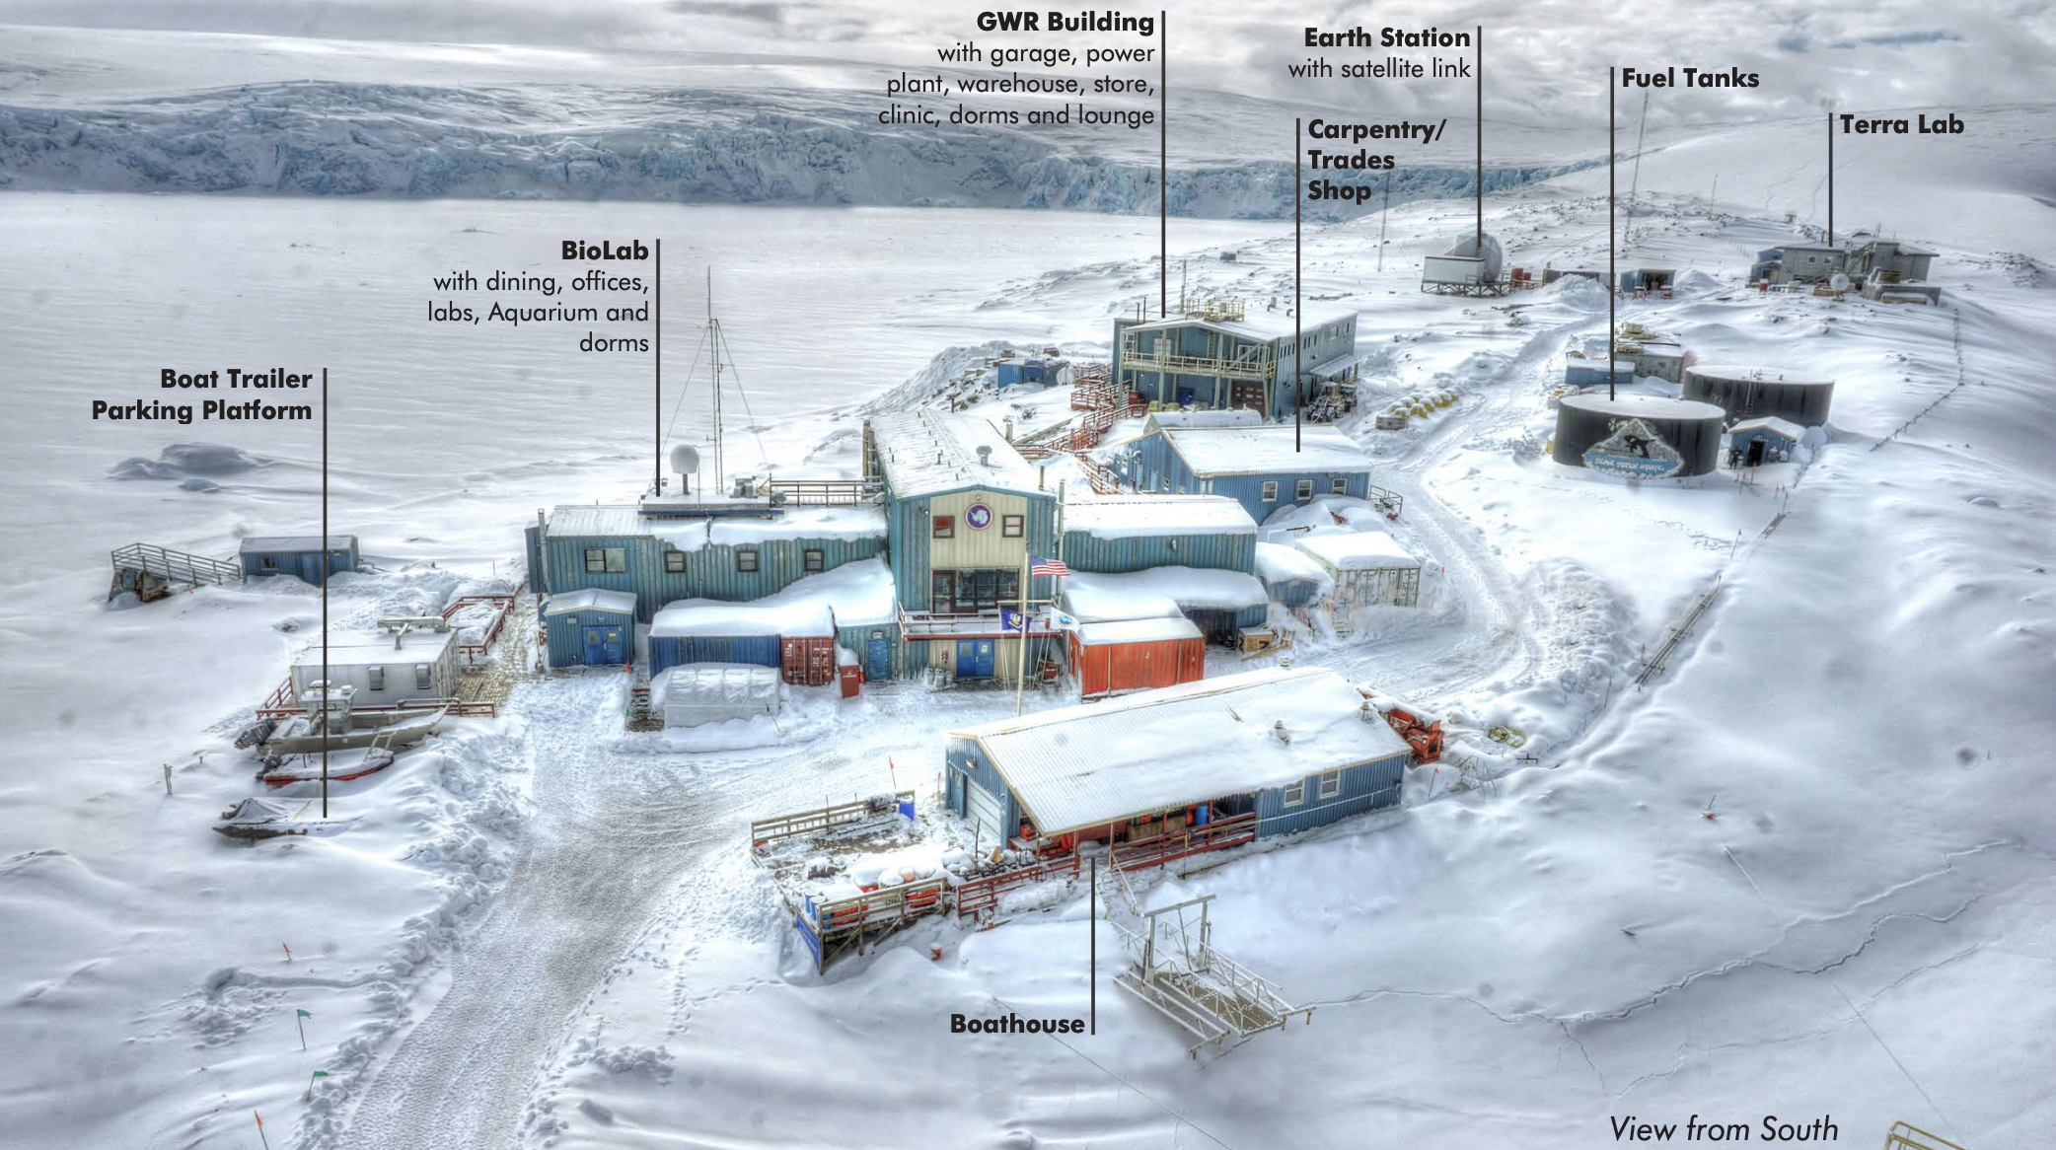

Slide 2
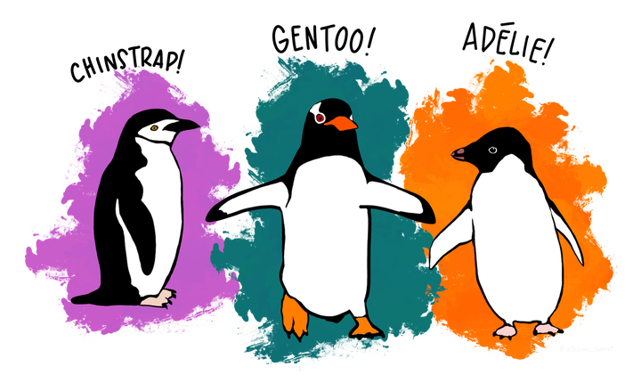
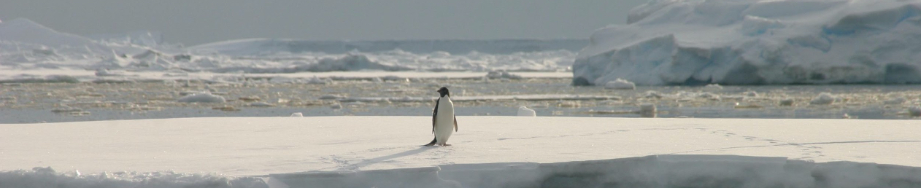

Slide 3
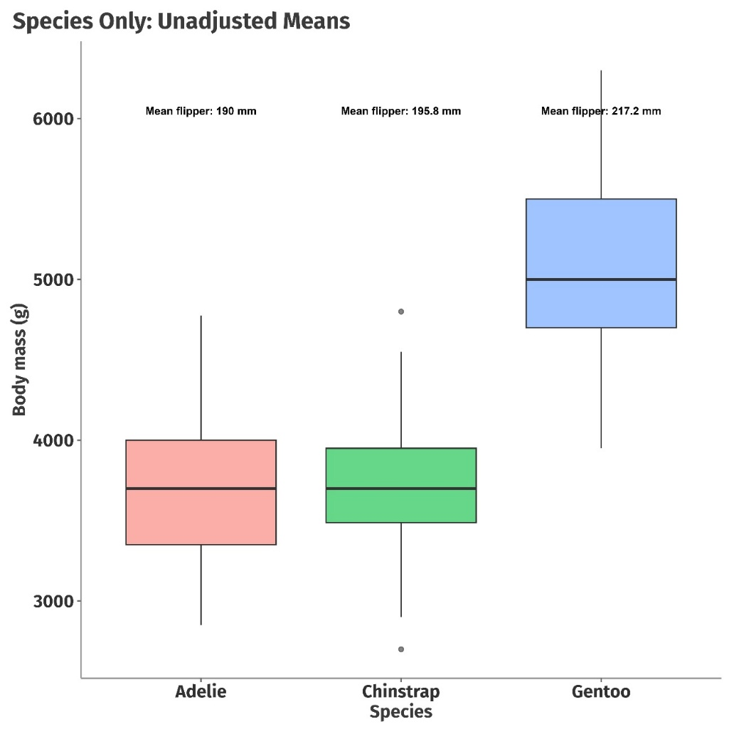
Does Species predict Body mass of palmer penguins?
We want to know if each species of penguins differ in their body weights and if so, how much?
There could be lot many other aspects that determines body weight which is beyond

Slide 4
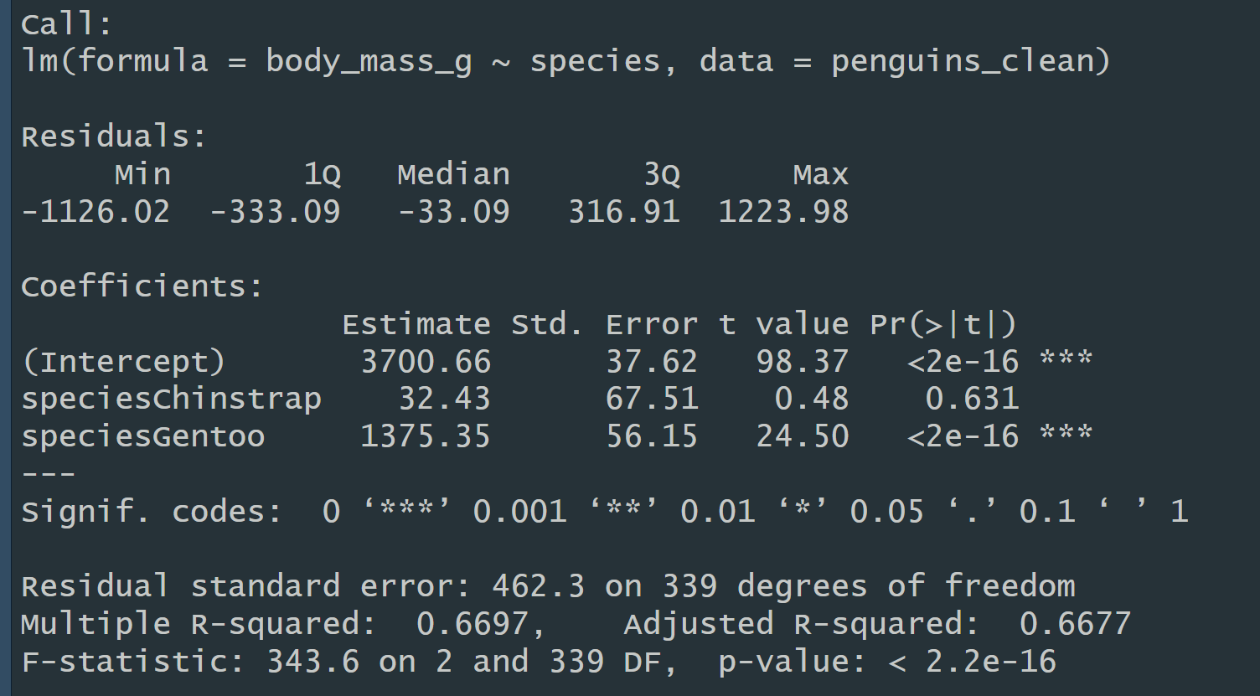
Mean body mass for Adelie penguins (the reference species)
Chinstraps are, on average, about 32 g heavier than Adelies - but the p-value (0.631) says this difference is not statistically significant
Gentoos are on average 1,375 g heavier than Adelies, and the difference is highly significant
A very important thing to understand is that the estimates for the other categories are presented relative to the reference level
So now, can we say this is a good model?

Slide 5
Does Species predict Body mass of palmer penguins?
We want to know if each species of penguins differ in their body weights and if so, how much?
There could be lot many other aspects that determines body weight which is beyond species

Slide 6
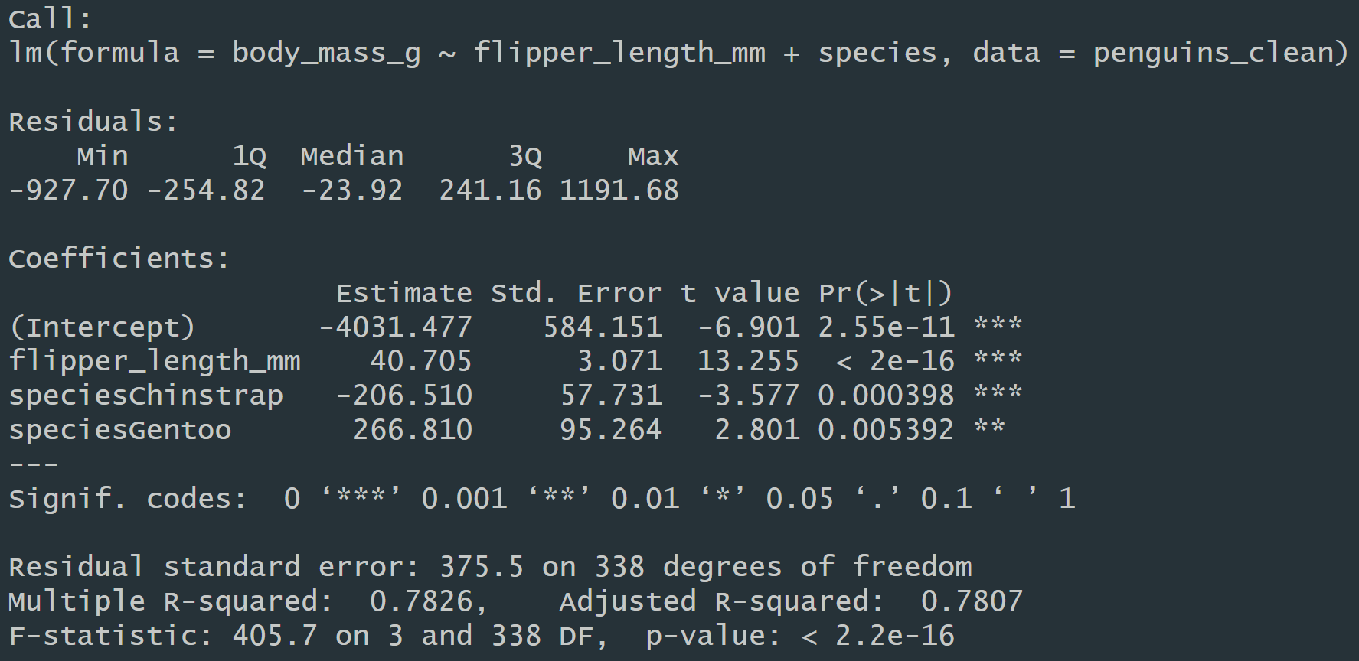
Expected body mass for an Adelie with flipper length 0 mm
For each 1 mm increase in flipper length, body mass increases by about 40.7 g, holding species constant
Chinstraps are about 207 g lighter than Adelies with the same flipper length.
Note: In the species-only model, Chinstraps were heavier (+32 g) than Adelies,but here they’re lighter.
That’s because flipper length was a confounder
Chinstraps have longer flippers, which inflated their mean mass when flipper length wasn’t accounted for
Gentoos are about 267 g heavier than Adelies with the same flipper length
In the species-only model, Gentoos were +1,375 g heavier
Adding flipper length explains most of that difference

Slide 7
Type III ANOVA vs Type I ANOVA

Slide 8
Contrast Coding

Slide 9
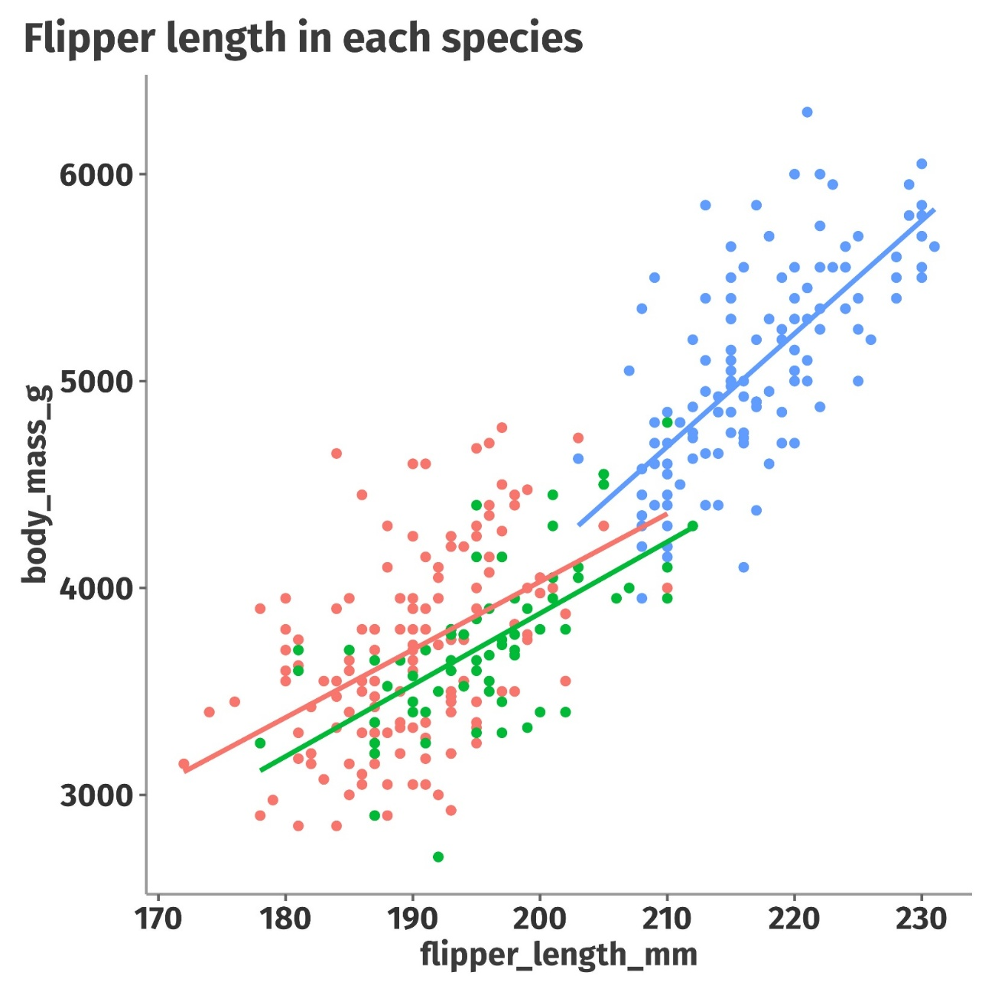
Should we bother about flipper length as well?

Slide 10
Multiple Regression with Interaction Effects
"Are male penguins' flippers longer than female penguins' flippers?" and your most accurate answer is, "Well, it depends on which species you are looking at," then you have an interaction effect!
The two variables act like chemical compounds combining them creates a different result than just adding them together.

Slide 11
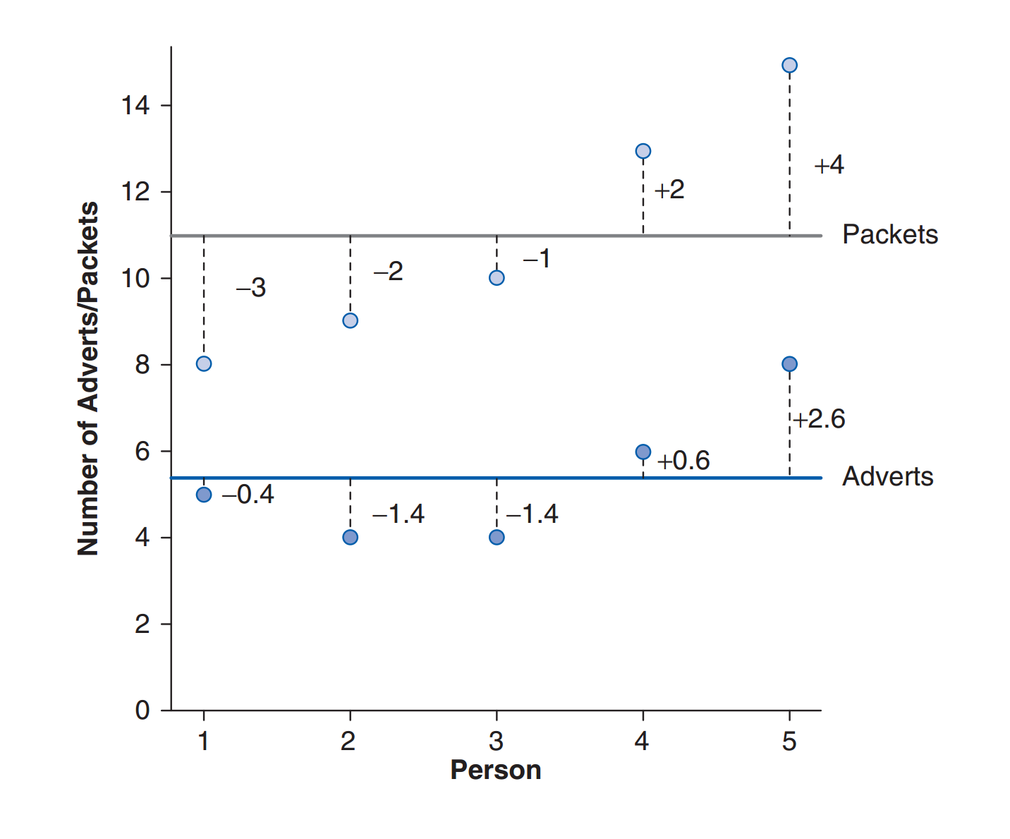
Covariance
The two variables act like chemical compounds combining them creates a different result than just adding them together.

Slide 12
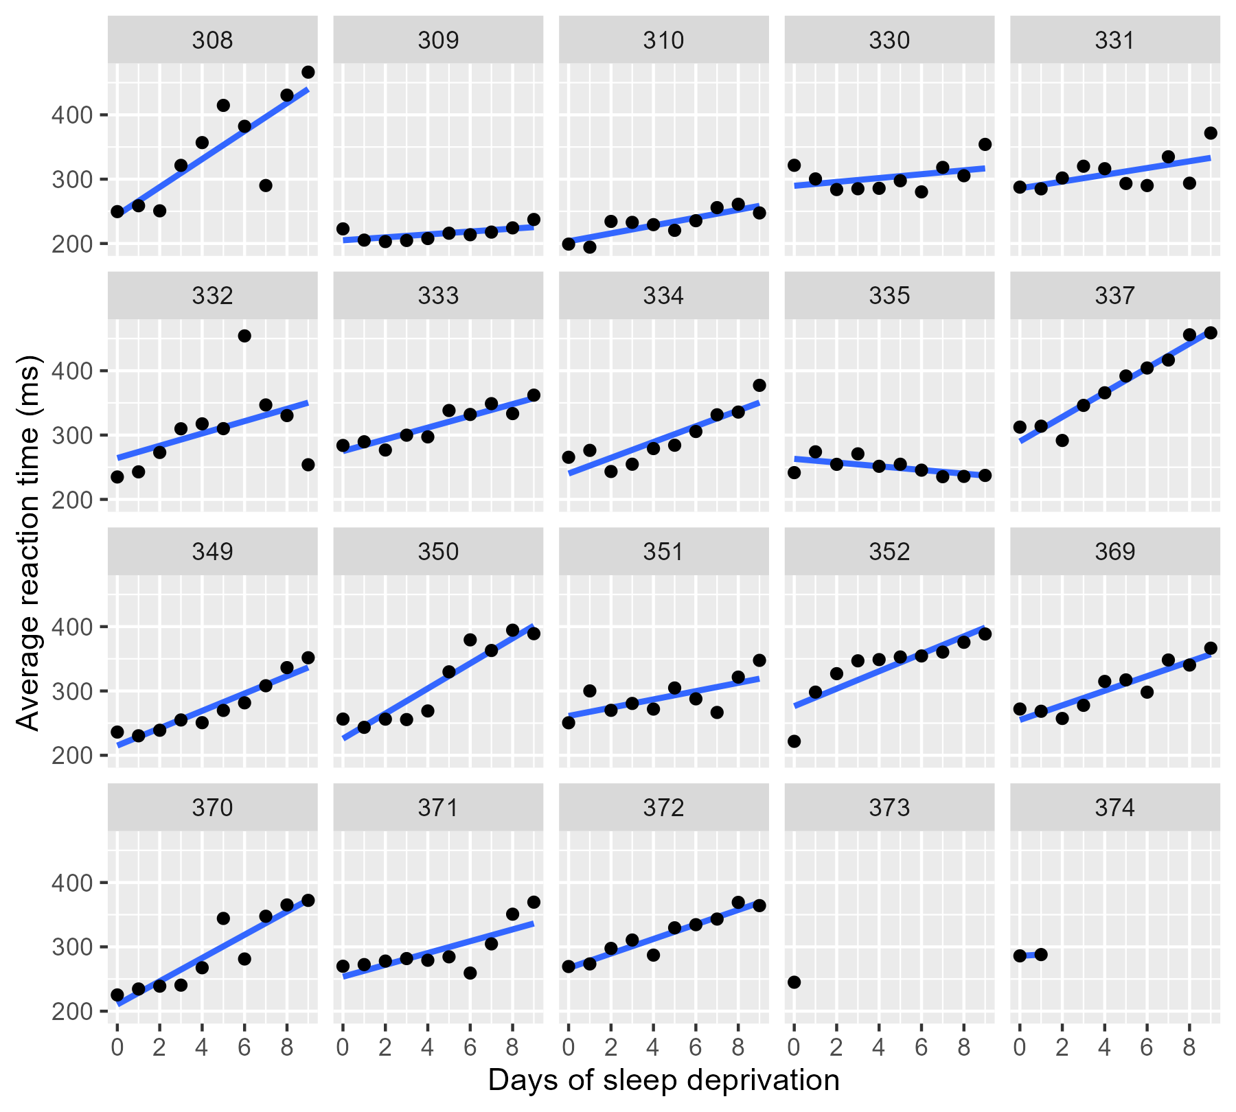
Sleep Deprivation and Reaction Times
No Pooling

Slide 13
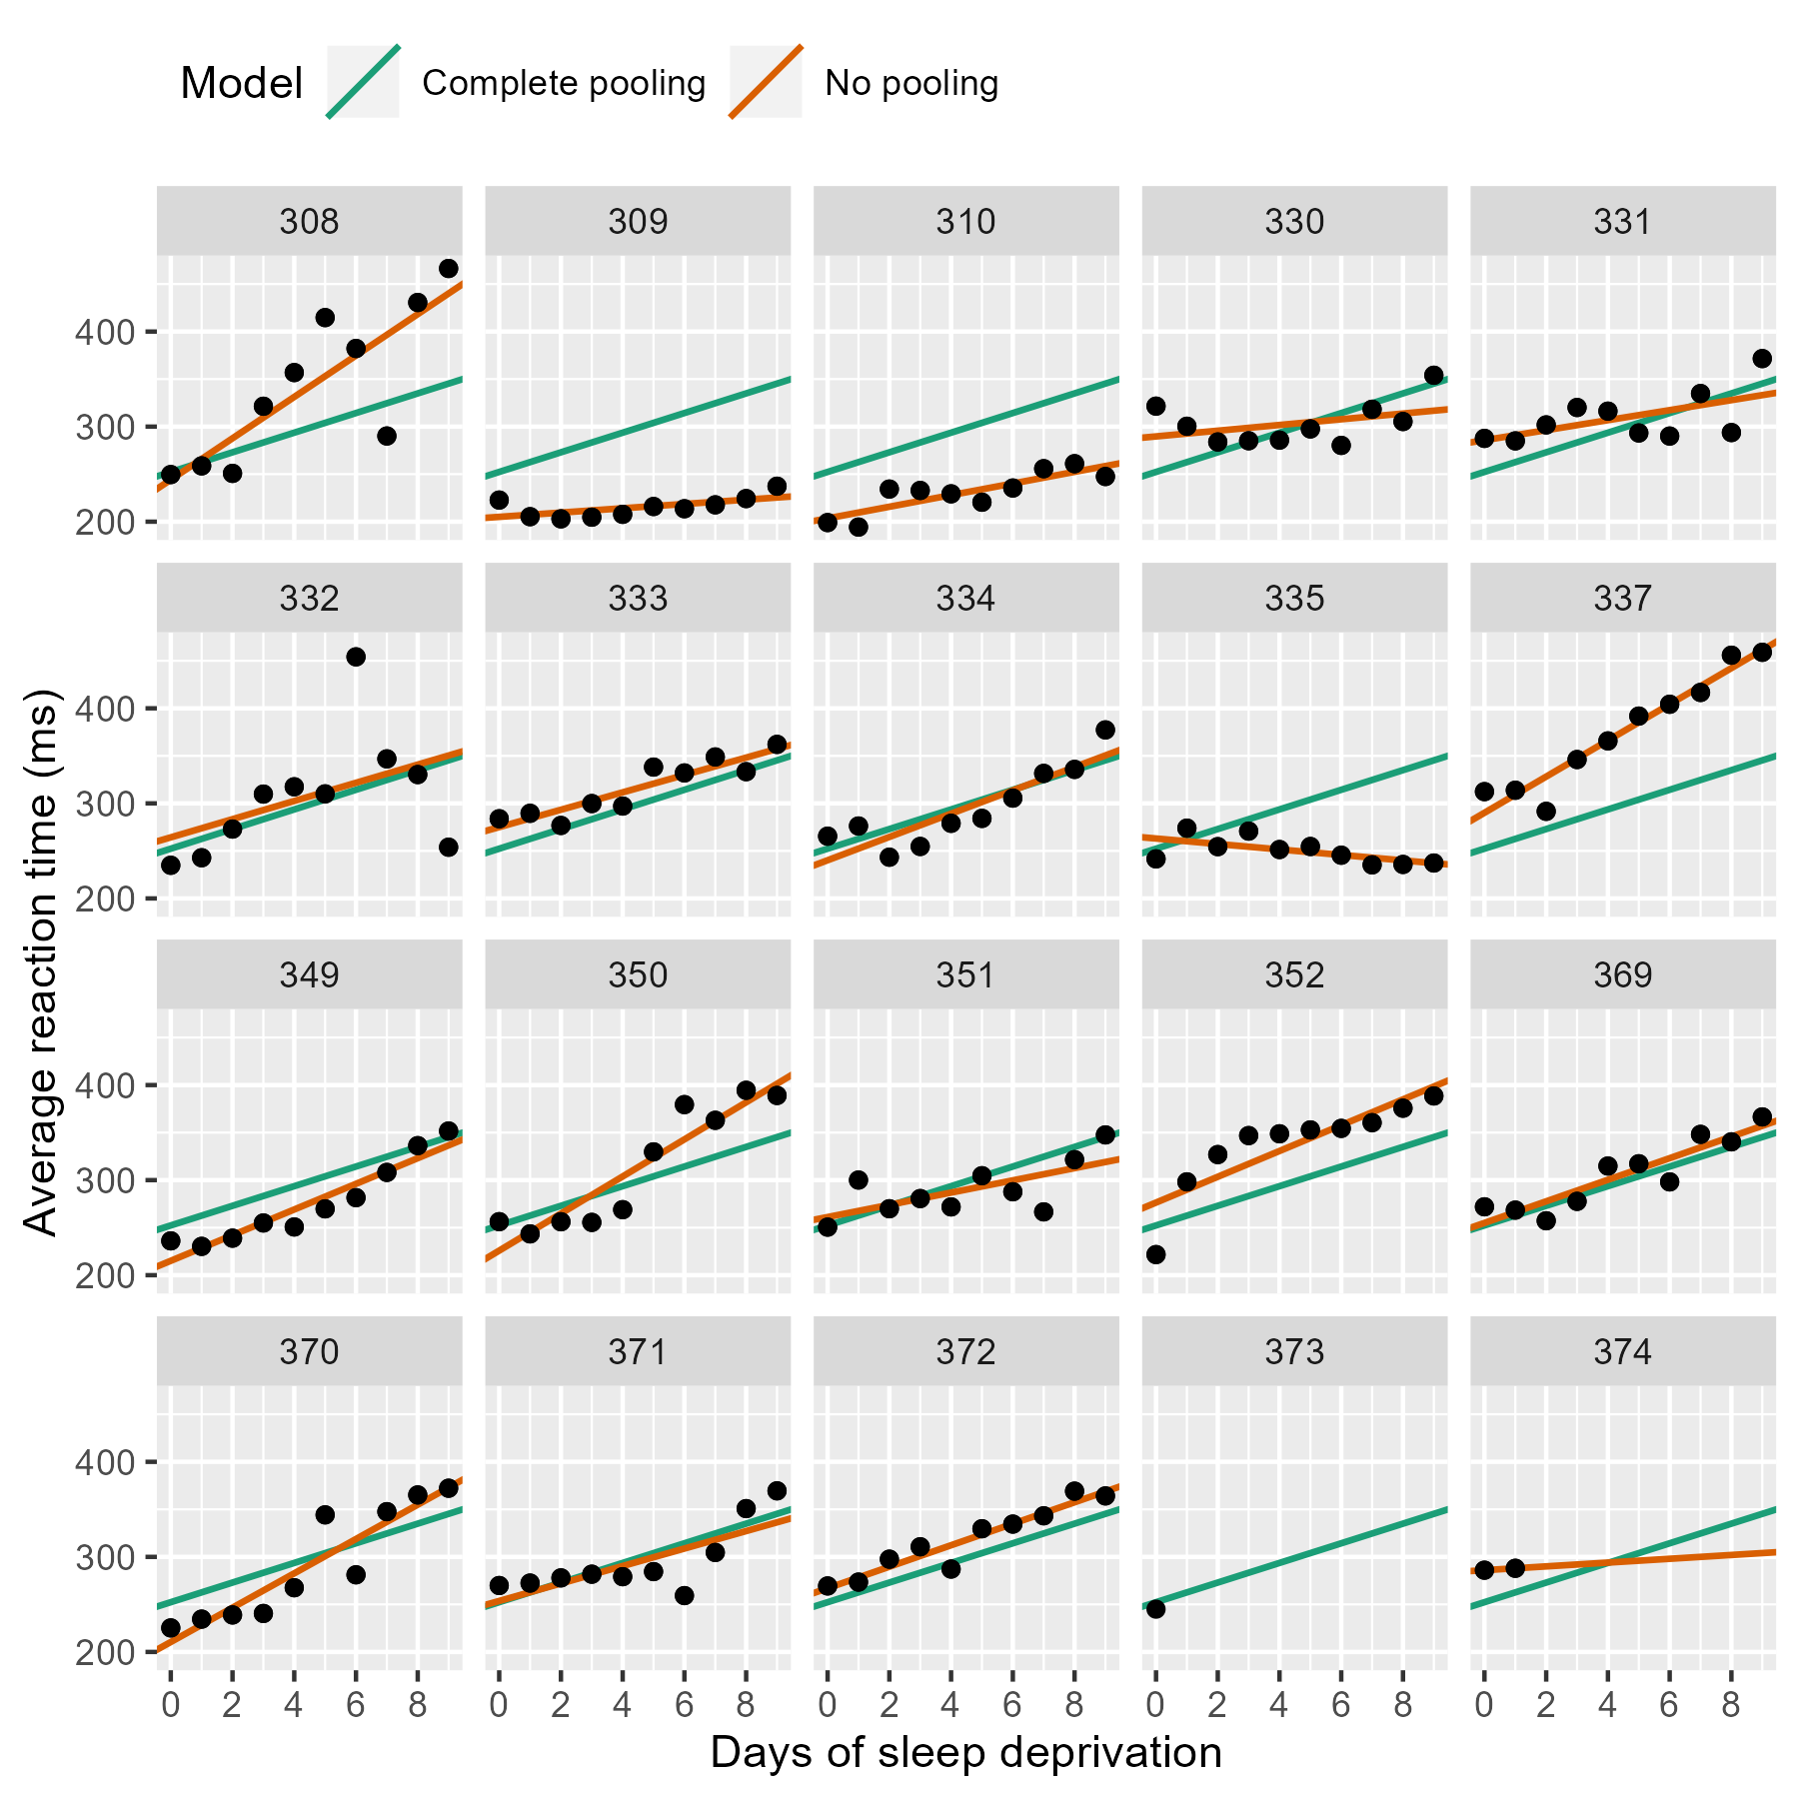
Sleep Deprivation and Reaction Times
Complete Pooling

Slide 14
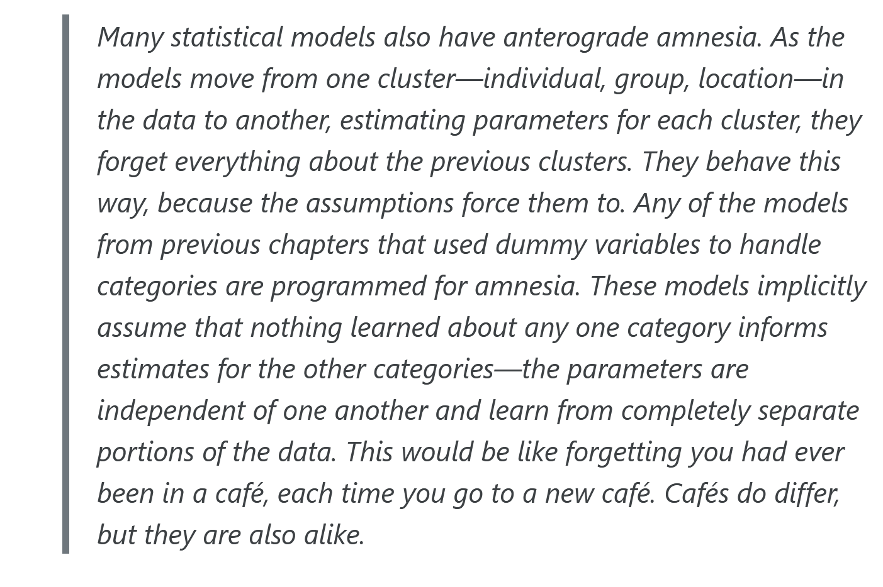

Richard McElreath and Statistical Rethinking

Slide 15
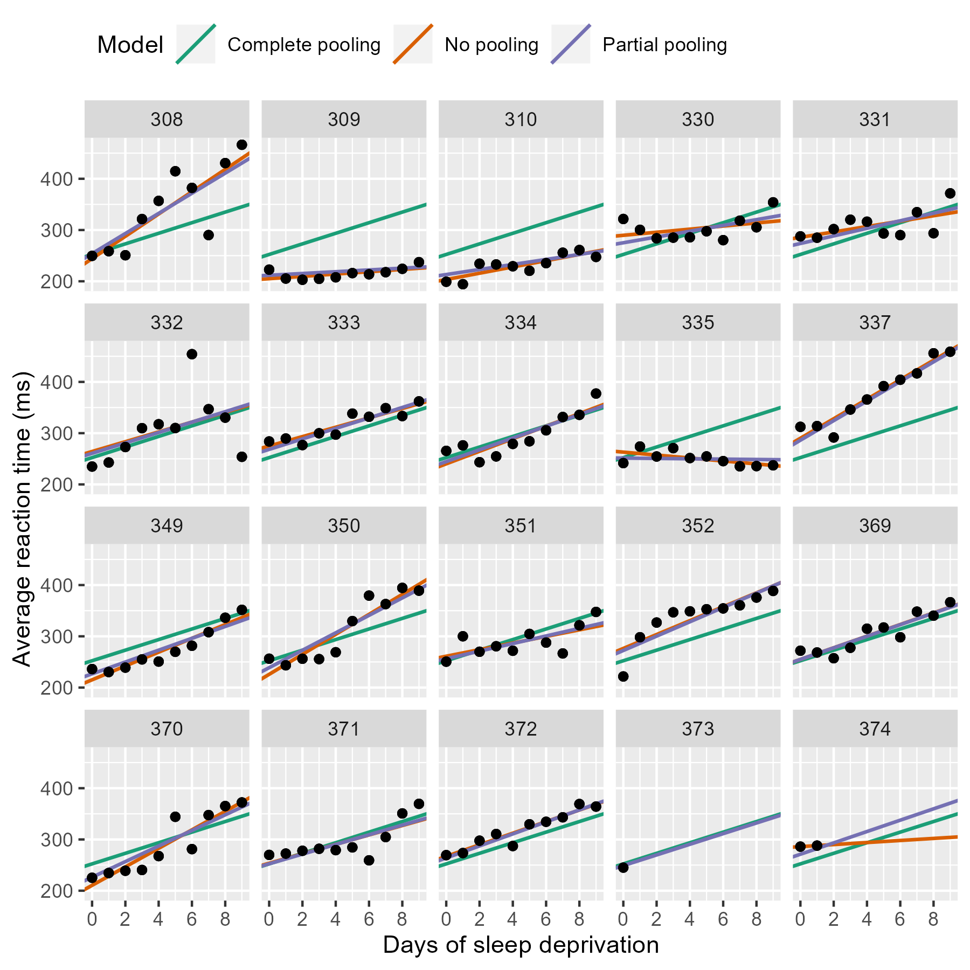
Sleep Deprivation and Reaction Times
Partial Pooling

Slide 16
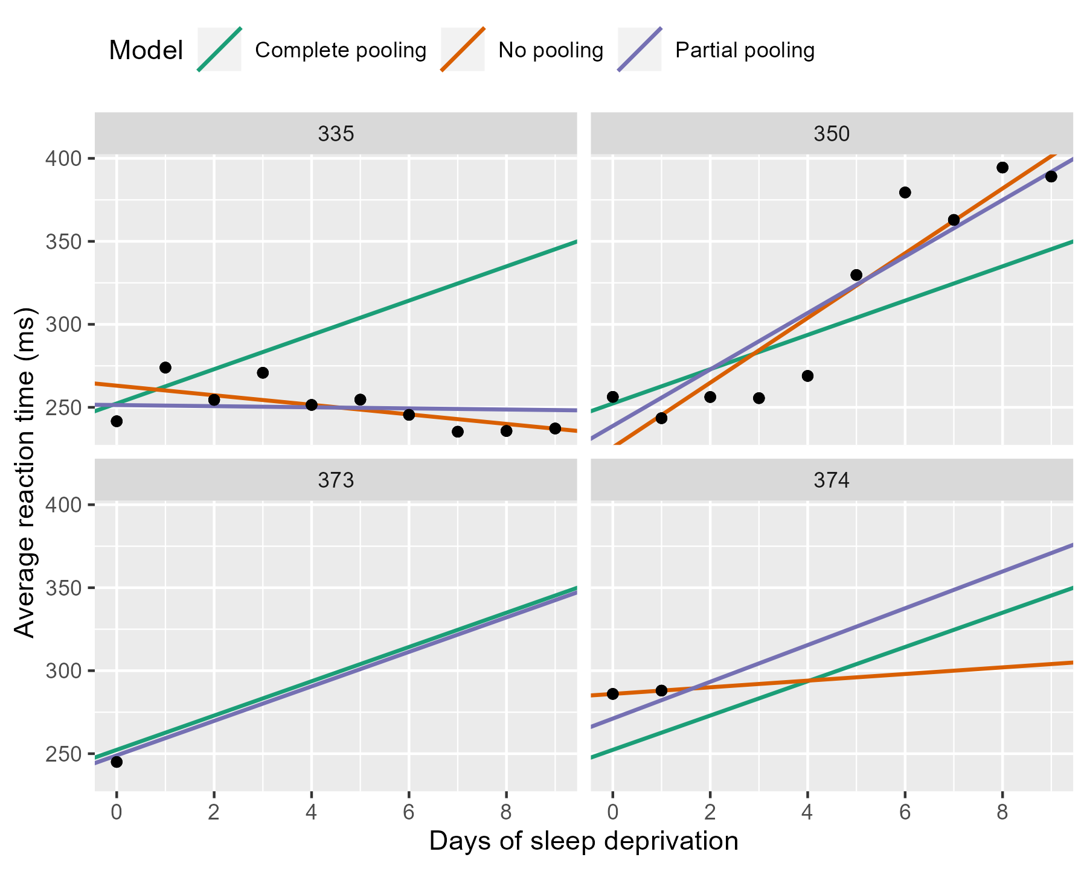
Sleep Deprivation and Reaction Times

Slide 17
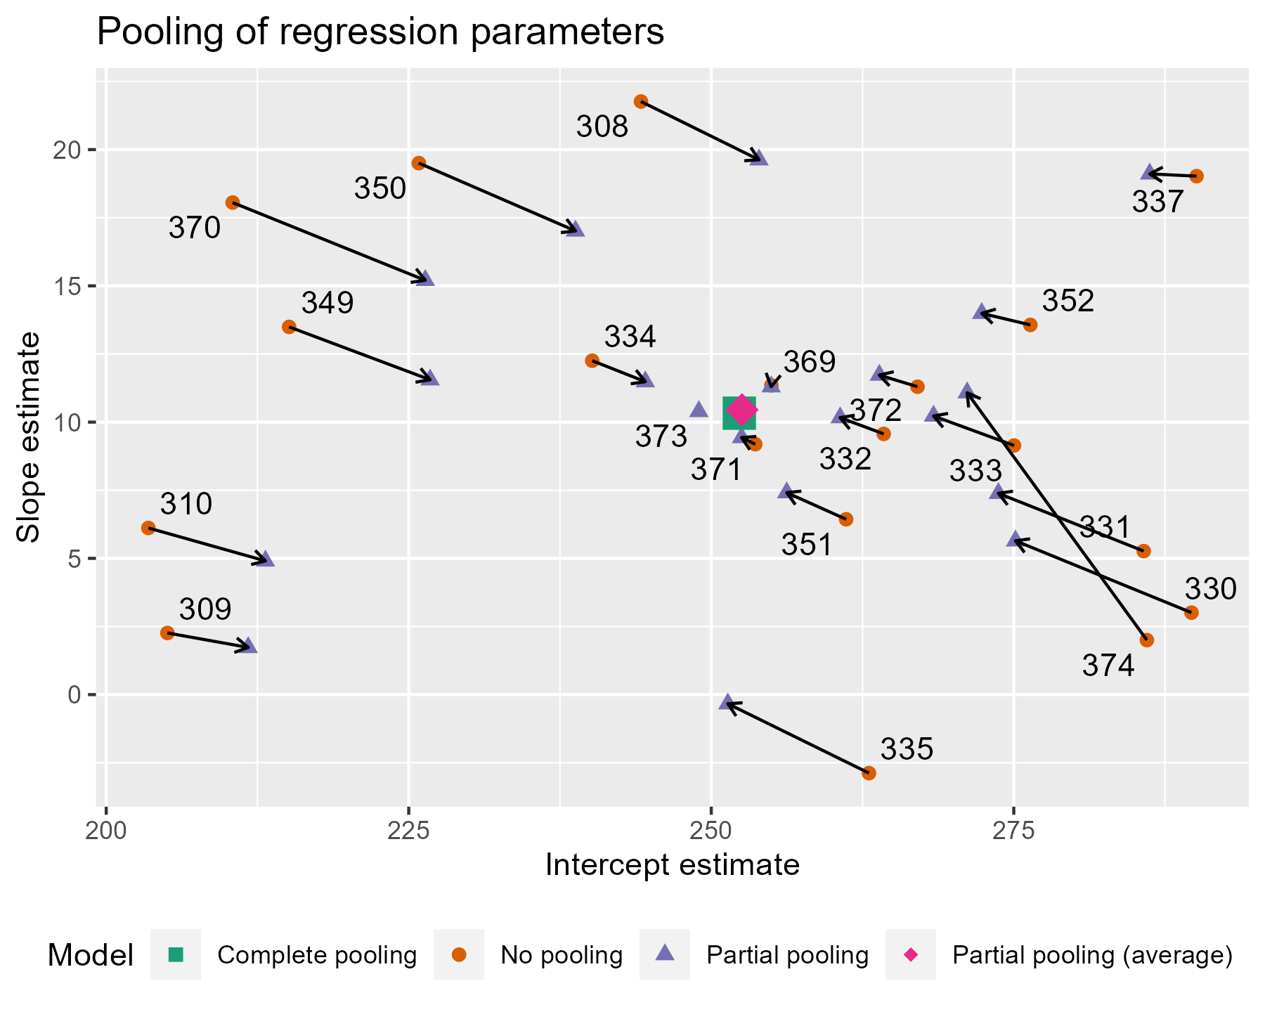
Sleep Deprivation and Reaction Times
Notes:
The average intercept and slope act like a center of gravity, pulling values parameter estimates towards it. Hmm, maybe gravity is not quite the right analogy, because the pull is greater for more extreme values. The lines near that center point are very short; they get adjusted very little. The lines in general get longer as we move away from the complete pooling estimate. The fewer the observations in a cluster (here, participants), the more information is borrowed from other clusters, and the greater the pull towards the average estimate. Participant 373 had one observation, so their slope estimate is the average. Likewise, 374 had only two observations, so they get pulled the farthest and receive a slope estimate near the overall average.

Slide 18
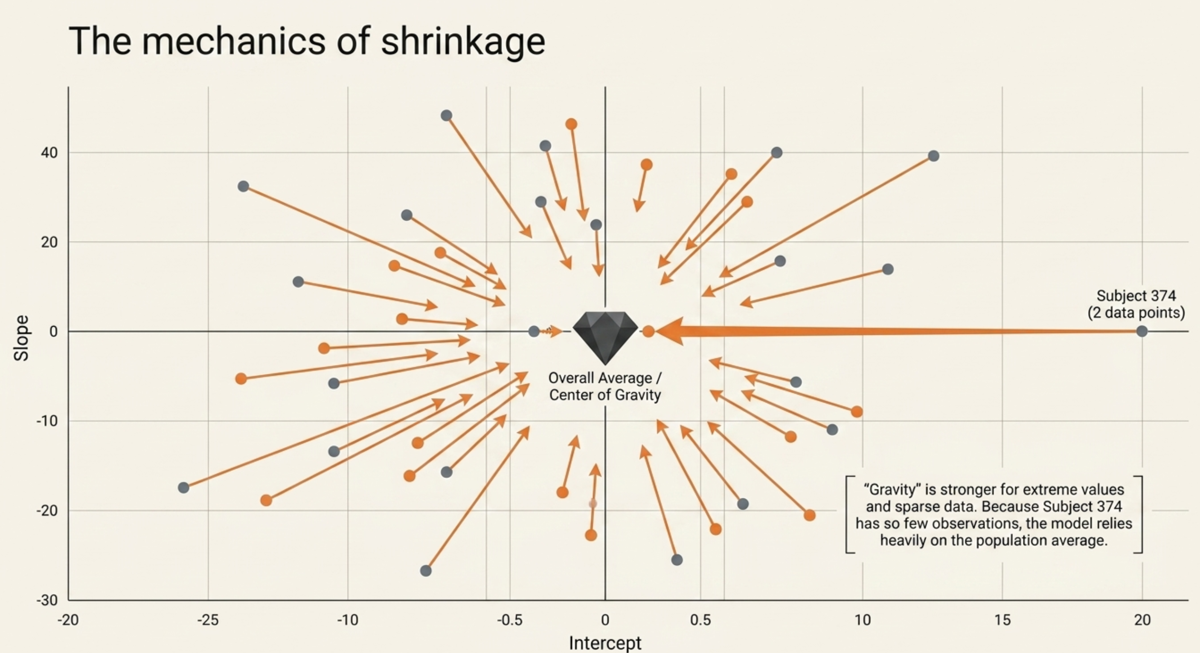
Notes:
The average intercept and slope act like a center of gravity, pulling values parameter estimates towards it. Hmm, maybe gravity is not quite the right analogy, because the pull is greater for more extreme values. The lines near that center point are very short; they get adjusted very little. The lines in general get longer as we move away from the complete pooling estimate. The fewer the observations in a cluster (here, participants), the more information is borrowed from other clusters, and the greater the pull towards the average estimate. Participant 373 had one observation, so their slope estimate is the average. Likewise, 374 had only two observations, so they get pulled the farthest and receive a slope estimate near the overall average.

Slide 19
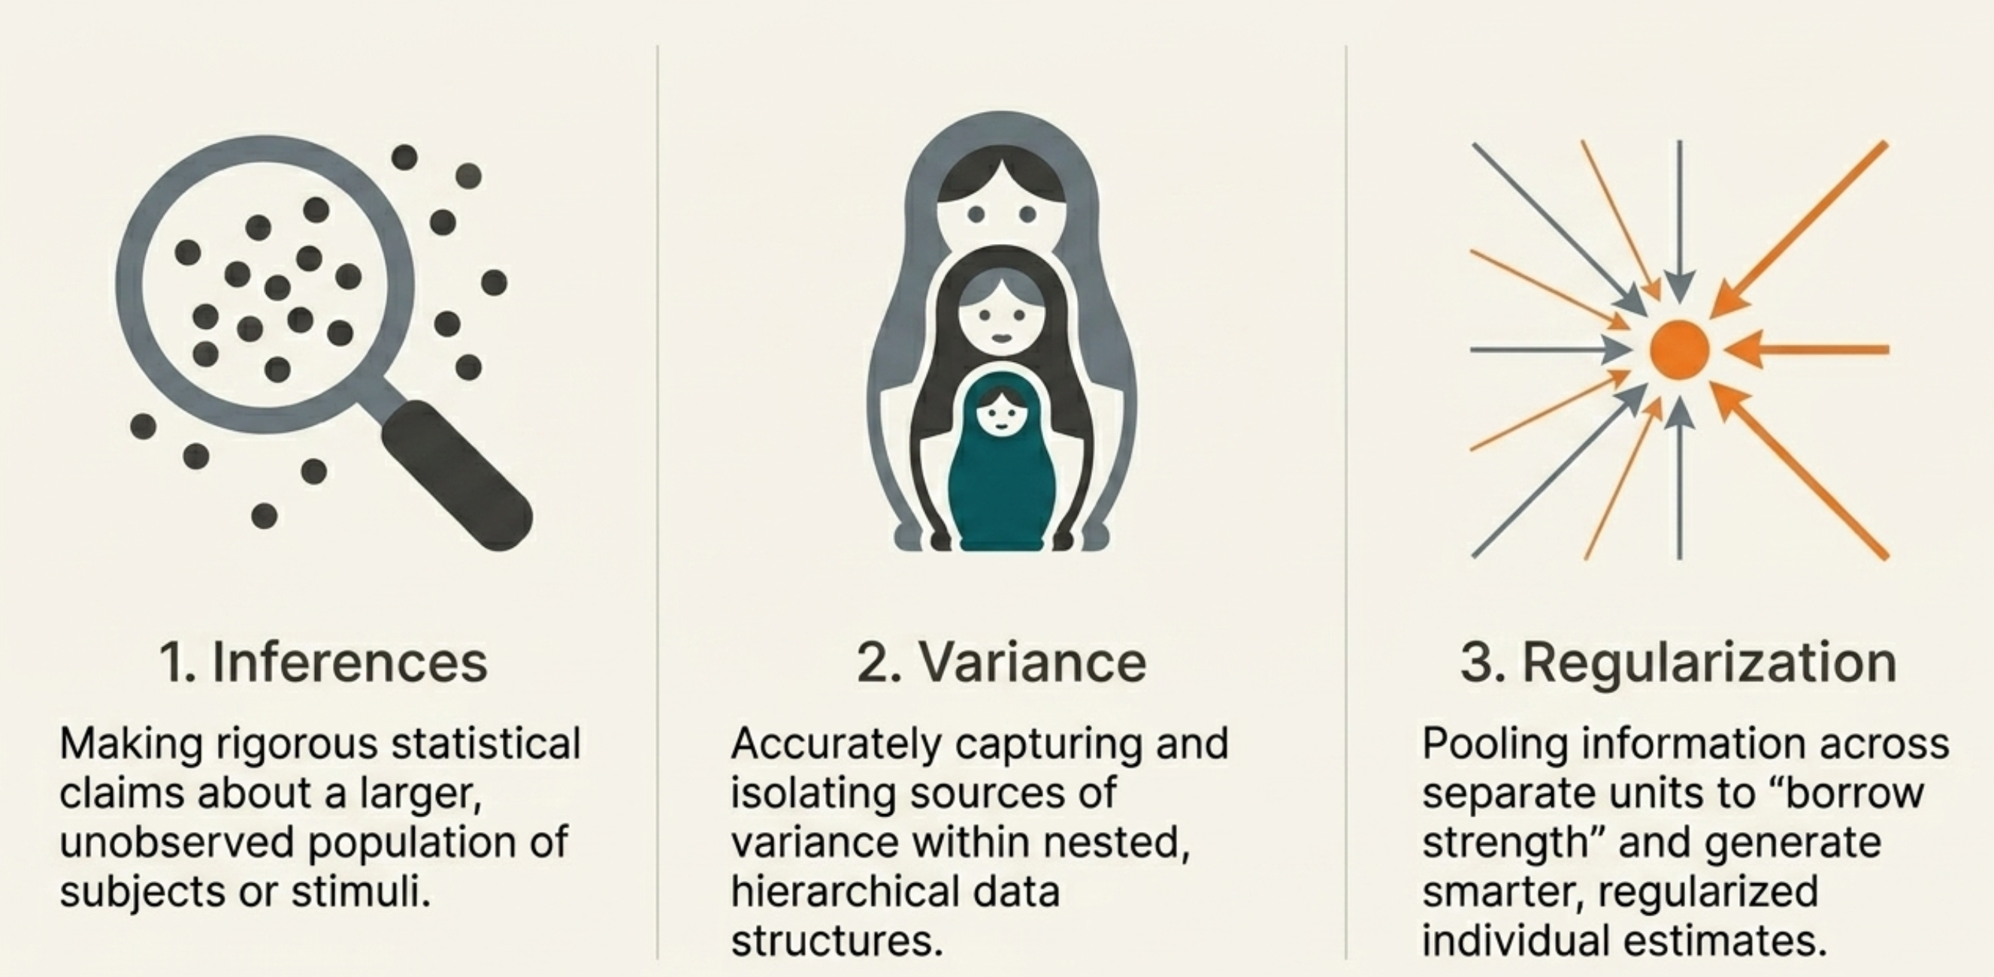
Sleep Deprivation and Reaction Times
Notes:
The average intercept and slope act like a center of gravity, pulling values parameter estimates towards it. Hmm, maybe gravity is not quite the right analogy, because the pull is greater for more extreme values. The lines near that center point are very short; they get adjusted very little. The lines in general get longer as we move away from the complete pooling estimate. The fewer the observations in a cluster (here, participants), the more information is borrowed from other clusters, and the greater the pull towards the average estimate. Participant 373 had one observation, so their slope estimate is the average. Likewise, 374 had only two observations, so they get pulled the farthest and receive a slope estimate near the overall average.

