Slide 1

Railway Reservation
-Rahul
-1NH16CS085

Slide 2
Introduction
This project is a simple console application built without the use of graphics. Named railway reservation system project in C, this program features two modes, password protection and some basic file handling operations to add and display train inquiry and reservation records. This project is complete and totally-error free, and I have presented the source code in a very understandable manner.
It’s Application of Queue (DS)

Slide 3
Scope of Project
This can be used in different railway stations.
User will get to know that seats are either full or not at any particular date.
Reliable and accurate.
User Friendly

Slide 4


Login
User
(Guest)
Administrator

Slide 5
Process Description – Admin Mode
Take Choice
Add New Train Detail
Display
Modify
Delete a Train Detail
Check PNR
Take : Train no
Take : Train no
Take data
Display all Details
Display all Reservation
Modify Details
Delete data

Slide 6
Process Description – User Mode
Take Choice
Reservation
Cancelation
Check PNR
Check Seat Availability
If seat available
If seat is not available
Enter PNR
Enter PNR
Enter Train no & Date
Take data
Cancelled
Display Details
Display No of Seat Available
Reservation done
Waiting List
Update waiting list

Slide 7

Functions Used
Admin
Add train detail
Display train detail
Modify Train Detail
Delete train detail
Check PNR info
User
Train details
Seat Availability
Book Ticket
PNR Enquiry
Cancellation of Ticket
Fare Enquiry

Slide 8
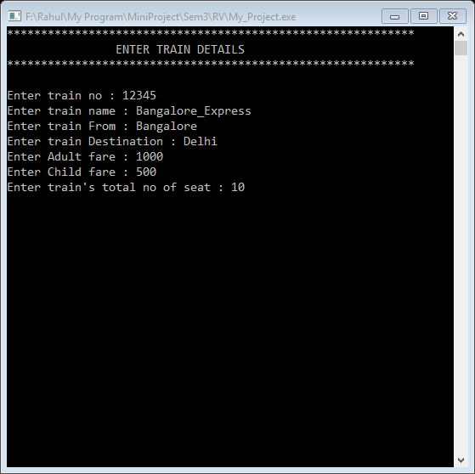

Add train detail
Function name: train_detail()
Work: Store data of train in database.
Input: Train detail like Train_no, Name, From, Destination, Fare.
Process: Stores data in database.
Output: N/A

Slide 9
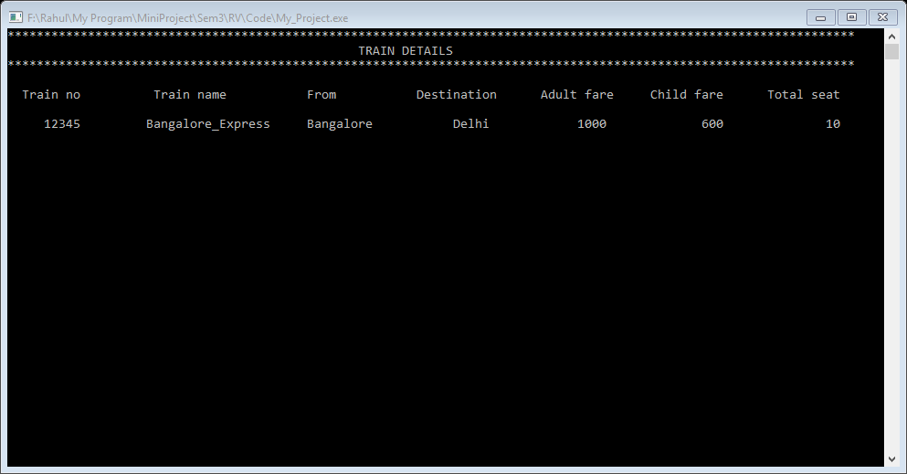
Display train detail
Function name: train_display()
Work: Display data of all trains from database.
Input: N/A
Process: Reads data from database.
Output: Display data of all trains.

Slide 10
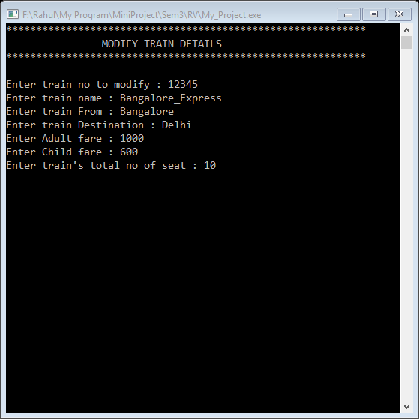
Modify Train Detail
Function name: train_modify()
Work: Update data of train in database.
Input: Train_no
If train_no matches with database takes new data for train.
Else it will print – ‘Train not found’
Process: Update database.
Output: N/A

Slide 11
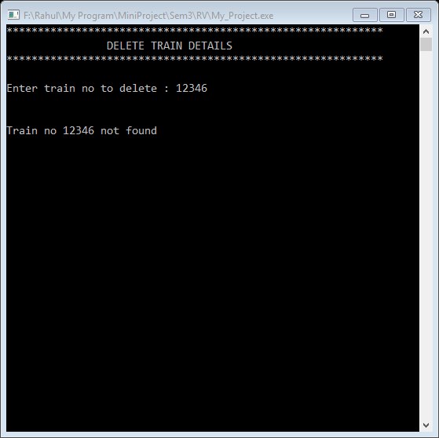
Delete train detail
Function name: train_delete()
Work: Delete data of train from database.
Input: Train_no
If train_no matches with database then delete data of train.
Else it will print – ‘Train not found’
Process: Update database.
Output: Train’s Data deleted

Slide 12
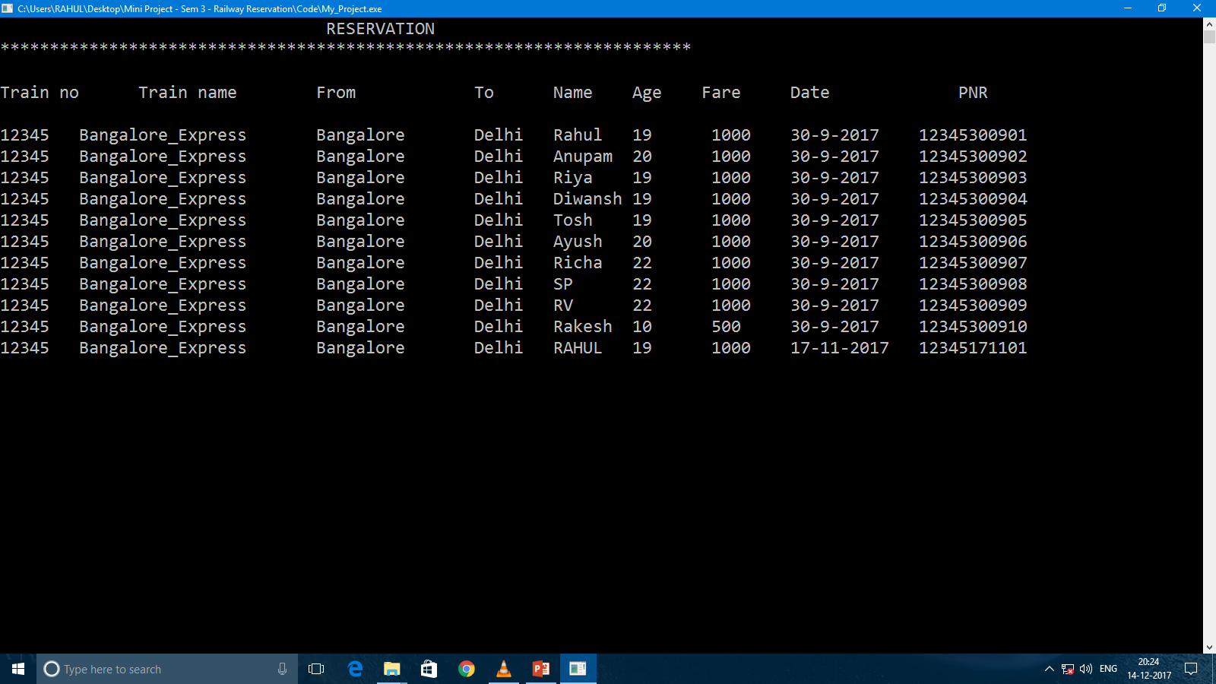
Check PNR info
Function name: display_reservation()
Work: Display all reservation details from database.
Input: PNR
If PNR matches with database takes new data for train.
Else it will print – ‘PNR not found’
Process: Reads data from database.
Output: Display data of all reservations.

Slide 13
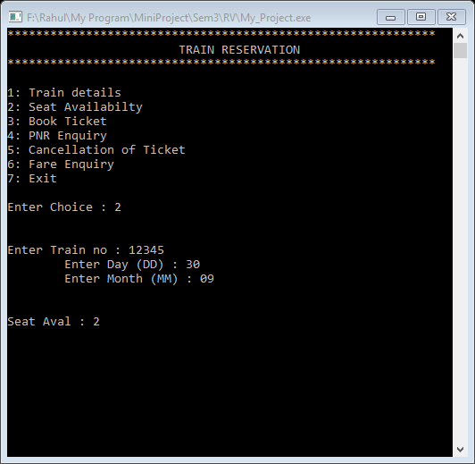
Seat Availability
Function name: seat_availabilty()
Work: Display no of seat available.
Input: Train no and Date to travel
Process: Count no of seats available.
Output: Display no of seats available.

Slide 14
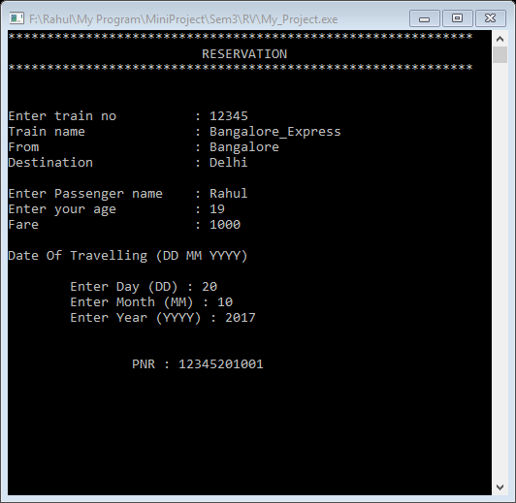
Book Ticket
Function name: reservation()
Work: Book 1 ticket at a time
Input: Train no, Passenger name, Passenger age & date of travel
Process: Stores reservation data in database
Output: Stores reservation data in database
PNR : train_no + date_of _travelling + seat no

Slide 15
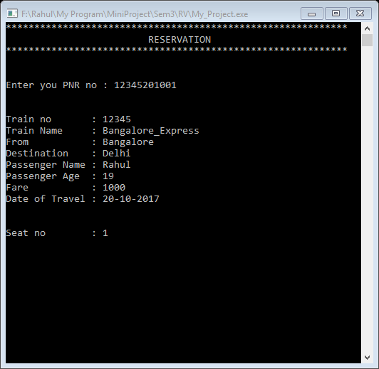
PNR Enquiry
Function name: pnr_enquiry()
Work: Display reservation details from database.
Input: PNR
If PNR matches with database takes new data for train.
Else it will print – ‘PNR not found’
Process: Reads data from database.
Output: Display data of reservations.

Slide 16
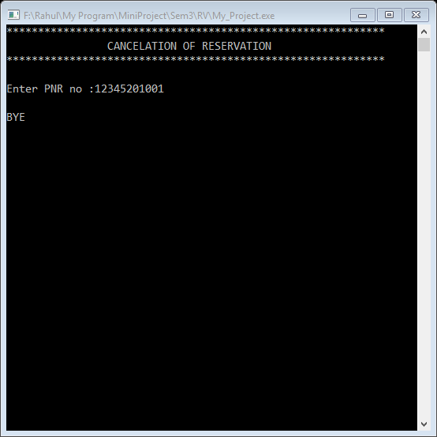
Cancellation of Ticket
Function name: cancel_reservation()
Work: Cancel the reservation.
Input: PNR
If PNR matches then delete the data
Else it will print – ‘PNR not found’
Process: Delete data of reservation.
Output: Update database and waiting list.

Slide 17
THANK YOU

