Slide 1
Migrating from 7.5.x to 8.x

Slide 2
Requesting migration
The process will be initiated by the application or production support team using a DataStage Operations Request
DIS will set up a meeting with the migrating team to review migration steps
DIS will create the project on a previously determined server. If file system requirements are greater than 700GB a SAN Disk Request will be required. This could take 2-3 weeks. Smaller projects will be built out quickly on an existing shared file system.
For projects requiring more than one development environment (including one or more test environments), business justification and management approval is required.

Slide 3
Migration Responsibilities
DIS Team
  Build the new projects in development, stage and prod (additional projects will be built with management approval from the application).
  Copy Password.ctl, MSTransferID.ctl and SetEnv.ksh from the existing project
  FTP Accounts will be transferred to the new servers along with rsa keys previously set up.
    We will be changing ftp accounts in non-prod so all non-prod systems use the same ftp account.
  DIS will provide the application team with the msdsadm rsa keys for the new server.
  DIS will attempt to provide extended support when possible. Please use ITG DataStage Operations requests to engage us.

Slide 4
Migration Responsibilities
Application or Production Support Team
  Export the jobs from 7.5.x and import them into 8.x
    This should only include jobs that are required. Copy jobs and obsolete jobs should not be carried into the new environment.
    Do not export zAdminZones, zDeveloperAreas or Utilities from 7.5.x.
  Copy project scripts, control files, etc.
  Provide target systems with the new msdsadm rsa key.
  Provide source systems with the new server name and ftp account.
  Work with TWS
    change the server jobs will run on.
    If jobs source the as_profile, change jobs to use the TWS vartable and change the command line
    The new MSSCRIPTDIR is /home/msdsadm/cfw
    The new id will be msds<mui> instead of msdsadm
    If jobs are in Autosys, transfer them to TWS
  Work with ITG
    Using an ITG Workflow Maintenance request add the new DataStage Deployment Object to your workflow
Notes:
How do we limit the # of jobs they migrate? C2B, PRDS.

Slide 5
Migration Responsibilities
  Test jobs to ensure they are working as expected in the new version
    Migrate jobs to use the new database connector stages when possible. A migration tool is available to automate this.
      OCI8 is no longer supported. If you used this stage, you will need to manually fix the job.
    Migrate any server jobs to parallel when possible
    Migrate any DB2 Enterprise jobs to use database stages or db2 load scripts
    Review # of nodes for the job and pick the optimal Config file (default is now 1 node). You should only use more nodes if required to meet SLA’s. This will be reviewed and pushed back when DIS reviews code during deployments.
  Test scripts to ensure they are working as expected in Linux
  Any teams not using the Common Framework will need approval to continue this option. PHS Legacy applications will be required to migrate to the framework as part of this migration.
Notes:
Can we force PHS Legacy to use Framework?

Slide 6
Unix Servers
Our servers run Redhat Linux.
Current dev engine servers are etlrd0001, etlrd0002 & etlrd0003.
You will need 3 UNIX groups to gain access to your new project
  msdstage – This should be your primary UNIX group. Required to access the DataStage binaries.
  mds<mui> - This is the UNIX POSIX group that gives you UNIX file system permissions.
  lds<mui> - This is the eLDAP group required to access DataStage through Designer, Director, etc.
DataStage is a multi-tier environment. Current service tier servers are etlrd0009 (dev)
You only need a user account on the engines

Slide 7
Unix File Systems
We use a standard directory structure for ease of management and to allow the same jobs to run in the multiple environments.
The directory for etl is /etldata on all server. Developers will have access to their project folders under this directory structure.
The directory for ftp is /ftphome on all servers. Developers won’t have access to these directories. Inbound files will be automatically moved to the /etldata directories. We will discuss this further later in this training.
Notes:
The “com” directory holds the DataStage binaries. Customers should not attempt to change any files here.
The “ftp” directory hold the projects ftp landing zones.
The “etl” directory hold the actual datastage project with file storage, control files, etc.
Each project will have it’s own subdirectory structure under the “etl” file system. Security is controlled by UNIX groups.
The Common Framework scripts are located under $AdminRoot/cfw/scripts. To allow teams to use the same command in all environments, we created a soft link called /home/msdsadm/cfw. You should use this path for your TWS jobs.

Slide 8
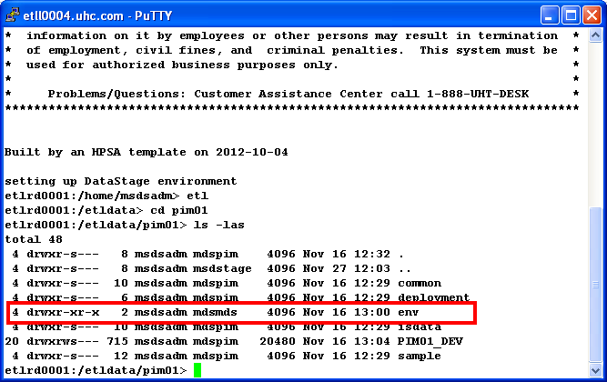
Unix File Systems (Cont.)
    The env this replaces the old /ds/etc directories and holds
    the project’s Password.ctl, MSTransferID.ctl
    and SetEnv.ksh.

Slide 9
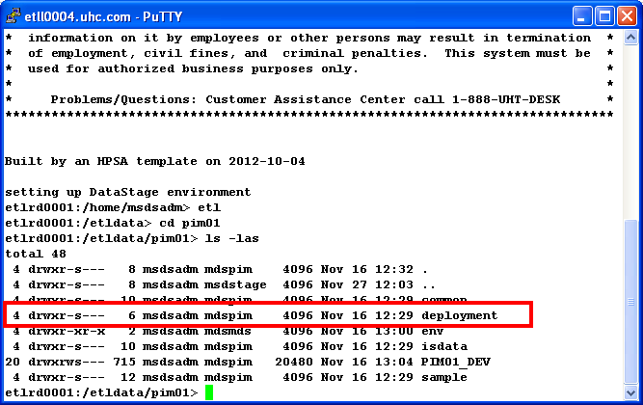
Unix File Systems (Cont.)
The deployment directory is where you will place isx files and common framework
data for your deployments. The ctl directory is where you will place your deployment
control file. Logs created during the deployment will go into the log directory. You
should place your isx files in the obj directory and dat files from CFW extracts will
go into the stg directory. Deployments will be covered in more details later in the
training.

Slide 10
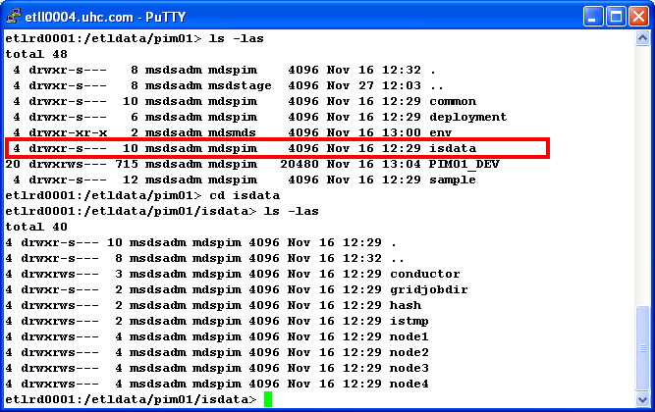
Unix File Systems (Cont.)
The isdata directory is used by your jobs for temporary files and datasets.
Node1-4 are used to hold the datasets for the different threads of your job execution.
The istmp directory can be used by your project as a temporary holding area.
The hash directory is to be used for the creating your hash files.

Slide 11
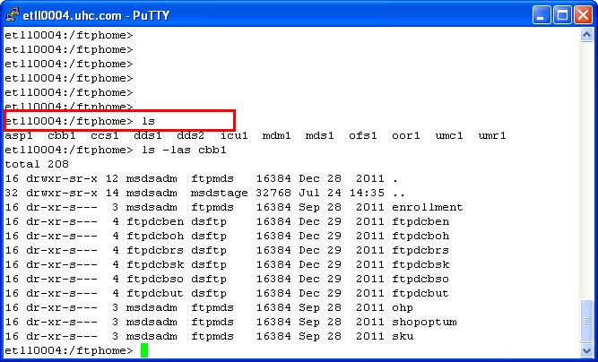
Unix File Systems (Cont.)
The ftp landing zone has directories for each project on the server. There are two types
of subdirectories, application directories used by transfers using CFT and ftp account
directories used for sftp transfers. Both types have an inbox subdirectory for dropping
    the files in. For security reasons, these directories are accessible by the transferring
    account only. Developers and other application users don’t have access. This directory
    is currently 100GB. If you plan on receiving files larger than 60-75GB you should work with
    the DIS team.
Notes:
For teams using the CFT agent method for file transfers the ftp directories will have a direct correlation with your etl application directory name.

Slide 12
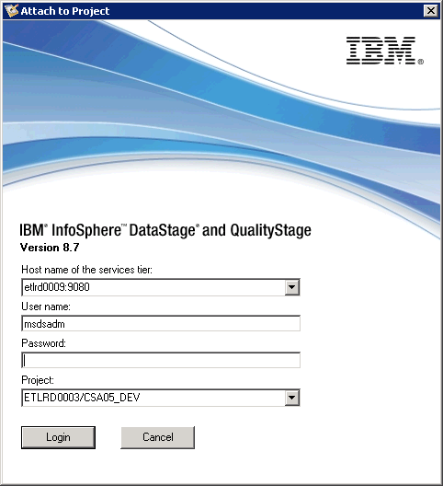
DataStage Tools
To connect to designer or director you will enter the service tier in the top dropdown.
The service tier will be etlrd009.uhc.com:9080 for dev,
Etlrs0006.uhc.com:9080 for stage and etlrp0006.uhc.com:9080 for production.
The user and password are next followed by selecting your datastage project from
the bottom dropdown.

Slide 13
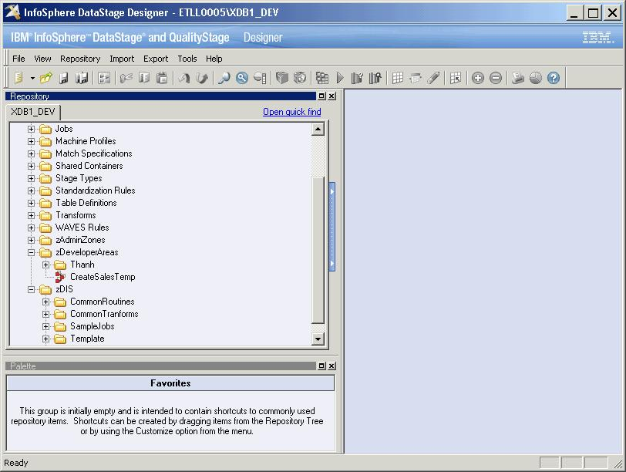
DataStage Tools (Cont.)
    The Jobs category will be used by projects. All your jobs and sub-categories should
    be created under the Jobs category. The zAdminZones category holds administration
    jobs. These jobs should not be modified, deleted or compiled. The zDeveloperAreas
    can be used by developers can create personal directories here and store test jobs.
    The zDIS category hold samples, templates and other useful objects for our customers.
Notes:
3.SampleJobs
a.Sample jobs that can be used by the developers to help them understand the Common Framework setup.
b.This will only exist in development.
4.Template
a.There are a large number of parameters available in the Common Framework. These parameters are case sensitive and must be entered exactly.
b.Templates were created to give developers jobs (sequence, server and parallel) jobs with all the parameters entered for you.
c. Right-click on a template job and select “Create Copy” to create a copy of the template. Then rename it to whatever you want for your job name.
d. You can remove any parameters you don’t wish to use. You can add any other parameters you need.
The functionality for import/export of dsx files and compiling jobs has moved from the old 7.5 Manager to the Designer.

Slide 14
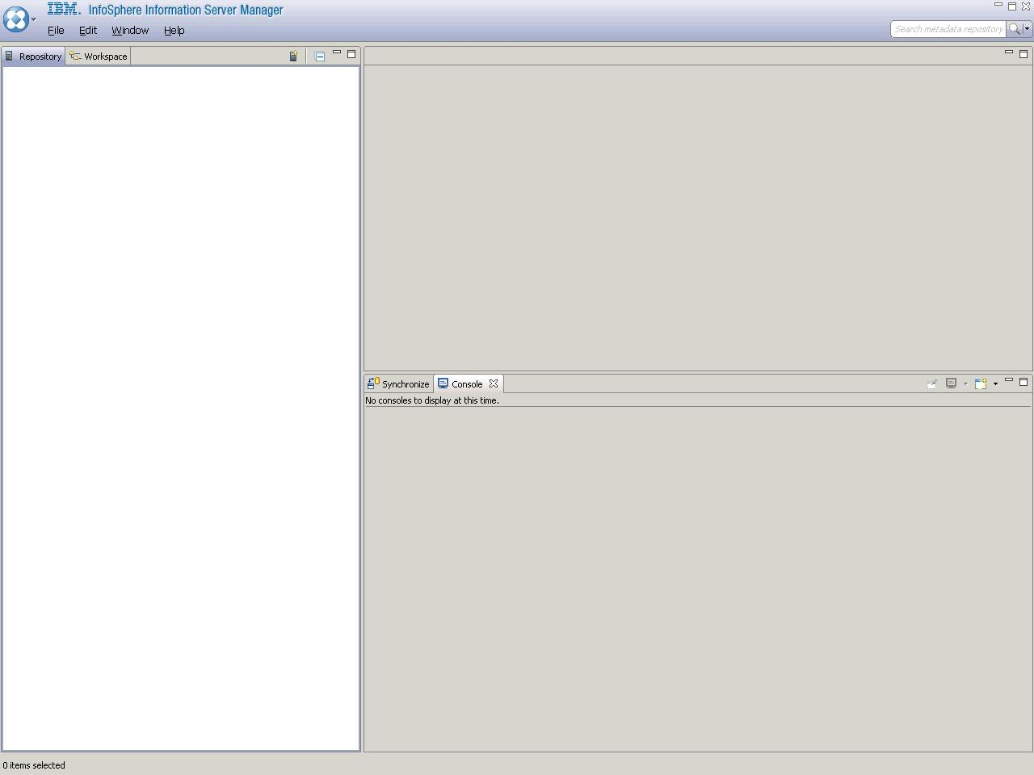
DataStage Tools (Cont.)
When you first go into manager, you won’t have any items populated in the treeview
on the left pane. You will right click here and select “Add Domain”.

Slide 15
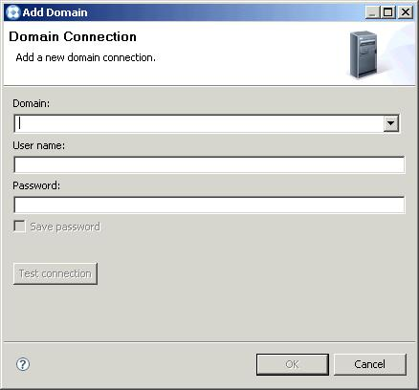
DataStage Tools (Cont.)
Enter the service tier:port for the domain (i.e. etll0031.uhc.com:9080). Then enter
your userid and password. Click ok. The domain will be added to the treeview.

Slide 16
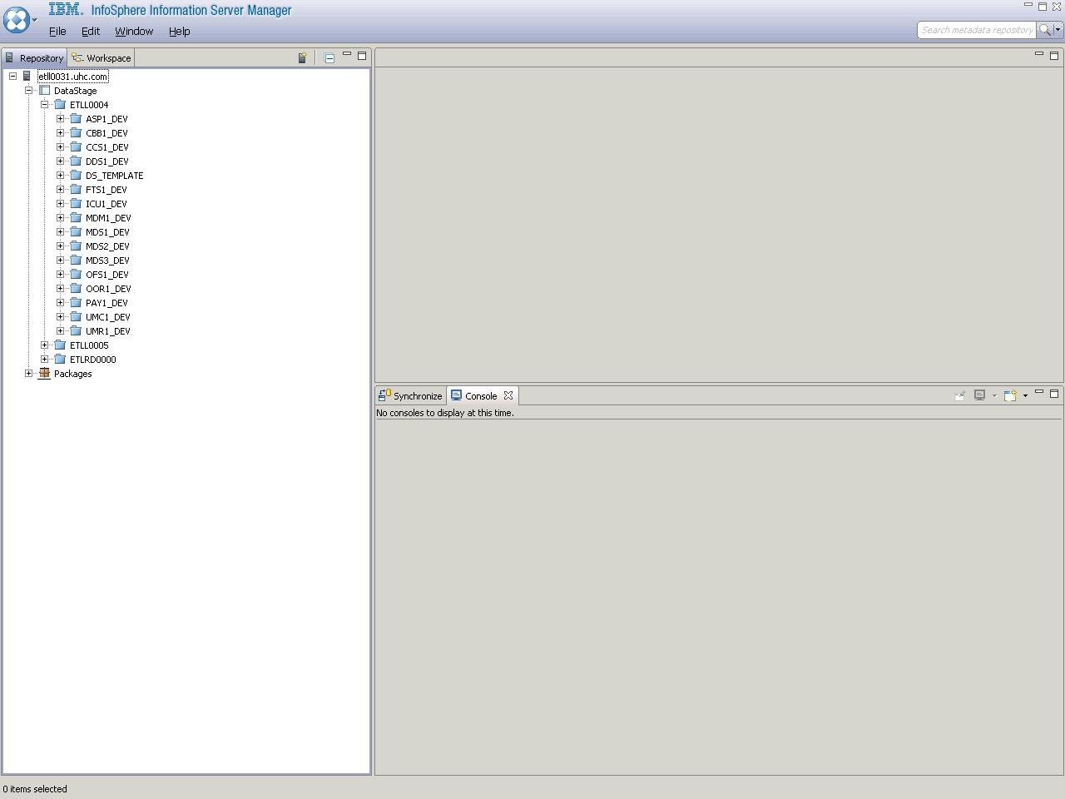
DataStage Tools (Cont.)
You can click the “+” to open the treeview list until you see your project. In the future,
when you connect to the Manager tool, you will see any domains you have added.
To connect to a domain right click on the domain and select “Connect”.

Slide 17
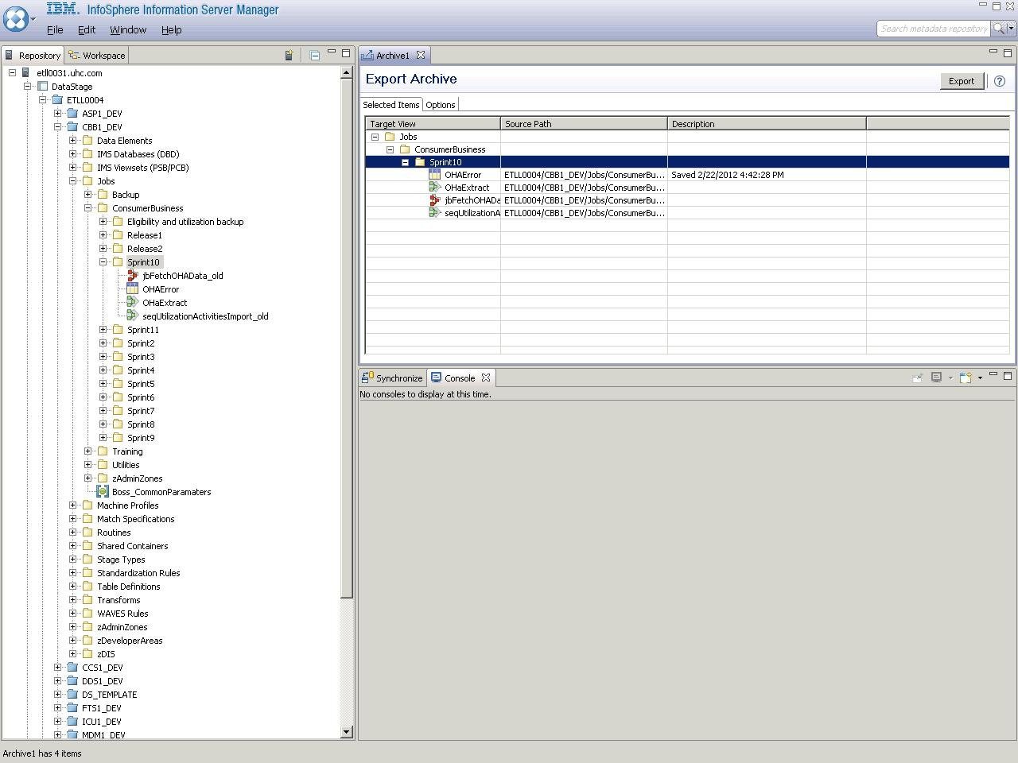
DataStage Tools (Cont.)
Right click on a category or multiple categories and select “Export” to add the
Jobs to the right pane. Once you get all the jobs you want you can press the
Export button to export those jobs in a binary (isx) format. This is different from the
Export in Designer which creates a text file in the old dsx format. Make sure to save
the file on your local C: drive. Then sftp it up to your DataStage server. You should
perform the transfer in a binary format.

Slide 18
ITG Deployments (Cont.)
Besides the InfoSphere Manager, another method for creating the isx file is to use the Linux command line.
Execute $AdminRoot/is/Clients/istools/cli/istool and enter the export command
export -domain etlrd009:9080 -username <userid> -password <password> -archive /etldata/cbb1/deployment/obj/jbInsertConsumer.isx -ds '-incexec -base="etlrd0001/CBB1_DEV/Jobs" "ConsumerBusiness/Release1/SOSalesImport/jbInsertConsumer.pjb"'
For more information on this command, you can use the following link
  http://publib.boulder.ibm.com/infocenter/iisinfsv/v8r5/index.jsp?topic=%2Fcom.ibm.swg.im.iis.iisinfsv.assetint.doc%2Ftopics%2Fcommandset.html

Slide 19
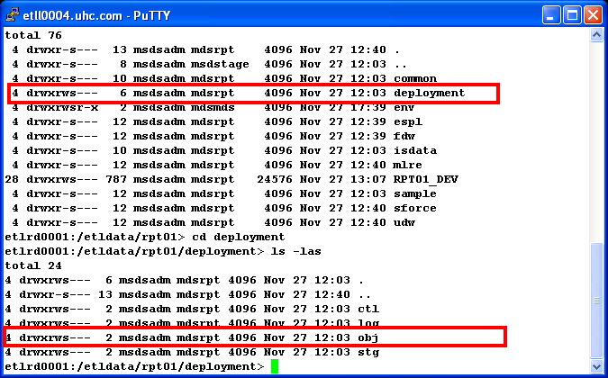
ITG Deployments (Cont.)
Your isx files should be placed in your obj directory. You can also create dat files using
the MSExtCFW.ksh script. This script will automatically place all the files in your
stg directory. You should then place a control file in the ctl directory to tell our
deployment scripts to load those records.

Slide 20
ITG Deployments (Cont.)
You can get a copy of a deployment control file from $AdminRoot/cfw/ctl/SampleGenDeploy.ctl. This control file is self-documenting and has examples in the comments.
The control file allows you to perform most of the self-service offerings as part of your deployment.
These include move file, copy file, run shell, etc.
To load the Common Framework records, create an entry for Run Shell. The following entry would load the ms_job table.
  |RunSH |$MSScript/MSLoadCFW.ksh |asp1 ms_job
The control file name must start with DISGenDeploymentCtl. After that you can include anything you want to make it unique. Or you don’t have to add anything. The extension must be .ctl.

Slide 21
ITG Deployments (Cont.)
Once you have all the files in your deployment directory, you are ready to use the unix tar command to tar the directories.
This will include not only the deployment directory, but any common/scripts, common/ctl, <appid>/scripts, etc.
When creating the tar file, make sure to use the relative path. Failure to follow this will result in your deployment failure.
Relative path is used to allow projects with multiple environments to deploy without changing anything.
The following is a sample of how to use a relative path.
  cd to your project directory (i.e. cd /etldata/cbb1)
  tar –cvf isdata/istmp/deploy1.tar ./common/scripts/newscript.ksh
  Note you place the tar file in your projects isdata/istmp directory as you don’t have write access to your current directory.

Slide 22
ITG Deployments (Cont.)
The last step is to copy or transfer your tar file to your ITG Staging area. This directory can be on your DataStage server or also an ITG Windows server.
You will then following the steps outlined in the ITG Deployment training to create your package and migrate it to the upper environments.

Slide 23
Questions
QUESTIONS

