Slide 1

TEAM
CELESTIAL MASHUP
TEAM MEMBERS
RAHUL V (ENG22AM0189)
KASALA BHAVANA (ENG22AMO153)
POOJITHA R (ENG22AM0160)
S RAKSHITHA (ENG22CS0423)
RAKSHITHA JK (ENG22AM0190)
POOJYANTH M (ENG23AM3003

Slide 2





INTRODUCTION
Landsat missions, operated by NASA and the USGS, have revolutionized Earth observation by providing the longest continuous dataset of remotely sensed measurements of the planet's land surface. For over four decades, Landsat satellites have collected vital information, enabling researchers, scientists, and governments to monitor changes in landscapes, urbanization, agriculture, and natural disasters. This wealth of satellite data, particularly the Surface Reflectance (SR) product, measures the amount of light reflected from the Earth's surface, offering crucial insights into various environmental and climatic conditions.

Slide 3
LANDSAT REFLECTANCE DATA: ON THE FLY AND AT YOUR FINGERTIPS
PROBLEM STATEMENT
Landsat missions provide the longest continuous dataset of Earth's land surface, but comparing ground-based spectral measurements with Landsat Surface Reflectance (SR) data is a complex and labor-intensive process. Users need to determine when the satellite will pass over specific areas and manually access the corresponding data. Currently, no integrated tool exists to facilitate this process efficiently.

Slide 4
LANDSAT REFLECTANCE DATA: ON THE FLY AND AT YOUR FINGERTIPS
SOLUTION
To Develop a web-based application that allows users to define a target location, receive notifications of upcoming Landsat passes, and access the corresponding Surface Reflectance (SR) data. This solution will streamline the process, enabling easy comparison between ground-based measurements and Landsat data. By automating these steps, the application will foster scientific exploration, experiential learning, and interdisciplinary thinking, empowering users to engage with satellite data more effectively.

Slide 5


OBJECTIVES
Target Location Definition: Users can specify the location by name, latitude/longitude, or select on a map.
Satellite Pass Prediction: Determine when a Landsat satellite will pass over the target location.
Custom Notifications: Enable users to set lead time and choose notification methods for overpass alerts.
Landsat Pixel Grid: Display a 3x3 grid of Landsat pixels, centered on the target location.
Scene Identification: Use the WRS-2 system to identify the Landsat scene containing the target pixel and display its extent on a map.
Cloud Coverage Filter: Allow users to set a cloud coverage threshold (e.g., less than 15%).
Data Time Span: Permit users to access the latest Landsat acquisition or data from a specific time period.
Scene Metadata: Acquire and display metadata like acquisition date, time, satellite, path/row, cloud cover, and image quality.
Landsat SR Data Access: Retrieve Surface Reflectance data for the target pixel and possibly display surface temperature.
Data Visualization: Show a graph of Landsat SR data across the spectrum (spectral signature) along with metadata.
Data Export: Allow users to download or share data in formats like CSV

Slide 6
OVERALL TECH STACK
Frontend:
Framework: React.js
Styling: CSS Modules, TailwindCSS
Mapping: Leaflet.js
Data Handling: Axios
Visualization: Chart.js
Backend:
Framework: Flask, FastAPI
Database: SQLite, Redis
API Integration: Landsat API, USGS Earth Explorer API
Task Scheduling: Celery, SMTP (for notifications)
Data Handling:
Tools: Python (NumPy, Pandas, GDAL, Rasterio)
Visualization: Matplotlib, GeoTIFF
APIs: USGS Landsat API, SentinelSat API

Slide 7
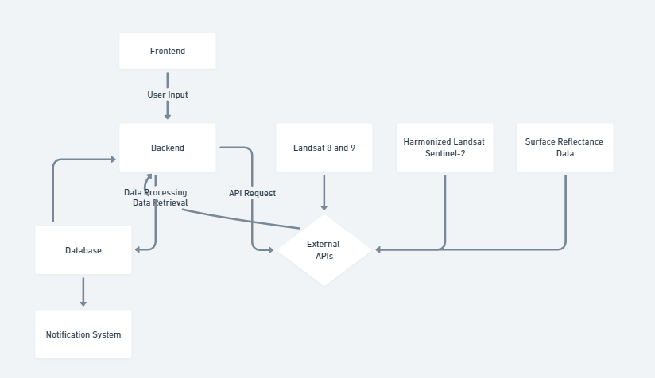
TECH FLOW

