Slide 1

Dr BABASAHEB AMBEDKAR TECHNOLOGICAL UNIVERSITY ,LONERE
DEPARTMENT Of Computer engineering

Slide 2
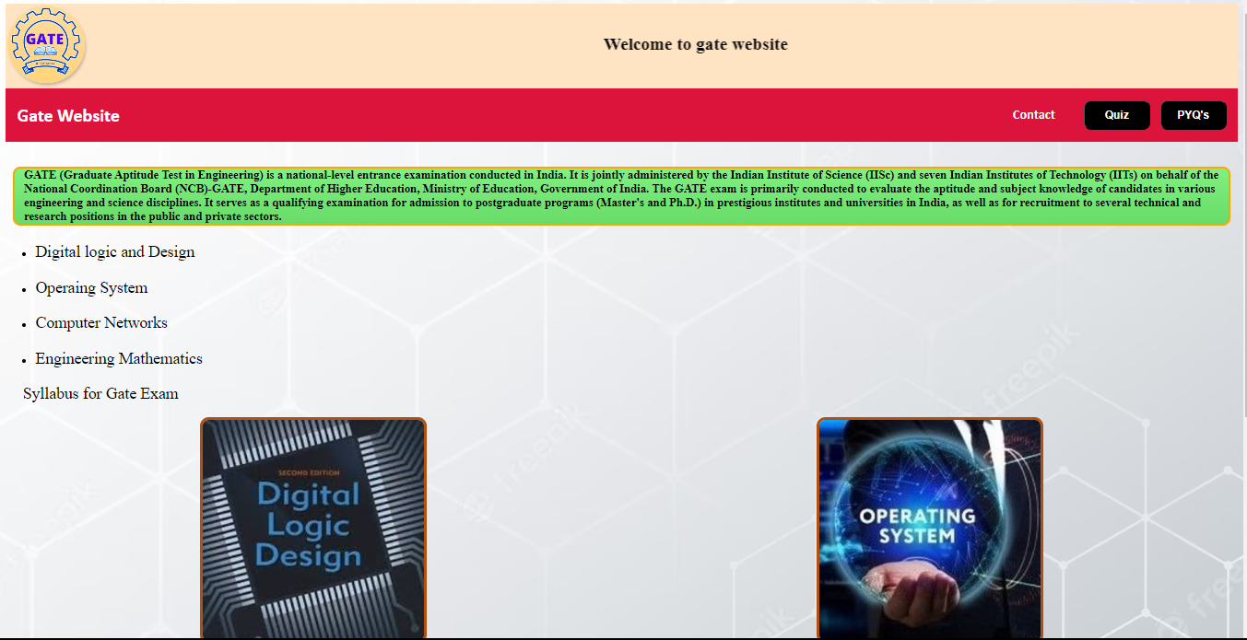
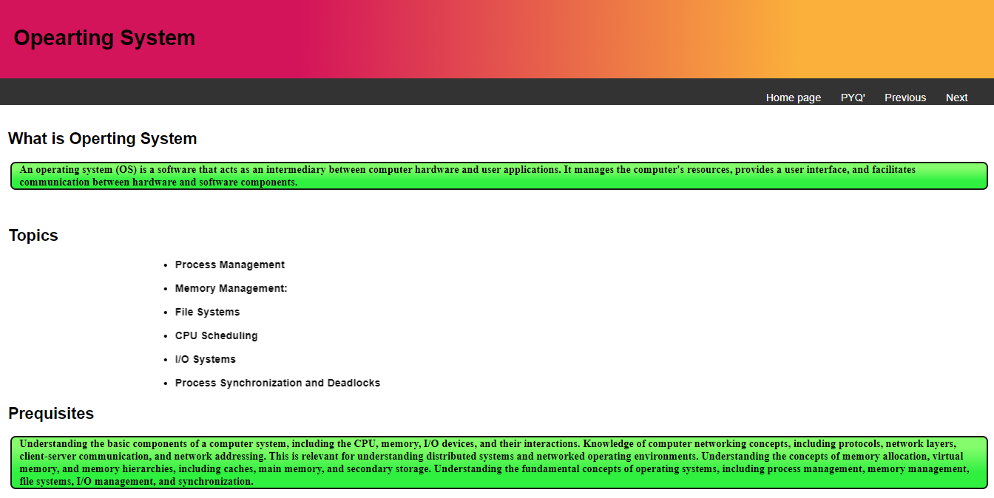
GATE WEBSITE
NAME:-RAHUL SIDDHARTH WANKHEDE BRANCH:-COMPUTER ENGINEERING PRN:-2130331245008
Guided by : Asst. Prof. Harsha Gaikwad

Slide 3
CONTENT
Introduction to My Gate Website
TOOLS USED FOR WEBSITE
HTML
CSS
JS
APPLICATIONS OF HTML CSS AND JAVASCRIPT

Slide 4
INTRODUCTION TO MY GATE WEBSITE
Graduate Aptitude Test in Engineering(GATE) offers a wide learning platform for Gate Aspirants
Services provided by our website
Subject wise important topics
Quiz related to each subject
PYQ’s for each subject
PYQ for overall all subject
Provide contact details for any Query

Slide 5
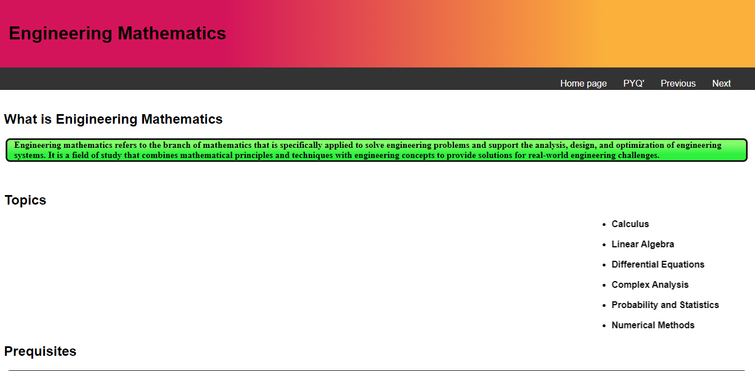
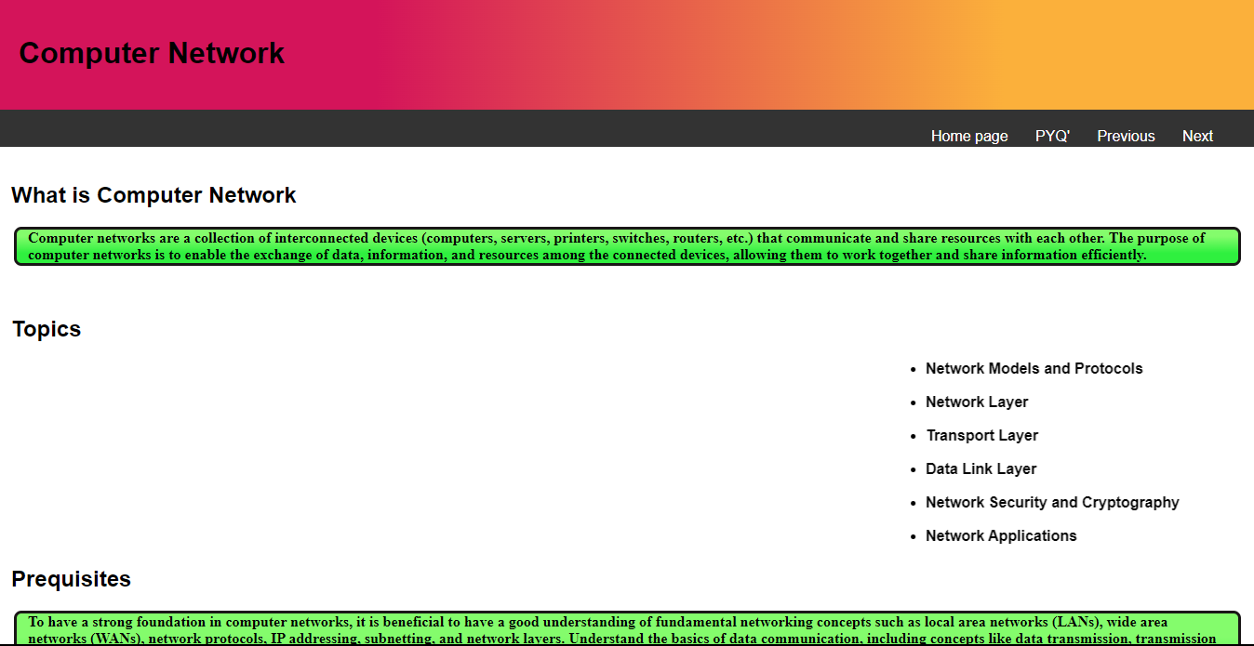

Slide 6
TOOLS USED FOR WEBSITE
HTML
Full Form :- HYPER TEXT MARKUP LANGUAGE
Creating and structuring web pages on the internet
It gives structure to website
Tags Used for Website are:-
<html> tag :- Encloses all other elements in the document
<body> tag:- Contains visible content including headings, paragraphs, images
<title> tag:- Appears as the title of the web page

Slide 7
<img> tag:- Image tag used to embed image into HTML document
<ul>,<ol>,<li> tag:- Used as creating list in HTML document
<ul>:- Used to create unordered list
<ol>:- Used to create ordered list
<li>:- Used to create list
<table>,<tr>,<td>:- Used to create table in HTML document
<table>:- Used to create table
<tr>:- Used to give rows to table
<td>:- Used to represent individual cell
<div> tag:- Used for grouping other HTML elements
<p> tag:- Used to display readable content in html document
<h1>,<h2>,<h3>,<h4>,<h5>,<h6> tag:- Used for heading in different styles

Slide 8

CSS(Cascading Style Sheets)
Styling language used for presentation and layout of HTML document
Allows developers and designer to control appearance.
CSS works as follows :-
Selectors: Uses to target specific HTML elements
Rules and Declaration:-It define the styles to be applied to the selected elements.
Specificity and Inheritance:- It is used when multiple CSS target the same elements

Slide 9
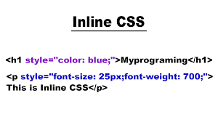
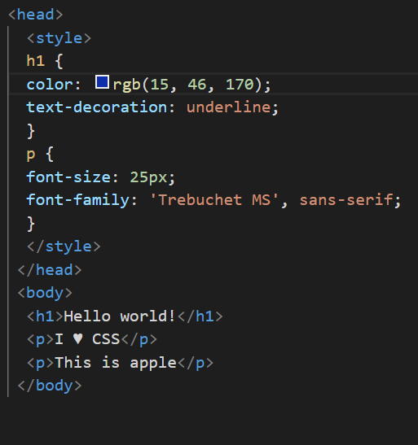
Types of CSS
Inline CSS:-
Internal CSS:-

Slide 10
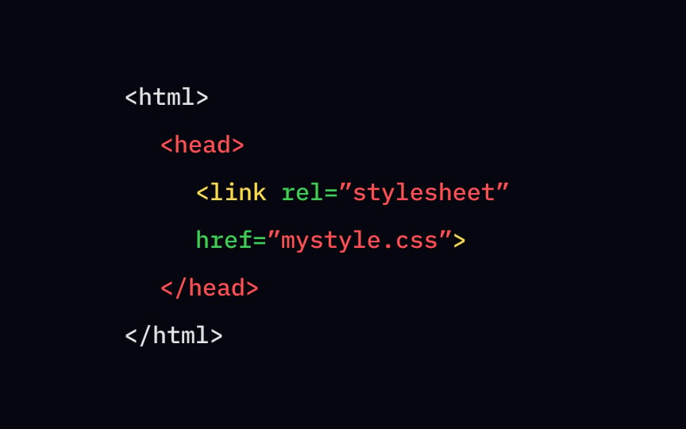
External CSS:-

Slide 11
CSS PROPERTIES AND STYLING
PROPETIES :-
Colors:- -Sets the color of text or foreground elements.
Font:- Controls the styling of fonts, including size, weight, and family.
Margin :- Margin sets the space around an element
Padding:-Gives space around element content
Background:- Controls the background color or image of an element.
Border:- Sets the border properties of an element, including width, style, and
color.
Display:- Specifies how an element is rendered, such as block, inline, or flex.

Slide 12
STYLING:-
Text Styling:- Color, font-size, font-family, and text-align enable you to control appearance of text.
Background styling:- Background color or image of elements.
Border styling:- Border-width, border style, and border-color allows to create borders around elements.
Margin :- Margin sets the space outside an element
Box shadow and :- Properties like box shadow and border-radius enable you to add shadow effects
Rounded corners:- border-radius enables rounded corners to elements.

Slide 13
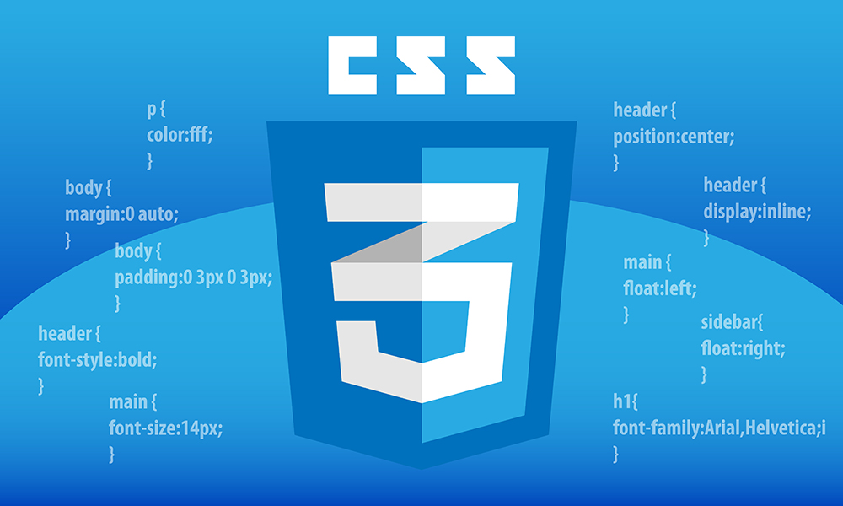
CSS ADVANCED STYLING
Rounded Corner:- Create elements with rounded corners
Gradients:- Backgrounds the linear gradient() and radial-gradient() functions
Transformation:- Ability to manipulate elements in 2D and 3D space

Slide 14

JS (JAVASCRIPT)
A high-level, interpreted programming language
Used for interactive and dynamic behavior to web pages
Runs on user’s web browser rather than the web server.
Here is how JavaScript:-
Embedding JavaScript:- Placed in ”head” tag section or at end of ”body” tag section of the HTML file.
Variables and Data Types:- Declare variables using keywords like var, let, or const
DOM Manipulation:- Provides methods and properties to access and manipulate HTML elements

Slide 15
METHODS AND PROPERTIES IN JS
METHODS:-
STRING METHOD:-
concat():- Concatenates two or more strings.
toUpperCase():-Converts a string to uppercase.
length:- Returns the length of a string.
indexOf():- Returns the index of a specified substring within a string.
split():- Splits a string into an array of substrings based on a specified delimiter

Slide 16
Math Object Methods:-
random():- Returns a random number between 0 and 1.
ceil():- Rounds a number up to the nearest integer.
max():- Returns the maximum value from a set of numbers.
pow():- Returns the result of raising a number to a specified power.
Document Objected Method:-
getElementById():- Retrieves an element by its ID
getElementsByClassName():- Retrieves elements by their class name
getElementsByTagName():- Retrieves elements by their tag name.

Slide 17
querySelector():- Selects the first element that matches a CSS selector
querySelectorAll():- Selects all elements that match a CSS selector.
createElement():- Creates a new element.
appendChild():- Appends a child element to a parent element.
removeChild():- Removes a child element from its parent.

Slide 18
APPLICATIONS OF HTML CSS AND JAVASCRIPT
Website Development
Web Applications
Responsive Web Design
Data Visualization
Web Accessibility:

Slide 19
THANK YOU
Made By :- RAHUL SIDDHARTH WANKHEDE

