Slide 1

GLOBAL BANK PRIVATE LIMITED
GLOBAL OR NOTHING

Slide 2
TEAM AND MENTOR
ANUSHRI N R
ARAVINDH SIVA S
BISWAJIT BUNIYA
RAHUL WANKHEDE
RAJ SHETTY
Mentored by: RAJASEKHAR

Slide 3

TABLE OF CONTENT
INTRODUCTION
OBJECTIVE OF THE PROJECT
SYSTEM REQUIREMENTS
TECHNOLOGIES USED
PROJECT MODULES
SNAPSHOTS
ADVANTAGES
FUTURE SCOPE
CONCLUSION
PROJECT DEMO

Slide 4
INTRODUCTION
The Admin Management System (AMS) is a full-stack application that provides functionalities for a bank administrator to manage customers, branches, and customer accounts.
The AMS has been developed using robust technologies like Spring Boot, JPA, and Hibernate for the backend functionality, MySQL for the database, and ReactJs for front-end implementation.
REST APIs are implemented using Hibernate to interact with the database. ReactJs then uses these APIs to query the database and fetch the data that it uses in its components. It provides an interactive and user-friendly interface.
Unit testing has been implemented using JUnit to test the REST APIs.

Slide 5
OBJECTIVE OF THE PROJECT
This project aims to offer seamless and hassle-free management of customer accounts and bank branches.
This application will allow performing the below operations:
1. Admin can delete any customer
2. Admin can add branch details
3. Admin can delete branch details
4. Admin can open an account for registered customer
5. Admin can close an account for registered customers
6. Display all customers’ details
7. Displays all branch-related details

Slide 6

SYSTEM REQUIREMENTS
Software Requirements
JDK 1.8 and above
Visual Studio code
Eclipse
Node Js
MySQL
Postman
Hardware Requirements
Disk Space: 1GB or above.
RAM: 2 GB or above.

Slide 7

TECHNOLOGIES USED
Spring Boot
React Js
Hibernate and JPA
MySQL
Postman
HTML
CSS
Bootstrap

Slide 8
PROJECT MODULES
ADMIN LOGIN
ADD CUSTOMER
DISPLAY CUSTOMERS
ADD BRANCH
DISPLAY BRANCHES
ADD ACCOUNT
DISPLAY ACCOUNTS

Slide 9

SNAPSHOTS

Slide 10
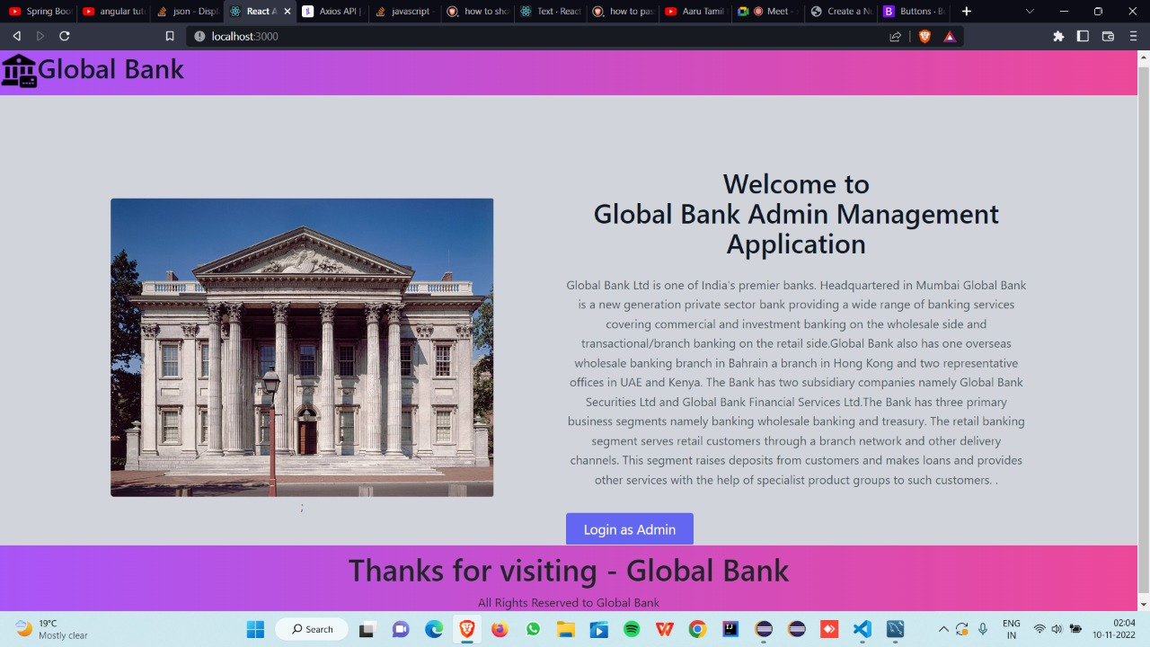
The above snapshot shows the landing page of our website. It has information about Global Bank and a link to log in as an Admin.

Slide 11
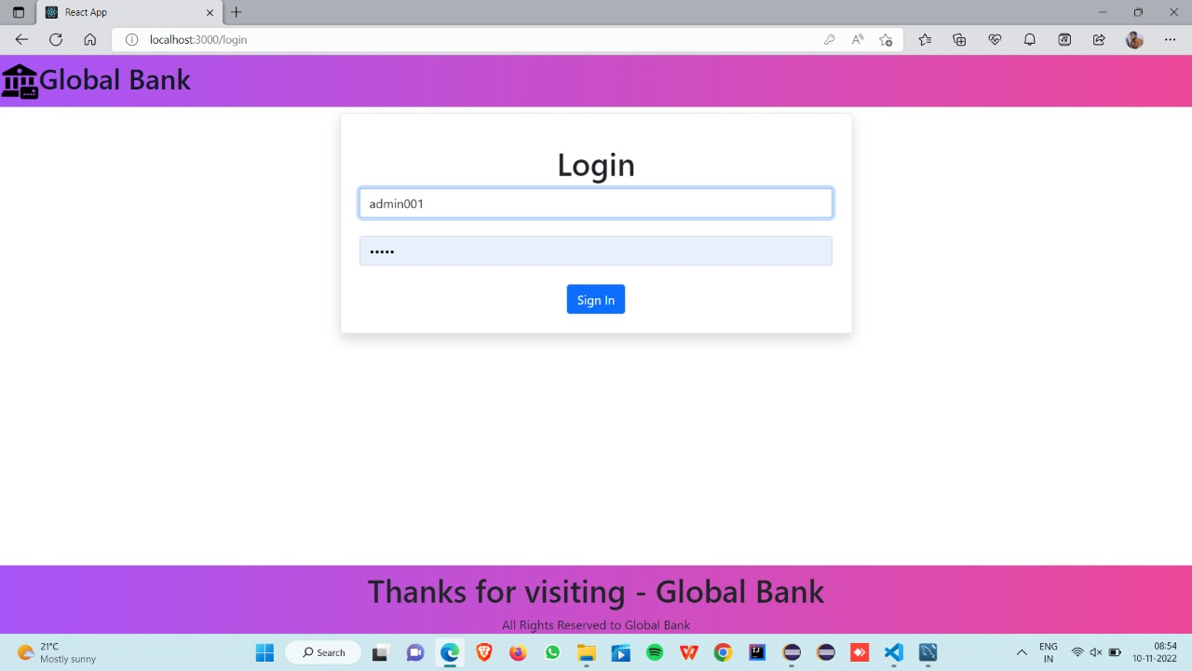
Once the user clicks on the Login as Admin button, they are redirected to this page where they need to enter the username and password in order to log in. Incorrect credentials lead to an error message being displayed.

Slide 12
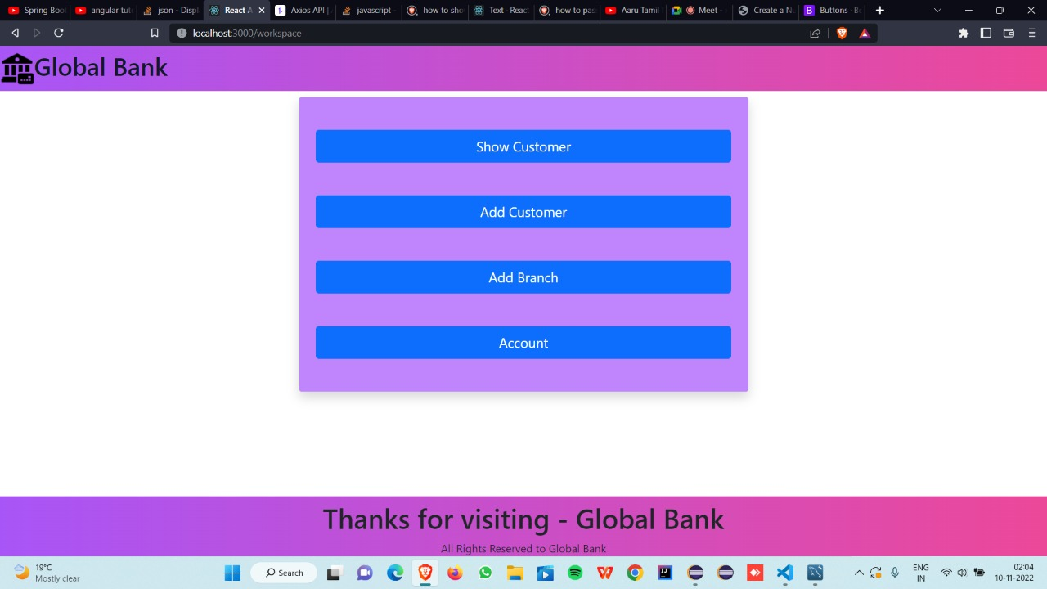
Once the correct login credentials are provided, the user is directed to the main page of our website. The snapshot shows the four functionalities available to the admin.

Slide 13
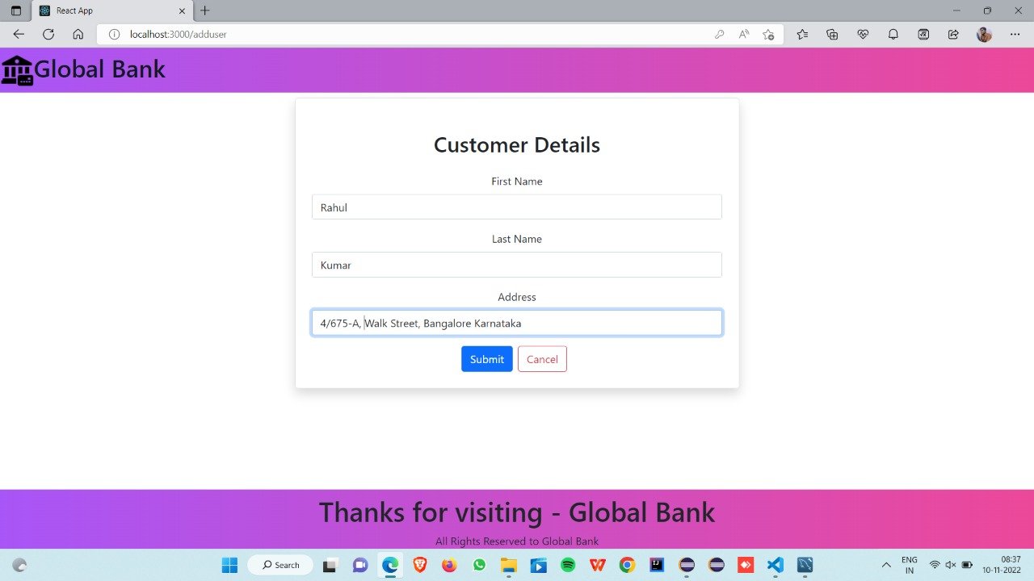
Add customer functionality
The customer ID will be autogenerated in the backend. The admin has to provide the first name, last name, and address of the customer.

Slide 14
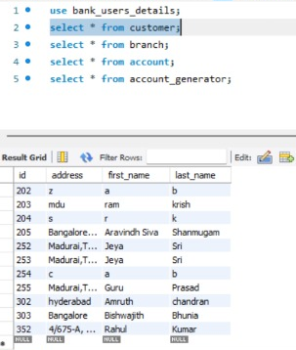
Customer Table
On the click of the submit button, a post request is made which adds the customer to the customer table.

Slide 15
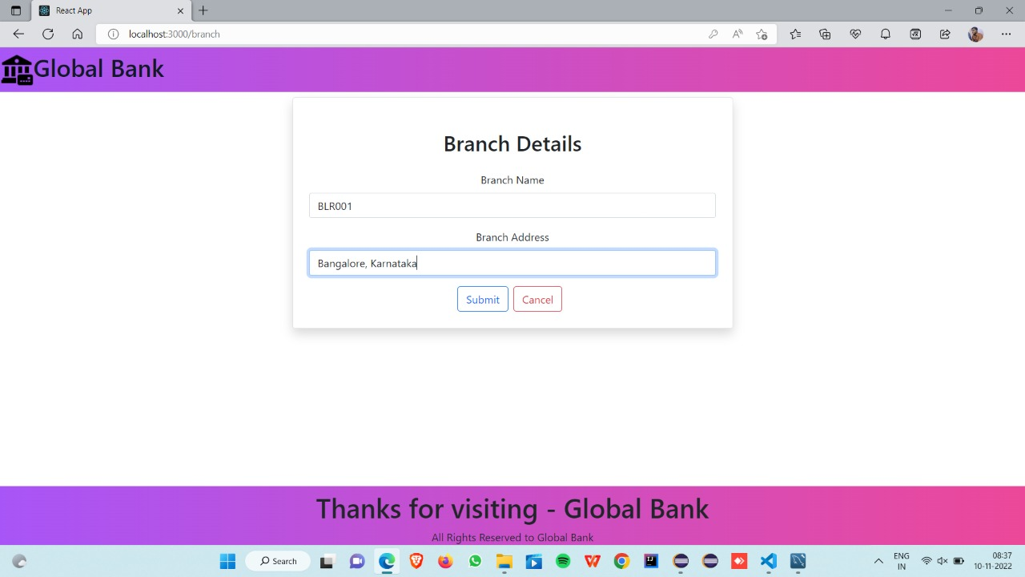
Add branch functionality
The branch ID is autogenerated by the backend. The admin has to provide the branch name and address and click on the submit button to add a branch.

Slide 16
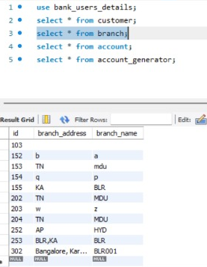
Branch Table
On the click of the submit button, a post request is made which adds the branch to the branch table.

Slide 17
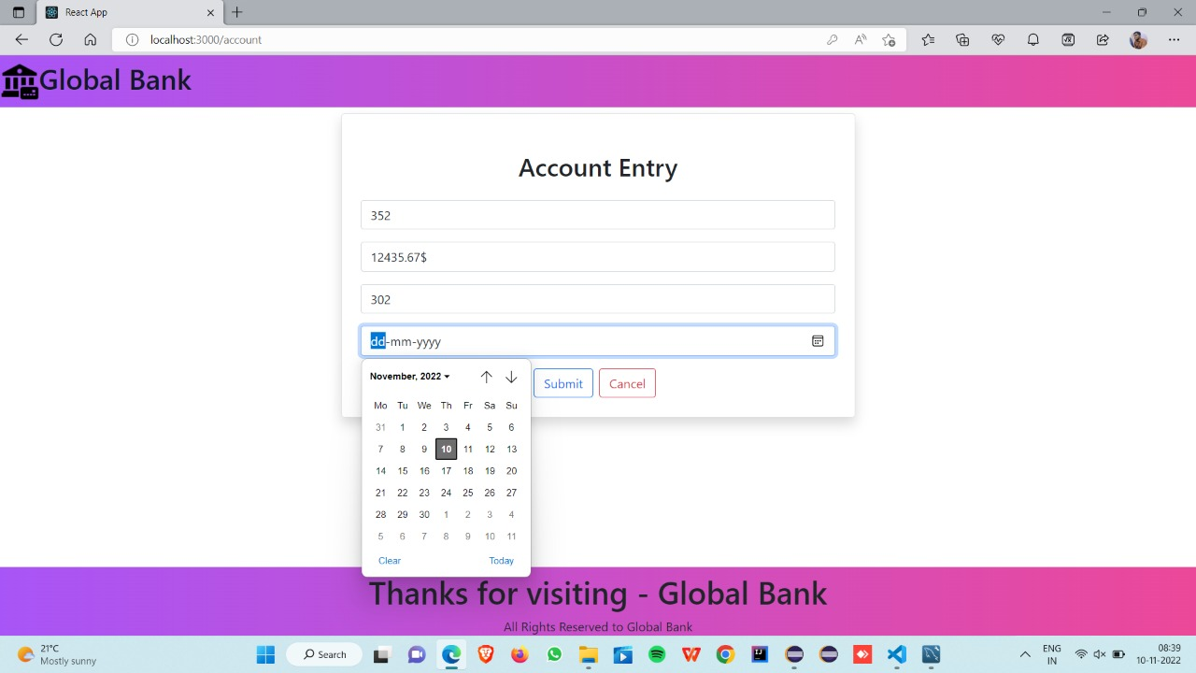
Create account functionality – date picker to select date

Slide 18
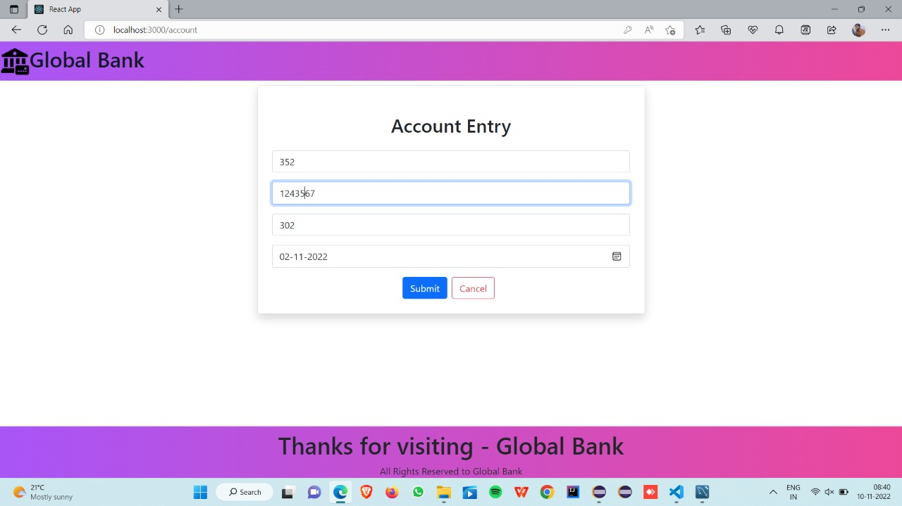
Create account functionality – cont.
The account ID is autogenerated by the backend. The admin needs to provide only the customer ID, branch ID, account balance, and opening date. A click on the submit button will create a new account.

Slide 19
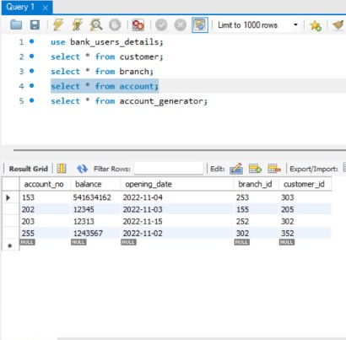
Account Table
On the click of the submit button, a post request is made which adds the account to the account table.

Slide 20
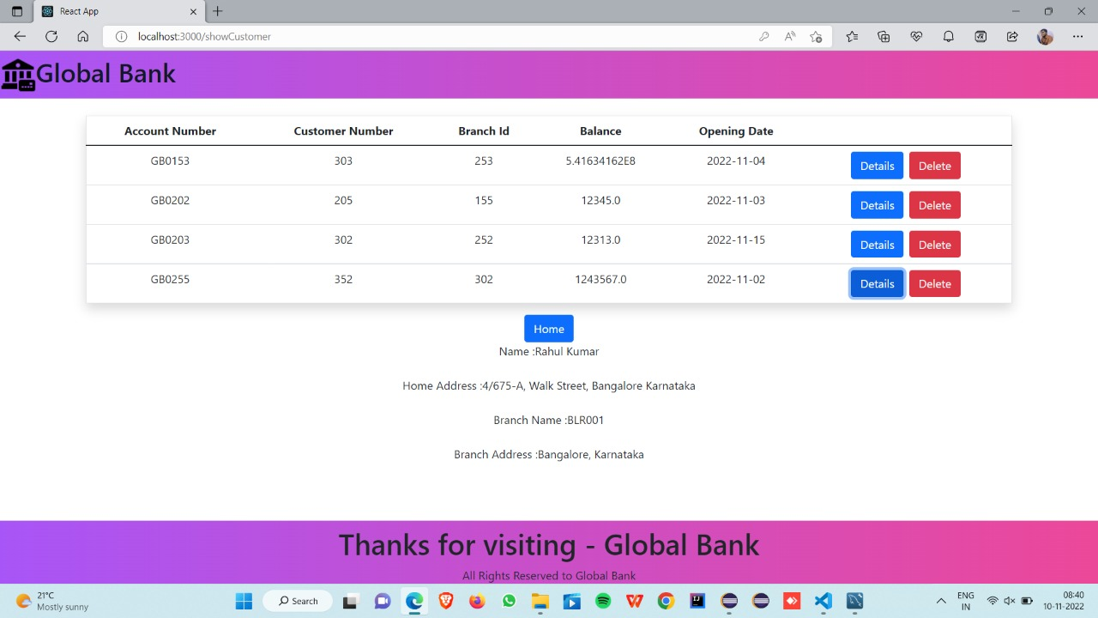
Display customer functionality

Slide 21
ADVANTAGES
Add customers
Manage customer accounts
Manage several branches and their details
Manage multiple accounts for a customer in and across branches
Auto-generation of account, customer, and branch identifiers
Admin authentication
User-friendly, seamless, hassle-free admin experience
APIs are unit tested to ensure reliable banking.

Slide 22
FUTURE SCOPE
Customer filtering and search operation.
Multi-admin authentication.
Sophisticated Frontend with greater admin functionalities
Indexed databases and normalizations for efficient database transactions.
Greater number of validations.
Extensive testing
DevOps

Slide 23
CONCLUSION
Seamlessly integrated front-end and backend technologies
Implemented REST APIs that communicate well with the database.
Unit tested REST APIs
Interactive and user-friendly website.

