Slide 1
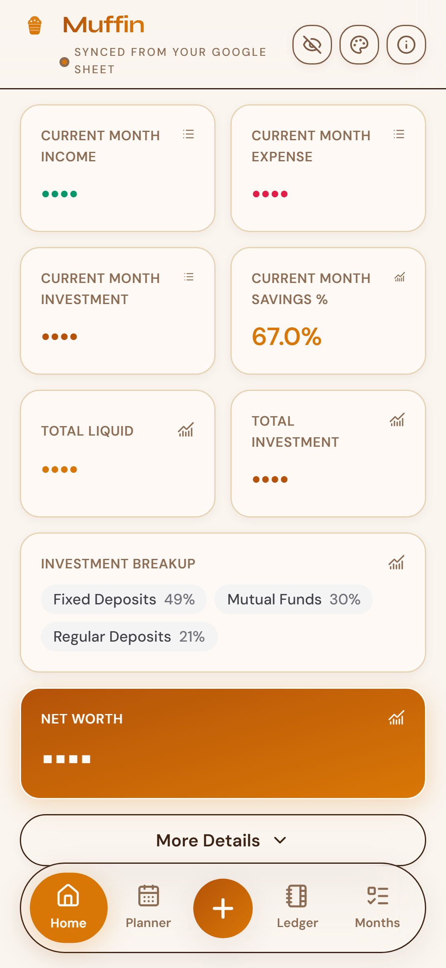
Muffin
Bake your money muffins.
A cozy personal finance PWA that turns your Google Sheet into a live phone dashboard — income, expenses, investments, PF, and net worth.
Product showcase · Amounts masked · Galaxy A55 frames

Slide 2
From spreadsheet to pocket
Keep the ledger you trust — enjoy the dashboard you deserve.
1
2
3
You already track in Sheets
Muffin reads & writes live
Phone-first clarity
Income, Expense, and Investment tabs stay human-editable.
OAuth-backed Netlify Functions sync securely — credentials never hit the browser.
KPIs, charts, ledger manage, planner scenarios, and six cozy themes.
Muffin · Cozy finance PWA
2 / 12

Slide 3
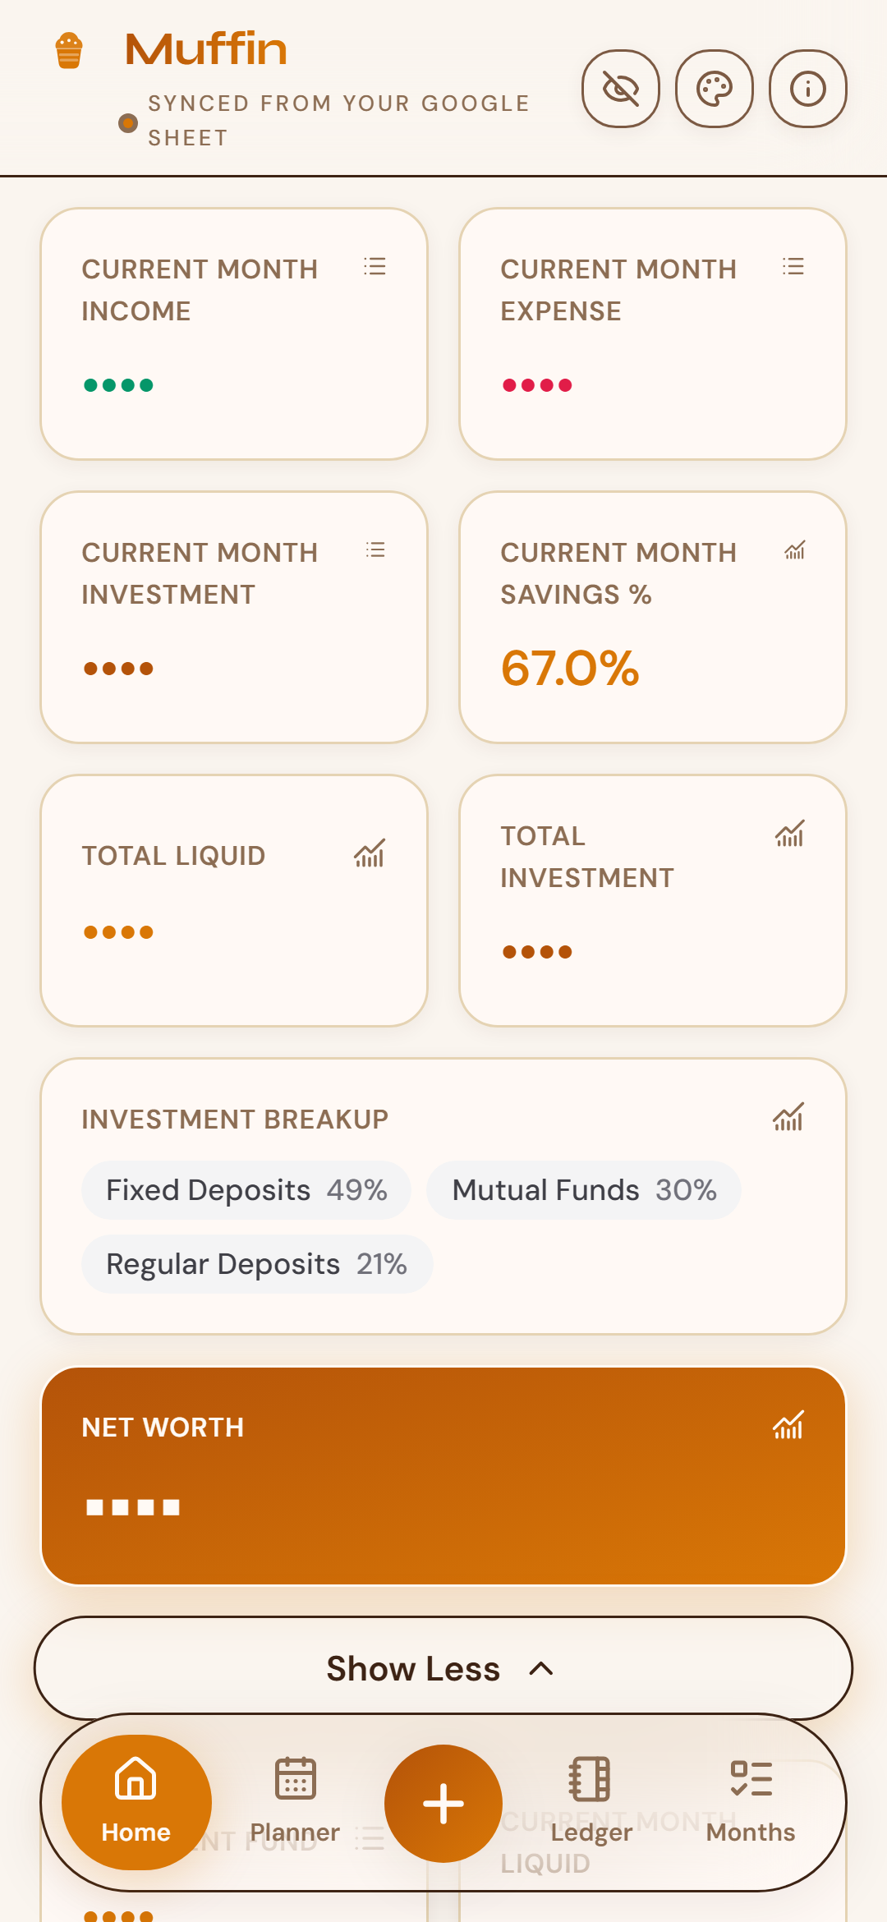
Home — your money at a glance
Masked amounts for sharing · tap any KPI to drill in.
On Home
Current-month income, spends, investments
Investment breakup chips + full pie
Net Worth hero card (theme accent)
Provident Fund under More Details
Growth & savings metrics
Home KPIs
More Details
Muffin · Cozy finance PWA
3 / 12

Slide 4
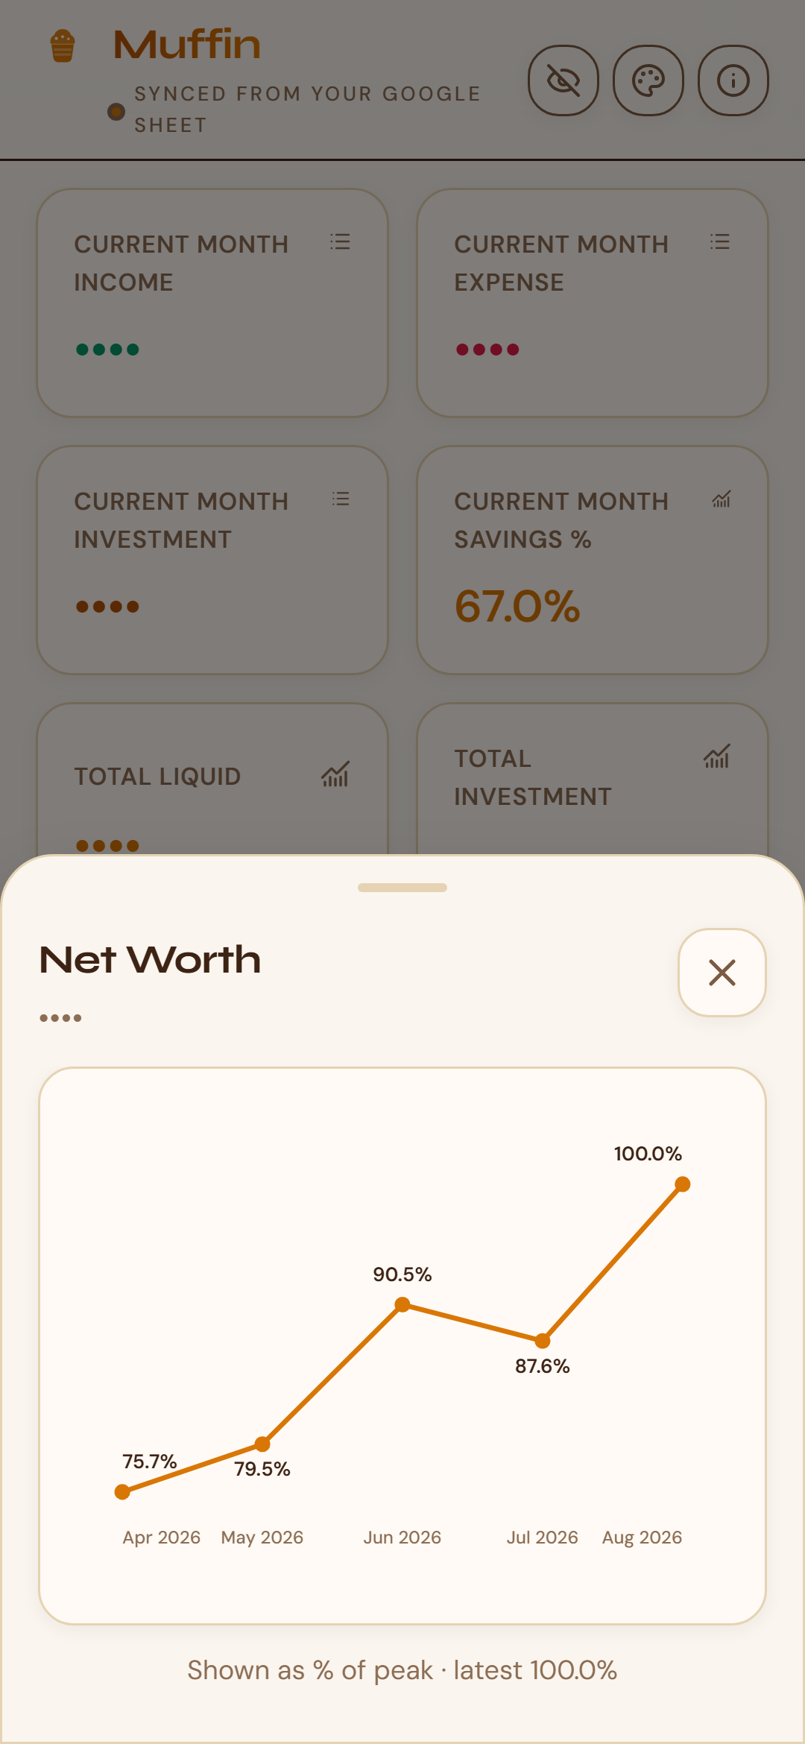
Drill-downs that feel native
Bottom sheets for charts and filtered lists — smooth enter & exit.
Chart modal kinds
Line — net worth, liquid, savings % trajectories
Pie — investment allocation (theme-aware colors)
List — this-month income / expense / investment / PF
Portaled above the nav · dim backdrop · spring motion
Muffin · Cozy finance PWA
4 / 12

Slide 5
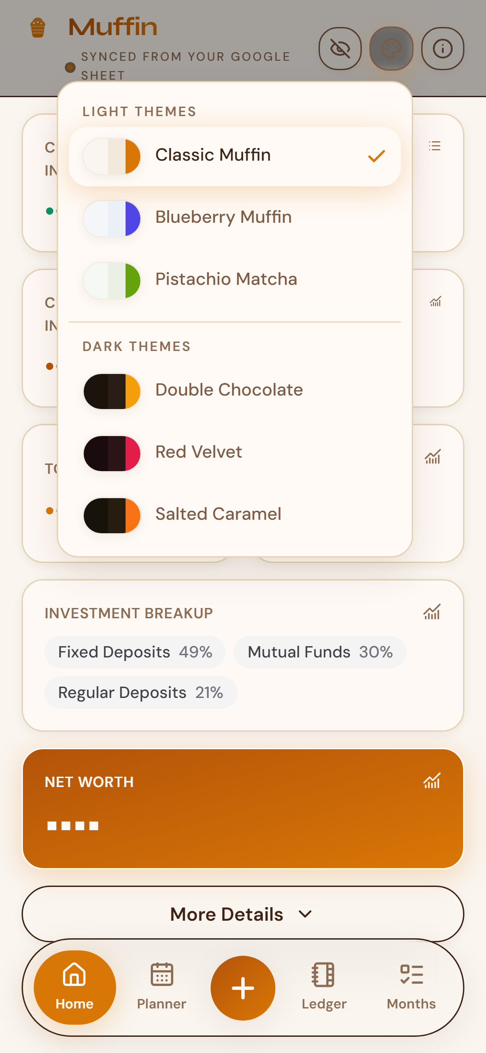
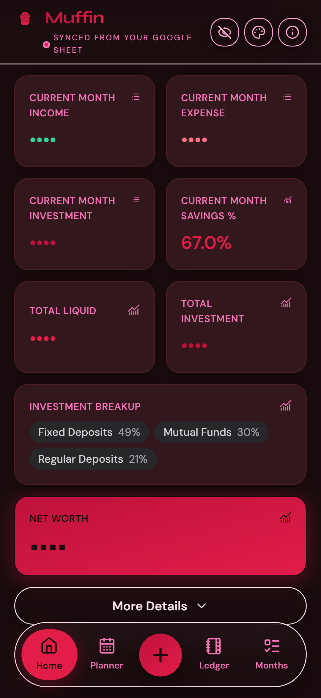
Six cozy muffin themes
3 light · 3 dark — persisted, FOUC-safe, charts included.
Classic
Blueberry
Pistachio
Chocolate
Velvet
Caramel
Theme picker
Red Velvet
Muffin · Cozy finance PWA
5 / 12

Slide 6
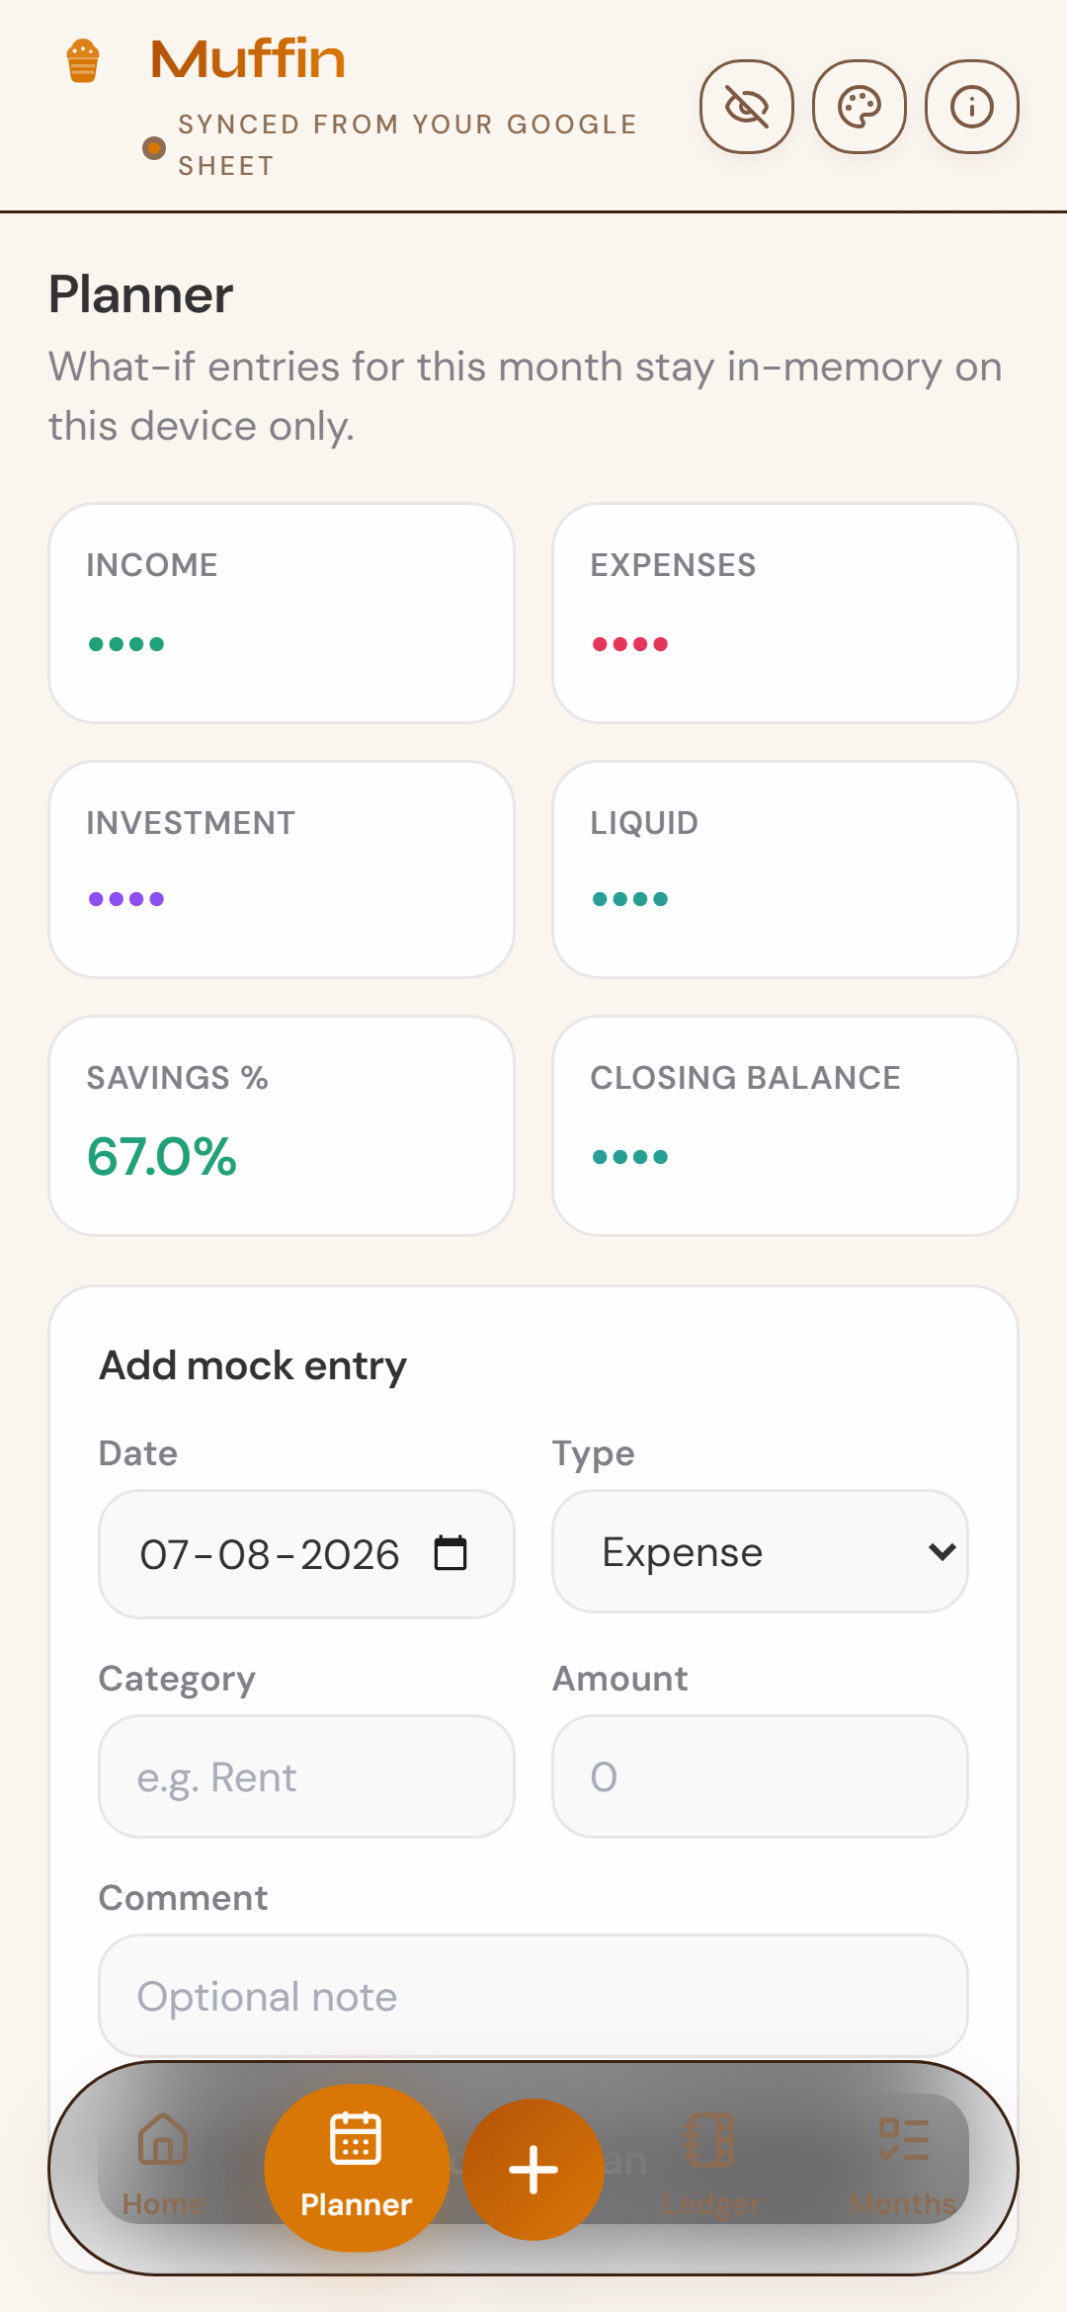
Planner — what-if without the sheet
Temporary scenarios stay on-device in localStorage.
Add provisional income, expense, or investment lines
See plan vs sheet for the current month
Never writes back to Google Sheets
Clear when you are done experimenting
Muffin · Cozy finance PWA
6 / 12

Slide 7
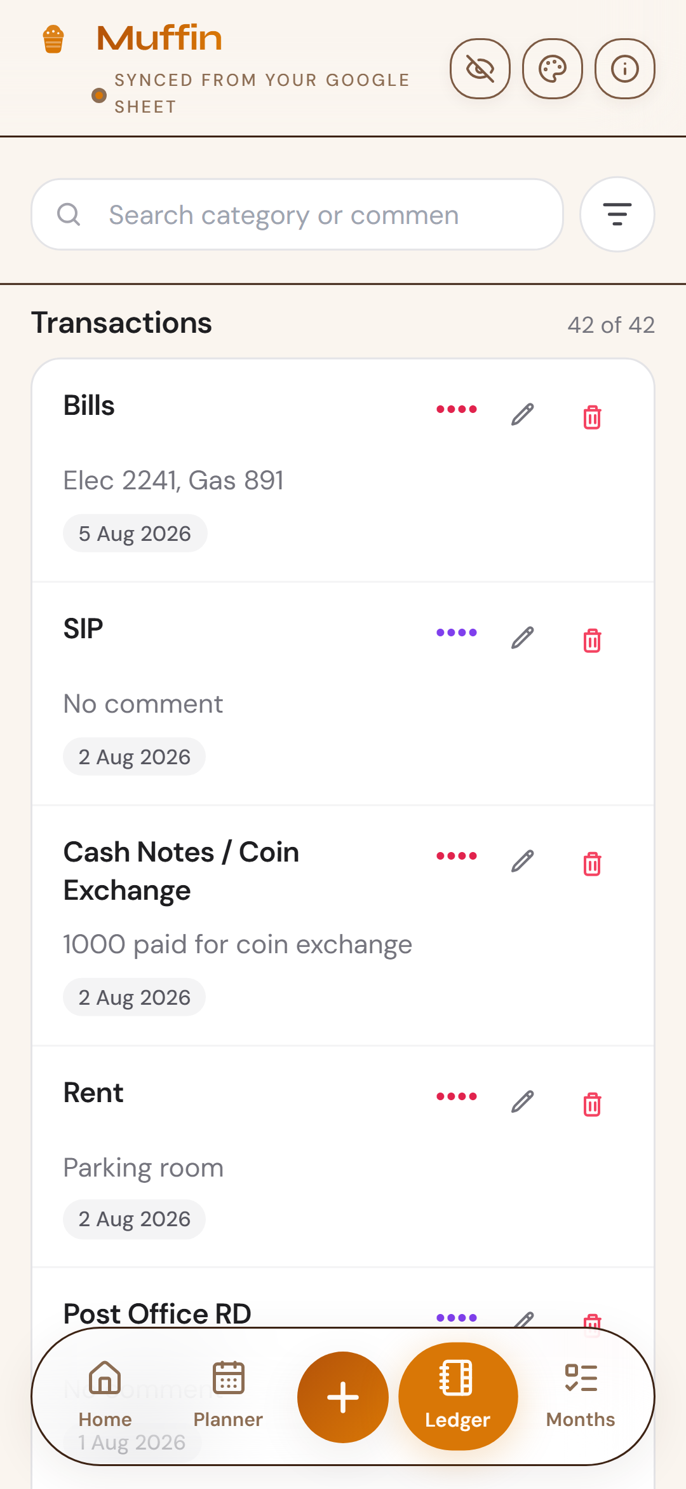
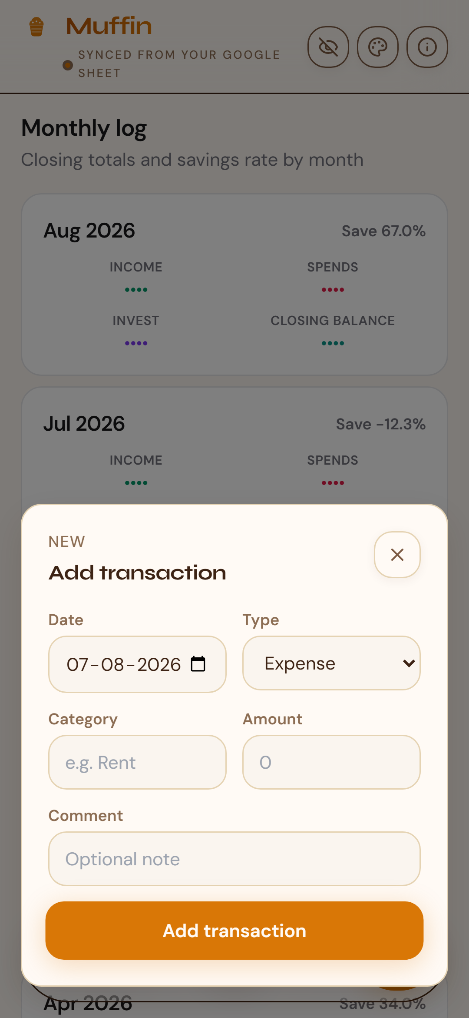
Ledger — search, filter, manage
Add / edit / delete write straight to your Google Sheet.
Full-text search
Type & date filters
Creatable Investment Type
PF labels carve out net worth
Add / edit modal
Muffin · Cozy finance PWA
7 / 12

Slide 8
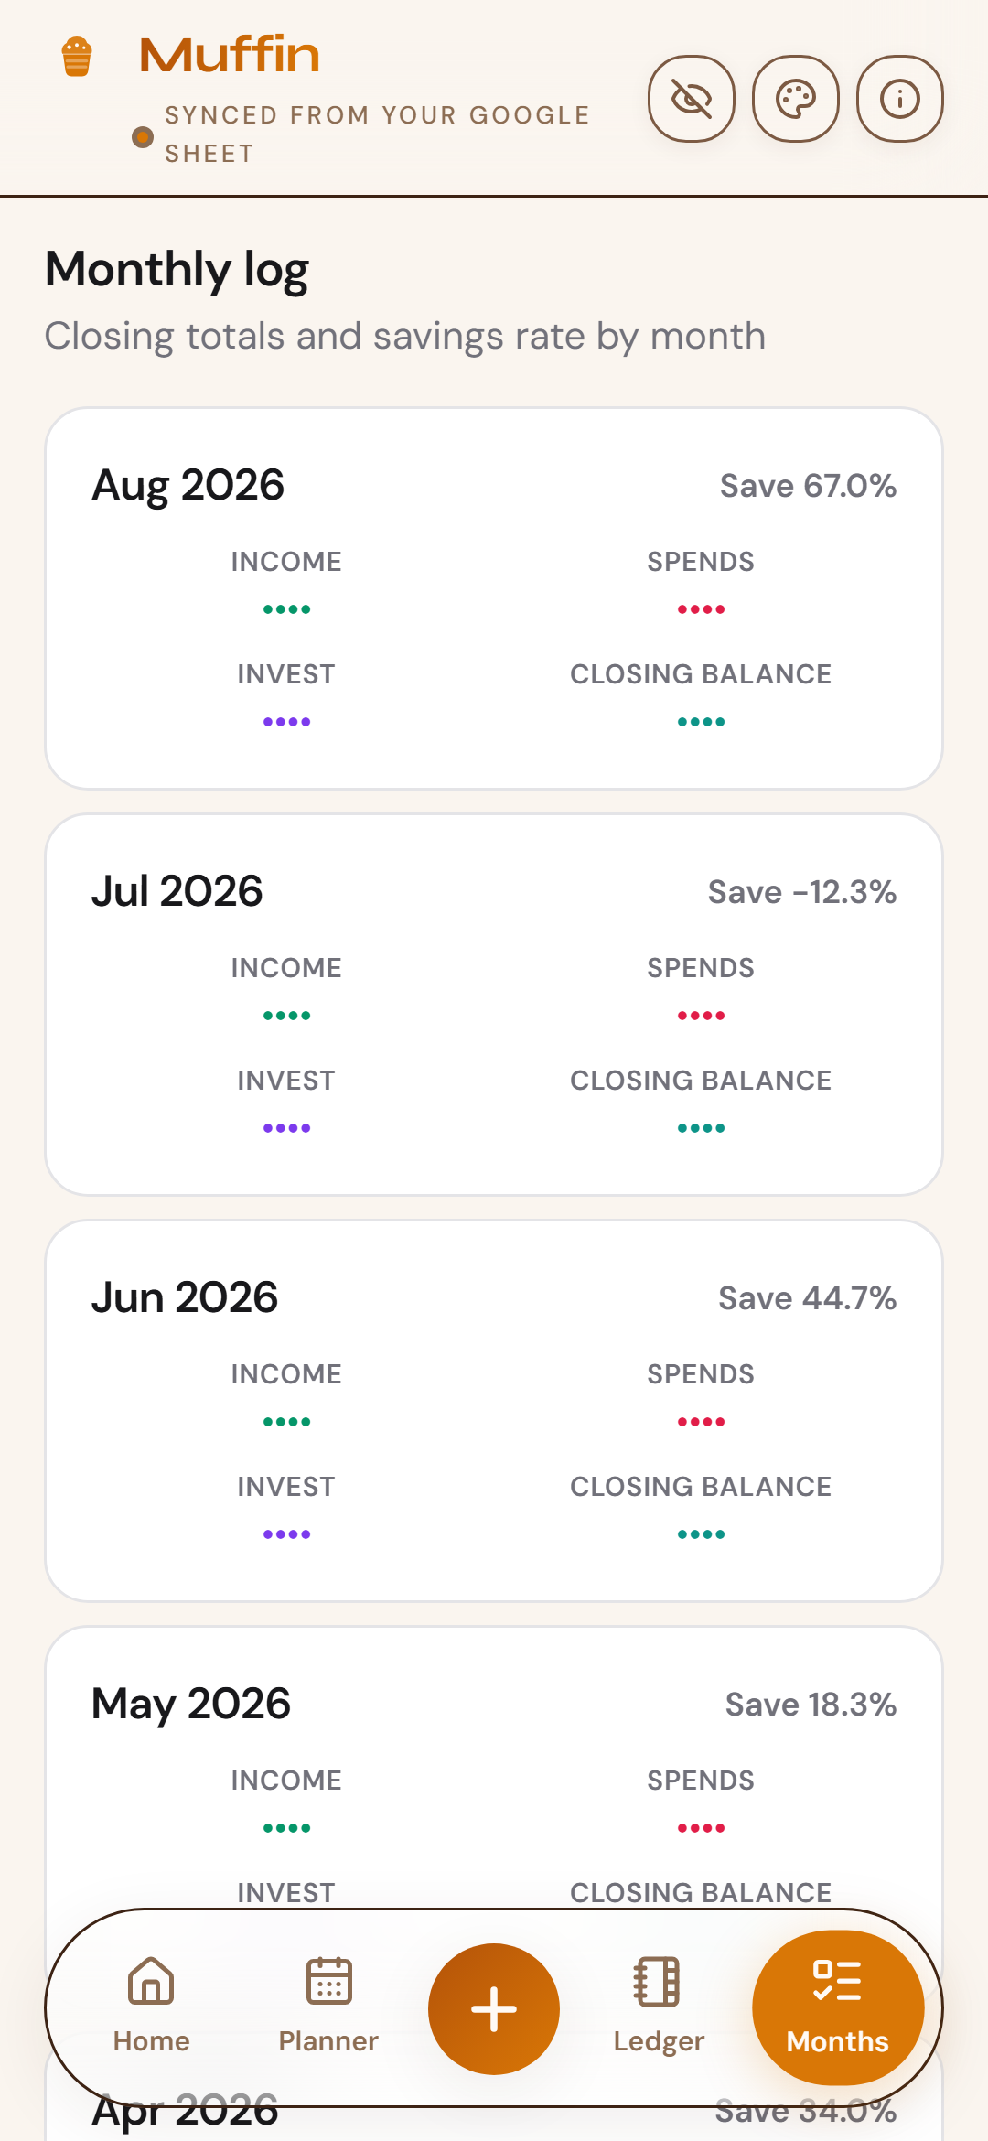
Monthly — history that stays readable
Per-month income, spends, investment, liquid, and savings %.
Why it matters
Spot seasonality, check savings discipline, and confirm investment cadence — without opening the spreadsheet.
Muffin · Cozy finance PWA
8 / 12

Slide 9
Privacy & polish
Feel soft. Stay private when you need to.
Amount masking
One tap hides figures as •••• — perfect for demos and shoulder-surfing.
Soft motion
Framer Motion springs, sliding tab pill, page fades, sheet enter/exit.
Tactile controls
Hover/tap scale, accent glow, cozy focus rings on inputs.
Glass chrome, solid sheets
Header/nav blur; modals stay crisp above the floating nav.
Muffin · Cozy finance PWA
9 / 12

Slide 10
Architecture
Thin, secure, sheet-native.
React PWA
(browser)
→
Netlify Function
transactions
→
Google Sheets
API + OAuth
Client never sees Google secrets. Metrics compute in the browser. Planner stays local. Theme & mask persist in localStorage.
Muffin · Cozy finance PWA
10 / 12

Slide 11
Stack
Lean runtime. Rich feel.
React 19
TypeScript
Vite 6
Tailwind CSS
UI
Types
Build
Tokens
Framer Motion
Lucide
react-select
Workbox PWA
Motion
Icons
Forms
Install
Netlify Functions
Google Sheets
Syne / DM Sans
OAuth 2.0
API
Data
Type
Auth
Muffin · Cozy finance PWA
11 / 12

Slide 12
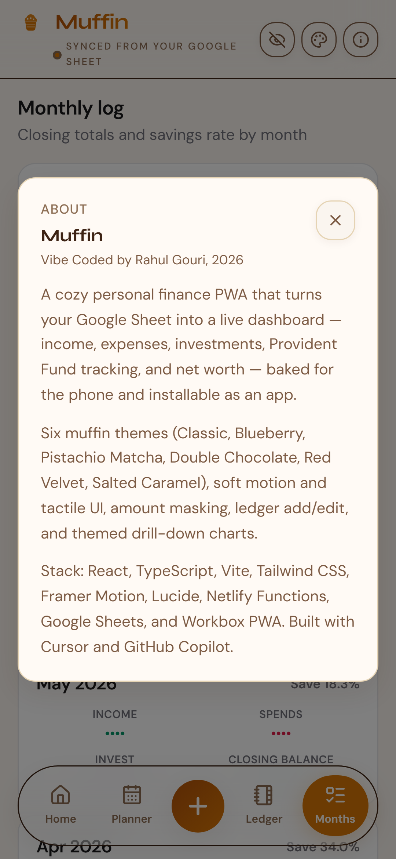
Muffin
Vibe Coded by Rahul Gouri, 2026
Install as a PWA on your phone. Keep the sheet. Enjoy the muffins.
Built with Cursor & GitHub Copilot.
Amounts in this deck are masked for privacy.

