Slide 1

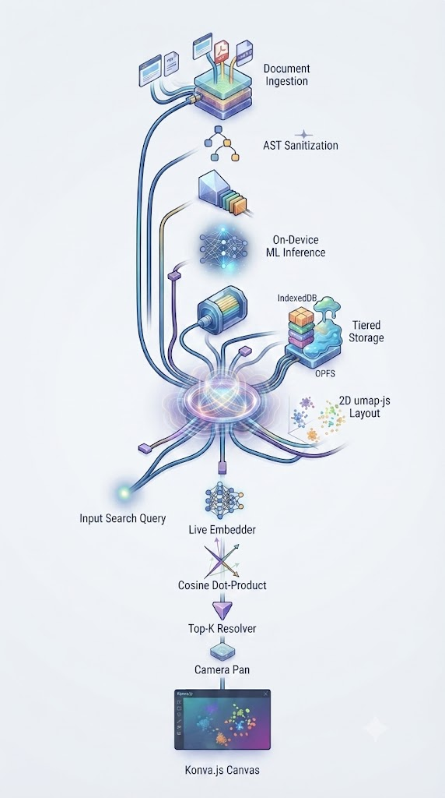

SOFTWARE ENGINEERING • UCS503
Spatial Memory & Local Web Search Canvas
“A browser extension that transforms tab management into an interactive 2D spatial canvas”
TEAM
Rahul Dadwal (1024160014)
Jyotsna Sachdeva (1024160133)
Bisman Singh Rai (1024160130)
Submitted to: Professor Jeelani Asif
Thapar Institute of Engineering & Technology

Slide 2

01 — INTRODUCTION
Introduction
Meridian: Latent Cartographer (our working name for the Spatial Canvas extension) turns your browser tabs into an interactive 2D map instead of a cramped strip of icons. It runs entirely on-device — a small WebAssembly AI model reads each page and quietly organises it for you, with nothing ever sent to a server.
384-d
on-device vector embeddings
Automatically captures active tabs, PDFs and notes in the background
Generates on-device semantic embeddings (Xenova/all-MiniLM-L6-v2)
Groups related pages into visual clusters you can pan, zoom and explore
100% local-first — your browsing history never leaves your machine
<20 ms
search-by-intent latency
60 FPS
smooth, pannable spatial canvas
Team: Rahul Dadwal (1024160014) • Jyotsna Sachdeva (1024160133) • Bisman Singh Rai (1024160130)
2

Slide 3
02 — MOTIVATION
Motivation
Every developer and researcher knows this feeling: forty tabs open, three PDFs, half-finished searches — and no memory of where anything was. Regular tab bars and bookmarks were never built for this kind of research.
TODAY
Tab bars show only tiny, clipped titles — spatial memory (“it was on the left, near the blue diagram”) is completely lost
Bookmark folders turn a living research trail into a flat, static list
Cloud “smart search” tools send browsing history to a server, adding latency, cost and privacy risk
Closing the laptop for the night shouldn’t mean losing a day of research context
Flat tabs — titles clipped, no memory of position
WITH SPATIAL CANVAS
“A zero-cost, local-first visual memory map lets you resume research with almost no friction — and total privacy.”
Clusters by meaning — search by intent, not keyword
Team: Rahul Dadwal (1024160014) • Jyotsna Sachdeva (1024160133) • Bisman Singh Rai (1024160130)
3

Slide 4
03 — PROBLEM STATEMENT
Problem Statement
Four recurring pain points, straight from how developers and researchers actually work:
1
Fragmentation & Tab Overload
2
Semantic Drift & Shallow Indexing
Information is scattered across flat, linear tab bars where titles and context get clipped.
Bookmarks store static URLs; simple text search misses code snippets, tables and buried details.
3
Latency & Privacy Risk
4
Memory Inefficiency
Cloud-based “smart search” adds network lag, API cost, and exposes browsing history externally.
Unmanaged screenshots and raw page snapshots quietly exhaust browser memory and storage.
Team: Rahul Dadwal (1024160014) • Jyotsna Sachdeva (1024160133) • Bisman Singh Rai (1024160130)
4

Slide 5
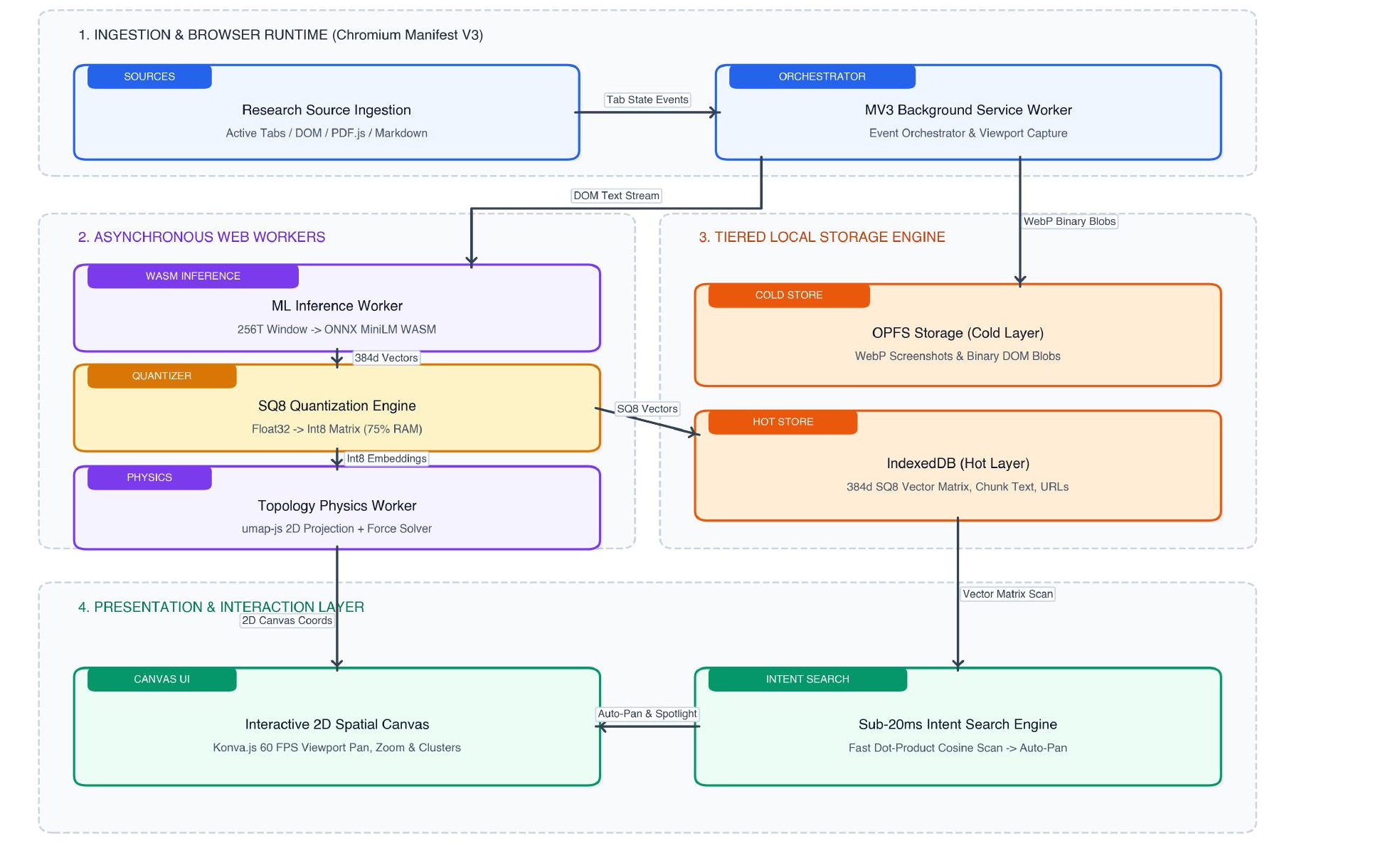
04 — OUR SOLUTION · 1 OF 3
System Architecture
A decoupled, client-side Chromium extension (Manifest V3) — nothing ever leaves the device.
Multi-source ingestion
Tabs, local PDFs (pdf.js), Markdown notes & code
Local-first AI engine
On-device MiniLM-L6-v2 via ONNX/WASM workers
Interactive 2D canvas
Konva.js force-directed clusters at 60 FPS
Tiered storage
IndexedDB (hot) + OPFS (cold), SQ8-quantized
Meridian's end-to-end architecture — decoupled MV3 ingestion, async ML workers, tiered storage and the canvas UI. (Source: team proposal, Fig. 3)
Team: Rahul Dadwal (1024160014) • Jyotsna Sachdeva (1024160133) • Bisman Singh Rai (1024160130)
5

Slide 6
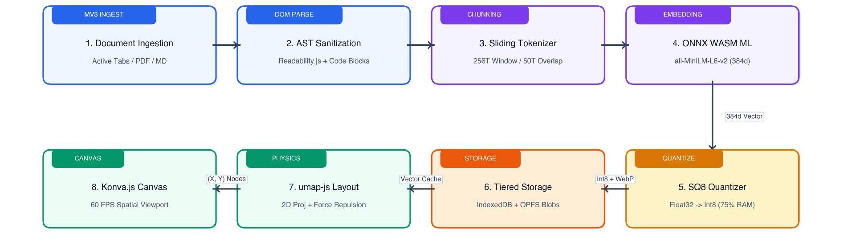
05 — OUR SOLUTION · 2 OF 3
Capture & Embedding Pipeline
Every tab is pushed through an eight-stage pipeline — from raw DOM to a point on the canvas:
Squarish pipeline architecture — DOM sanitization, sliding-window chunking, on-device WASM embedding, SQ8 quantization and 60 FPS canvas projection. (Source: team proposal, Fig. 1)
256-token window / 50-token overlap
384-d embeddings
SQ8 → ~75% smaller
60 FPS force layout
Team: Rahul Dadwal (1024160014) • Jyotsna Sachdeva (1024160133) • Bisman Singh Rai (1024160130)
6

Slide 7
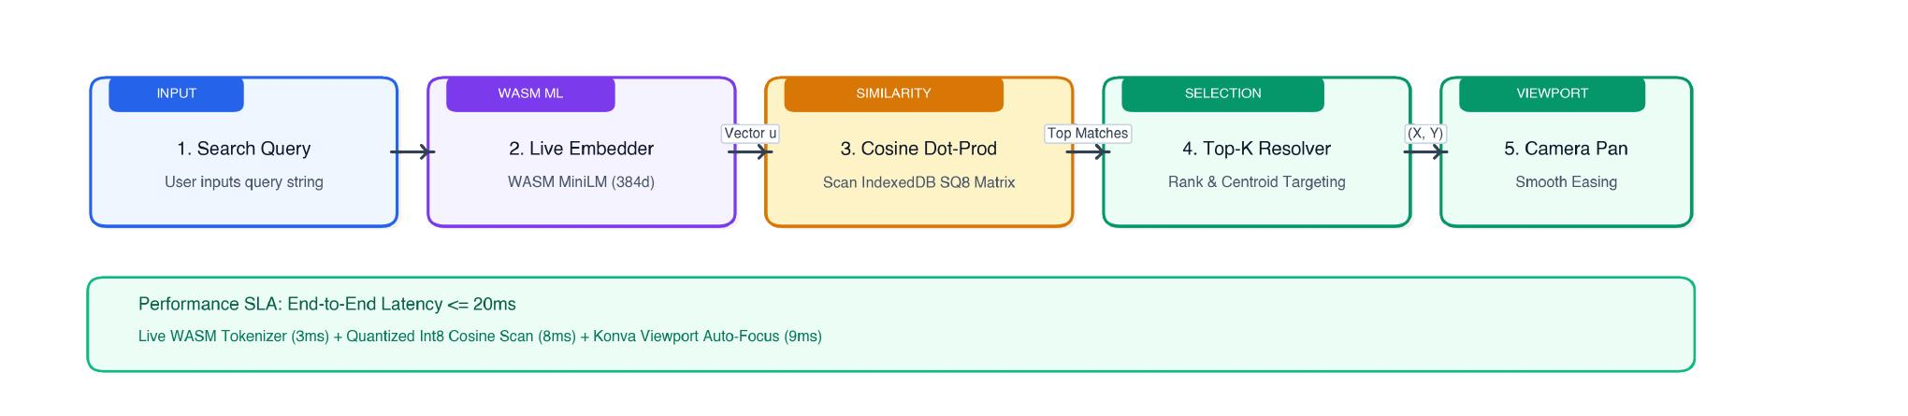
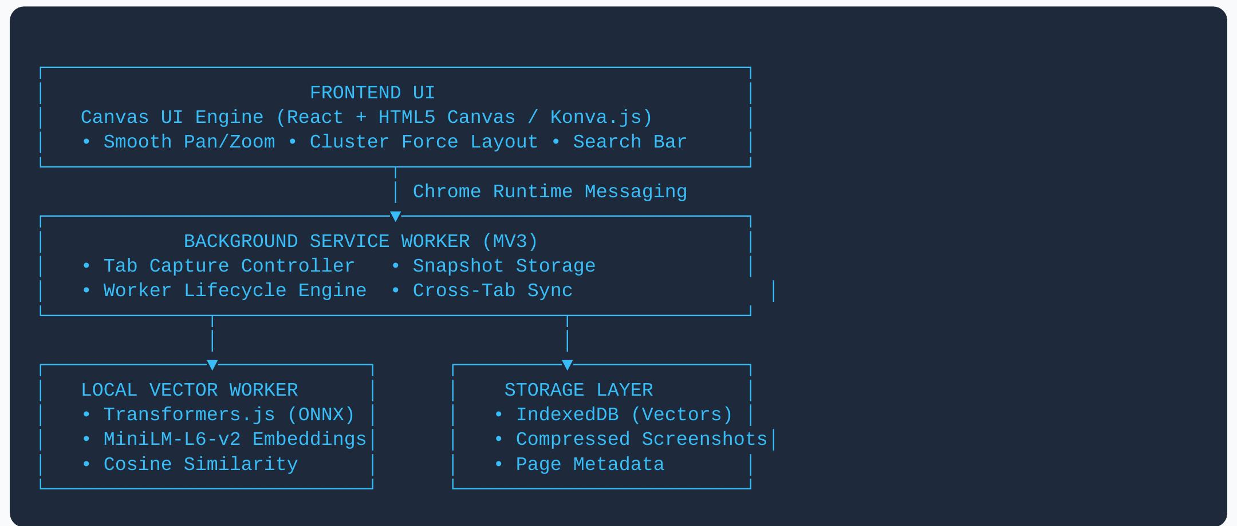
06 — OUR SOLUTION · 3 OF 3
Search, Storage & Delivery
Real-time search retrieval — live WASM embedding, SQ8 cosine scoring and smooth viewport easing, end to end in ≤20ms. (Source: team proposal, Fig. 2)
BUILT WITH
React + Vite
Konva.js
Transformers.js (WASM)
IndexedDB + OPFS
Manifest V3
One click exports the whole canvas as a single, shareable .html file — vectors and thumbnails included, no backend required.
System at a glance — Spatial Canvas PRD architecture diagram
Team: Rahul Dadwal (1024160014) • Jyotsna Sachdeva (1024160133) • Bisman Singh Rai (1024160130)
7

