Slide 1
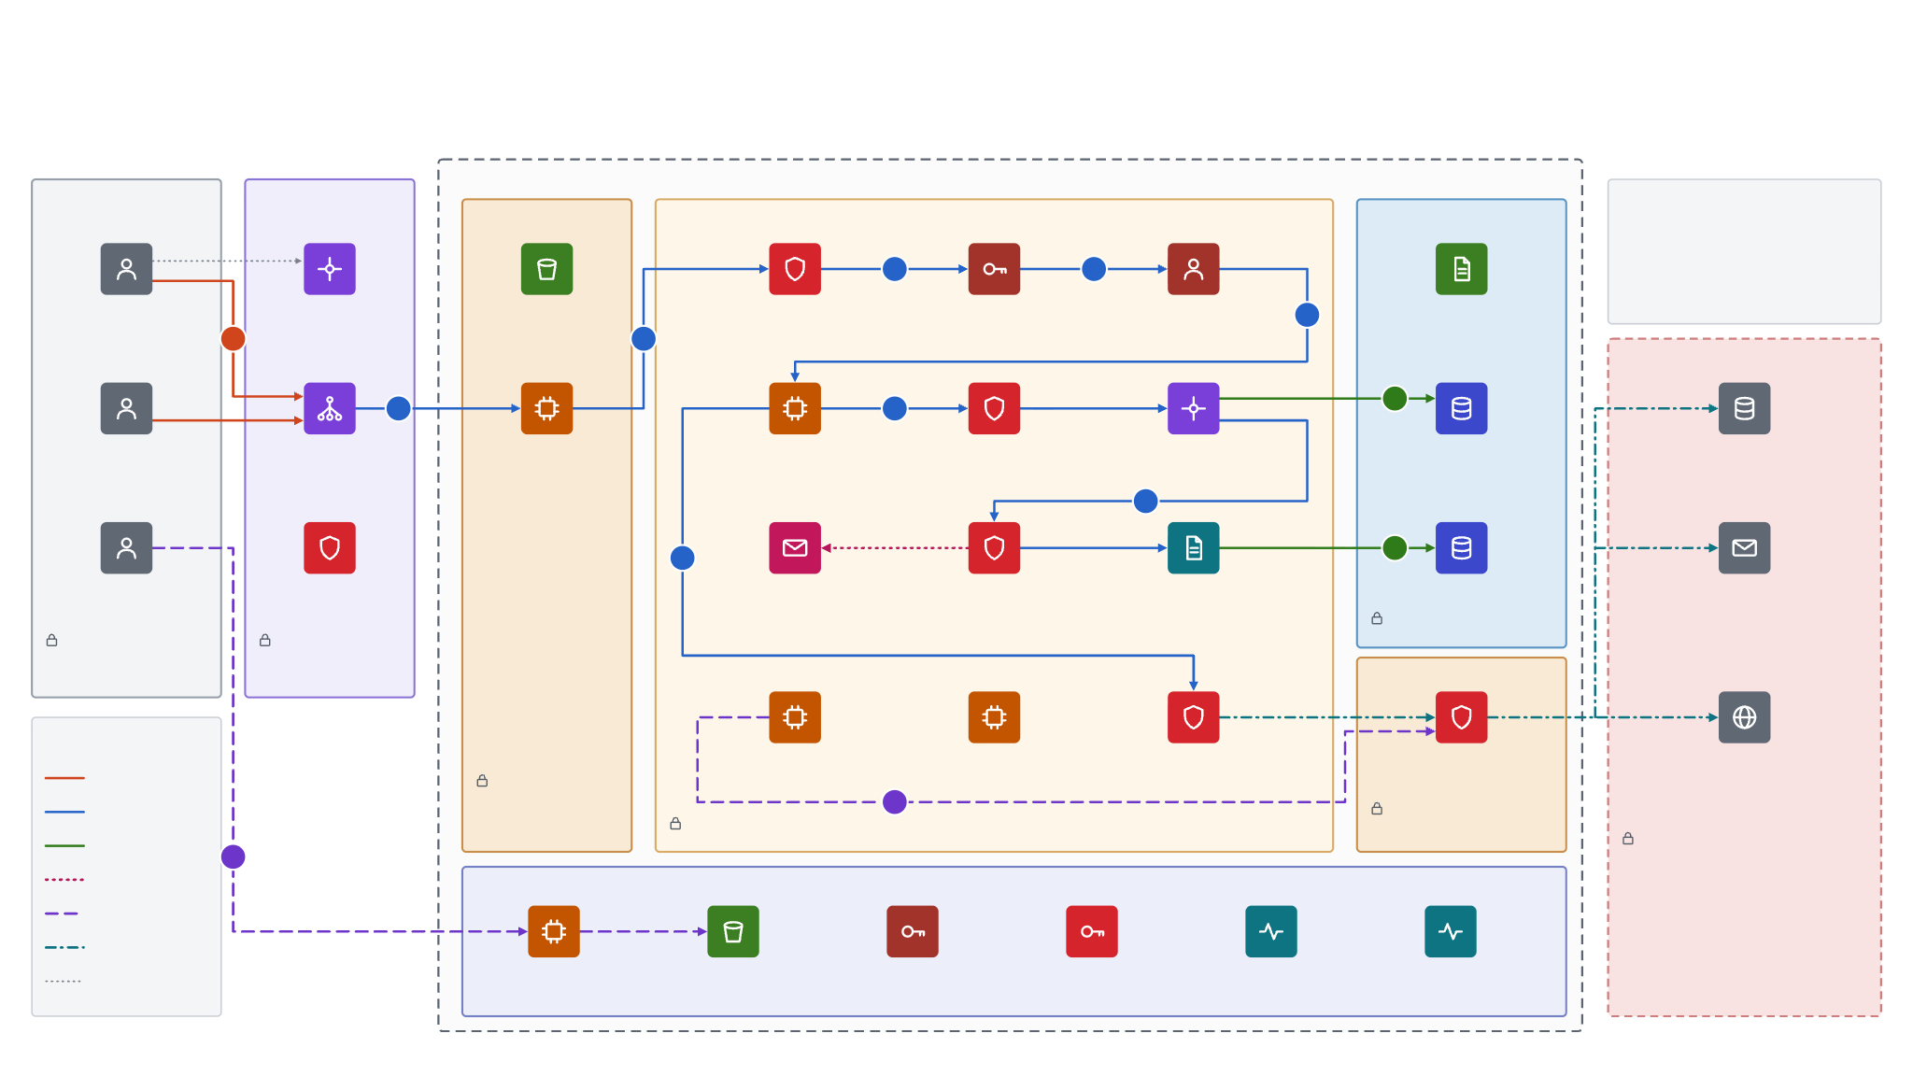
High-Level Security Design (Including Traffic Flow) — End to End
OpPal on Google Cloud Run · component level · “(target)” = recommended hardening, not in today’s deploy scripts · project and region names are sample
Google Cloud project · us-central1 (sample)
Clients
Google edge
oppal-frontend
oppal-bck · Cloud Run · FastAPI · 1 instance · non-root user
Data tier
Says no
No PHI in LLM prompts
No write-back on one signature
No SQL that widens LOB scope
No secrets baked into images
HTTPS /api
4
5
Analysts
(LOB-scoped)
Cloud DNS
React SPA
(static assets)
Security
middleware
Token auth
(HMAC-SHA256)
RBAC + ABAC
LOB scope
6
Context Brain
(Markdown)
1
3
Third parties
read-only SQL
9
2
8
Compliance
officers ×2
HTTPS load
balancer (target)
nginx reverse
proxy
Orchestrator
agents
SQL validation
gates
MCP data
service
Warehouse
(SQLite)
Enterprise warehouses
Snowflake · BigQuery
10
< 0.85 withheld
≥ 0.85 answer
hash append
11
7
Platform admin
(gcloud)
Cloud Armor WAF
(target)
Review queue
Trust gate
≥ 0.85
Provenance
receipt
Audit ledger
Write-back systems
Facets · QNXT · webhook
No network port; read via MCP only
Untrusted · browser holds an 8 h signed token
TLS 1.2+ cert · OWASP rules · per-IP limits
Egress
PHI-scrubbed
Traffic legend
Public
LB-only ingress · real IP from XFF · TLS to API
Action engine
maker-checker
Simulation
sandbox
PHI Guard
(scrub + tokenise)
Egress firewall
+ NAT (target)
LLM providers
Anthropic · OpenAI
Gemini · Azure
Inspected
A
443 only · allow-listed hosts
Deny by default: bearer token on every /api route · 120 req / 60 s per client · RBAC + ABAC per route · every refusal written to the ledger
Only PHI-scrubbed text reaches an LLM · write-back is dry-run by default
Data
B
Async
Shared security & governance services
Admin / deploy
Egress
Control plane
Cloud Build
Artifact
Registry
IAM service
accounts
Secret Manager
(target)
Cloud Logging
Cloud
Monitoring
Notes:
Read it left to right, outermost trust boundary first: untrusted clients, Google's edge, the GCP project, then the two Cloud Run services, the data tier and controlled egress. Red tiles are controls; line style is the trust level (legend bottom-left). Numbers 1 to 11 follow one analyst question end to end; A is an approved write-back; B is a deployment. The next slide lists every step with its control. What ships today vs. target: the repo's Cloud Run commands deploy oppal-frontend and oppal-bck with --allow-unauthenticated, TLS terminated by Google's front end, and no load balancer or Cloud Armor (the nginx config itself recommends an external HTTPS LB plus Cloud Armor). The token-signing secret and settings.json (LLM API key) live on the instance's in-memory disk, which is why the backend runs at max-instances 1. Items marked (target) close those gaps: LB + Armor in front, run.app ingress restricted to the LB, secrets in Secret Manager, and an egress allow-list. Controls that exist in code today: deny-by-default bearer tokens (HMAC-SHA256, 8 h), PBKDF2 password hashing, 120 req/60 s rate limit, RBAC/ABAC with LOB scoping, nosniff / frame DENY / no-referrer / no-store headers, PHI Guard wrapping every LLM provider, read-only scope-enforced MCP execute(), 0.85 trust gate, maker-checker with two compliance officers, a dry-run write-back adapter, and the SHA-256 hash-chained audit ledger.

Slide 2
Request path, step by step — the control at each hop
# | Step | Control enforced
1 | Analyst opens OpPal over HTTPS | DNS → Google HTTPS load balancer · TLS 1.2+ managed cert (target)
2 | LB forwards to the frontend | Cloud Armor WAF + per-IP limits; run.app ingress = LB only (target)
3 | nginx proxies /api/* to backend | TLS with SNI · real client IP from X-Forwarded-For · 50 MB body cap
4 | Security middleware admits call | 120 req / 60 s per client · HMAC-SHA256 bearer token (8 h) · deny by default
5 | Role and LOB scope resolved | RBAC per route · ABAC LOB filter · every refusal written to the ledger
6 | Orchestrator grounds question | Graph-RAG over the governed Context Brain; out-of-scope LOB refused
7 | Prompt goes to the chosen LLM | PHI Guard tokenises PHI/PII first · egress 443 to allow-listed hosts
8 | Generated SQL is validated | Read-only + scope gates; rejected LLM SQL falls back to a governed template
9 | MCP data service runs it | execute() is final: scope always injected, no adapter can bypass it
10 | Answer is trust-scored | Below 0.85 the SQL is withheld and the question goes to the review queue
11 | Every step is hashed | Provenance receipt appended to the SHA-256 chained audit ledger
A | Approved action written back | Maker-checker by two compliance officers · dry-run adapter by default
B | Platform admin deploys | Cloud Build → Artifact Registry → Cloud Run under least-privilege accounts
Notes:
One row per numbered badge on the previous slide. Rows marked (target) are recommended hardening for production; everything else is enforced in the OpPal code today. The response travels back along the same TLS path in reverse.

