Slide 1

FMS
Team 4:
MURALI KRISHNA SAI CHUKKA & 09
RUPESH SAI RAM DODDALA & 10
KAVIN KUMAR ARUMUGAM & 63
RAHUL REDDY YERVA & 59
TEJASWI AYYADAPU & 03

Slide 2
Technologies & Packages
MEAN stack for web.
Bcrypt js
Mongoose
passport-jwt
angular2-toaster
ngx-qrcode2
underscore js
Ionic 3 and Cordova for mobile.

Slide 3
Modules delivered
Login. (Rahul)
User. (Rupesh)
User Group. (Kavin)
Reasons. (Rahul)
Area. (Kavin)
Line. (Rupesh)
Machine. (Murali)
Machine Group. (Murali)

Slide 4
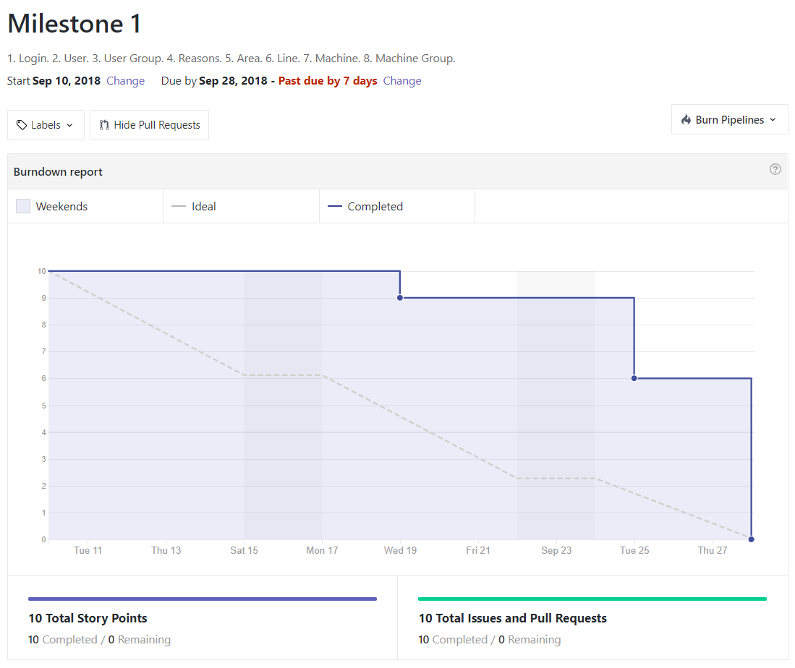
Burndown chart

Slide 5
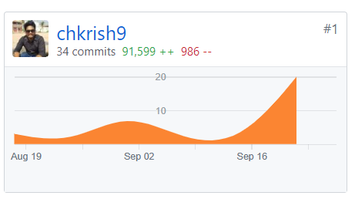
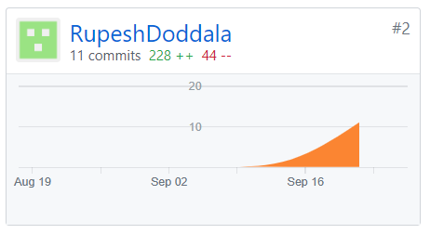
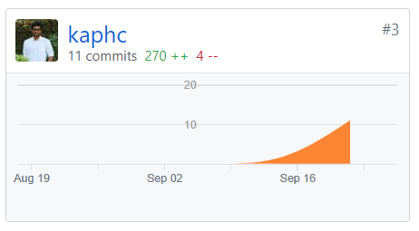
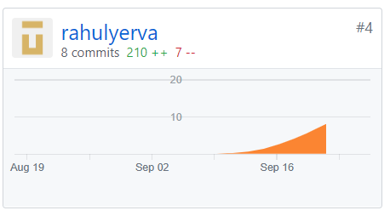
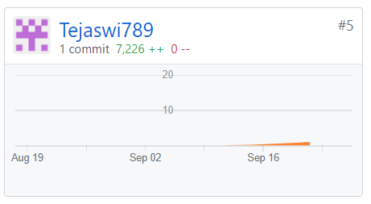
Contribution

Slide 6
DEMO

Slide 7
Questions ?

Slide 8
Thank you.

