Slide 1
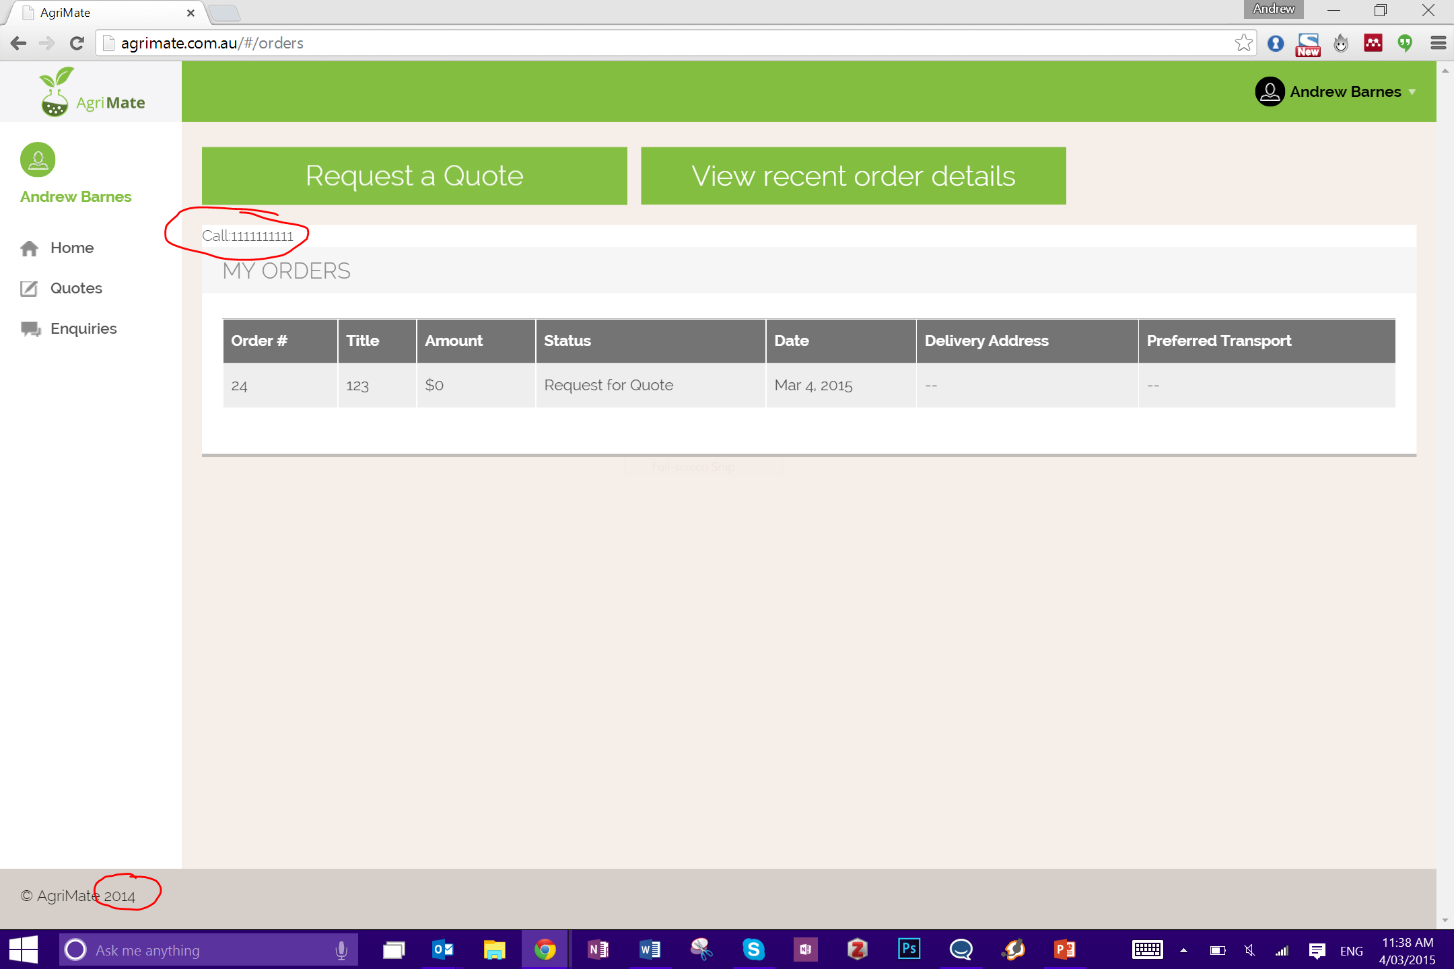
Ensure this shows accurate value
Delete
Open Order
Change ‘Title’ to ‘Order Name’
How does user change this / enter this?
Need new button from this page to go to detail page.
Remove this column
Change to 2015

Slide 2
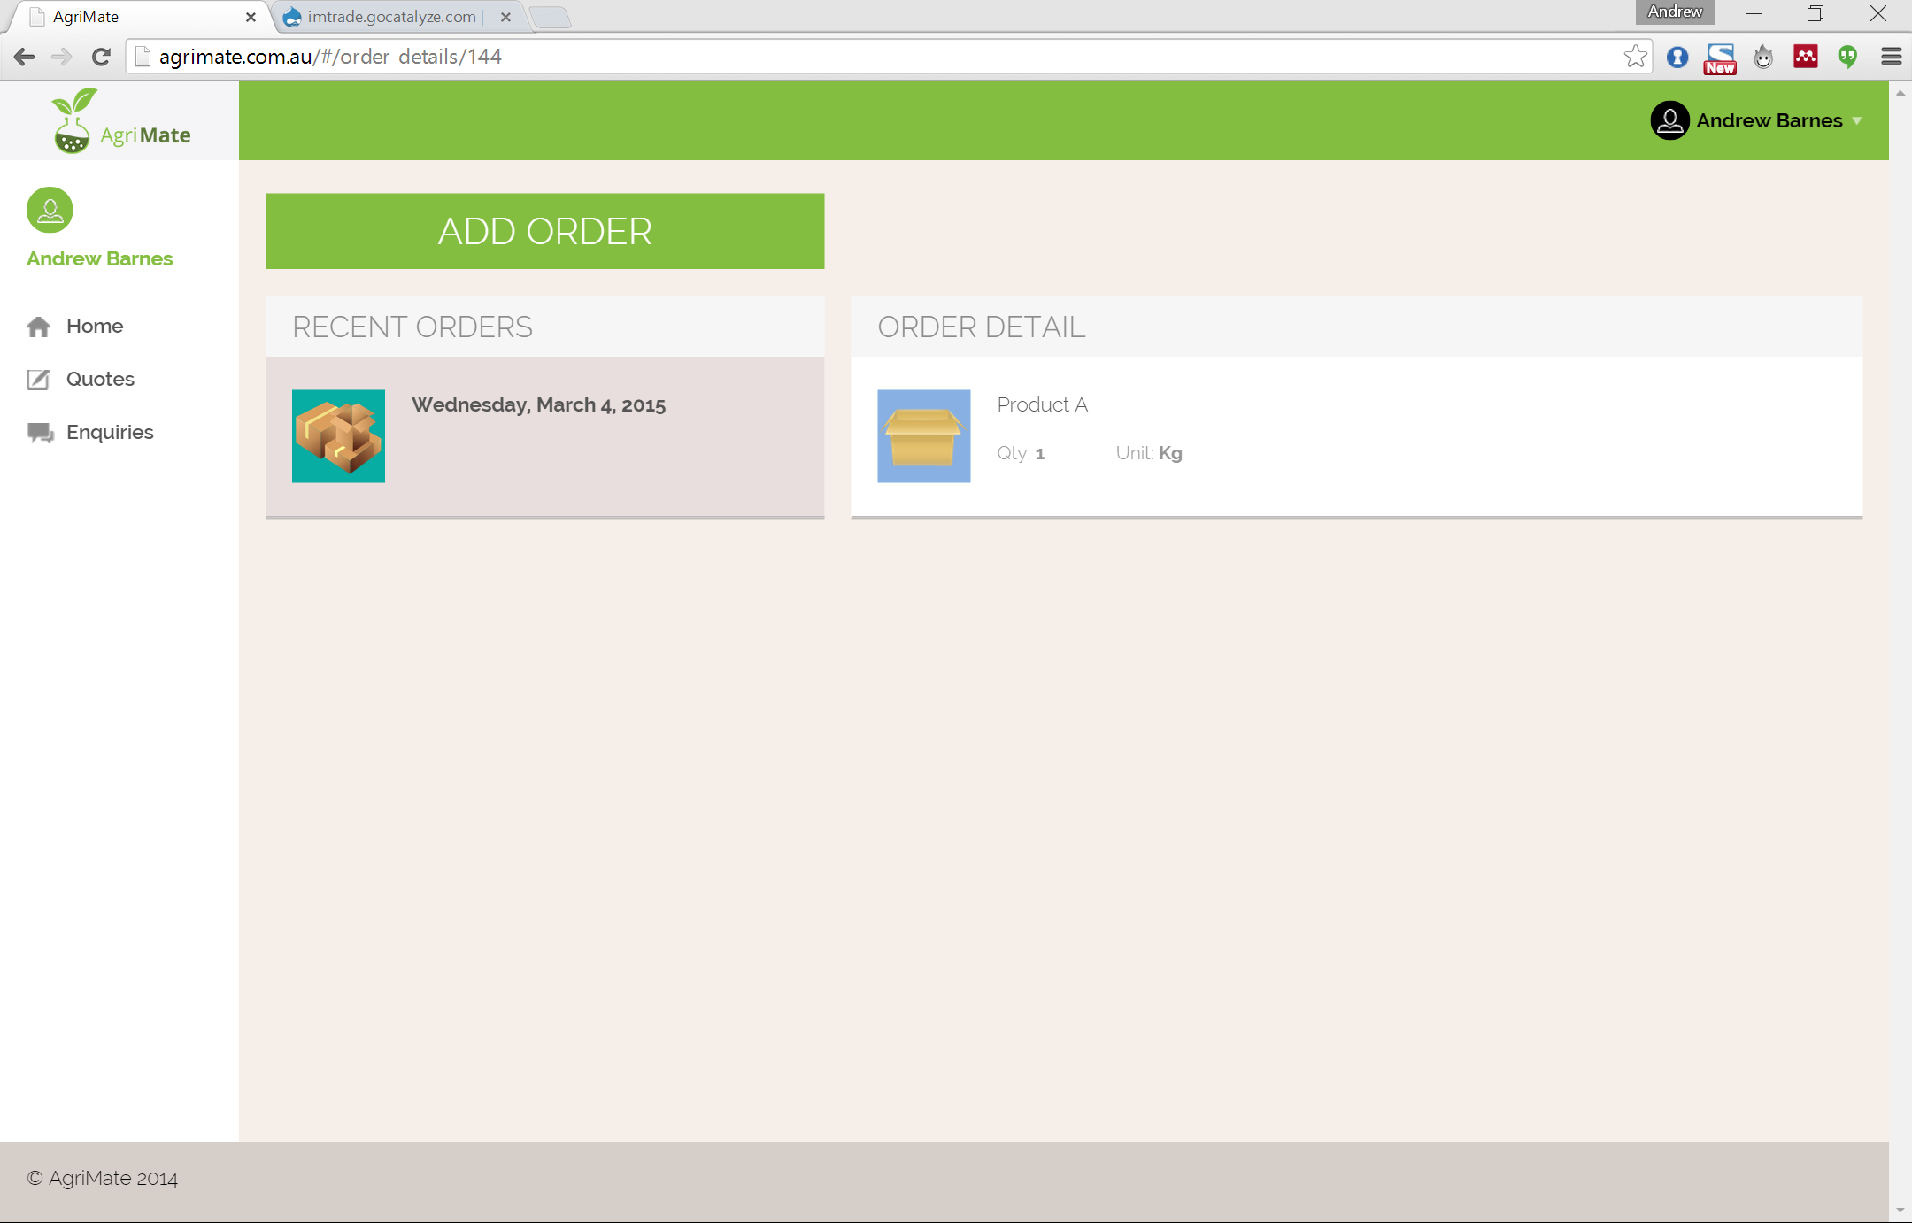
Quoted: $XYZ
Confirm
Cancel

Slide 3
Field = quoted amount
Quoted: $XYZ
Accept
Reject
Add ‘Order Name’ in here
Update OrderItem.Status

Slide 4
Quoted: $XYZ
Confirmed
Once entered the user cannot update it

