Slide 1
Title of the Paper
CECS 000: Course Name​
Spring 20223
Group #: Students
Student 1
Student 2
…
Student n
​
Instructor: Professor Mahshid Fardadi

Slide 2
Agenda
Motivation
Existing work
Proposed solution
Contribution
Conclusion

Slide 3
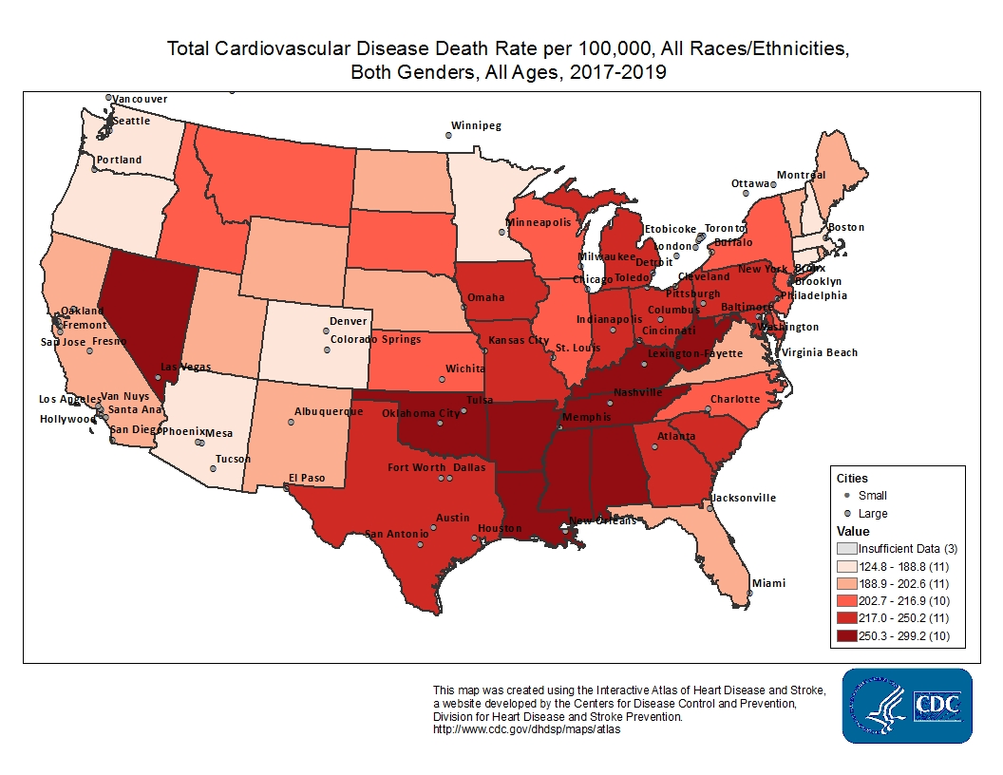
Introduction
Cardiovascular diseases (CVDs) are the leading cause of death globally.
17.9 million death (2019)
32% of all global deaths.
Important to detect CVD early detection – need of the hour
Risk stratification
Notes:
CDC data
death
Early detection . (fixing).
ML based soltions.
1 Minute

Slide 4
Motivation
Can we trust Machine Learning based solution?
Challenges
Out-of-Distribution Generalization
Incorrect Feature Attribution
High-Risk Decision Making
Can we have reliable uncertainty quantification
(confidence) in these predictions?
Notes:
Example:
1. IBM’s “Watson for Oncology” program²⁸ was suspended after an investment of $62 million, allegedly owing to problematic clinical recommendations that resulted in poor acceptance by clinicians.
2. Google’s machine-learned initiative to detect diabetic retinopathy²⁹ struggled when it encountered “real-world” images in clinics in Thailand that were of lower quality than those in its training set, causing considerable frustration to both patients and staff.
How good is your prediction ˆy?
How confident are you that the prediction ˆy for a new object is the correct label?
If the label y is a number, how close do you think the prediction ˆy is to y?
Can we allow a user to specify a confidence level or error rate so that a method cannot perform worse than the predefined level or rate before prediction
The usual prediction goal: we want new predictions to perform as well as past predictions
One possible goal can be to provide confidence/uncertainty level for all possible outcomes.

Slide 5
Existing Approach
Start
Performance measure | Traditional algorithm | Goal
Accuracy | Maximize | Controlled by confidence level
Efficiency | Fixed | Maximize
Problem statement in Health Care (CVD)
Decision for solution approach
Statistical approach
Deep Learning
Performance metrics
Inference
Decision Making and Action : Human intervention
Fig 1: Existing approach to solve machine learning based problem.
Stop
Notes:
Here, we consider all the existing approaches and method used for statistical and deep learning.
Our prime focus is designing a method which will contribute to Inference and decision making by HUMAN.
Almost all the algorithm is going to consider the accuracy as a metrics for prediction.
Let’s try to see this way in figure.
SLT: allows us to estimate with respect to some confidence level the upper bound on the probability of error.
- Bounds produced may depend on the VC-dimension of a family of algorithms or other numbers that are difficult to attain for methods used in practice.
The bounds usually become informative when the size of the training set is large.
Traditional statistical methods can be used to compute confidence intervals
Small sample size means the confidence intervals are often too broad to be useful
Bayesian methods need strong underlying assumptions

Slide 6
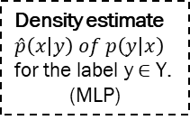
Proposed Solution
Start
Input dataset
dataset (CVD)
Validated i.i.d and Exchangeability?
YES
Exp1 = 0; Exp2 = 1
NO
SHAPly feature selection
Density estimate
$\hat{p}\left(x | y\right) of p\left(y | x\right)$
for the label y ∈ Y.
(MLP)
Deep Learning Classifier
Select favorite algorithm
Algorithm agnostic
Feature extraction
Design non-conformity score
Design NCF for MLP
Exp1 = { }; Exp2 = { }
Representation Vector Recovery
Perform hypothesis testing and calculate p-values
Output set-prediction along with Confidence and Credibility
Translate Confidence to
Risk scores
Fig 3. Architecture of deep learning models.
Stop
Fig 2: Framework for conformal prediction.

Slide 7
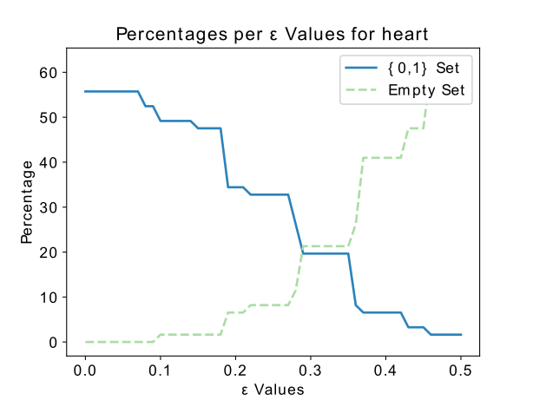
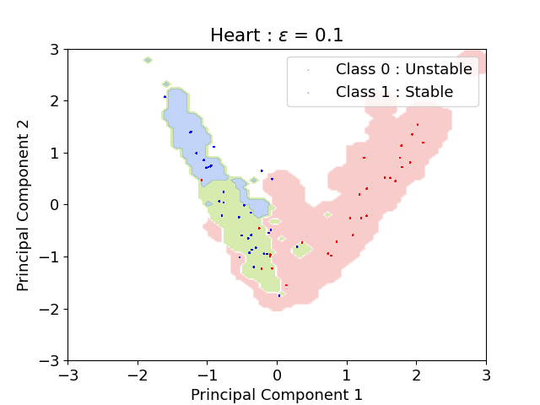
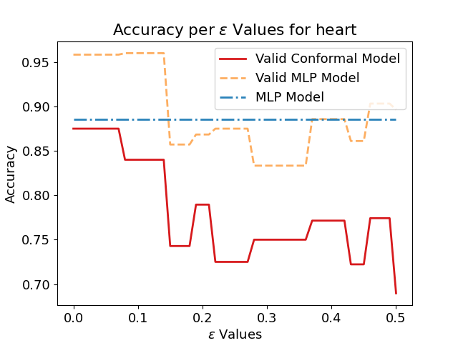
Density-based CP (MLP)
Fig 6. The accuracy and the percentages according to epsilon for Heart
Fig 7. Visualization of the density regions - first two dimensions of a PCA
Non-empty intersection (in green) representing a region of random uncertainty.
Fig 8. Valid conformal accuracy: the accuracy of the conformal model when one considers only the singleton predictions 0 or 1 (without taking into account the {0,1} and the empty sets).
Notes:
Result depend on ∈ : when ∈ is small, the model has high precision and a large number of classes predicted for each observation. On the contrary, when ∈ is large, there are no more cases classified as ∅ and fewer cases predicted by label.

Slide 8
Conclusion
Trustworthy and reliable predictions
Algorithm agnostic
Result is set (rather than point) prediction
Notes:
Trustworthy predictions for high-risk decision making.
Algorithm agnostic – use any algorithm; only requirement is designing a non-conformity score for each algorithm.
optimization of density estimation based on neural networks.

