Slide 1
Design Specification and AI-Driven Digital Twin Architecture for Storage Devices
Hemant Gaikwad Dell Technologies
Rahul Vishwakarma WorkOnward
Notes:
Hello everyone. Thank you for joining today. The work has been done in collaboration with Hemant, who, unfortunately was not able to be present here. Today I’m going to walk through a practical architecture for creating standards‑compliant digital twins of storage devices and broader datacenter elements so we can design anywhere and test everywhere—without waiting for scarce hardware. Our north star is simple: combine open industry standards—DMTF Redfish and SNIA Swordfish—with AI to produce realistic, schema‑conformant device behaviors that we can use throughout the SDLC: prototyping, development, validation, and even chaos drills.

Slide 2
Agenda
Why digital twins for storage devices
Architecture and implementation approaches
Technical components and tooling
Security and business value
Notes:
Here’s the agenda – this, this, and this.

Slide 3




Why now? first-to-market pressure, limited hardware
Reduced prototype hardware; tight schedules
High prototype cost; costly edge case production
Bottleneck in design and validation
Limited test coverage
Notes:
Here’s the current problem statement – If you’re feeling the pressure to be first to market, you’re not alone. At the same time, prototype hardware is limited, schedules are tighter, and per‑unit costs are higher than ever. Those realities create a perfect storm: teams are blocked waiting on lab time, critical tests get deferred, and we make late decisions under uncertainty. [pause]

Slide 4
Opportunity
Standards-compliant digital twins that act like real devices
Notes:
The core idea behind today’s talk is to break that dependency by generating reliable, standards‑compliant device behaviors up front—so design, software, and validation can move in parallel with hardware.

Slide 5
Digital Twin
/ˈdɪdʒɪtəl twɪn/¹
Virtual representations of real-world entities and processes, synchronized at a specified frequency and fidelity.
A real-world entity and/or process to be twinned
A virtual representation of that object and/or process
The data that connects them together
¹Source: https://www.digitaltwinconsortium.org
Notes:
A Digital Twin is not a single product to be
procured, but instead a complete ecosystem
of different software and hardware solutions
- all integrated together to achieve a desired
outcome.
Digital Twins offer the ability to evolve as
reality changes, and they are of most use
when an asset or process is changing over
time. Unlike a simulation, a digital twin can
provide a near-real-time comprehensive
linkage between the physical and
digital worlds.
This interactivity between the real and digital
worlds yields realistic models which can make
predictions with a high level of confidence and
support a broad set of applications.

Slide 6
What’s a Digital Twin (for Storage)?
Simulates resources, states, failures like real HW
Exposes Redfish/Swordfish REST endpoints
Validated JSON responses, schema-true

Slide 7
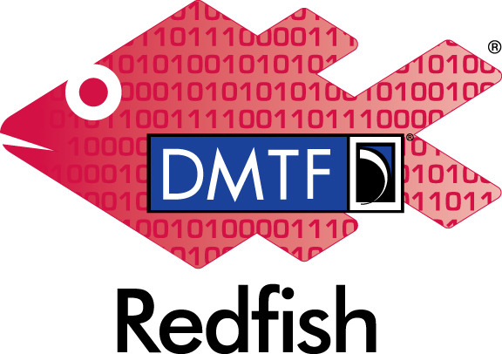


Leaning on Open Standards
standardized management for servers, storage, networking
storage management extensions on top of Redfish
data models, conformance profiles - a single source of truth
Predictable, interoperable APIs and payloads
Notes:
Our foundation is standards. Redfish defines a modern, RESTful model for management. Swordfish extends that model for storage constructs—Volumes, Storage Services, Data Protection, and so on. Because both provide schemas and conformance materials, we can drive the twin’s shape and behavior directly from the standards, not from ad‑hoc guesses.

Slide 8
Vision - AI-Driven, Standards-Compliant Digital Twins
Device generation
LLMs outputs compliant device configs and responses
Runtime validation
validation against Redfish/Swordfish JSON Schema
Stateful behavior
CRUD, telemetry, faults, lifecycle events
Scalable fleets
thousands of heterogenous twins in minutes

Slide 9
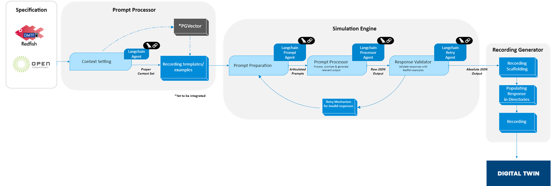
Architecture

Slide 10
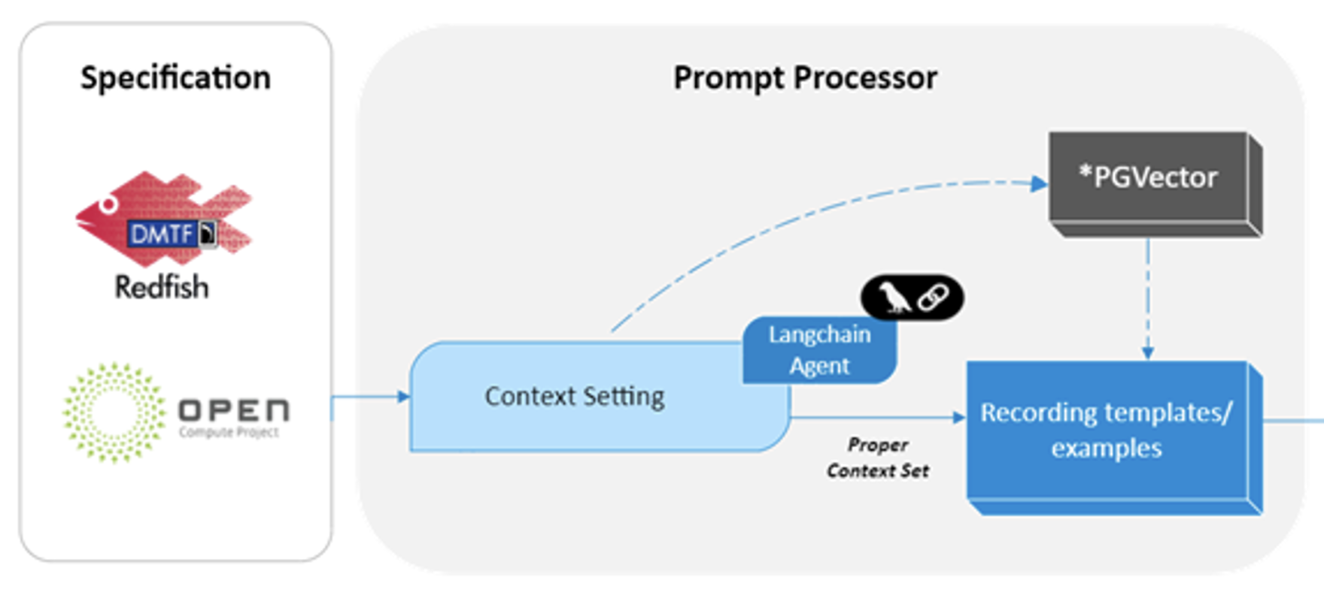
Prompt Processor
LangChain Agent to establish the proper context
Highly accurate JSON data for each resource

Slide 11
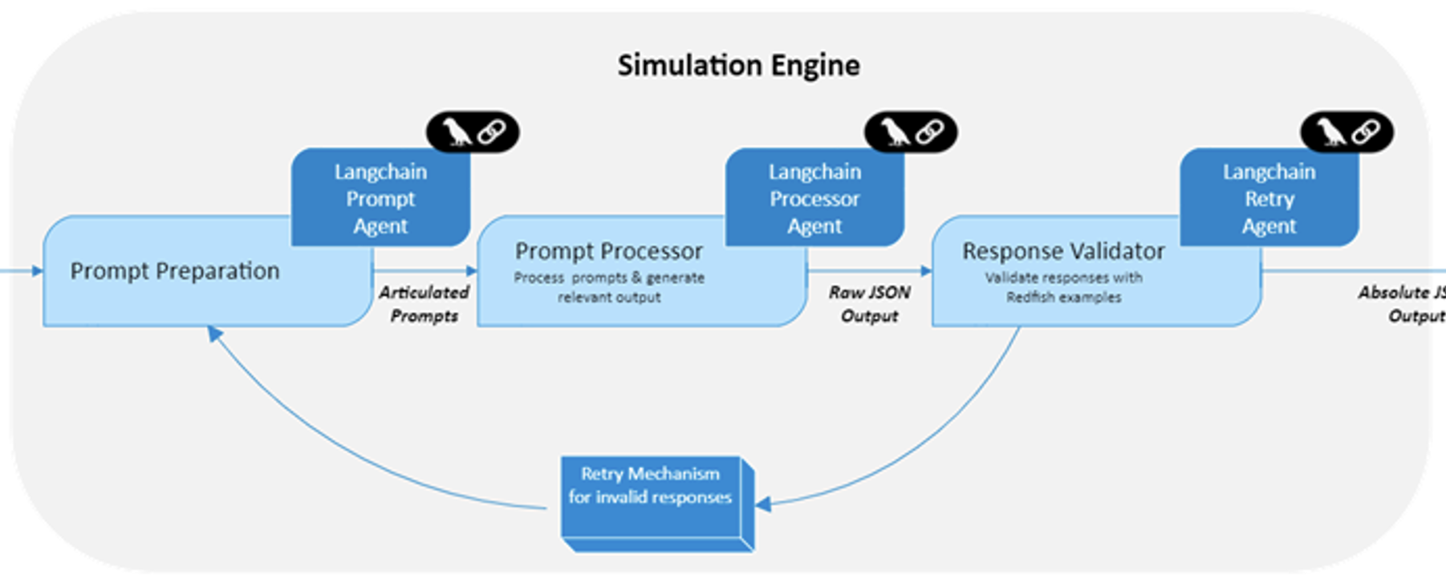
Simulation Engine
'Response validator’ - validates the generated JSON data and will retry the generation if the generated data seems inaccurate, hallucinated or to be missing some key values.
Notes:
Simulation engine: The generated prompts are subsequently passed to the LLM, along with example files that specifies what data to be newly generated and what data to be kept the same navigating through the entire JSON attributes across a given resource. The application also has a built-in 'Response validator' that is part of this engine. The main function of this validator is to validate the generated JSON data and will retry the generation if the generated data seems inaccurate, hallucinated or to be missing some key values.​

Slide 12
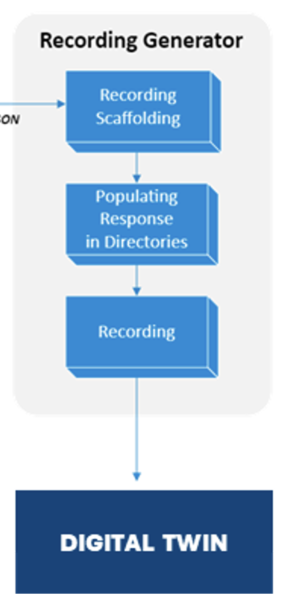
Recording Generator
Populate respective recording directories that adheres to the actual Redfish devices
Organizes JSON output into Redfish folder hierarchy
Simulated devices can be utilized by various product teams to perform rapid prototyping, design, development & testing, thereby catering to their hardware requirements and dependencies
Notes:
Recording generator: Upon executing the prompts, generating the data and validating them, the recording generator will now populate them in their respective recording directories that adheres to the actual Redfish device structure.​
​
Finally, this polished output can be further customized for randomizing the unique attributes, thus simulating N number of unique device endpoint on the data center network.
These simulated devices can be utilized by various product teams to perform rapid prototyping, design, development & testing, thereby catering to their hardware requirements and dependencies.

Slide 13
(Alternate) Architecture
Embedding generator
Knowledge retriever
Validation and Compliance
Insight generator
Analytics integrator

Slide 14
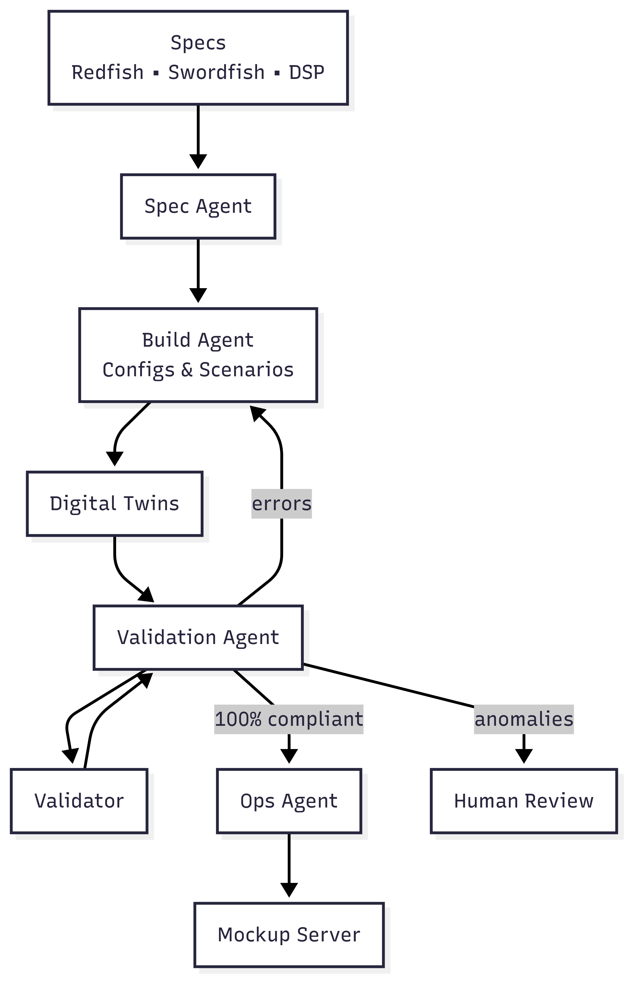
Agentic AI for Digital Twin
Reasoning and planning agent
Adaptive testing
Knowledge driven
Notes:
This architecture incorporates
a reasoning and planning agent that decomposes tasks into
subtasks and coordinates various specialised agent tools to
guide execution

Slide 15
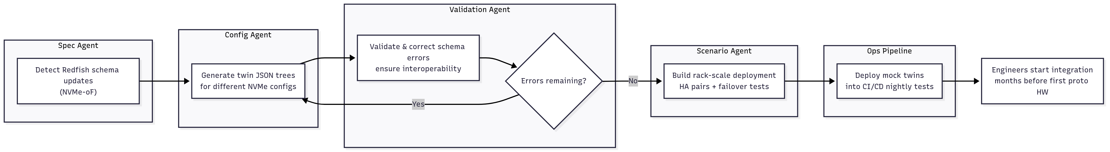
Example scenario
Notes:
Imagine a storage vendor building a new all-flash array:
A Spec Agent detects new Redfish schema updates for NVMe-oF.
A Config Agent generates twin JSON trees for different NVMe configs.
A Validation Agent corrects schema errors, ensures interoperability.
A Scenario Agent builds a rack-scale deployment with HA pairs + failover tests.
Ops pipeline deploys the mock twins into CI/CD nightly tests. 👉 Engineers start integration months before first proto HW arrives.

Slide 16
Demo
Device creation
Infrastructure simulation
UI for device status change

Slide 17
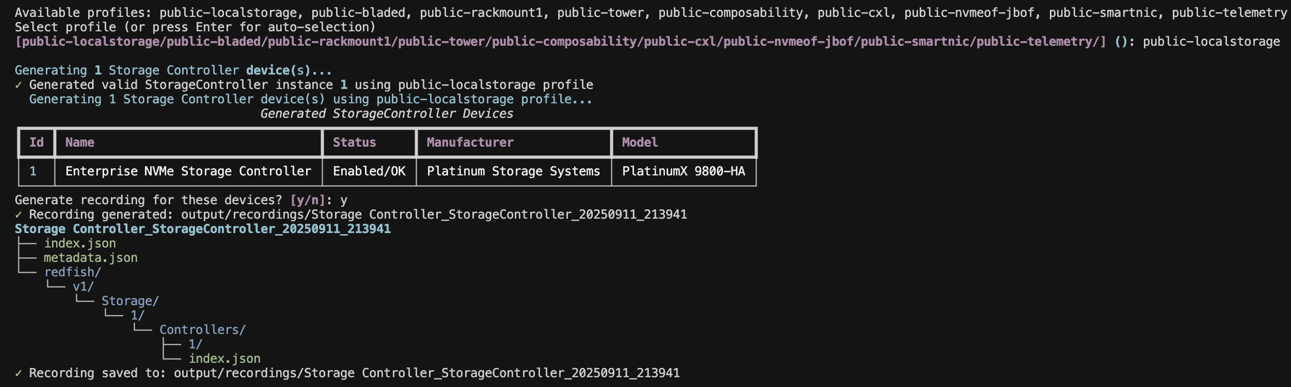
Device Creation

Slide 18
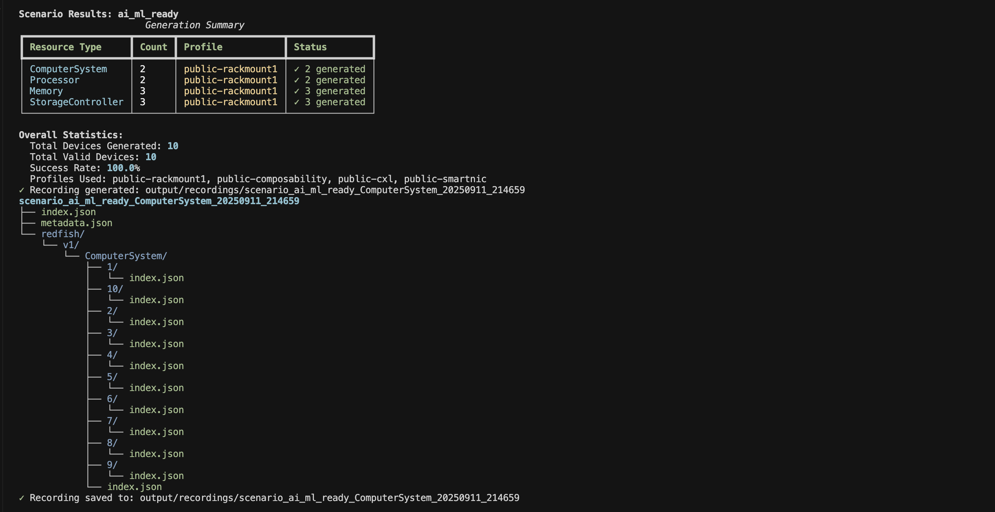
Infrastructure simulation

Slide 19
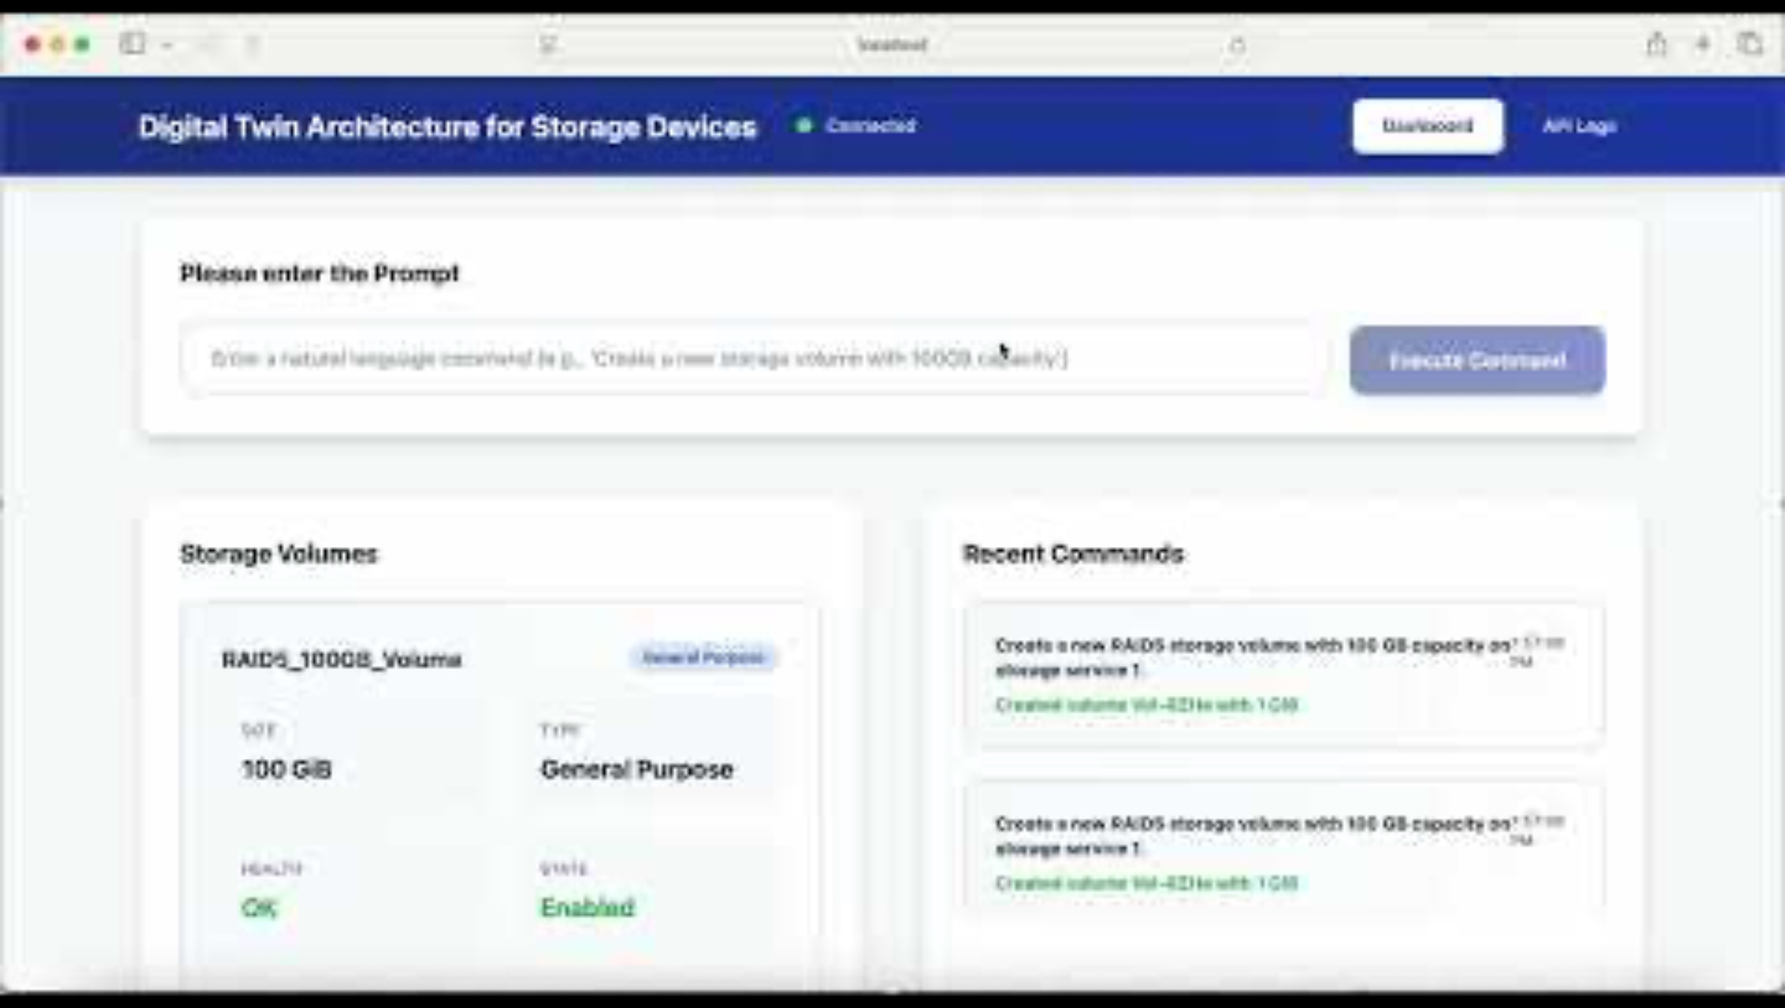
UI for device status change

Slide 20
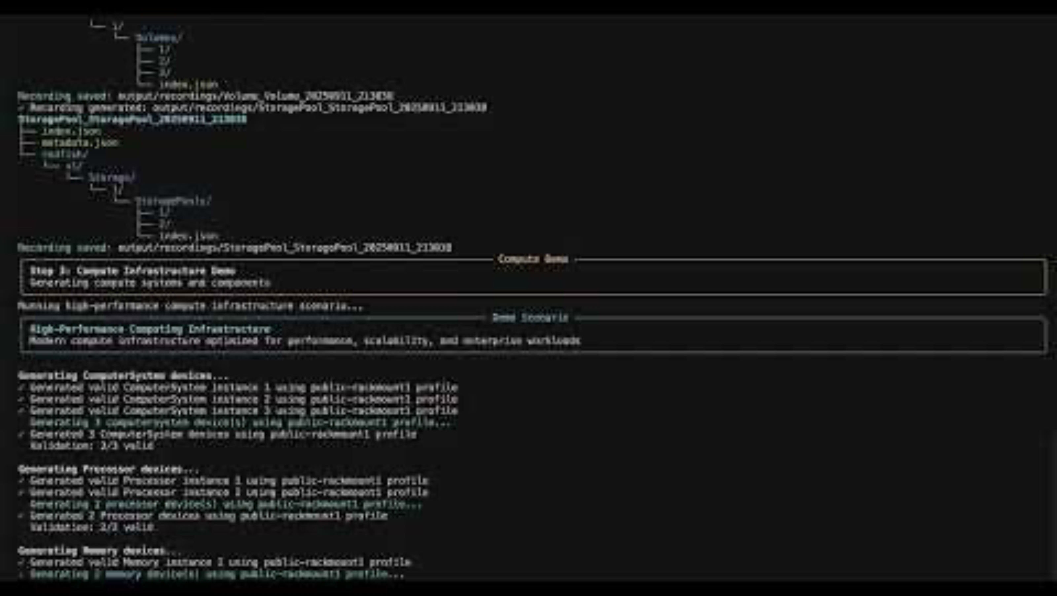
Infrastructure simulation

Slide 21

https://github.com/rahvis/DMTF-Redfish-Digital-Twin

Slide 22
Contributions
Specification-driven, standards-conformant generation
Autonomous, device-agnostic prompt optimization
Multi-layered validation for conformance assurance
Zero-touch extensibility for scalable simulation
Notes:
Specification-Driven, Standards-Conformant Generation: Leverages Redfish specifications and contextual examples to generate schema-compliant resource models with structural and semantic precision.
Autonomous, Device-Agnostic Prompt Optimization: Dynamically constructs optimized prompts for any datacenter device type enabling future-proof extensibility without manual customization.
Multi-Layered Validation for Conformance Assurance: Implements a comprehensive validation pipeline to ensure generated JSON outputs are complete, structurally accurate, and compliant with Redfish schema definitions.
Zero-Touch Extensibility for Scalable Simulation: Architected for seamless, code-free onboarding of new resource types, supporting rapid, standards-based simulation across heterogeneous datacenter environments.

Slide 23
Prompt Engineering & Structured Generation
System prompt - “Always emit JSON that validates against schema X”
Few-shot exemplars from Swordfish/Redfish samples
JSON mode, schema-guided sampling (constrained decoding)
Ask the model to explain conformance deltas (self-checks)
Notes:
We design prompts to produce only schema‑valid JSON. Few‑shot examples anchor the model to the right shapes. Tool calls let the model fetch authoritative fragments—like enum values or URI patterns—instead of hallucinating. We favor constrained decoding so invalid JSON is rare, and we log a self‑check explanation to help triage any drift we see. System prompt: “Always emit JSON that validates against schema X”
Few-shot exemplars from Swordfish/Redfish samples
Function calling: look up schema fragments, device state, error catalogs
Constrained decoding: JSON mode, schema-guided sampling
Self-checks: ask the model to explain conformance deltas (for logging)
Prompt: You are an expert in DMTF Redfish standards and SNIA Swordfish extensions with deep knowledge of enterprise storage, compute, and networking infrastructure.
Generate a JSON response for a Storage Controller that strictly adheres to Redfish specification v1.8.0 and represents enterprise-grade infrastructure suitable for SNIA SDC 2025 demonstration.
Context:
{
"device_type": "Storage Controller",
"resource_type": "StorageController",
"required_properties": ["Manufacturer", "Model", "SerialNumber"],
"property_types": {
"Manufacturer": "string",
"Model": "string",
"SerialNumber": "string"
},
"mockup_profile": "public-localstorage"
}
Requirements:
1. Must be valid JSON with proper Redfish structure
2. Must include all required Redfish properties for StorageController
3. Must use correct data types as per schema specification
4. Must include realistic, enterprise-grade values
5. Must follow exact Redfish naming conventions and @odata patterns
6. Must demonstrate advanced features and capabilities
7. Must be suitable for professional infrastructure demonstration
8. Must include SNIA Swordfish extensions where applicable

Slide 24
Tooling Stack (Example Options)
Runtime: containers/Kubernetes; event bus (e.g., NATS/Kafka)
Validation: JSON Schema validators; OpenAPI validators
DevX: SDKs, Postman collections, Redfish/Swordfish examples
CI/CD: GitHub Actions/GitLab CI; ephemeral test envs
Storage: document DB for state snapshots and diffs
Notes:
You can build this with common, well‑supported tools. Containers manage scale; an event bus handles telemetry and jobs. Use widely used JSON Schema and OpenAPI validators. Keep examples and collections close to developers, and spin ephemeral environments in CI for every PR so tests run against fresh fleets.

Slide 25
Security & Governance
No sensitive customer data in prompts
Policy guardrails
Audit
Notes:
Treat the twin platform as production software. Keep prompts and corpora free of sensitive data. Enforce security behaviors—authentication, headers, and error handling—exactly as real devices would. Create an audit trail that ties each test result back to the exact schema, model, and runtime build used. No sensitive customer data in prompts; standards-only corpora
Policy guardrails: forbidden properties, security headers, auth flows
Audit: signed artifacts for schemas, prompts, and responses
Isolation: per‑tenant sandboxes; network egress control
SBOM & supply chain: track model, schema, and runtime versions

Slide 26
Outcomes & ROI
Shorter validation cycles; earlier defect discovery
Broader coverage
Interoperability confidence via standards compliance
Lower capex/opex for labs; reproducible tests for auditors
“Design anywhere, test everywhere” development culture
Notes:
Shorter validation cycles; earlier defect discovery
Broader coverage: realistic faults & timing without lab hardware
Interoperability confidence via standards compliance
Lower capex/opex for labs; reproducible tests for auditors
“Design anywhere, test everywhere” development culture

Slide 27
Key Takeaways
Scale and speed without hardware
Standards-compliant validation
Faster cycles, lower costs
Zero-touch onboarding of new device types
Notes:
Key Takeaways
AI-driven digital twins can generate thousands of standards-compliant storage device simulations in minutes, eliminating hardware dependencies for development and testing
Multi-layered validation ensures both structural and semantic accuracy while leveraging Redfish/Swordfish specifications for guaranteed interoperability
Organizations achieve significant ROI through shorter validation cycles, earlier defect discovery, and reduced lab infrastructure costs
Zero-touch extensibility enables rapid onboarding of new device types without manual customization, supporting scalable simulation across heterogeneous datacenter environments
Scale and speed without hardware - Generate thousands of compliant simulations in minutes
Standards-compliant validation - Multi-layered accuracy using Redfish/Swordfish specs
Faster cycles, lower costs - Earlier defect discovery with reduced lab infrastructure
Future-proof extensibility - Zero-touch onboarding of new device types

Slide 28
Thank you for attending!
Please remember to rate this session. You get access the presentations at http://sniadeveloper.org/conference

