Slide 1
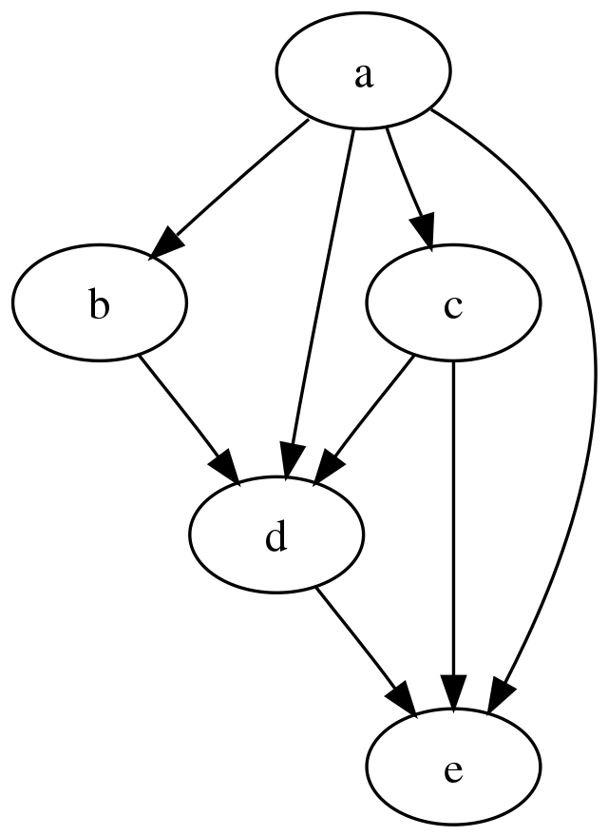
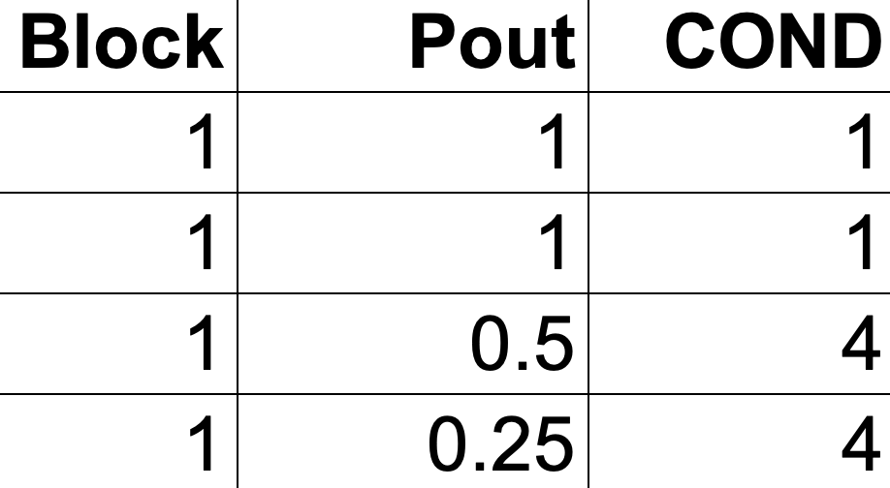
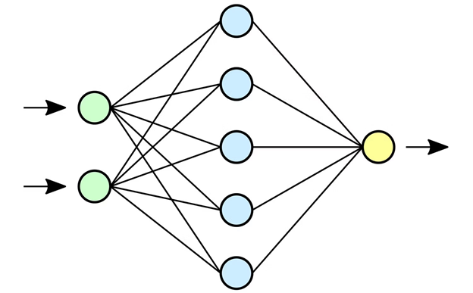
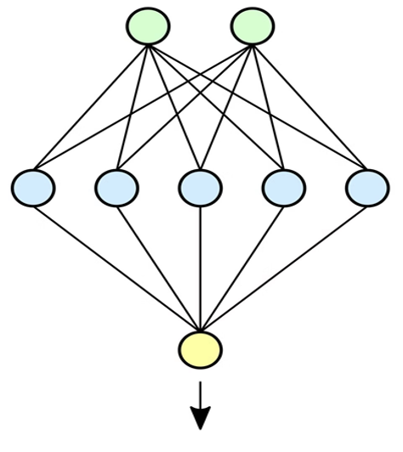


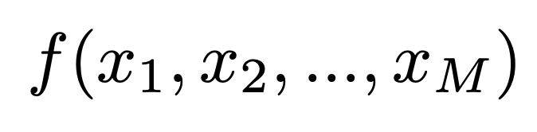



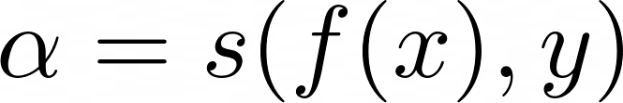
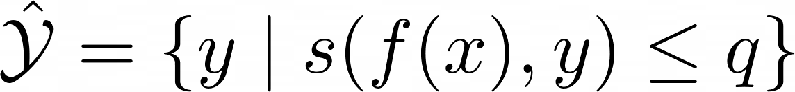
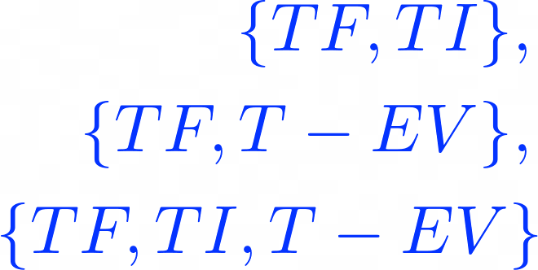


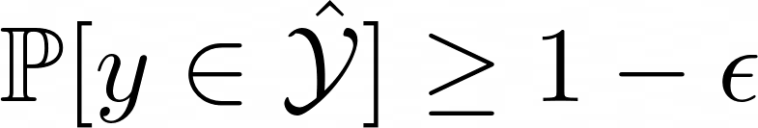


A
Code Branching
cGAN
Conformalized Generator & Discriminator
A
Code Branching
B
RTL to Graph
Euclidian representation
0.0031366234,0.0,0.0
0.16764905,0.0910366,0.01159358
0.05329431,0.019860107,0.18703224
0.21500663,0.11880148,0.0
0.21176252,0.117008954,0.01518486
A
Data
Source dataset has labels TF_{s} and TI_{s}
Uni-modal
Multi-modal
Modal 1
Modal 2
B
New dataset
Graph representation
Labels
TF_{S} → TF_{G}
TI_{S} → TI_{G}
TF_{s} : Trojan Free
TI_{s} : Trojan Infected TF_{G} : Trojan Free (Synth)
TI_{G} : Trojan Infected (Synth) T-EV: Trojan Evolved
Early Fusion
TF {TF_{S} ,TF_{G}}, TI {TI_{S}}, T-EV {TI_{G}}
Modal 1
Modal 2
Late Fusion
Modal 1
Modal 2
C
Merge with source
Conformal
Wrapper
Evolved
Train
Calibrate
Test
Conformal
Wrapper
Dataset
Uncertainty Quantifier
Y=w1​⋅X1​+w2​⋅X2​
Uncertainty Quantifier
nonconformity score
ML Model
Uncertainty aware multimodal deep learning
Uncertainty aware multimodal deep learning
Choose the winning approach: Early Fusion or Late Fusion
Guaranteed
coverage
Set Prediction
Ranking HT
Calibrated Explanation
Classification
Trojan Free
Trojan Infected
Uni-modal approach
Multi-modal approach

