Slide 1
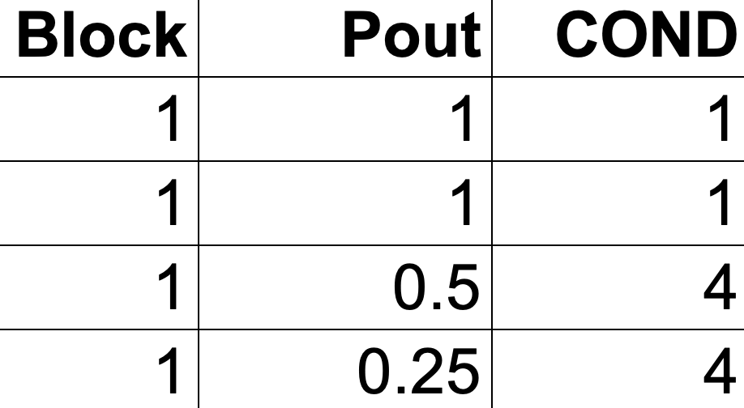
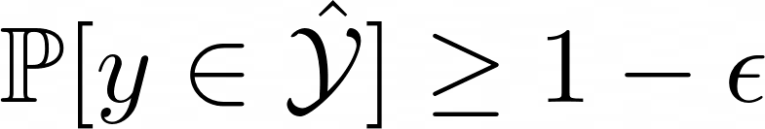
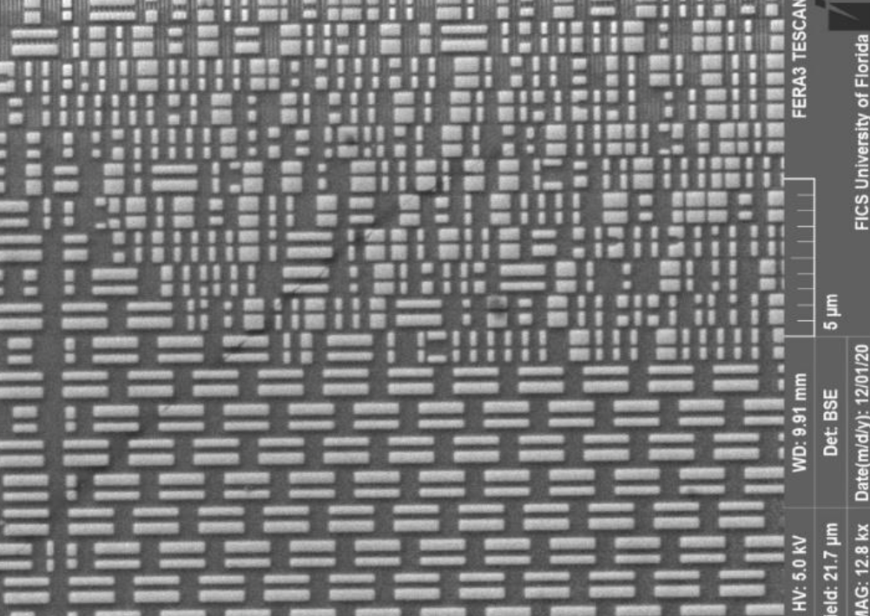
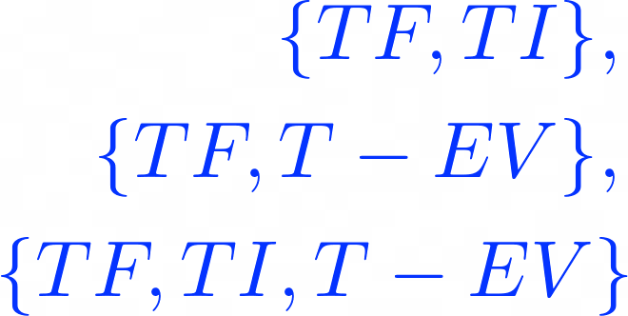



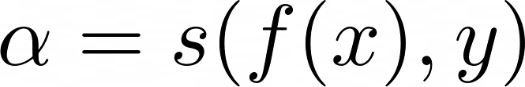

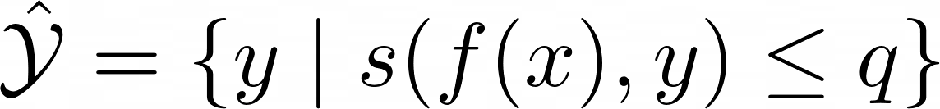

1
Data Features
2
Create evolving trojans
3
Conformal Framework
4
Inference
A
Code Branching
A
Generate data
Original
Evolved
A
Guaranteed
coverage (based on calibration)
cGAN
Dataset
Source dataset has labels TF_{s} and TI_{s}
Conformalized Generator & Discriminator
Train
Calibrate
Test
Used in the experiment
Algorithm-agnostic
B
Set Prediction
B
SEM Images
TF_{s} : Trojan free (source)
TI_{s} : Trojan infected (source)
High quality dataset
Provides set of labels for informed decision making
Use “any” ML Model
B
Label new dataset
Not used in the experiment. Included here only as an example
TF_{S} → TF_{G}
TI_{S} → TI_{G}
nonconformity score
Unique for each ML Model
C
Ranking HT: Prioritize the resolution
C
RTL to Graph
p-values
C
Merge with source
Used to create set prediction
TF {TF_{S} ,TF_{G}}, TI {TI_{S}}, T-EV {TI_{G}}
D
“Calibrated Explanation” when the model says – “I don’t Know”
Not used in the experiment. Included here only as an example
TF: Trojan free; TI: Trojan infected; T-EV: Trojan evolved
Set Prediction
Note: TF_{G} are skipped in the final created dataset

Slide 2
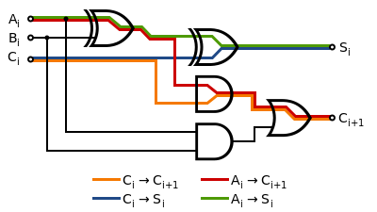











State-of-the-Art Methods
PALETTE (Our Method)
Hardware Trojan Detection Engine
Conformal Wrapper
(ML Model)
Trojan Free
Point Prediction
Lack of Trust
Confidence Set
Trojan Infected
No Guarantee

Slide 3
