Slide 1
Fuzzy Logic approach for Capacity Projection
Rahul Vishwakarma

Slide 2
Agenda
Data Domain Backup Storage
Capacity Projection Feature
Why HOFTS
Applying HOFTS
Forecast Accuracy and Comparison
Demo
Next Steps

Slide 3








Data Domain backup storage Market leader in PBBA segment
Data Domain Management Center
Large Enterprise
Midsize Enterprise
Small Enterprise
/ROBO
Data Domain Virtual Edition
Data Domain DD3300
Data Domain DD6300
Data Domain DD6800
Data Domain DD9300
Data Domain DD9800
Supports DD Cloud DR
Supports DD Cloud DR
Supports DD Cloud DR
Supports DD Cloud DR
Supports DD Cloud DR
Supports DD Cloud DR
 | Supports Instant Access
Supports DD Cloud Tier
Supports DD Cloud Tier
Supports DD Cloud Tier
Supports DD Cloud Tier
Supports DD Cloud Tier
Supports Instant Access
Supports Instant Access
Supports Instant Access
Supports Instant Access
Supports Instant Access
Supports HA Configurations
Supports HA Configurations
Supports HA Configurations

Slide 4
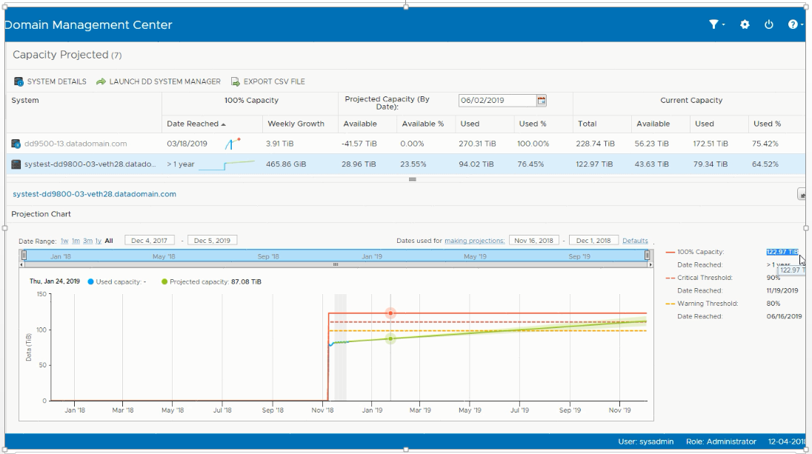
Capacity Projection Feature

Slide 5
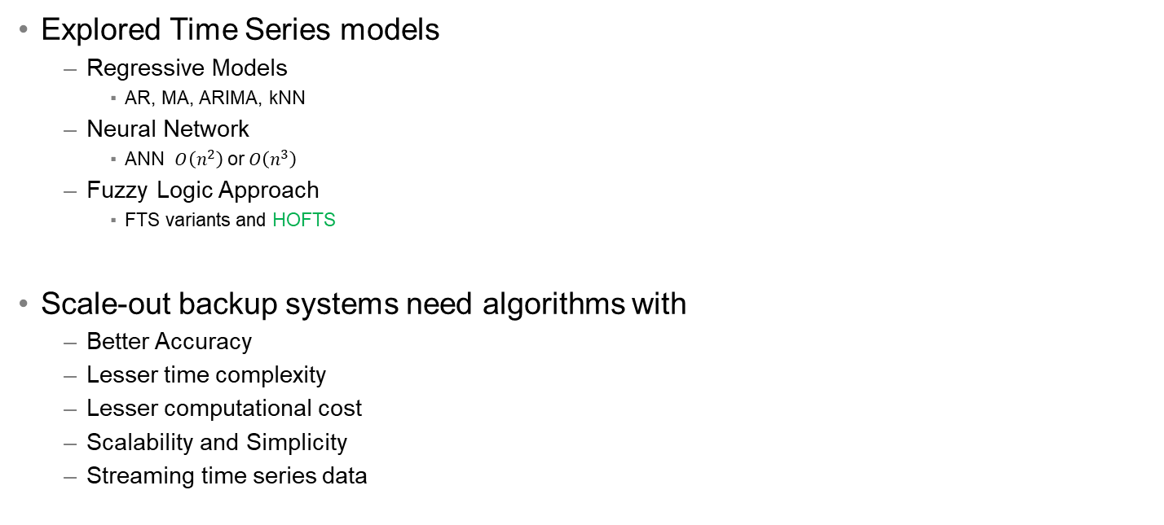
Why Higher Order Fuzzy Time Series (HOFTS)
Explored Time Series models
Regressive Models
AR, MA, ARIMA, kNN
Neural Network
ANN $O\left(n^{2}\right)$ or$O\left(n^{3}\right)$
Fuzzy Logic Approach
FTS variants and HOFTS
Scale-out backup systems need algorithms with
Better Accuracy
Lesser time complexity
Lesser computational cost
Scalability and Simplicity
Streaming time series data
 | Segmented Regression | HOFTS
Accuracy | Low | High
Data Trend | Linear | Non-Linear
Data points | 15 | 5
Complexity | Medium | Low

Slide 6
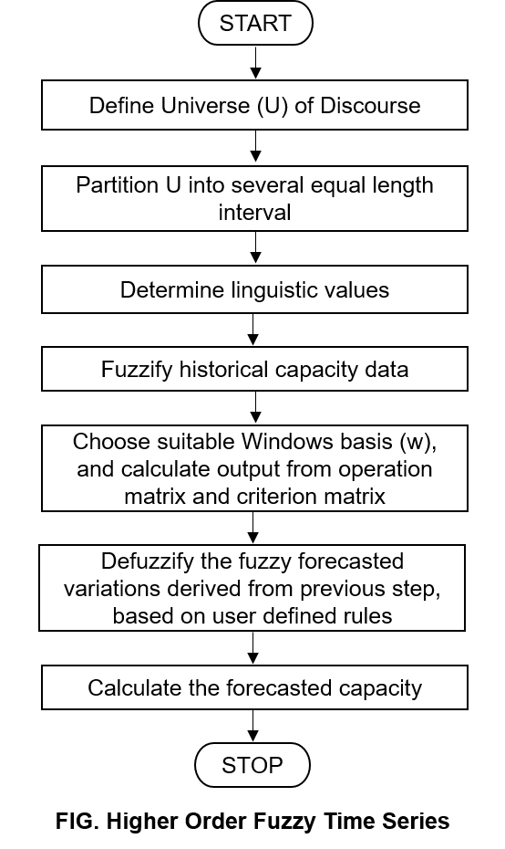

Applying HOFTS
Data Collection
Autosupport from Customers
Time Series parameters
Time: 365 Days
Capacity: Post Compression
Performance Analysis
Computational Complexity
FLR (Fuzzy Logic Relation) $O\left(n\right)$
Forecasting $O\left(1\right)$
Time Complexity = $O\left(n\right)$ + $O\left(1\right)$ = $O\left(n\right)$
Notes:
We translated the problem statement as a time series, where the input parameter was daily data growth for 1 year.
Now, the time interval is defined by the user. We can even have 90 days, but finding the optimal time interval for forecasting is another problem statement.
The input to HOFTS is a csv file containing sequence of daily data growth for 365 days.
Let us simplify the flow diagram on right had side. These are the steps involved in forecasting using HOFTS.
The first step is to define universe of discourse. Here we have 365 (number of days) and then create interval partition of equal length. For e.g, we can have length of interval partition = 5.
So, in each interval we will have 73 elements.
Next step is to create linguistic values. For e.g, very low, low, medium, high, and then we use these values for create Fuzzified values of input data.
The user creates rules for Defuzzification and it is used for forecasting.

Slide 7
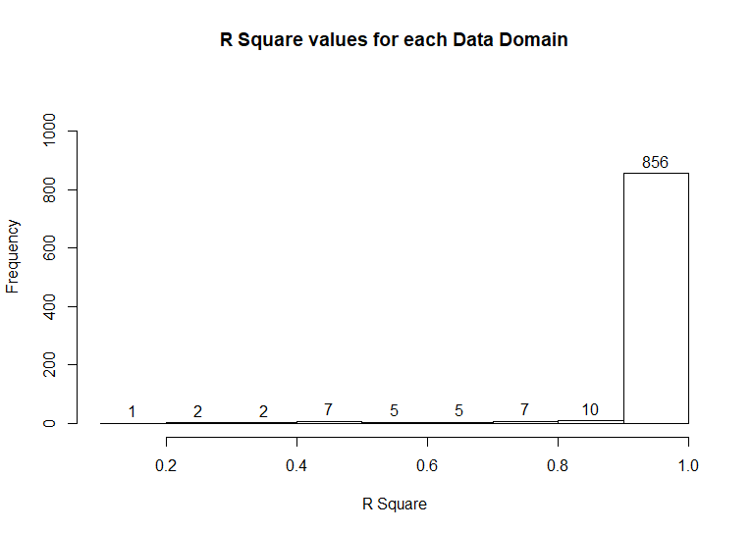
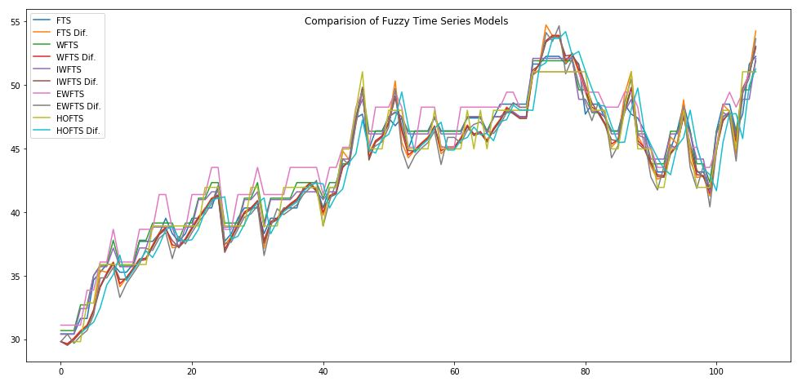
Forecast Accuracy & Comparison
$$95.64\% \left(895\right) Systems ∃ R^{2}∈\{0.9, 1.0\}$$
Model | FTS | FTS Diff | WFTS | WFTS Diff | IWFTS | IWFTS Diff | EWFS | EWFS Diff | HOFTS | HOFTS Diff
RMSE | 0.85 | 0.47 | 0.95 | 0.99 | 0.88 | 0.34 | 1.5 | 0.81 | 0.28 | 1.47
MAPE (%) | 1.4 | 0.86 | 1.84 | 1.86 | 1.61 | 0.74 | 2.97 | 1.71 | 0.62 | 2.62
Notes:
We ran HOFTS for 895 Data Domain and see that around 95% of the system accuracy lies between 0.9 – 1.0, which looks more promising for model deployment.
Vet few of the Systems had poor forecasting results.
We also tried to evaluate variants of FTS and compared the predicted values.

Slide 8
Demo

Slide 9
Work in Progress
Parameter selection
Study correlation between post compression and deduplication ratio
n-step ahead forecasting
Evaluating Direct-Recursive Hybrid Multi-step Forecast Strategy
Multivariate model
M factor Fuzzy time series
Hybridized models (Neuro-fuzzy approach)
Distributed execution
pyFTS and dispy libraries to validate HOFTS over install base

Slide 10
References
Ajoy K. Palit and Dobrivoje Popovic. 2005. Computational Intelligence in Time Series Forecasting: Theory and Engineering Applications (Advances in Industrial Control). Springer-Verlag, Berlin, Heidelberg.
Chen, 2014 Chen Mu-Yen, A high-order fuzzy time series forecasting model for internet stock trading. (Future Generation Computer Systems). vol. 37, number , pp. 461--467, 2014.
Hwang, Chen et al., 1998 Hwang Jeng-Ren, Chen Shyi-Ming and Lee Chia-Hoang, Handling forecasting problems using fuzzy time series. (Fuzzy sets and systems). vol. 100, number 1, pp. 217--228, 1998.
Mark Chamness. 2011. Capacity forecasting in a backup storage environment. In Proceedings of the 25th international conference on Large Installation System Administration (LISA'11). USENIX Association, Berkeley, CA, USA, 12-12.
Pritpal Singh. 2016. Applications of Soft Computing in Time Series Forecasting (Simulation and Modeling Techniques). Springer-Verlag, Berlin, Heidelberg.
Song and Chissom, 1993 Song Qiang and Chissom Brad S, Fuzzy time series and its models. (Fuzzy sets and systems). vol. 54, number 3, pp. 269--277, 1993.

Slide 11
Backup Slides

Slide 12
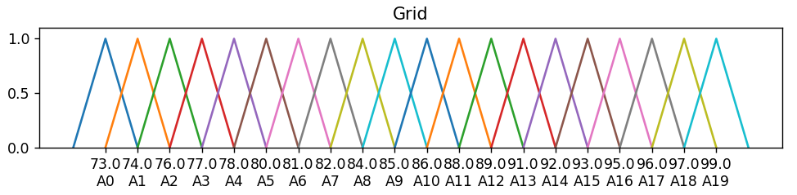
HOFTS Example
Universe of Discourse (U) 90 Days
Linguist Terms: A0 (Very Low), A1 (Low), …, A9 (Medium), …, A18 (High), A19 (Very High)
Interval Partitioning (len = 20)
(2nd Order FLRG)
A10,A10 -> A11, A12
A10,A11 -> A11, A12, A13, A5, A6, A7, A8
A10,A12 -> A11, A12, A13, A5, A6, A7, A8
...
A9,A8 -> A10, A11, A8, A9
A9,A9 -> A10, A11, A12, A8, A9
Notes:
We translated the problem statement as a time series, where the input parameter was daily data growth for 1 year.
Now, the time interval is defined by the user. We can even have 90 days, but finding the optimal time interval for forecasting is another problem statement.
The input to HOFTS is a csv file containing sequence of daily data growth for 365 days.
Let us simplify the flow diagram on right had side. These are the steps involved in forecasting using HOFTS.
The first step is to define universe of discourse. Here we have 365 (number of days) and then create interval partition of equal length. For e.g, we can have length of interval partition = 5.
So, in each interval we will have 73 elements.
Next step is to create linguistic values. For e.g, very low, low, medium, high, and then we use these values for create Fuzzified values of input data.
The user creates rules for Defuzzification and it is used for forecasting.

Slide 13
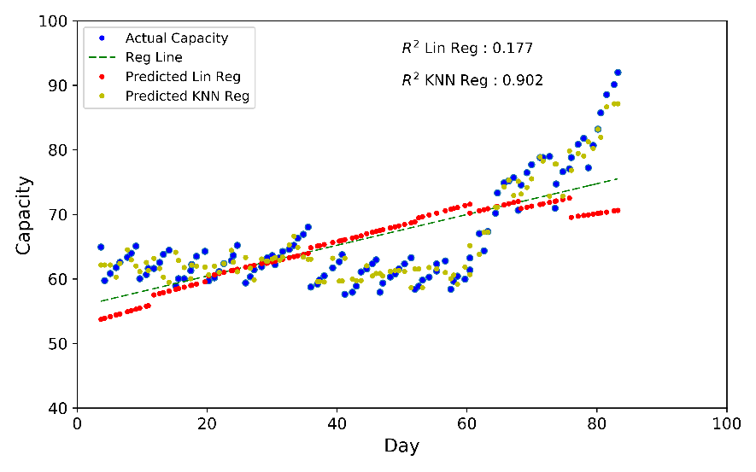
Linear regression and KNN

Slide 14
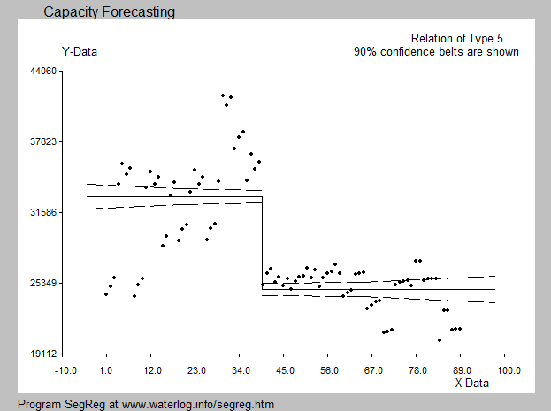
Segmented Regression

Slide 15
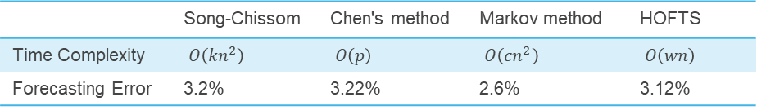
Time Complexity Comparison
 | Song-Chissom | Chen's method | Markov method | HOFTS
Time Complexity | $O\left({kn}^{2}\right)$ | $O\left(p\right)$ | $O\left({cn}^{2}\right)$ | $O\left(wn\right)$
Forecasting Error | 3.2% | 3.22% | 2.6% | 3.12%

