Slide 1
Inverse Problem of Uncertainty Quantification in Machine Learning
An approach towards trustworthy prediction
Rahul Vishwakarma
Software Quality Senior Engineer, DP APP SUST
Feb 24, 2020

Slide 2
Agenda
Machine Learning
Quantifying Uncertainty
Conformal Prediction
Applications
Curve fitting
Probabilistic
Learning framework
Data Protection

Slide 3
Machine Learning

Slide 4
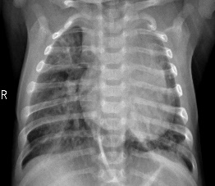





Machine Leaning
HISTORICAL DATASET
CLASSIFIER
ALGORITHM
SVM
Random Forest
Naïve Bayes
Decision Trees
Logistic Regression
Ensemble methods
PREDICTION
$$\left(x_{1},y_{1}\right),\left(x_{2},y_{2}\right), . . ., \left(x_{n},y_{n}\right)$$
Accuracy
$$Train$$
$$Test$$
98%
98%
NEW DATA
MODEL
PREDICTION
$${(x}_{n+1})$$
$$f\left(x\right)→y$$
$y_{n+1}$

Slide 5
Quantifying Uncertainty

Slide 6
Uncertainty Sources
Data
Model
Uncertainty Estimates | Description
Probabilistic | Model output as probability
Statistical | Prediction interval
Resampling | Monte Carlo Simulation
Fuzzy | Non-Probabilistic
Evidence Based | Dempster-Shafer theory
Impacts accuracy
Noise
Missing values
Anomaly
Function Approximation
Data Distribution
Parameters
Model Fit
Prediction Uncertainty

Slide 7
Conformal Prediction

Slide 8




Conformal Framework
DATASET
Point Prediction
CLASSIFIER
ALGORITHM
Accuracy
$$\left(x_{1},y_{1}\right),\left(x_{2},y_{2}\right), . . ., \left(x_{n},y_{n}\right)$$
98%
DATASET
CONFORMAL FRAMEWORK
UNCERTAINTY ESTIMATE
$y_{n+1}$
$$\left(x_{1},y_{1}\right),\left(x_{2},y_{2}\right), . . ., \left(x_{n},y_{n}\right)$$
CLASSIFIER
ALGORITHM
CONFIDENCE
$${(x}_{n+1})$$
CREDIBILITY

Slide 9

Framework Foundation
Hypothesis Testing
$$L∈\{0, 1\}$$
Algorithmic Randomness
Nonconformity Score
Transductive Inference
Confidence and Credibility

Slide 10
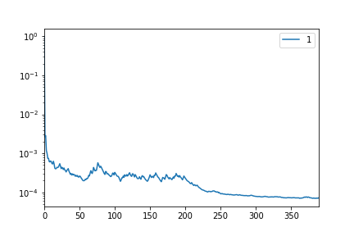
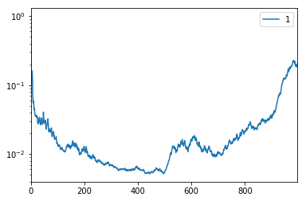
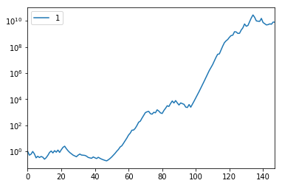
Exchangeability Test
Exchangeable
Exchangeable
Non-Exchangeable

Slide 11
Applications

Slide 12
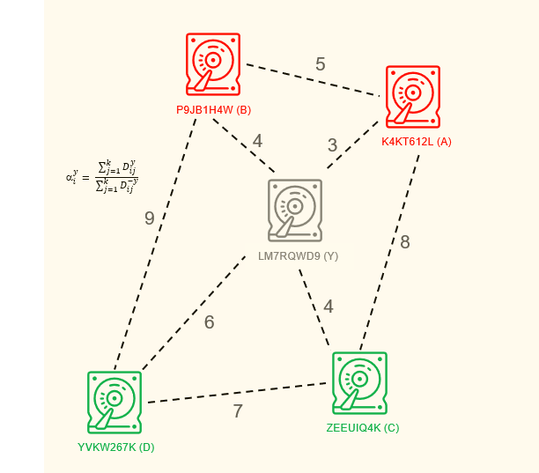
Disk Drive reliability
Given
Disk Drives dataset
Predict
Label of new Disk
Model
K-Nearest Neighbor (k =1)
Uncertainty estimation
Confidence and Credibility

Slide 13
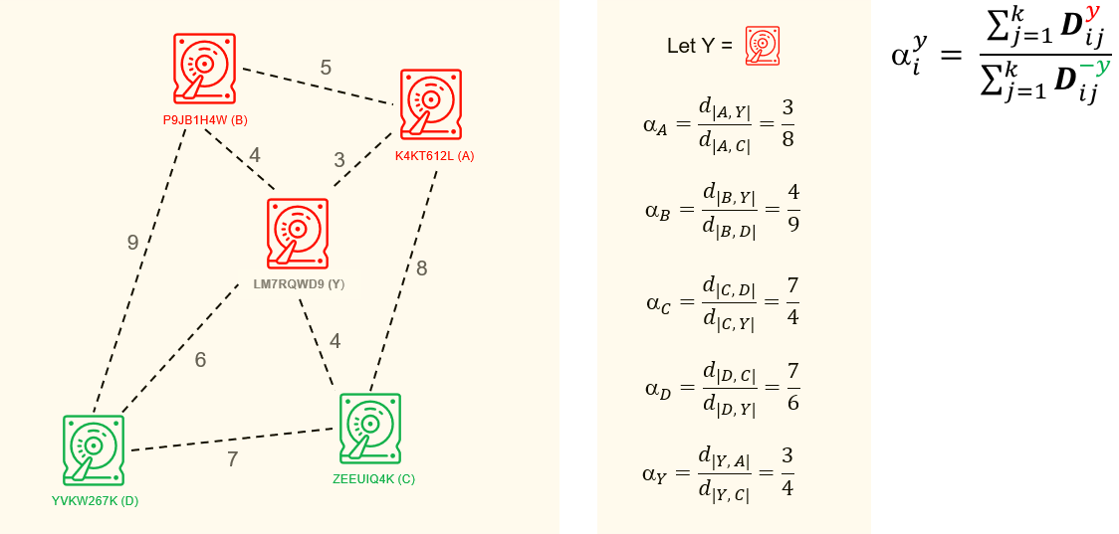
Nonconformity Score
Hypothesis A: Label Failed

Slide 14
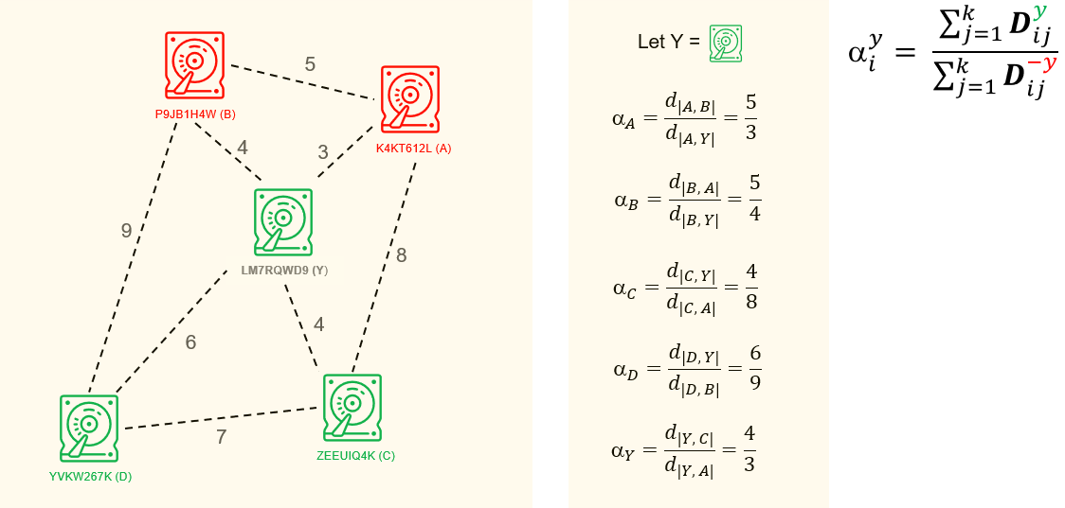
Nonconformity Score
Hypothesis A: Label Normal

Slide 15
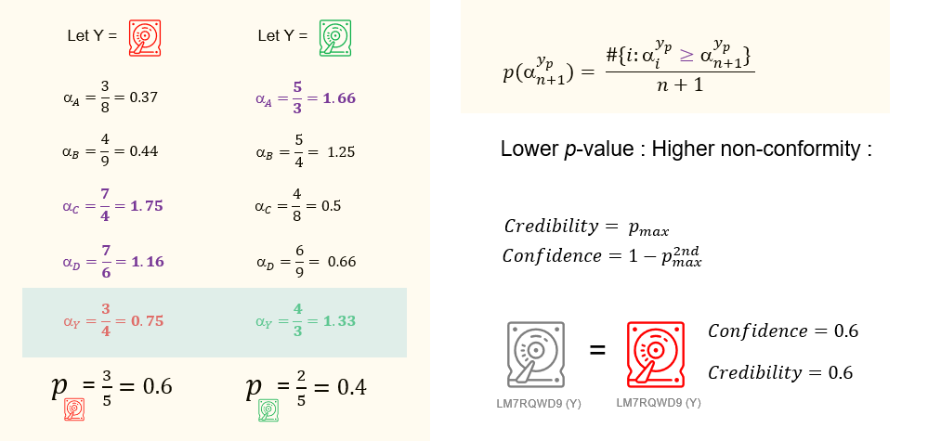
Uncertainty Estimation

Slide 16
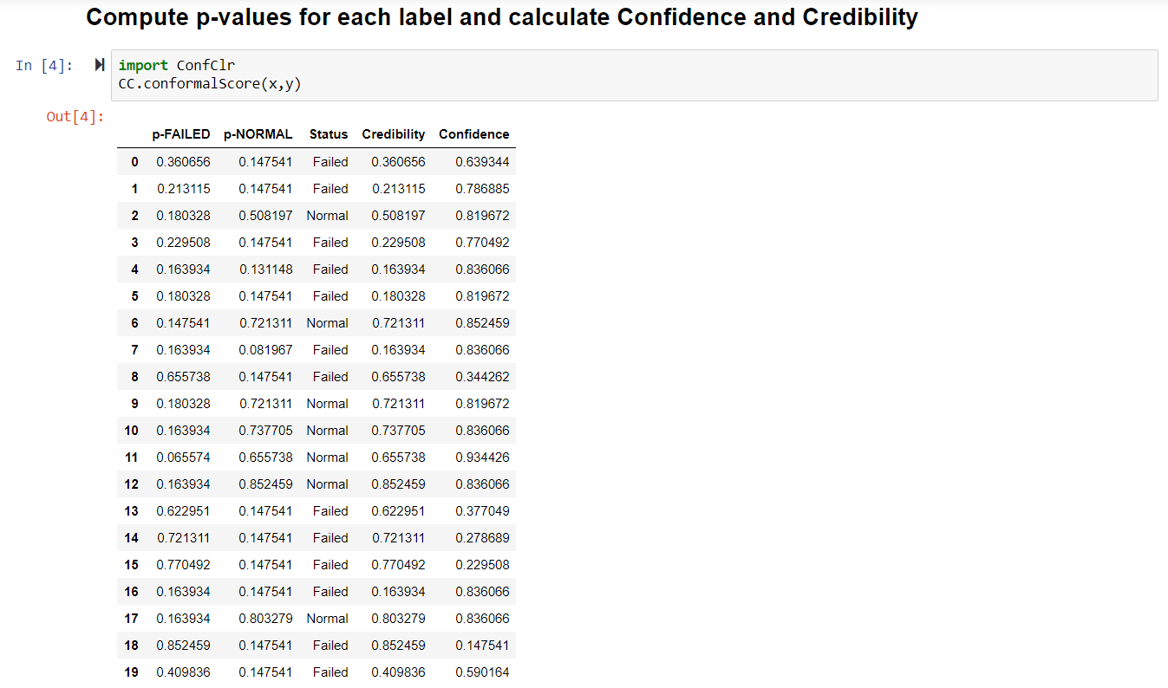
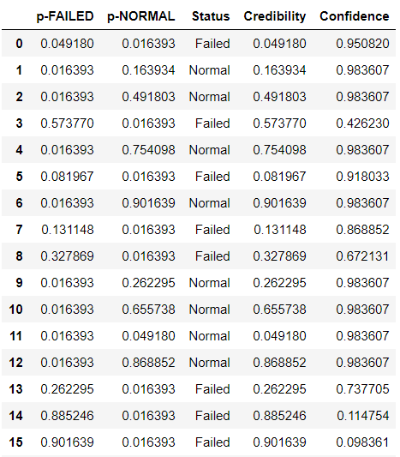
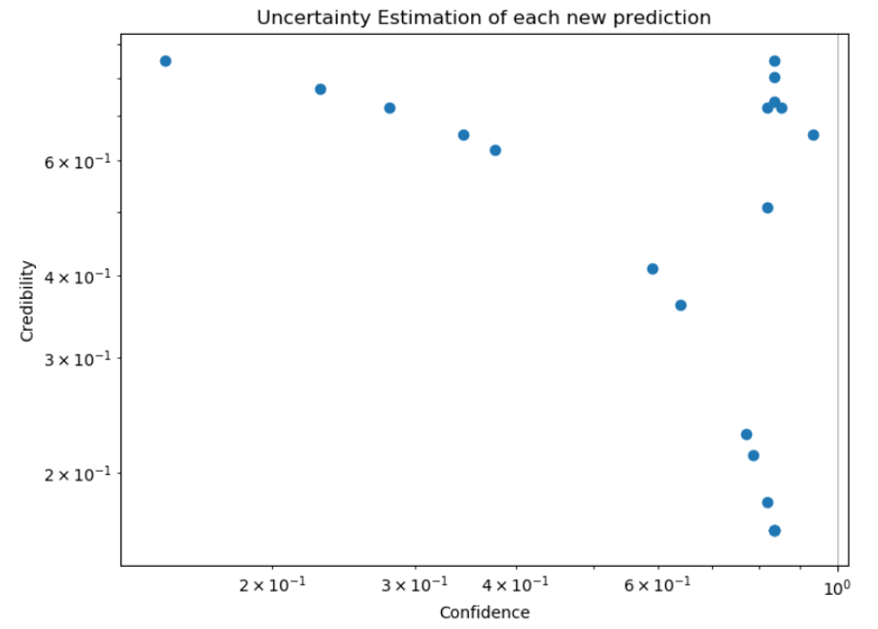
Prediction with Explainable Reliability

Slide 17
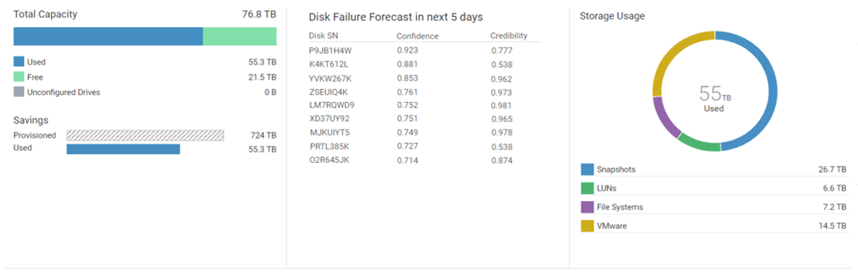
Use Case: Classification
Ranking disk drives which will fail in next 5 days

Slide 18
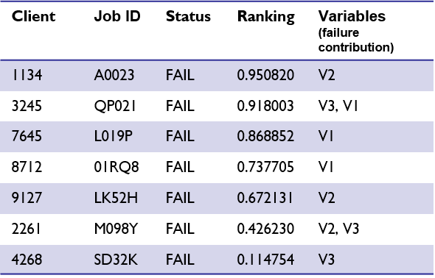
Use Case: Classification
Backup job failure prioritization
Client 7645: Martingale test for Variable 1

Slide 19


What problems can we solve?
 | Anomaly detection
Solutions
Risk sensitive systems
 | Pricing Insurance
Financial modeling
 | Hardware reliability Demand forecasting
Infrastructure
*IP not claimed
 | Medical diagnostics
Classification
Regression
Time Series
Healthcare

Slide 20
Contributions
Label Ranking
Label Ranking
Accept or Reject Prediction
ConfClr
Healthy node
Detect system degradation
Optimal destination
Confidence : High
Credibility: Not too Low
Python package on PyPi
pip install ConfClr

Slide 21
“As far as the laws of mathematics refer to reality, they are not certain; and as far as they are certain, they do not refer to reality.” – Albert Einstein

Slide 22
References
V. Vovk, A. Gammerman, and G. Shafer, Algorithmic learning in a random world. Springer, 2005.
G. Shafer and V. Vovk, “A tutorial on conformal prediction,” The Journal of Machine Learning Research, vol. 9, pp.
Balasubramanian, V., Ho, S. and Vovk, V. (2014). Conformal Prediction for Reliable Machine Learning.

Slide 23
Abstract
Machine Learning methods are a much-discussed topic today in storage industry. Everyone wants to have a data driven insightful decision-making capabilities into their products using machine learning algorithms. All seem happy with the point prediction, i.e. if the model is 95% accurate based on historical data, it is 'assumed' that the prediction for new data point is also the same. Are we really certain about the prediction accuracy of new data point? We need to understand the confidence and reliability of each new prediction, but the reliable estimation of prediction confidence remains a significant challenge in Data Science.
One way of solving Inverse problem of uncertainty quantification is based on algorithmic theory of randomness, which is a 'learning framework' and can be wrapped with your favorite algorithm to provide a 'sets of predictions' with a bound on the error rate allowing predictions complemented with valid confidence measures, i.e. confidence of each prediction and credibility indicated by informativeness of data.

