Slide 1
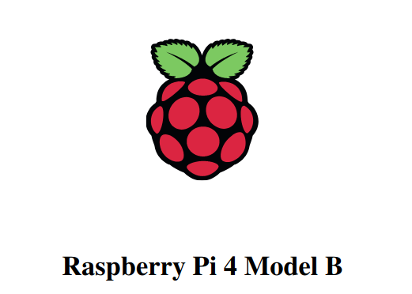
By Khushal

Slide 2
Introduction
The Raspberry Pi is a low cost, credit-card sized computer.
It plugs into a computer monitor or TV, and uses a standard keyboard and mouse.
Its use to explore computing, and to learn how to program in languages like Scratch and Python.
Its avaiable with either 1, 2 and 4 GB RAM.

Slide 3
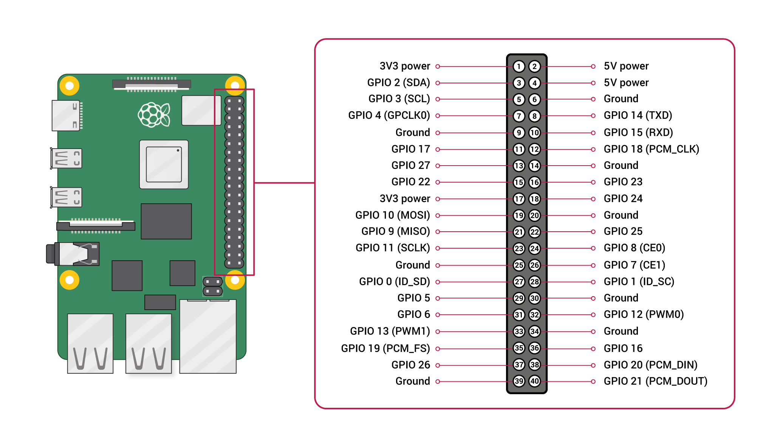
GPIO Pins

Slide 4
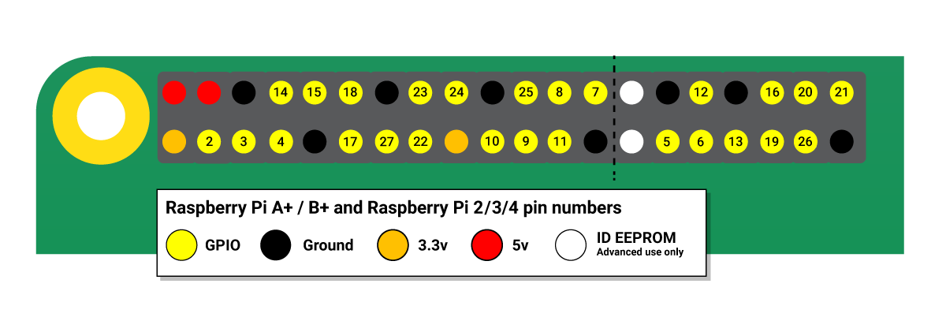
GPIO Pins

Slide 5
GPIO Pins
28x user GPIO supporting various interface options:
Up to 6x UART
Up to 6x I2C
Up to 5x SPI
1x SDIO interface
1x DPI (Display Parallel Interface)
1x PCM
Up to 2x PWM channels
Up to 3x GPCLK outputs

Slide 6
GPIO Pins
GPIO pins can be switched (multiplexed) into various other modes backed by dedicated peripheral blocks such as I2C, UART and SPI.
Wirinig PI provide functionality for convenient programming for program in C.
pinMode(PIN_nr, OUTPUT); //Set direction O/P
pinMode(PIN_nr, INPUT); //Set direction I/P
digitalWrite(PIN_nr, HIGH); // Set Pin
digitalWrite(PIN_nr, LOW); // Clear Pin
digitalRead(PIN_nr); // Read pin

Slide 7
GPIO Pins
#include <wiringPi.h>
int main (void)
{
wiringPiSetup () ;
pinMode (3, OUTPUT) ;
for (;;)
{
digitalWrite (3, HIGH) ; delay (500) ;
digitalWrite (3, LOW) ; delay (500) ;
}return 0 ;
}
$ gcc -Wall -o buttons buttons.c -lwiringPi

Slide 8
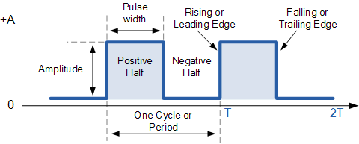
GPIO Pins
Interrupt can be set using GPIO pins by using:
wiringPiISR(button, INT_EDGE_FALLING, &myInterrupt);
Here,
Button = GPIO_pin_number
EDGE = Rising or Falling
MyInterrupt = ISR

Slide 9
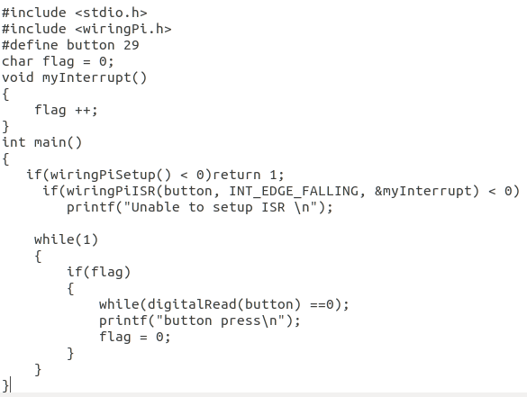
GPIO Pins

Slide 10
GPIO Pins
#include <linux/gpio.h> // Header file
int gpio_request(unsigned int gpio, const char *label);
void gpio_free(unsigned int gpio); // Free requested GPIO
int gpio_direction_input(unsigned int gpio); // Set for sensor
int gpio_direction_output(unsigned int gpio, int value);
void gpio_set_value(unsigned int gpio, int value);
int gpio_get_value(unsigned int gpio); // Read GPIO

Slide 11
Thanks...

