Slide 1
NutriMyWay Portal Overview
Members and Admin Settings
Detailed Walkthrough

Slide 2
Members Page: Features & Functionalities
The Members page is the central hub for managing all members.
Member Lookup & Onboarding
Search by Mobile, Email, or Membership No.
Quick registration for new members directly from the interface.
Health Records Tracking
Logs Weight, BMI, Body Fat, Visceral Fat, and Muscle Mass.
Includes Metabolic Age, BMR, and Resting Heart Rate.

Slide 3
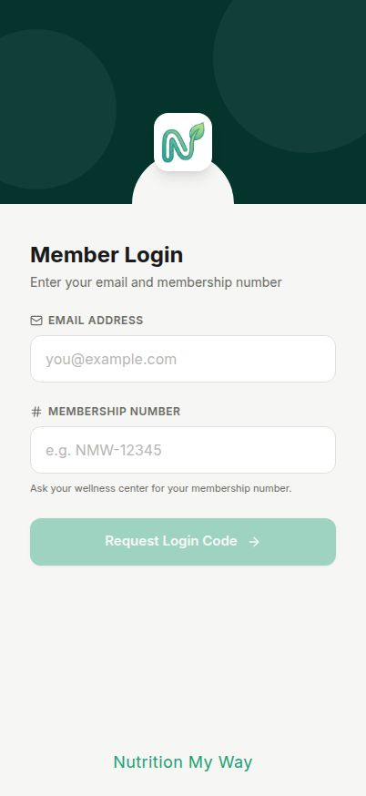
Members Page Screenshot

Slide 4
Admin Settings: Features & Functionalities
Configures global settings and operational parameters for the center.
Broadcast Settings
Schedule automated announcements and messages to members.
Manage retention periods and broadcast history.
Flavour & Inventory Management
Configure active operational days (Mon-Sun).
Define and manage units of measurement (g, kg, ml, pcs, etc.).

Slide 5
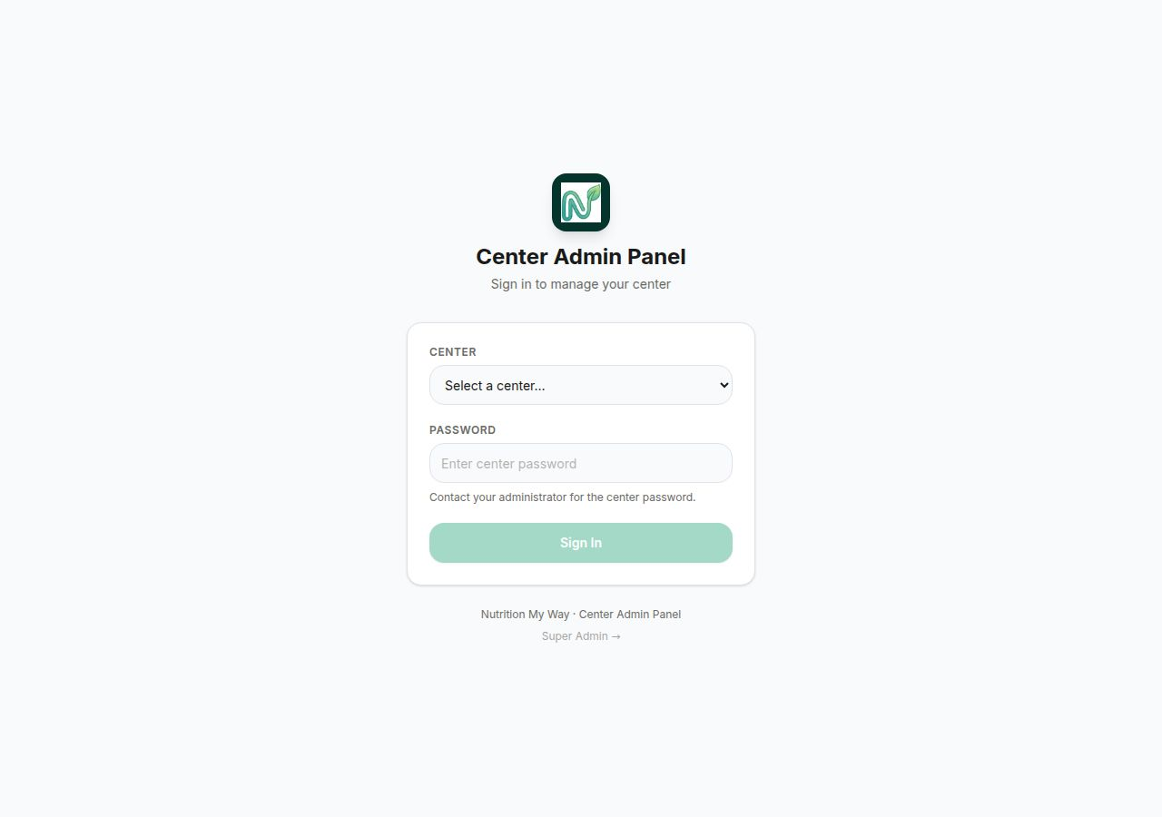
Admin Settings Screenshot

Slide 6
Summary & Conclusion
Streamlined Member Management
Provides easy access to health metrics and membership statuses.
Efficient Center Operations
Centralizes communication and inventory configurations.

