Slide 1
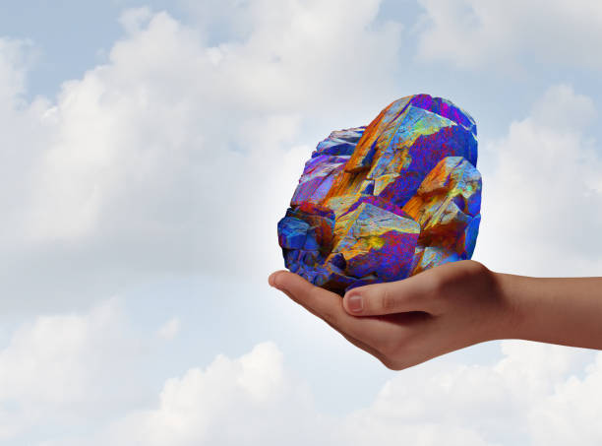

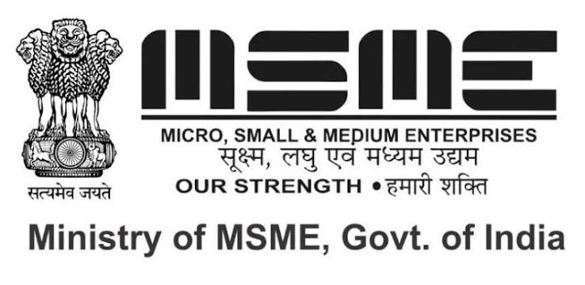

India International Strategic Minerals Expo (IISMExpo) - 2027
The India International Strategic Minerals Expo (IISME) is one of the India’s premier business and knowledge platforms dedicated to the future, that protects and promotes the interests of India's Rare Earth Mining, Metal, and Mineral-based sectors and allied industries.
Bringing together Mining companies, manufactures, Technology providers, Government organisations, Research institutions, Startups, Importers and Exporters, Distributors IISME creates a dynamic ecosystem for collaborations and growth.
Organized by:
Supported by:
15,000+ 250+ 500+
Exhibitors VIP Buyers Meeting Visitors
AMIGOCONNECT
Website: www.iismexpo.Com

Slide 2
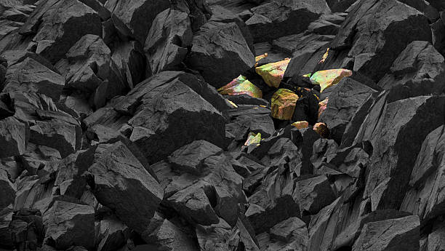
India International Strategic Minerals Expo (IISMExpo) - 2027
Overview of India International Strategic Minerals Expo (IISME)
Established: 2026
Role: Provide Platforms to protects and promotes the interests of India's Rare Earth Mining, Metal, and Mineral Sectors
Sectors Covered: Private, Joint, and Public Sectors
IISME dedicated to promote wide range of natural resource and processing fields:
Rare Earth Metals
Mining and coal
Metal making and mineral processing
Cement production
Granite, stone, marble, and slate
The organization helps key stake holders to deal with major industry challenges, including:
Lease grants, renewals, and tenures
Production and taxation rules
Trade and exports
Labor matters
200+ 250+ 5000+
Exhibitors VIP Buyers Visitors
AMIGOCONNECT
Website: www.iismexpo.Com

Slide 3
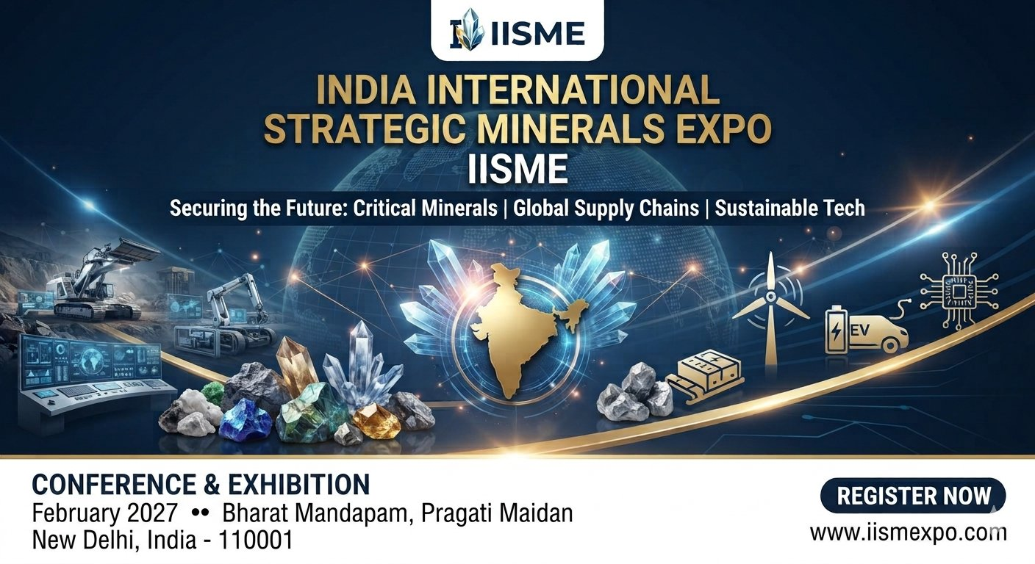
About the Event
India International Strategic Minerals Expo (IISMExpo) – 2027 is India’s premier international exhibition dedicated to critical minerals, commodities, investment, clean energy, and low-carbon technologies. Hosted in Bharat Mandapam, New Delhi, India this landmark event unites the entire mineral resources value chain to drive the future of energy transition.
The Strategic Context - As India accelerates toward its 2070 net-zero target, the demand for essential minerals like lithium, nickel, cobalt, copper, graphite, and rare earth elements is skyrocketing. Facing tight domestic reserves and limited mining capacity, India is actively prioritising strategic stockpiling to safeguard industrial growth and ensure uninterrupted resource security.
National Critical Mineral Mission (NCMM)
To combat geopolitical supply risks and foster self-reliance, the Government of India has launched the National Critical Mineral Mission (NCMM). Backed by a massive budget exceeding ₹34,000 crores (USD 4 billion), this strategy aims to build a resilient, globally competitive critical minerals ecosystem encompassing:
Exploration & Mining
Beneficiation & Processing
Advanced Recycling & Recovery
The Pivotal Role of State Governments
This exhibition spotlights state governments as the bedrock of India's processing capabilities. As the primary implementing agencies, states are instrumental in:
Accelerating infrastructure development
Streamlining regulatory frameworks
Fostering industrial ecosystems for clean-energy manufacturing
Website: www.iismexpo.Com

Slide 4
India International Strategic Minerals Expo (IISMExpo 2027)
Blueprint for India's Critical Mineral Future
A B2B, G2B Event Framework | National Critical Mineral Mission
India International Strategic Minerals Expo (IISMExpo 2027) is the definitive international platform for India's mining and mineral ecosystem.
The Mission:
Connect government, industry, finance, and technology to drive strategic, 21st-century mining priorities.
The Scope:
Cover the complete resource lifecycle—from exploration and processing to sustainable manufacturing, mine closure, and community transition.
The Expo Showcases in Eight Sectors:
Rare Earth Metals and commodities
Mining
Metal making and mineral processing
Critical raw materials
Clean‑Energy Transition
Technology Innovation
Strategic Investments
AI, Technology Advancements & Hydrogen in Mining
Website: www.iismexpo.Com

Slide 5
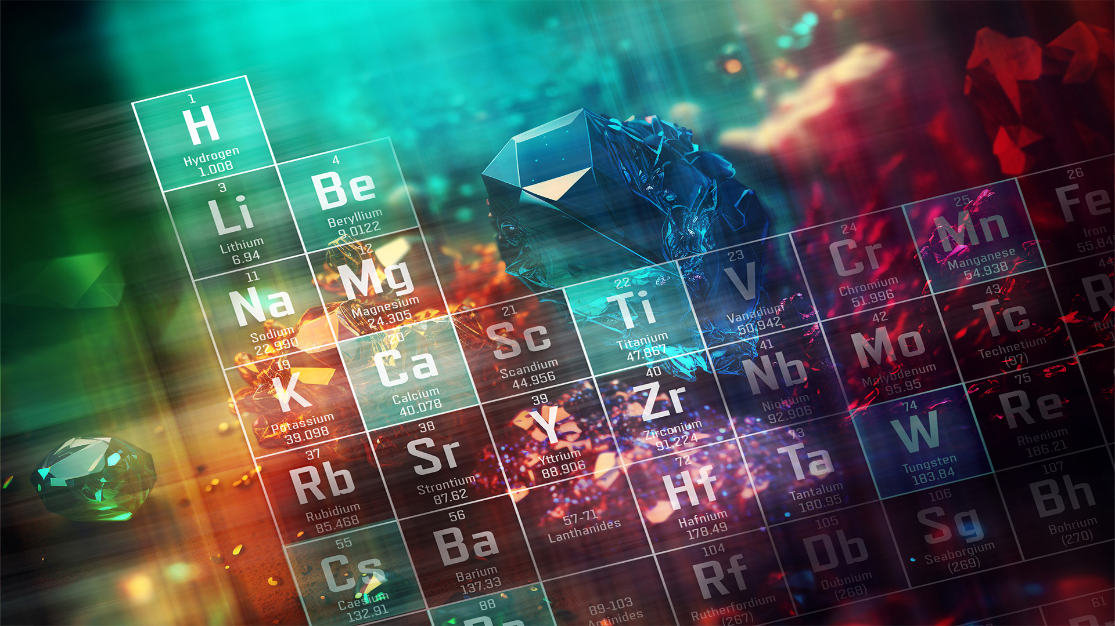

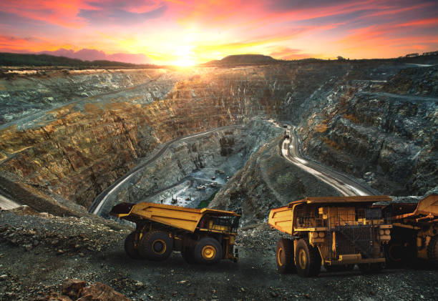
Strategic Vision & Objectives
Why Now?
• Aligns with India's National Critical Mineral Mission & Net-Zero targets.
• Secures supply chain resilience for high-tech industries and EV sectors.
• Promotes domestic exploration, refining, and urban mining innovations.
Key Event Goals
• Foster global tech transfer in REE exploration and processing.
• Attract foreign direct investment (FDI) and venture capital into mining.
• Create a unified B2B G2B platform for policymakers, PSUs, and private buyers.
Website: www.iismexpo.Com

Slide 6
Why Exhibit:
Connect With Stake holders and Distributors
Launch Innovative Products
Generate G2B and B2B Opportunities
Meet Prospective Buyers, Importers and Exporters
Build strategic partnership
Expand into India’s growing Rare Earth, Mining Sector
Source and Identify New Business Opportunities and Technology
Understand Best Practice
Government Schemes
Develop New Suppliers
Website: www.iismexpo.Com

Slide 7

WAYS IISMEXPO EMPOWERS YOUR BRAND
TO MEET ITS STRATEGIC MARKETING OBJECTIVES:
India International Strategic Minerals Expo (IISME) over the three days will create a multi-pronged spectrum of activities to help you to achieve all these objectives and much more through a wide array of activities including but not limited to:
Exhibition: World class exhibition with 200+ exhibitors showcasing a wide array of products/Services covering all needs of buyers from across the global in an environment that is conductive to productive discussions.
Conference: A highly sector focused conference that will bring together all stake holders of the sectors to discuss debate and collaborate on growth strategies leveraging proven best practice, cutting edge technologies and shared networks.
Excellence Awards: The awards for Excellence in Mining and Metals, Rare Earth Metals will put a spotlight on the product, organisations and leaders of the Mining sector that are making exemplary contribution to the sector. The Winners success stories will be showcased as a part of the post event on Print Media, Electronic and social media.
B2B Meetings: Exhibitors opting for some specific packages will get the options of picking up names from the pre-registered buyers for facilitate one to one meeting. This works like an added advantage providing you the opportunities to ensure you don’t miss out the opportunity of meeting big buyers.
Social Meida Amplifications: We will be running an intensive social media campaign with an extensive reach to our database, followership of about 50,000+ professionals, in addition to our general campaigns we will be delighted to develop special promotions for you on an exclusive basis.
Product launch Support: In case you are planning on any new product/Services launch at the event we will be happy to help create that attention and visibility around the same by aligning it with the opening and closing ceremonies, conference session, VIP Visit or Exclusive Print Coverage in The HINDUSTAN TIMES or THE ECONOMIN TIMES (will be discussed separately)
Individual Post Event Promotion: Print Coverage in THE HINDUSTAN TIMES or THE ECONOMIN TIMES (will be discussed separately). This will provide another opportunity to showcase your success story to the industry and public.
Website: www.iismexpo.Com

Slide 8
PAVILLIONS
Mines and Minerals
Rare Earth Metals
Mining Machinery
Chemicals
OEM, EV and Batteries
Logistics Service Providers
. Artificial Intelligence (AI) and advanced software architectures
Website: www.iismexpo.Com

Slide 9
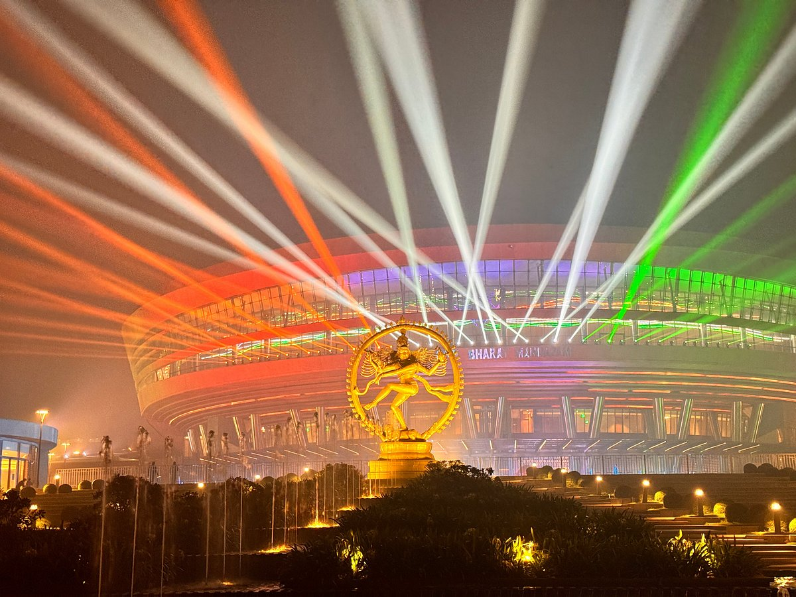
Venue
New Delhi | Bharat Mandapam, Pragati Maidan (IECC)
3-4-5 February 2027
Website: www.iismexpo.Com

Slide 10
Sectors
Exploration & Mining Tech
AI mapping, advanced drilling rigs, deep-earth geophysical sensors.
Processing & Metallurgy
Chemical refining tech, pilot plant models, advanced metallurgy.
Strategic Applications
Permanent magnets, EV motors, defense systems, aerospace tech.
Circular Economy
E-waste urban mining, recycling tech, battery recovery systems.
1.Exploration & Extraction
This sector focuses on finding and pulling resources out of the ground.
Geological Exploration & Surveying: Companies specializing in remote sensing, core drilling, and geochemical mapping to locate mineral deposits.
Mining Operations: Open-pit and underground mining operations extracting raw ores (e.g., bastnäsite and monazite for rare earths, chalcopyrite for copper).
Mining Equipment & Machinery: Manufacturers of heavy earthmovers, drill rigs, crushing units, and automated mining systems like Caterpillar Mining.
2.Processing & Refining
Raw ore is virtually useless without intensive chemical and metallurgical processing to isolate pure metals.
Beneficiation & Concentration: Crushing, grinding, and froth flotation sectors that separate valuable mineral grains from waste rock (gangue).
Chemical Cracking & Hydrometallurgy: Acid leaching and solvent extraction plants specifically designed to separate individual Rare Earth Elements (REEs) like Neodymium, Dysprosium, and Praseodymium, which are chemically very similar and notoriously difficult to isolate.
Smelting & Alloying: Converting purified mineral concentrates into industrial metals and master alloys.
3.Advanced Manufacturing
This sector transforms processed minerals into the high-tech components that drive the modern economy.
Permanent Magnet Manufacturing: The largest sector for critical rare earths. Purified Neodymium-Iron-Boron (NdFeB) magnets are essential for Electric Vehicle (EV) drivetrains and wind turbine generators.
Clean Energy & Battery Storage: Production of lithium-ion batteries, fuel cells, and solar photovoltaics using cobalt, nickel, lithium, and copper.
Defence & Aerospace Technologies: Sectors utilizing rare earths and specialty titanium/nickel alloys for jet engines, missile guidance systems, satellites, and night-vision optics.
Electronics & Semiconductors: Utilization of critical minerals for polishing silicon wafers, creating micro capacitors, and manufacturing displays (using europium and yttrium for phosphors).
4. Cross-Cutting & Support Sectors
Mineral Recycling & Circular Economy: E-waste and battery recycling sectors focused on urban mining to recover secondary rare earths, copper, and cobalt.
Environmental & Waste Management: Companies managing tailings ponds, acid mine drainage mitigation, and sustainable mine closures.
Commodity Trading & Investment: Financial institutions, metal exchanges, and venture capital firms funding resource exploration and strategic stockpiling.

Slide 11
Target Audience & Ecosystem Mapping
Exhibitor Profiles
• Global Mining Technology Providers
• Heavy Machinery & Refining Equippers
• Geological & Software Engineering Firms
• E-Waste Processing Innovators
Website: www.iismexpo.Com

Slide 12
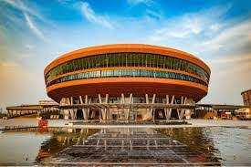
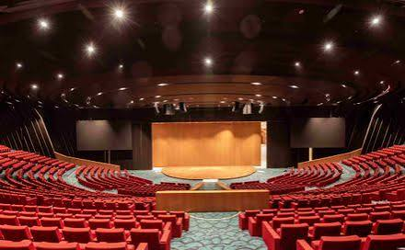
Conference Agenda:
Location: Bharat Mandapam, New Delhi, India - 110001
Day 1:
Bidding & Block Allocation
Supply Chain De-risking
Sustainable 'Green' Mining
Day 2:
Policy, Investment & Global Trade.
Exploration, Technology & Processing
Clean Energy & Low-Carbon Integration
Downstream Manufacturing & Recycling
Website: www.iismexpo.Com

Slide 13
Let's collaborate to build a resilient critical mineral future.
AMIGOCONNECT
For More Details and Exhibition Participation : WhatsApp: +91 9971587831, +91 9220803001, Email: padam@amigoconnect.com

