Slide 1


PROPANE
Atom count verified
Valence checked
Same connectivity confirmed
MOLECULAR FORMULA
LEWIS STRUCTURE
H
H
H
C H
3
8
H
C
C
C
H
H
H
H
CONDENSED STRUCTURAL FORMULA
BOND-LINE FORMULA
CH CH CH
3
2
3

Slide 2
ETHANOL
Atom count verified
Valence checked
Same connectivity confirmed
MOLECULAR FORMULA
LEWIS STRUCTURE
H
H
C H O
H
C
C
O
H
2
6
H
H
CONDENSED STRUCTURAL FORMULA
BOND-LINE FORMULA
CH CH OH
3
2
OH

Slide 3
ACETONE (propan-2-one)
Atom count verified
Valence checked
Same connectivity confirmed
MOLECULAR FORMULA
LEWIS STRUCTURE
H
O
H
C H O
3
6
H
C
C
C
H
H
H
CONDENSED STRUCTURAL FORMULA
BOND-LINE FORMULA
O
CH COCH
3
3

Slide 4
Atom count verified
ACETIC ACID (ETHANOIC ACID)
Valence checked
Same connectivity confirmed
MOLECULAR FORMULA
LEWIS STRUCTURE
H
O
C H O
2
4
2
H
C
C
O
H
H
CONDENSED STRUCTURAL FORMULA
BOND-LINE FORMULA
O
CH COOH
3
OH

Slide 5
Atom count verified
ETHYL ACETATE (ETHYL ETHANOATE)
Valence checked
Same connectivity confirmed
MOLECULAR FORMULA
LEWIS STRUCTURE
H
O
H
H
C H O
4
8
2
H
C
C
O
C
C
H
H
H
H
CONDENSED STRUCTURAL FORMULA
BOND-LINE FORMULA
O
CH COOCH CH
3
2
3
O

Slide 6
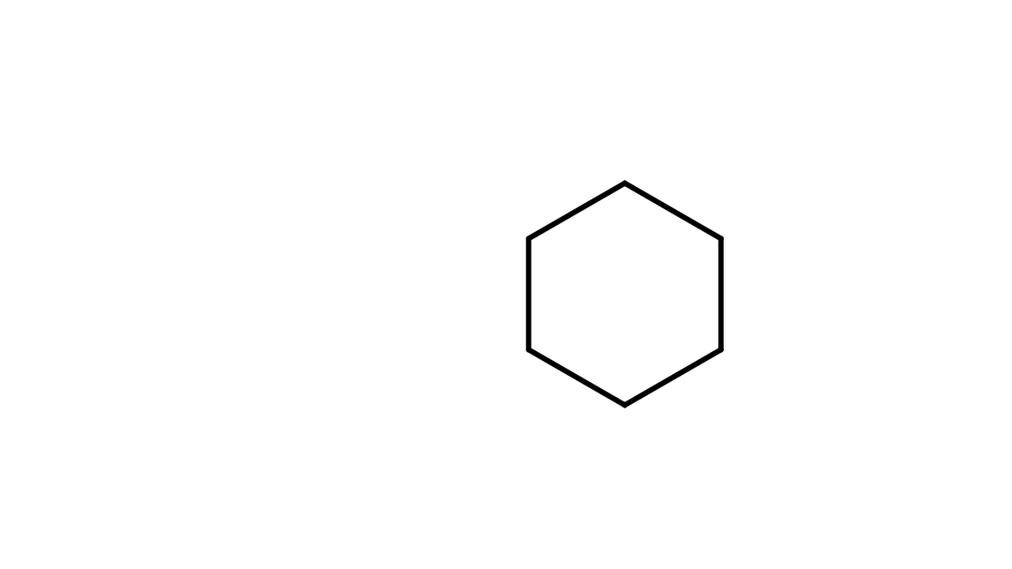
Atom count verified
CYCLOHEXANE
Valence checked
Same connectivity confirmed
MOLECULAR FORMULA
LEWIS STRUCTURE
H
H
H
C
H
H
C
C
H
C H
6
12
H
C
C
H
H
C
H
H
H
CONDENSED STRUCTURAL FORMULA
BOND-LINE FORMULA
CH
CH
CH
CH
CH
CH
2
2
2
2
2
2

Slide 7
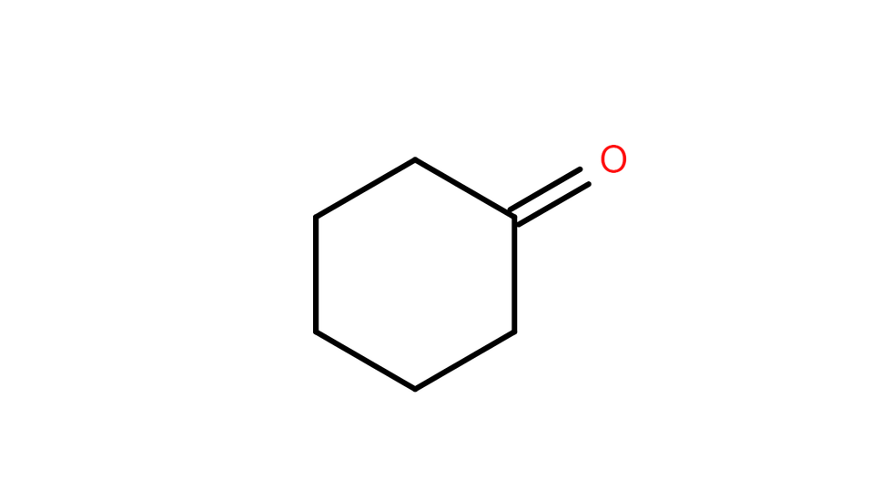
Atom count verified
CYCLOHEXANONE
Valence checked
Same connectivity confirmed
MOLECULAR FORMULA
LEWIS STRUCTURE
H
O
H
C
C
C H
O
H
H
C
C
6
10
H
H
C
C
H
H
H
H
CONDENSED STRUCTURAL FORMULA
BOND-LINE FORMULA
O
CH
(CH
)
CO
2
2
4

Slide 8
Atom count verified
ACETAMINOPHEN (PARACETAMOL)
Valence checked
Same connectivity confirmed
MOLECULAR FORMULA
LEWIS STRUCTURE
H
H
C H NO
C
C
H
8
9
2
O
C
C
N
H
H
C
C
C
C
H
H
H
O
H
CONDENSED STRUCTURAL FORMULA
BOND-LINE FORMULA
OH
O
HOC H NHCOCH
6
4
3
N
H

Slide 9
Atom count verified
ASPIRIN (ACETYLSALICYLIC ACID)
Valence checked
Same connectivity confirmed
MOLECULAR FORMULA
LEWIS STRUCTURE
H
O
O
C
H
H
C H O
H
C
O
C
9
8
4
C
C
C
H
C
C
O
H
C
H
H
CONDENSED STRUCTURAL FORMULA
BOND-LINE FORMULA
O
OH
CH
COOC
H
COOH
3
6
4
O

Slide 10
Atom count verified
CAFFEINE
Valence checked
Same connectivity confirmed
MOLECULAR FORMULA
LEWIS STRUCTURE
H
H
H
C
O
N
C
H
H
C H
N O
C
O
C
C
H
8
10
4
2
N
N
C
C
C
H
H
N
H
H
CONDENSED STRUCTURAL FORMULA
BOND-LINE FORMULA
O
N
CH
NC
N
O
(NC)
NC
3
2
(=O)N(CH )C(=O)
3
N
O
N

