Slide 1
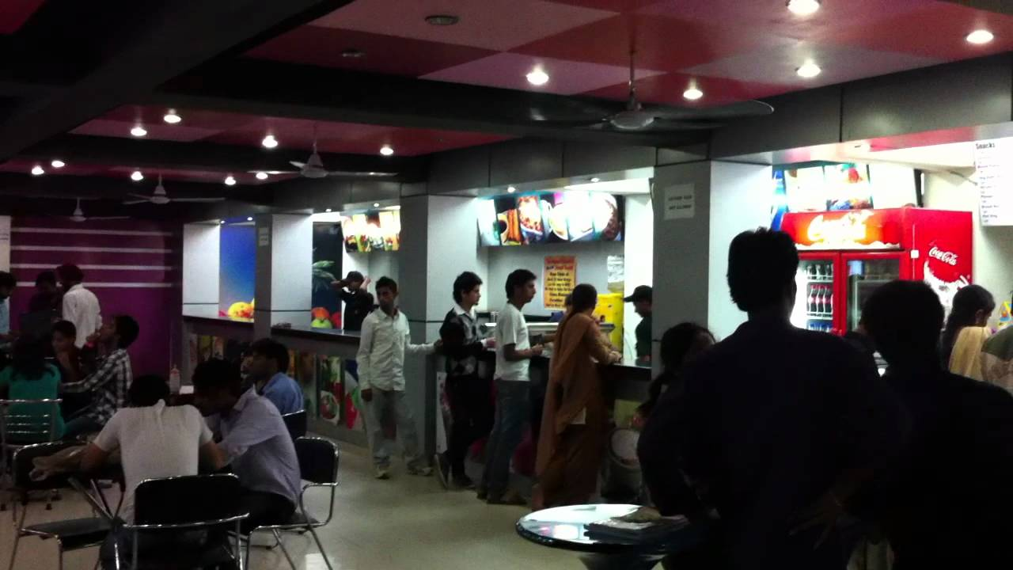
CANTEEN MANAGEMENT SYSTEM
BANGALI BAWARCHI

Slide 2
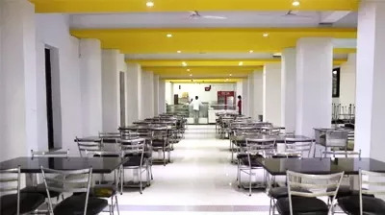
CONTENT
INTRODUCTION
SCOPE OF A PROJECT
KEY POINTS
MODULES
CONCLUSIONS

Slide 3
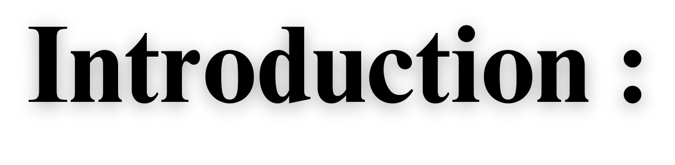
A canteen management system is a software application that helps manage the operations of a canteen or cafeteria, such as in schools, colleges, hospitals, or offices. The system enables efficient management of orders, inventory, payments, and customer information, providing an easier and more streamlined process for canteen staff and customers.
The use of a canteen management system can help increase the accuracy of order processing, reduce errors in payments and inventory, and improve overall customer satisfaction. Additionally, it can provide valuable insights into customer preferences and sales data, which can be used to make informed decisions on menu items and pricing.
In this context, using Java's Swing library and JFrames can be a powerful tool for developing a user-friendly and efficient canteen management system. By designing a visually appealing and intuitive user interface and implementing the necessary functions, a Java-based canteen management system can help enhance the efficiency and profitability of canteen operations.

Slide 4
SCOPE OF A PROJECT
Menu Management: The system should provide a menu management module that allows canteen staff to manage the menu items, including their prices, ingredients, and availability.
Ordering: The system should allow customers to place orders for food items, view the status of their orders, and make payments through the system.
Inventory Management: The system should allow the canteen staff to manage the inventory of ingredients and supplies, as well as track their usage and reorder levels.
Billing and Payment: The system should generate bills for customers based on their orders and provide a payment module that allows customers to make payments through the system.
Reporting: The system should provide various reports for the canteen staff and administrators, such as sales reports, inventory reports, and customer feedback reports.
User Management: The system should provide user management functionality that allows the administrators to manage the access and permissions of different users (e.g., canteen staff, customers, and administrators).

Slide 5
KEY POINTS
User-friendly interface: The system should have a user-friendly interface for canteen staff and customers, making it easy to place orders, manage inventory, and generate reports.
Accurate inventory management: The system should allow the canteen staff to manage the inventory of ingredients and supplies accurately, reducing wastage, and preventing stockouts.
Payment integration: The system should integrate with payment gateways to allow customers to make payments seamlessly, and the canteen staff to track payments easily.
Customization: The system should be customizable to the specific needs of the organization, allowing for the addition of new menu items, integration with other systems, and customization of reports.
Security: The system should be secure, protecting the personal and financial information of customers and ensuring that only authorized users have access to the system.
Reporting: The system should provide various reports to help the canteen staff and administrators make informed decisions, such as sales reports, inventory reports, and customer feedback reports.
Scalability: The system should be scalable to accommodate the needs of the organization as it grows, allowing for the addition of new canteen locations and users.

Slide 6
MODULES
LOGIN
MENU LIST PANEL
EMPLOY PANEL
ORDER PANEL
PAYMENT PANEL

Slide 7
CONCLUSION
canteen management system is an essential tool for streamlining operations, improving efficiency, and enhancing the customer experience. By automating processes such as menu management, ordering, inventory management, and payment processing, the system can reduce errors, save time, and provide useful insights and reports for decision-making. Additionally, the system's user-friendly interface, customization options, and scalability make it a valuable investment for organizations of all sizes. Overall, a well-designed canteen management system can help organizations improve their bottom line, better serve their customers, and stay ahead of the competition.

Slide 8


