Slide 1
Web engineering
Responsive Design

Slide 2
Bootstrap navbar

Slide 3
Bootstrap Buttons
Button Styles
Bootstrap provides seven styles of buttons with the following classes:
.btn-default
.btn-primary
.btn-success
.btn-info
.btn-warning
.btn-danger
.btn-link
<button type="button" class="btn btn-default"> Default </button>

Slide 4
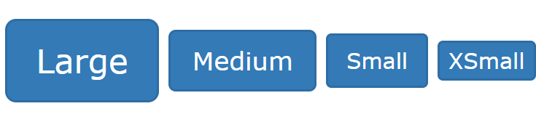
Button Sizes
Bootstrap provides four button sizes with the following classes:
.btn-lg
.btn-md
.btn-sm
.btn-xs

Slide 5
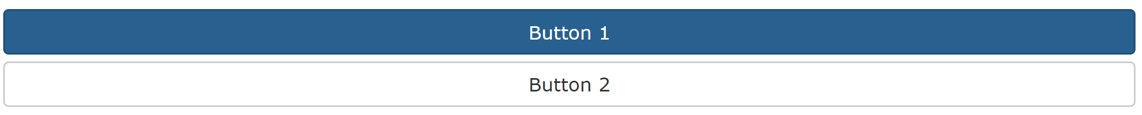
Block Level Buttons
A block level button spans the entire width of the parent element.
Add class .btn-block to create a block level button:

Slide 6
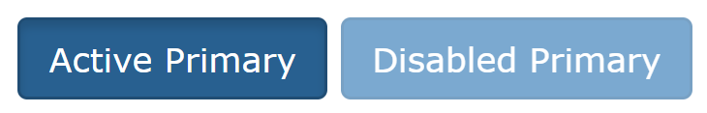
Active/Disabled Buttons
A button can be set to an active (appear pressed) or a disabled (unclickable) state:
The class .active makes a button appear pressed, and the class .disabled makes a button unclickable:
Buttons

Slide 7
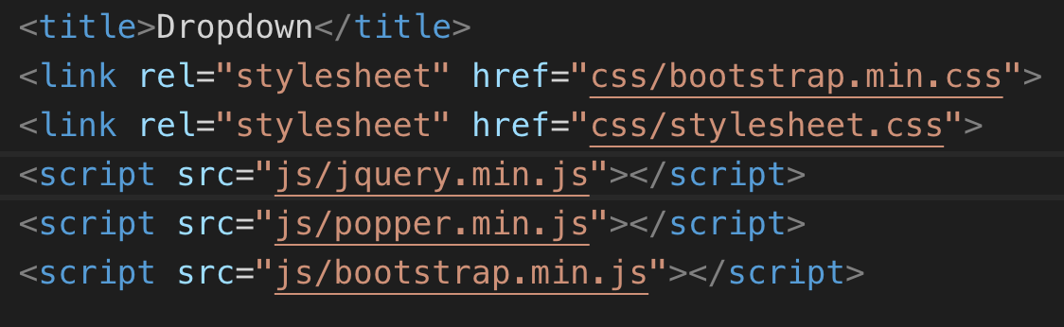
Dropdown buttons
Dropdowns are built on a third party library, Popper.js, which provides dynamic positioning and viewport detection. Be sure to include popper.min.js before Bootstrap’s JavaScript

Slide 8
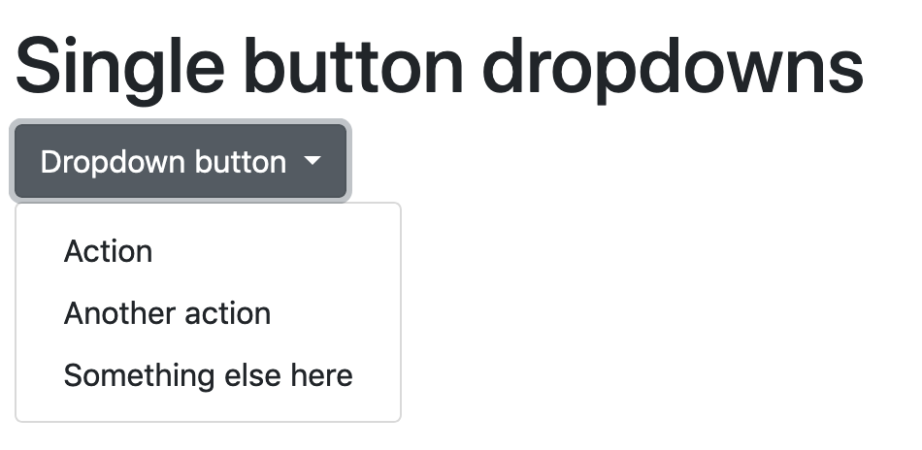
<div class="dropdown">
<button class="btn btn-secondary dropdown toggle" type="button" id="dropdownMenuButton" data-toggle="dropdown" aria-haspopup="true" aria-expanded="false">
Dropdown button
</button>
<div class="dropdown-menu" aria-labelledby="dropdownMenuButton">
<a class="dropdown-item" href="#">Action</a>
<a class="dropdown-item" href="#">Another action</a>
<a class="dropdown-item" href="#">Something else here</a>
</div>
</div>

Slide 9
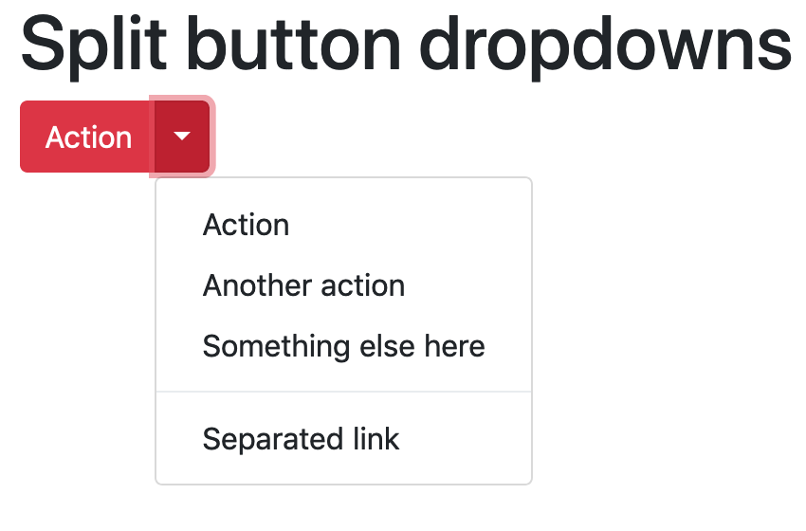
<div class="btn-group">
<button type="button" class="btn btn-danger">Action</button>
<button type="button" class="btn btn-danger dropdown-toggle dropdown-toggle-split" data-toggle="dropdown" aria-haspopup="true" aria-expanded="false">
<span class="sr-only">Toggle Dropdown</span>
</button>
<div class="dropdown-menu">
<a class="dropdown-item" href="#">Action</a>
<a class="dropdown-item" href="#">Another action</a>
<a class="dropdown-item" href="#">Something else here</a>
<div class="dropdown-divider"></div>
<a class="dropdown-item" href="#">Separated link</a>
</div>
</div>
Similarly, create split button dropdowns with virtually the same markup as single button dropdowns, but with the addition of
.dropdown-toggle-split for proper spacing around the dropdown caret.

Slide 10
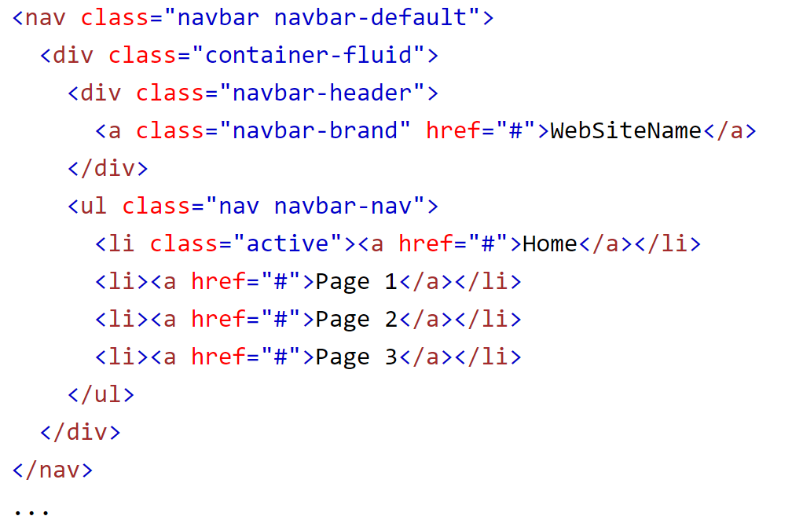
Bootstrap navbar
A standard navigation bar is created with <nav class="navbar navbar-default">.
Black Navbar: change the .navbar-default class into .navbar-inverse
Top Fixed Navbar: The .navbar-fixed-top class makes the navigation bar fixed at the top:

Slide 11
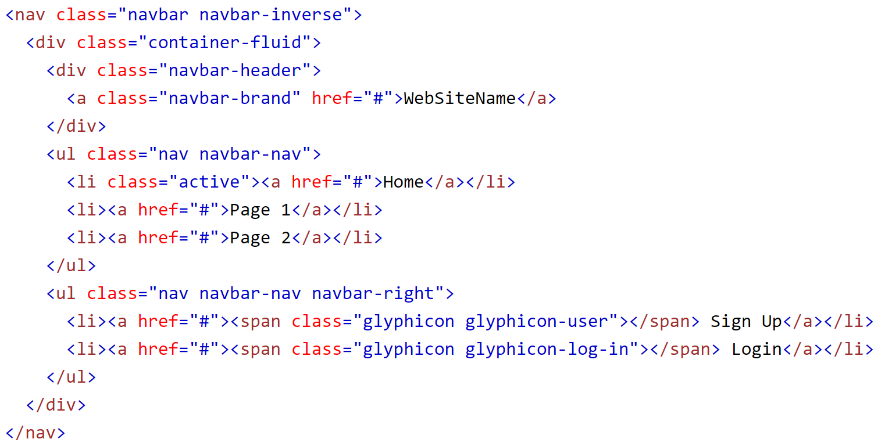
Right-Aligned Navigation Bar
The .navbar-right class is used to right-align navigation bar buttons.

Slide 12
Bootstrap 4
With Bootstrap, a navigation bar can extend or collapse, depending on the screen size.
A standard navigation bar is created with the .navbar class, followed by a responsive collapsing class: .navbar-expand-xl|lg|md|sm (stacks the navbar vertically on extra large, large, medium or small screens).
To add links inside the navbar, use a <ul> element with class="navbar-nav". Then add <li> elements with a .nav-item class followed by an <a> element with a .nav-link class:
<!-- A grey horizontal navbar that becomes vertical on small screens -->
<nav class="navbar navbar-expand-sm bg-light"> <!-- Links --> <ul class="navbar-nav"> <li class="nav-item"> <a class="nav-link" href="#">Link 1</a> </li> <li class="nav-item"> <a class="nav-link" href="#">Link 2</a> </li> <li class="nav-item"> <a class="nav-link" href="#">Link 3</a> </li> </ul> </nav>

Slide 13
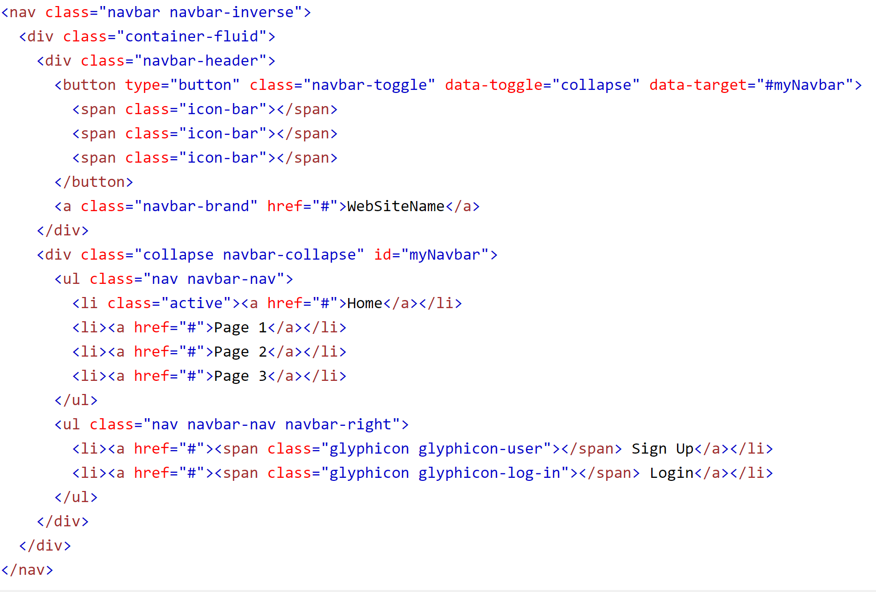
Collapsing The Navigation Bar

Slide 14
Bootstrap 4
<nav class="navbar navbar-expand-md bg-dark navbar-dark"> <!-- Brand --> <a class="navbar-brand" href="#">Navbar</a> <!-- Toggler/collapsibe Button --> <button class="navbar-toggler" type="button" data-toggle="collapse" data-target="#collapsibleNavbar"> <span class="navbar-toggler-icon"></span> </button> <!-- Navbar links --> <div class="collapse navbar-collapse" id="collapsibleNavbar"> <ul class="navbar-nav"> <li class="nav-item"> <a class="nav-link" href="#">Link</a> </li> <li class="nav-item"> <a class="nav-link" href="#">Link</a> </li> <li class="nav-item"> <a class="nav-link" href="#">Link</a> </li> </ul> </div> </nav>

Slide 15
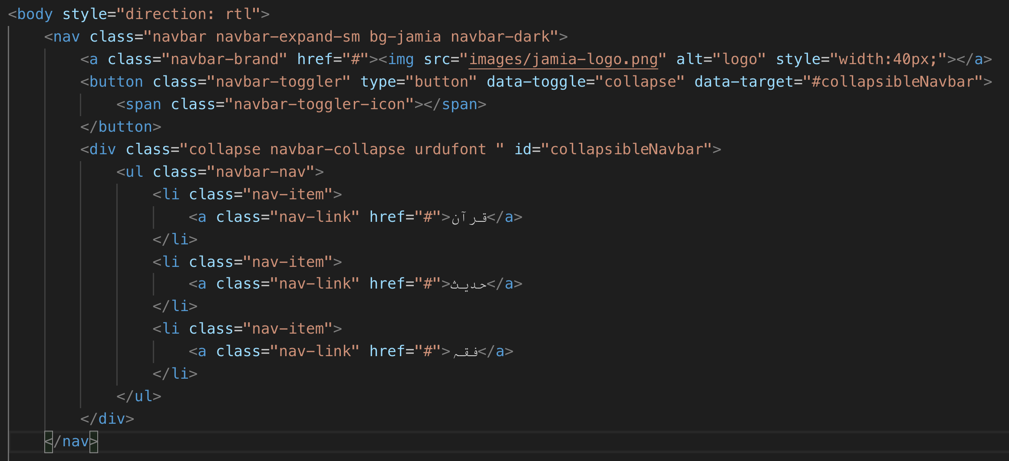



Slide 16

Bootstrap 4 CARD
A basic card is created with the .card class, and content inside the card has a .card-body class:
A card in Bootstrap 4 is a bordered box with some padding around its content. It includes options for headers, footers, content, colors, etc.
A basic card is created with the .card class, and content inside the card has a .card-header, .card-body, .card-footer class:
<div class="card"> <div class="card-header">Header</div> <div class="card-body">Content</div> <div class="card-footer">Footer</div> </div>
To add a background color the card, use contextual classes (.bg-primary, .bg-success, .bg-info, .bg-warning, .bg-danger, .bg-secondary, .bg-dark and .bg-light.

Slide 17
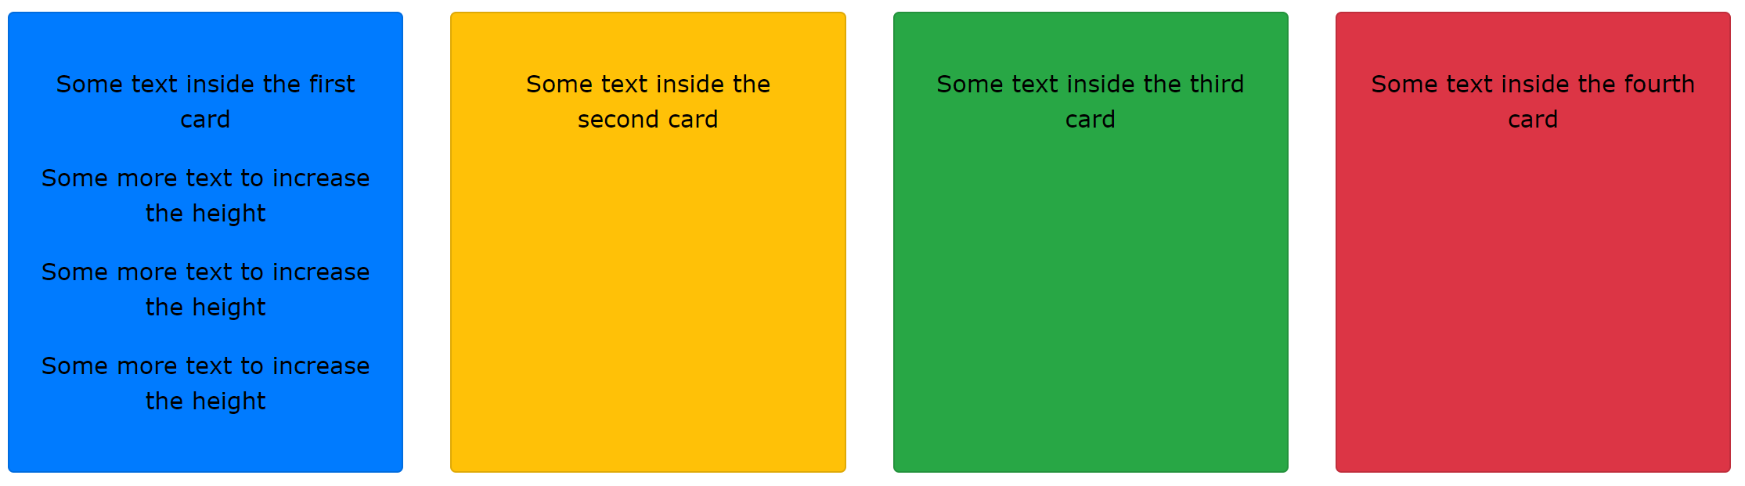
Card deck
<div class="card-deck"> <div class="card bg-primary"> <div class="card-body text-center"> <p class="card-text">Some text inside the first card</p> </div> </div> <div class="card bg-warning"> <div class="card-body text-center"> <p class="card-text">Some text inside the second card</p> </div> </div> <div class="card bg-success"> <div class="card-body text-center"> <p class="card-text">Some text inside the third card</p> </div> </div> <div class="card bg-danger"> <div class="card-body text-center"> <p class="card-text">Some text inside the fourth card</p> </div> </div> </div>
The .card-deck class creates a grid of cards that are of equal height and width. The layout will automatically adjust as you insert more cards.
Note: The cards are displayed vertically on small screens (less than 576px):

Slide 18
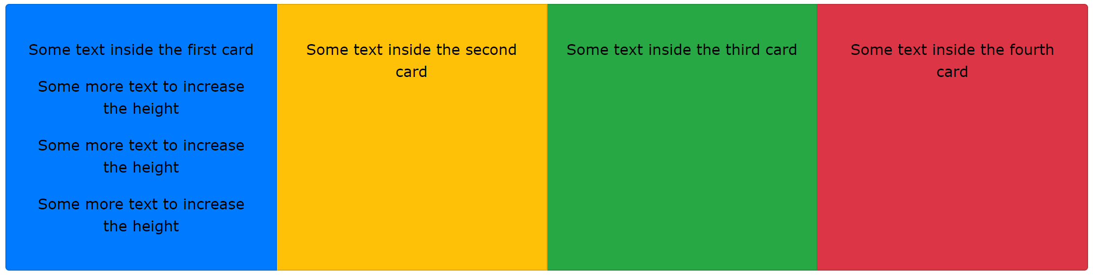
Card group
<div class="card-group"> <div class="card bg-primary"> <div class="card-body text-center"> <p class="card-text">Some text inside the first card</p> </div> </div> <div class="card bg-warning"> <div class="card-body text-center"> <p class="card-text">Some text inside the second card</p> </div> </div> <div class="card bg-success"> <div class="card-body text-center"> <p class="card-text">Some text inside the third card</p> </div> </div> <div class="card bg-danger"> <div class="card-body text-center"> <p class="card-text">Some text inside the fourth card</p> </div> </div> </div>
The .card-group class is similar to .card-deck. The only difference is that the .card-group class removes left and right margins between each card.
Note: The cards are displayed vertically on small screens (less than 576px), WITH top and bottom margin:

Slide 19
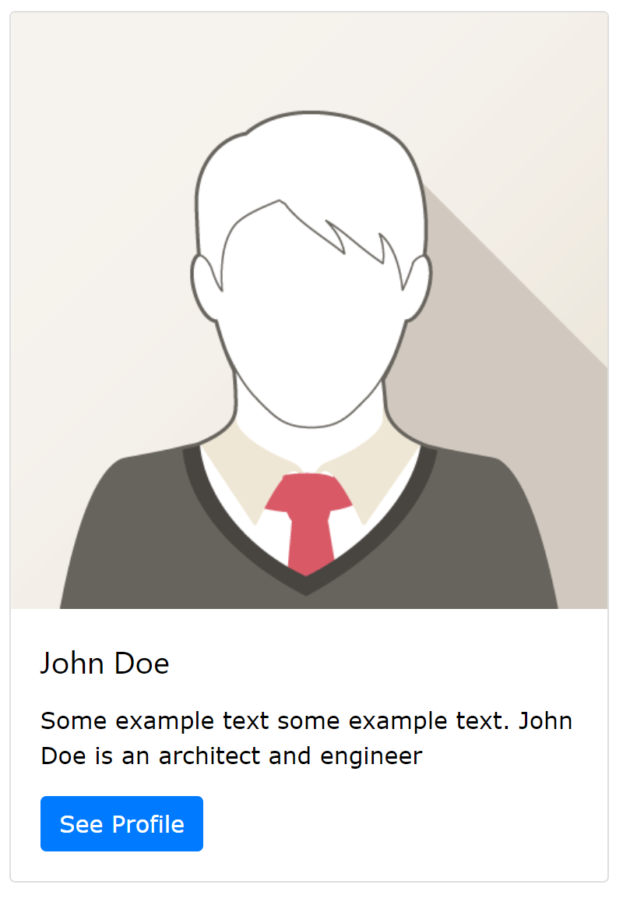
Adding image to card
<div class="card" style="width:400px"> <img class="card-img-top" src="img_avatar1.png" alt="Card image"> <div class="card-body"> <h4 class="card-title">John Doe</h4> <p class="card-text">Some example text.</p> <a href="#" class="btn btn-primary">See Profile</a> </div> </div>

