Slide 1
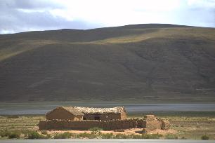
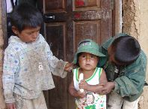
Developing and Using
Case Studies
A way to communicate and learn from “Internationalization” Experiences

Slide 2
Case Study Format:
Internationalizing Extension
Context: Background information, climate, concerns, issues
2. Strategies Described: approaches taken, agencies and actors involved
3. Challenges: concerns that emerged, various perspectives
4. Outcomes: accomplishments, changes, lessons learned

Slide 3
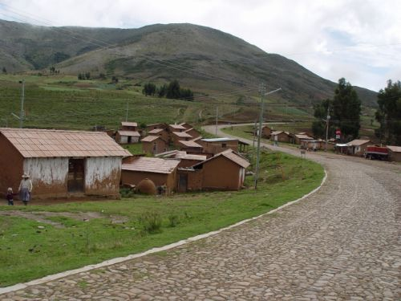
1. Context
Information about the organizational and environmental setting
Climate of the organization or setting
History or conditions influencing the situation
Current concerns or issues

Slide 4
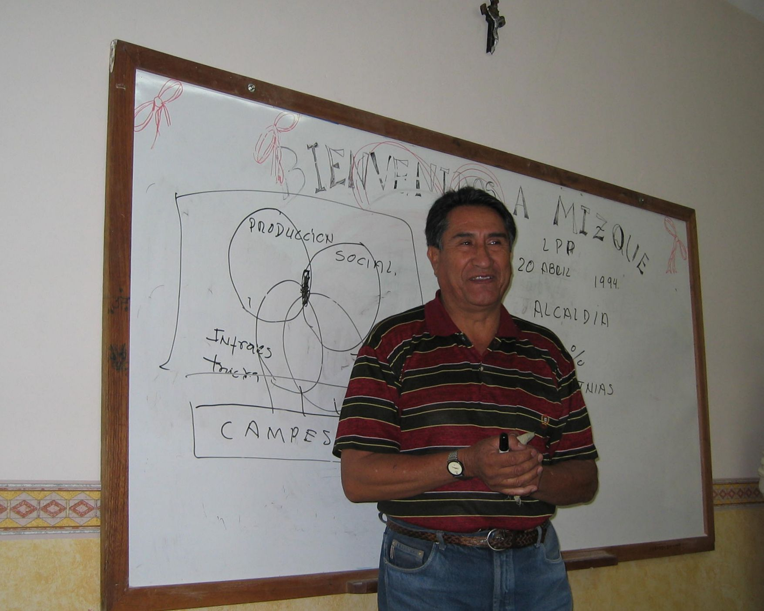
2. Strategies Described
Facts about the case—narrative that describes what innovations were introduced
Actors involved
Strategies tried
Goals or outcomes expected

Slide 5
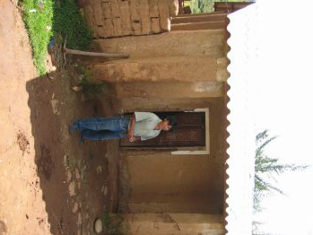
3. Challenges Encountered
Challenges that emerged
Perspectives of various actors
Decisions taken
Actions or changes made

Slide 6

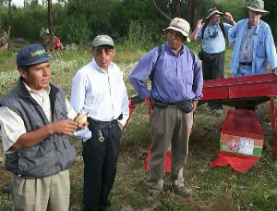
4. Outcomes
Results of changes taken or practices continued
Analysis of post-intervention situation
Accomplishments or outcomes
Lessons learned

Slide 7
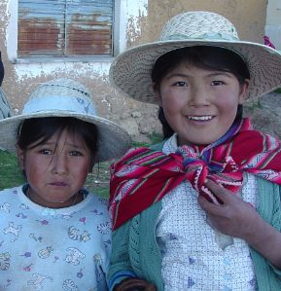
Use of a case study
Read the written case study
Analyze the strategies and resulting outcomes—what happened and why?
Discuss what could have been done to further enhance
outcomes, how could this experience be adapted/replicated
Highlight principles or lessons learned

