Slide 1

Introduction to HP LoadRunner
Getting Familiar with LoadRunner
>>>>>>>>>>>>>>>>>>>>>> www.softwaretestinggenius.com <<<<<<<<<<<<<<<<<<<<<<

Slide 2
Getting Familiar with LoadRunner
  Why LoadRunner
  System Requirements
  LoadRunner Installation
  LoadRunner Terminology
  LoadRunner Components
  How LoadRunner Works
>>>>>>>>>>>>>>>>>>>>>> www.softwaretestinggenius.com <<<<<<<<<<<<<<<<<<<<<<

Slide 3
Why LoadRunner
An industry-leading performance and load testing product by Hewlett-Packard (since it acquired Mercury Interactive in November 2006).
LoadRunner reduces the personnel requirements by replacing human users with virtual users or Vusers. These Vusers emulate the behavior of real users — operating real applications.
Because numerous Vusers can run on a single computer, LoadRunner reduces the hardware requirements.
The LoadRunner Controller allows you to easily and effectively control all the Vusers — from a single point of control.
LoadRunner monitors the application performance online, enabling you to fine-tune your system during test execution.
>>>>>>>>>>>>>>>>>>>>>> www.softwaretestinggenius.com <<<<<<<<<<<<<<<<<<<<<<

Slide 4
Why LoadRunner
LoadRunner automatically records the performance of the application during a test. You can choose from a wide variety of graphs and reports to view the performance data.
LoadRunner checks where performance delays occur: network or client delays, CPU performance, I/O delays, database locking, or other issues at the database server. LoadRunner monitors the network and server resources to help you improve performance.
Because LoadRunner tests are fully automated, you can easily repeat them as often as you need.
>>>>>>>>>>>>>>>>>>>>>> www.softwaretestinggenius.com <<<<<<<<<<<<<<<<<<<<<<

Slide 5
System Requirements- Controller, VuGen and Analysis System Requirements
Processor:
  CPU Type: Intel Core, Pentium, AMD or compatible
  Speed: 1 GHz minimum. 2 GHz or higher recommended
  Intel Hyper-Threading technology is not supported.
Operating System: The following 32-bit Windows operating systems are supported:
  Windows Vista SP1
  Windows XP Professional SP2 or SP3
  Windows Server 2003 Standard
  Edition/Enterprise Edition SP2
  Windows Server 2003 Standard
  Edition/Enterprise Edition R2 SP2
RAM:
  Minimum: 512 MB
  Recommended: 1 GB or higher
>>>>>>>>>>>>>>>>>>>>>> www.softwaretestinggenius.com <<<<<<<<<<<<<<<<<<<<<<

Slide 6
System Requirements- Controller, VuGen and Analysis System Requirements
Screen Resolution: Minimum: 1024 x 768
Browser
  Microsoft Internet Explorer 6.0 SP1 or SP2
  Microsoft Internet Explorer 7.0
Available Hard Disk Space: Minimum 1.5 GB
>>>>>>>>>>>>>>>>>>>>>> www.softwaretestinggenius.com <<<<<<<<<<<<<<<<<<<<<<

Slide 7
System Requirements- Load Generator
Processor:
  CPU Type: Intel Core, Pentium, AMD or compatible
  Speed: 1 GHz minimum. 2 GHz or higher recommended
  Intel Hyper-Threading technology is not supported.
Operating System: The following 32-bit Windows operating systems are supported:
  Windows Vista SP1
  Windows XP Professional SP2 or SP3
  Windows Server 2003 Standard
  Edition/Enterprise Edition SP2
  Windows Server 2003 Standard
  Edition/Enterprise Edition R2 SP2
RAM:
  Minimum: 1 GB
  Memory depends on protocol type and system under test and can vary greatly.
>>>>>>>>>>>>>>>>>>>>>> www.softwaretestinggenius.com <<<<<<<<<<<<<<<<<<<<<<

Slide 8
System Requirements- Load Generator
Browser
  Microsoft Internet Explorer 6.0 SP1 or SP2
  Microsoft Internet Explorer 7.0
Available Hard Disk Space: Minimum 1 GB
>>>>>>>>>>>>>>>>>>>>>> www.softwaretestinggenius.com <<<<<<<<<<<<<<<<<<<<<<

Slide 9
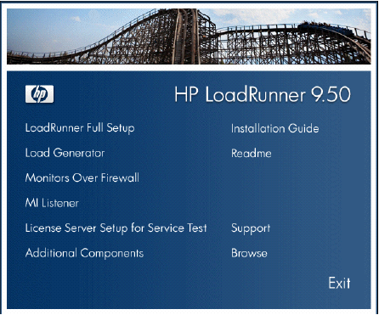
LoadRunner Installation
Run the setup.exe file in the root directory of the installation disk.
The LoadRunner Setup program begins and displays the installation menu page.
>>>>>>>>>>>>>>>>>>>>>> www.softwaretestinggenius.com <<<<<<<<<<<<<<<<<<<<<<

Slide 10
LoadRunner Installation
LoadRunner Full Setup. Provides the option to install the main LoadRunner features and components including the Controller, the VuGen, Analysis, and the Load Generator.
Load Generator. Installs the components needed for running virtual users to generate load, and the MI Listener.
>>>>>>>>>>>>>>>>>>>>>> www.softwaretestinggenius.com <<<<<<<<<<<<<<<<<<<<<<

Slide 11
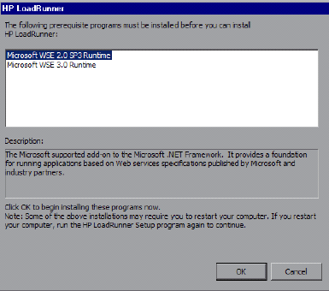
LoadRunner Installation
If necessary, install prerequisite software.
Click OK and follow the on-screen instructions to install the listed software before continuing with the LoadRunner installation.
If you click Cancel, the installer will exit because LoadRunner cannot be installed without the prerequisite software.
>>>>>>>>>>>>>>>>>>>>>> www.softwaretestinggenius.com <<<<<<<<<<<<<<<<<<<<<<

Slide 12
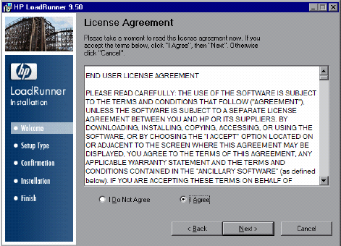
LoadRunner Installation
Review the License agreement.
If the terms of the license agreement are acceptable to you, choose I Agree.
Click Next to proceed.
>>>>>>>>>>>>>>>>>>>>>> www.softwaretestinggenius.com <<<<<<<<<<<<<<<<<<<<<<

Slide 13
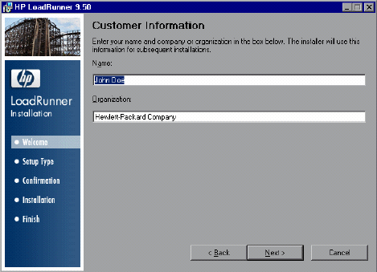
LoadRunner Installation
Register the LoadRunner Installation on your computer.
In the Customer Information page, enter your name and organization name.
Click Next to proceed.
>>>>>>>>>>>>>>>>>>>>>> www.softwaretestinggenius.com <<<<<<<<<<<<<<<<<<<<<<

Slide 14
LoadRunner Installation
Select a setup type. (Only for LoadRunner Full Setup)
In the Setup Type page, choose between a Complete or Custom setup.
  Complete. Installs the complete set of LoadRunner features. Most users should select this option.
  Custom. Installs only those LoadRunner features that you choose to install.
Click Next to proceed.
>>>>>>>>>>>>>>>>>>>>>> www.softwaretestinggenius.com <<<<<<<<<<<<<<<<<<<<<<

Slide 15
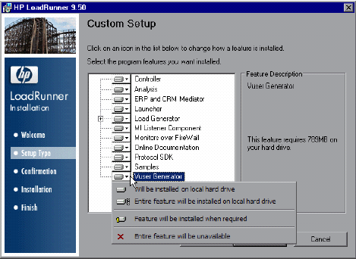
LoadRunner Installation- Custom Options
Select features to install. (Only for Custom setup)
If you chose to perform a Custom installation of LoadRunner, select the LoadRunner features that you want to install.
By default, all the features are selected for installation.
>>>>>>>>>>>>>>>>>>>>>> www.softwaretestinggenius.com <<<<<<<<<<<<<<<<<<<<<<

Slide 16
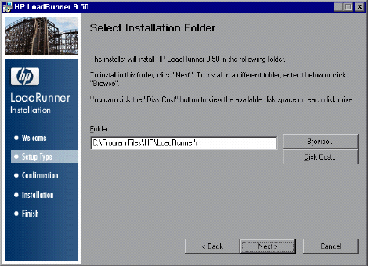
LoadRunner Installation
Select an installation folder.
Accept the proposed folder for the installation or browse to an alternate folder.
Click Disk Cost to check the disk space for each drive. The dialog box displays the size, available space, and required space for each disk.
Click OK to close the Disk Cost dialog box. Click Next to proceed.
>>>>>>>>>>>>>>>>>>>>>> www.softwaretestinggenius.com <<<<<<<<<<<<<<<<<<<<<<

Slide 17
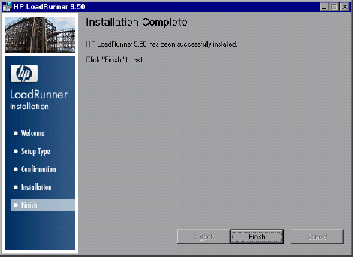
LoadRunner Installation
Complete the installation process.
When the installation is complete, a wizard page opens, confirming successful installation.
>>>>>>>>>>>>>>>>>>>>>> www.softwaretestinggenius.com <<<<<<<<<<<<<<<<<<<<<<

Slide 18
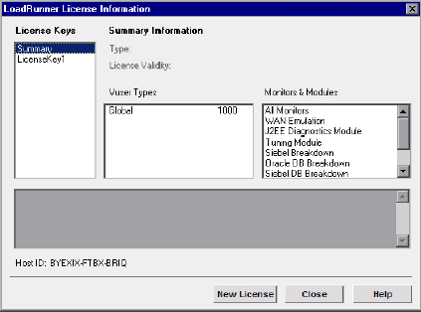
LoadRunner Installation
Finish the Installation.
Click Finish. The LoadRunner Launcher opens displaying the LoadRunner License Information Dialog Box.
The LoadRunner installation is now complete. To start LoadRunner, select start > Programs > LoadRunner > LoadRunner. Select the application that you want to run from the LoadRunner launcher window.
>>>>>>>>>>>>>>>>>>>>>> www.softwaretestinggenius.com <<<<<<<<<<<<<<<<<<<<<<

Slide 19
LoadRunner Installation- Uninstall, Repair, Modify
To uninstall LoadRunner, use the Windows Add/Remove Programs utility. Alternatively, you can run the setup.exe file located in the root directory of the LoadRunner installation disk and select the Remove option in the Setup Wizard.
To repair LoadRunner, run the setup.exe file located in the root directory of the LoadRunner installation disk and select the Repair option in the Setup Wizard
If you want to install additional LoadRunner features after you have completed the installation, run the setup.exe file located in the root directory of the LoadRunner installation disk, select the Modify option in the Setup Wizard, and then select the additional features from the list of available features.
>>>>>>>>>>>>>>>>>>>>>> www.softwaretestinggenius.com <<<<<<<<<<<<<<<<<<<<<<

Slide 20
LoadRunner Terminology
Scenarios:
  Using LoadRunner, application performance testing requirements are divided into scenarios.
  A scenario defines the events that occur during each testing sessions.
  For example, a scenario defines and controls the number of users to emulate, the actions that they perform, and the machines on which they run their emulations.
Vusers
  In a scenario, LoadRunner replaces human users with virtual users or Vusers.
  In a scenario, Vusers emulate the actions of human users—submitting input to the server.
  A scenario can contain tens, hundreds, or even thousands of Vusers.
>>>>>>>>>>>>>>>>>>>>>> www.softwaretestinggenius.com <<<<<<<<<<<<<<<<<<<<<<

Slide 21
LoadRunner Terminology
Vuser Scripts
  The actions that a Vuser performs during the scenario are described in a Vuser script
  When a scenario is executed, each Vuser executes a Vuser script. Vuser scripts include functions that measure and record the performance of the server during the scenario.
Transactions
  To measure the performance of the server, transactions are defined.
  Transactions measure the time that it takes for the server to respond to tasks submitted by Vusers.
>>>>>>>>>>>>>>>>>>>>>> www.softwaretestinggenius.com <<<<<<<<<<<<<<<<<<<<<<

Slide 22
LoadRunner Terminology
Rendezvous Points
  Rendezvous points are used into Vuser scripts to emulate heavy user load on the server.
  Rendezvous points instruct multiple Vusers to perform tasks at exactly the same time.
  For example, to emulate peak load on the bank server, we insert a rendezvous point to instruct 100 Vusers to simultaneously deposit cash into their accounts.
Controller
  LoadRunner Controller is used to manage and maintain scenarios.
  Using the Controller, we can control all the Vusers in a scenario from a single workstation.
>>>>>>>>>>>>>>>>>>>>>> www.softwaretestinggenius.com <<<<<<<<<<<<<<<<<<<<<<

Slide 23
LoadRunner Terminology
Hosts
  When you execute a scenario, the LoadRunner Controller distributes each Vuser in the scenario to a host.
  The host is the machine that executes the Vuser script, enabling the Vuser to emulate the actions of a human user.
Performance Analysis
  Vuser scripts include functions that measure and record system performance during load-testing sessions.
  During a scenario run, you can monitor the network and server resources.
  Following a scenario run, you can view performance analysis data in reports and graphs.
>>>>>>>>>>>>>>>>>>>>>> www.softwaretestinggenius.com <<<<<<<<<<<<<<<<<<<<<<

Slide 24
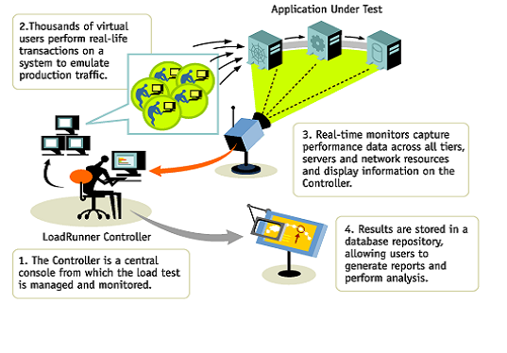
How LoadRunner Works
>>>>>>>>>>>>>>>>>>>>>> www.softwaretestinggenius.com <<<<<<<<<<<<<<<<<<<<<<

Slide 25
How LoadRunner Works
LoadRunner works by creating virtual users who take the place of real users operating client software sending requests using the HTTP protocol to web servers.
Requests from many virtual user clients are generated by "Load Generators" in order to create a load on various servers under test
The Controller controls load test runs based on "Scenarios" invoking compiled "Scripts" and associated "Run-time Settings".
>>>>>>>>>>>>>>>>>>>>>> www.softwaretestinggenius.com <<<<<<<<<<<<<<<<<<<<<<

Slide 26
How LoadRunner Works
Scripts are crafted using "Virtual user script Generator" (named "VU Gen"), It generates C-language script code to be executed by virtual users by capturing network traffic between Internet application clients and servers.
During runs, the status of each machine is monitored by the Controller.
At the end of each run, the Controller combines its monitoring logs with logs obtained from load generators, and makes them available to the "Analysis" program, which can then create run result reports and graphs for Microsoft Word, Crystal Reports, or an HTML webpage browser.
>>>>>>>>>>>>>>>>>>>>>> www.softwaretestinggenius.com <<<<<<<<<<<<<<<<<<<<<<

Slide 27
Questions - To Review Your Skills
What is the latest version of LoadRunner available in market and what are its new features?
What are the differences between system configurations for LoadRunner Controller and Load Generators?
What are virtual users and what is their role in load testing?
List the components of LoadRunner and how they works.
>>>>>>>>>>>>>>>>>>>>>> www.softwaretestinggenius.com <<<<<<<<<<<<<<<<<<<<<<

Slide 28
Thank You
>>>>>>>>>>>>>>>>>>>>>> www.softwaretestinggenius.com <<<<<<<<<<<<<<<<<<<<<<

