Slide 1
Software Testing

Slide 2

Agenda
  What is Software Testing
  Goals of Testing
  Quality Assurance & Quality Control
  Verification & Validation
  Testing Process
  Software Development Life Cycle (SDLC)
  SDLC Models
  Software Testing Life Cycle (STLC)
  Test Levels
  Test Types
  Test Techniques
  Test Tools
  Test Strategy
  Test Plan
  Requirement Traceability Matrix

Slide 3
What is Software Testing?
Software testing is an investigation conducted to provide stakeholders with information about the quality of the product or service under test. Software testing also provides an objective, independent view of the software to allow the business to appreciate and understand the risks of software implementation. Test techniques include, but are not limited to, the process of executing a program or application with the intent of finding software bugs.
Software testing can also be stated as the process of validating and verifying that a software program/application/product:
  meets the business and technical requirements that guided its design and development;
  works as expected; and
  can be implemented with the same characteristics.

Slide 4

Goals of Testing
Identification of Detects/faults
Establish confidence in software
Provide information for decision making
Preventing Defects
Evaluate properties of software
  Reliability
  Performance
  Memory Usage
  Security
  Usability

Slide 5

Quality Assurance (QA)
  The function of software quality assurance is to assure that, appropriate standards, processes and procedures are implemented for the project.
  Software QA involves the entire software development PROCESS - monitoring and improving the process, making sure that any agreed-upon standards and procedures are followed, and ensuring that problems are identified and dealt with. It is oriented to 'prevention‘.

Slide 6

Quality Control (QC)
  QC involves operation of a system or application under controlled conditions and evaluating the results
  The controlled conditions should include both normal and abnormal conditions. Testing should intentionally attempt to make things go wrong to determine if things happen when they shouldn't or things don't happen when they should. It is oriented to 'detection'.

Slide 7

Verification and Validation
  Verification: the process of evaluating a system or component to determine whether the products of the given development phase satisfy the conditions imposed at the start of that phase [BS 7925-1]
  Validation: determination of the correctness of the products of software development with respect to the user needs and requirements [BS 7925-1]
  Example
    Verification– Requirement Review, Design Review
    Validation – Integration Testing, System Testing, Regression Testing

Slide 8
Testing Process
  Test Planning & Control
    Define objectives of testing
    Specification of test activities
    Test control is an ongoing activity comparing actual progress against the plan
    It involves taking necessary action to meet the test objectives
  Test Analysis and Design
    Review requirements
    Identify, create and prioritize Test conditions
    Identify, create and prioritize High level test cases
    Identify test data to support the test conditions and test cases
    Design test environment setup and identify any required infrastructure and tools
    Create bidirectional traceability between requirements and test cases

Slide 9
Testing Process
  Test Implementation & Execution
    Finalize, implement and prioritize test cases (including test data)
    Develop and prioritize test suites from test cases for efficient test execution
    Verify test environment has been set properly
    Verify and update bidirectional traceability between requirements and test cases
    Execute test suite and compare actual results with expected results
    Report defects when actual results do not match expected results

Slide 10
Testing Process
  Evaluation of Exit Criteria and Result Reporting
    Check test logs against exit criteria specified in test plan
    Assess if more test are required or if exit criteria specified should be changed
    Write test summary report for stakeholders
  Test Closure
    Collect data from completed test activities to consolidate experience, testware and numbers
    Test closure activities occur at project milestones when a software system is released, project is completed or maintenance release is completed

Slide 11
Software Development Life Cycle (SDLC)
Requirements:
Business requirements are gathered in this phase
Meetings with managers, stake holders and users are held in order to determine the requirements
  Who is going to use the system?
  How will they use the system?
  What data should be input into the system?
  What data should be output by the system?
  how the user interface should work?
The overall result is the system as a whole and what it should perform.
The artifacts are Business Requirement Document (BRD), Functional Specification (FS)
Design:
The software design is the phase where system engineers analyze and understand the business of the proposed system by studying the requirements document. The design phase consists of High level design where the overall system design in terms of functional architecture and database design is specified and Low Level design where the details of the module is explained.
During these phases, the software's overall structure is defined.

Slide 12
Software Development Life Cycle (SDLC)
Coding:
Code is produced as a deliverable during implementation, and this an important phase of the software development life cycle.
With respect to the type of application, the right programming language is chosen
Implementation may overlap with both the design and testing phases
Testing:
During testing, the implementation is tested against the requirements to ensure that the product is actually solving the needs addressed and gathered during the requirements phase
Normally programs are written as a series of individual modules, the system is tested to ensure that interfaces between modules work (integration testing), the system works on the intended platform and with the expected volume of data (volume testing) and that the system does what the user requires (acceptance/beta testing)
Installation, Operation and maintenance:
Software will definitely undergo change once it is delivered to the customer. There are many reasons for the change. Change could happen due to defects, new features being incorporated or enhancements in the existing system.

Slide 13
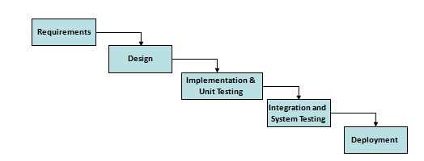
SDLC Models : Waterfall Model
Waterfall Model
Advantages:
• Simple and easy to use
• Easy to manage due to the rigidity of the model – each phase has specific deliverables and a review process
• Phases are processed and completed one at a time
• Works well for smaller projects where requirements are very well understood
Disadvantages:
1. Time consuming
2. Never backward
3. Difficulty responding to change while developing
4. No early prototypes of the software are produced

Slide 14
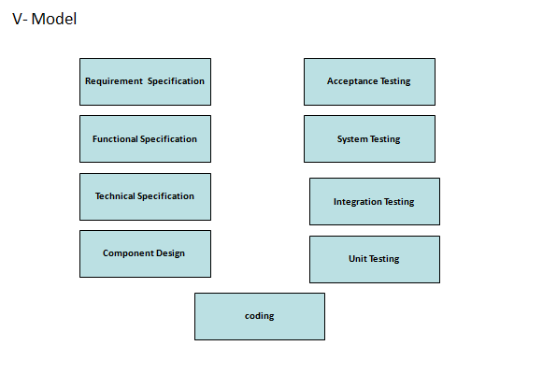
SDLC Models : V-Model
Verification is on left hand side and Validation on right hand side.
to change while

Slide 15
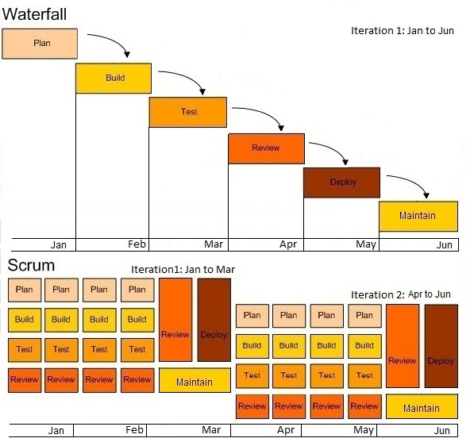
SDLC Models : Agile Scrum Model

Slide 16
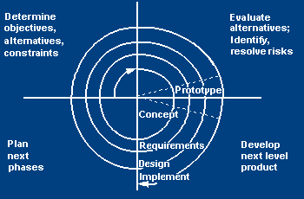
SDLC Models
Spiral Model
As the name implies, the spiral model follows an approach in which there are a number of cycles (or spirals) of all the sequential steps of the waterfall model. Once the initial cycle is completed, a thorough analysis and review of the achieved product or output is performed. If it is not as per the specified requirements or expected standards, a second cycle follows, and so on. This methodology follows an iterative approach and is generally suited for very large projects having complex and constantly changing requirements.

Slide 17
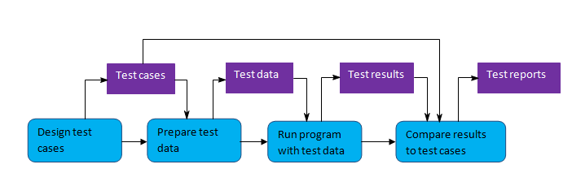
Software Testing Life Cycle (STLC)
The test development life cycle contains the following components/steps:
  System study-Assess development plan and status
  Review SFS/SRS
  Develop Test plan
  Design test cases
  Test Cases Execution
  Analyze the Test Results
  Defects Reporting
  Test Closure

Slide 18


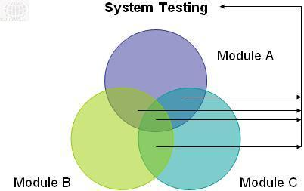

Test Levels
Unit Testing:
Unit testing refers to tests that verify the functionality of a specific section of code, usually at the function level. These type of tests are usually written by developers as they work on code (white-box style), to ensure that the specific function is working as expected.
Integration Testing: is a type of software testing that seeks to verify the interfaces between components against a software design. Software components may be integrated in an iterative way or all together ("big bang"). Integration testing works to expose defects in the interfaces and interaction between integrated components (modules).
System testing: Tests a completely integrated system to verify that it meets its requirements
Acceptance testing: performed by the user/customer, to verify if the software product is developed according to the standards and specified criteria and meets all the requirements specified.

Slide 19
Test Types
  Static
  Dynamic
    Testing of Function (Functional Testing)
    Testing of Non-functional Software Characteristics
    Testing of Software Structure/Architecture
    Testing Related to Changes

Slide 20
Test Types – Black Box and White Box
Functional testing : The functions that a system, subsystem or component are to perform may be described in work products such as requirements specification, use cases or a functional specification.
Functional testing considers the external behavior of the software (Black box testing)
Structural testing : Structural (White-Box) testing may be performed at all test levels. Structural testing are used to help measure the thoroughness of testing through assessment of coverage of a type of structure.
Coverage is the extent that a structure has been exercised by a test suite, expressed as a percentage of the items being covered.
At all test levels, especially in component testing and component integration testing, tools can be used to measure the code coverage of elements such as statements or decisions.
If coverage is not 100% then more tests may be designed to test those items that were missed to increase coverage

Slide 21



Test Types – Non Functional Testing
Performance testing is a way to determine how fast a system or sub-system responds under a particular workload.
Load testing is a way to evaluate the software product with increasing load, whether that be large quantities of data or a large number of users. This is generally referred to as software scalability.
Stress testing is a way to evaluate the software product beyond the limits of its anticipated or specified workloads or with reduced availability of resources (memory or disk space).
Volume testing is a way to evaluate the software product when subjected to large volumes of data.

Slide 22



Test Types – Non Functional Testing
Reliability Testing:
The reliability of the software product to perform its required functions under stated conditions for a specified period of time, or for a specified number of operations. [ISO 9126]
Usability Testing:
Testing to determine whether the software product is understandable, easy to learn, easy to operate and attractive to the users
Security testing : It is essential for software that processes confidential data to prevent system intrusion by hackers.
Internationalization :
It will verify that the application still works, even after it has been translated into a new language or adapted for a new culture (such as different currencies or time zones).

Slide 23
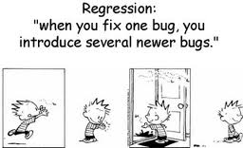
Test Types – Testing related to changes
Retesting :
After a defect is detected and fixed, the software should be retested to confirm that the original defect has been successfully removed. This is confirmation testing.
Regression Testing
Regression testing is the repeated testing of an already tested program, after modification, to discover any defects introduced or uncovered as a result of the changes.

Slide 24
Testing Techniques - Static
Static
Informal Review
Walkthroughs
Static Analysis
Technical Review
Inspection

Slide 25
Testing Techniques - Dynamic
Dynamic
Behavioral
Structural
Non-functional
Functional
Load
Equivalence
Partitioning
Control
Flow
Usability
Data
Flow
Boundary
Value Analysis
Performance
Statement
Decision Table
Branch/Decision
Branch Condition
State Transition

Slide 26
Test Case Design Techniques
Involves designing the test cases (inputs and outputs) used to test the system.
The goal of test case design is to create a set of tests that are effective to identify defect.
Test Design Techniques:
  Equivalence Partition testing;
  Boundary Value Analysis
  Decision Table
  State Transition

Slide 27
Test Case Design Techniques
Equivalence Partitioning
Input data and output results often fall into different classes where all members of a class are related
Each of these classes is an equivalence partition or domain where the program behaves in an equivalent way for each class member
Test cases should be chosen from each partition
Boundary Value Analysis
Behavior at the edge of equivalence partition is more likely to be incorrect than behavior within the partition.
Boundaries are an area where testing is likely to yield defects.

Slide 28
Test Case Design Techniques
Decision Table
Decision tables are a good way to capture system requirements that contain logical conditions.
Each column of the table corresponds to a business rule that defines a unique combination of condition and which result in the execution of the actions associated with that rule.
State Transition
A system may exhibit different response depending on current condition or previous history.
The state transition diagram allows to view the software in terms of its states, transition between states, the inputs or events that trigger state changes and the actions which may result from those transitions
Tests can be designed to cover sequence of states, to exercise every transition or to test invalid transitions

Slide 29
Test Case Design Techniques Contd.
An input field of a accounting system accepts values Rs 10000 to 15000
Equivalence Partitioning
Invalid class: <10000
Valid class: 10000 to 15000
Invalid class: > 15000
Boundary value analysis:
9999, 10000, 10001
14999, 15000, 15001

Slide 30
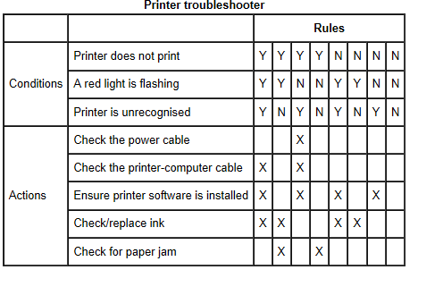
Test Case Design Techniques Contd.
The following is an example where decision table is used.
It has four quadrants:
Conditions | Condition alternatives
Actions | Action entries

Slide 31
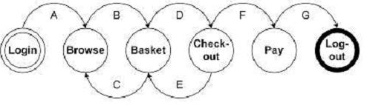
Test Case Design Techniques Contd.
Given the following state transition diagram. Identify the valid and invalid transition.
Exhibit:
Login Browse Basket Checkout Basket Checkout Pay Logout.
Login Browse Basket Checkout Pay Logout.
Login Browse Basket Checkout Basket Pay Logout.
Login Browse Basket Browse Basket Checkout Pay Logout.

Slide 32
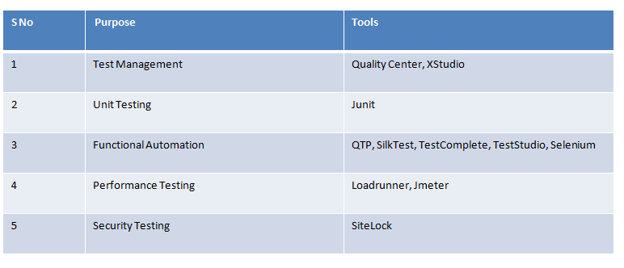
Test Tools

Slide 33

Test Strategy
Test Strategy defines the approach of testing i.e. What, Why, When and How in testing
Test Strategy or Test Approach is a set of guide lines that describes test design. Test strategy says - How testing is going to be performed? What will be the test architecture?

Slide 34

Test Plan
A test plan is a document that describes the objectives, scope, approach and focus of a software testing effort . It is an outline that describes the testing portion of the software development cycle. It is created to inform project managers, testers, and developers about key areas of the testing process.

Slide 35
Test Plan - Contents
1) Test Plan Identifier
2) Introduction
3) Test Items
4) Features to be Tested
5) Features not to be Tested
6) Approach
7) Entry and Exit Criteria
8) Suspension Criteria and Resumption Criteria
9) Test Deliverables
10) Environmental Needs
11) Staffing and Training Needs
12) Roles and Responsibilities
13) Test Schedule
14) Risks and Contingencies
15) Approvals

Slide 36
Test Strategy Vs Test Plan
Test Plan: the set of ideas that guide a test project
Test Strategy: the set of ideas that guide test design
Test Logistics: the set of ideas that guide the application of resources to fulfil a test strategy
Test Plan = Test Strategy + Test Logistics

Slide 37
Requirement Traceability Matrix
Requirement Traceability Matrix
It is the process of documenting the links between the user requirements for the
system you're building and the work products developed to implement and verify
those requirements. These work products include Software requirements, design
specifications, Software code, test plans and other artifacts of the systems
development process. Requirements tracing helps the project team to understand
which parts of the design and code implement the user's requirements, and which
tests are necessary to verify that the user's requirements have been implemented
correctly.

Slide 38

Questions?
Questions?

Slide 39


