Slide 1
Customer Satisfaction Analysis
57.3%
B2C Marketplace
of delivered orders flow
through the weaker half
of sellers
Python · Pandas · Plotly · Olist Dataset (2016-2018)
Google DA Certification Capstone Project
The key finding

Slide 2
Situation
CSAT is declining.
We need to understand why.
Context
Three questions we set out to answer
Cartana connects independent sellers with buyers across multiple product categories. CSAT scores declined for two consecutive quarters, with internal reporting pointing to delivery delays and product quality inconsistency as potential drivers.
The VP of Product commissioned a structured investigation from the Growth Analytics team.
What drives satisfaction in customer satisfaction?
1
2
How does delivery performance impact CSAT?
3
Is seller performance a key mechanism behind issues?
Marketplace · Customer Satisfaction Analysis · Situation

Slide 3
Analytical next steps
What will be the approach?
The analysis was structured into three focus points:
Category-level Variation
01
We need to validate whether dissatisfaction is localized or systemic.
To identify where satisfaction differs across the marketplace:
Average review score by category: which categories systematically underperform and where issues are concentrated.
Score distribution across categories: whether lower averages are driven by consistent underperformance or a share of negative reviews
Delivery Performance
02
Then we will test whether operational execution explains satisfaction outcomes, and quantify impact of delivery on customer experience.
Delivery delay vs Review Score (correlation): how satisfaction changes as delivery delays increase.
Score distribution by delivery bucket: how late deliveries shift the review profile beyond the average.
Late Delivery rates among low-rated reviews: whether poor experiences are driven by delayed orders
Seller Performance
Lastly it is important to determine whether variation is driven by a platform-wide issue or specific sellers.
This way we identify the root cause mechanism behind delivery issues.
Seller-level score and late delivery rate distribution: how much performance varies across sellers.
Buyer outcomes by seller performance tiers: comparing customer experience between higher- and lower-performing sellers.
Share of orders flowing through low-performing sellers: how much of the marketplace is exposed to levels of sellers.
03
Marketplace · Customer Satisfaction Analysis · Next Steps

Slide 4
Analytical next steps
Key preparation decisions
Step | Goal
To ensure analysis reflects real customer experience without distortion from data structure or edge cases, the following steps are highlighted:
Joined datasets at order level (1 row per delivered order) | Avoid duplication from item-level joins
Focused on delivered orders only | Be able to compare delivery and reviews.
Created delivery performance features | → delivery_delta ( know actual vs estimated delivery) → delivery_bucket ( separate on-time, 1-3, 4-7, 7+ days late)
Created binary flags for analysis | → is_late (showcase delivery impact) → is_bad (showcase low satisfaction proxy)
Limited extreme delivery outliers for analysis | Retain most of reliable data to focus on typical customer experience.
Marketplace · Customer Satisfaction Analysis · Next Steps

Slide 5
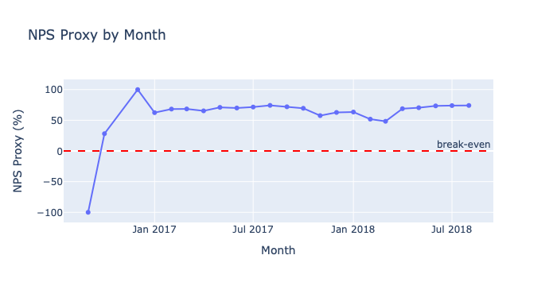
Finding 1
Satisfaction varies significantly across the marketplace.
Average Review Score by Category
4.15
overall avg score
NPS proxy: 66.1%
Score range: 3.66 → 4.55
across categories
Bottom: office_furniture, audio, home_comfort
Top: books, food_drink
Marketplace · Customer Satisfaction Analysis · Finding 1: Satisfaction Landscape

Slide 6
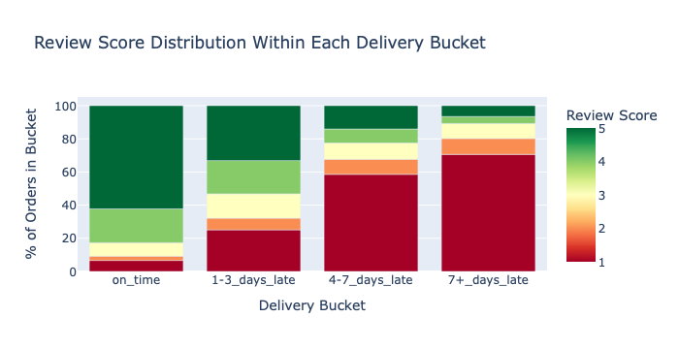
Finding 2
Delivery performance is the primary driver of satisfaction.
2.59
Review Score Distribution Within Each Delivery Bucket
point drop in avg score
from on-time to 7+ days late
4.29 → 1.70
on-time avg 7+ days late avg
Late orders: 6.8% of volume · 33% of bad reviews · 4.9× more likely among 1-2 star reviews
Marketplace · Customer Satisfaction Analysis · Finding 2: Delivery Performance

Slide 7
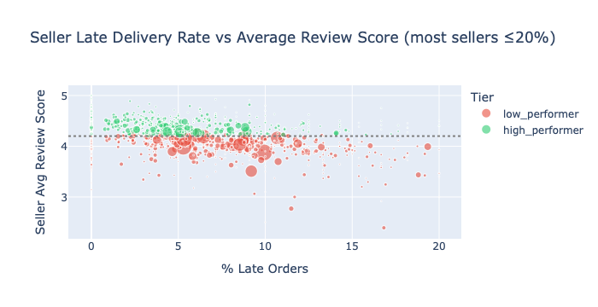
Finding 3
Seller performance variation is the mechanism.
57.3% of orders flow through the weaker half of sellers.
This is a systemic exposure problem, not an edge case.
Seller Late Rate vs Avg Score
High
Low
Avg review score
4.39
4.00
% 5-star reviews
66.9%
54.0%
% 1-star reviews
5.7%
12.4%
Late delivery rate
4.8%
8.0%
Order share
42.7%
57.3%
Marketplace · Customer Satisfaction Analysis · Finding 3: Seller Performance Variation

Slide 8
Recommendations
Three interventions, each addressing the mechanism directly.
Seller quality indicator at point of purchase
01
Surface a reliability score (review consistency + on-time rate) when buyers browse.
Buyers self-select toward quality; sellers have direct incentive to improve.
Effort: Medium · Owner: Product, Marketplace Experience
Proactive notification for at-risk deliveries
02
Flag orders likely to arrive 7+ days late and notify buyers early with a revised estimate.
Honest early communication reduces satisfaction damage even when outcomes are poor.
Effort: Medium · Owner: Product, Buyer Experience
Monthly performance summary to low-performing sellers
03
Send bottom-quartile sellers their score vs category average and on-time rate.
Pair with Seller Success outreach for sellers persistently below 3.5.
Effort: Low-Medium · Owner: Seller Success + Product
Marketplace · Customer Satisfaction Analysis · Recommendations

