Slide 1
Standardization

Slide 2
What does it means?
Setting Standards
Loss Reductions
Reporting Standards
Company training culture
Establishing adherence to the Standard
Increased transparency
Encouraging the continuous improvement of the standard Variability reduction

Slide 3
How to achieve ?
Gitlab
Project planning
Source code management
Git
Version Control System
Capture footprint of every task
Git workflow
Generate SOP
accomplish work in a consistent and productive manner

Slide 4
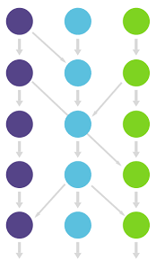
GITlab
Create and add SSH
A protocol for secured access from one computer to another over server
Create Group and Project
Group contains of members which is working on project to share their work and add project to work on
Create branch, Fork Project and add file
For members working on same project branches, duplication of the project and files need to be added for easy access and understand the workflow which has been done by individual.
Create Issues, Merge Request, add assign and milestones for the task in the project.

Slide 5
Git
Track change in code
Coordinate the work among all members
Speed, data integrity and support distributed workflows.

Slide 6
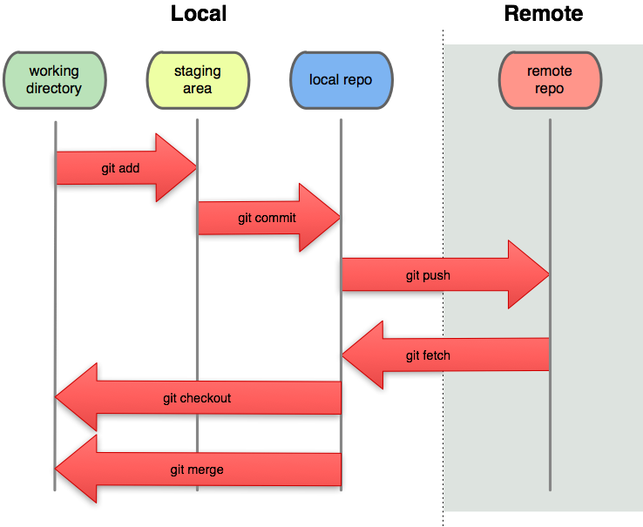

Slide 7
GIT workflow
Accomplish work in productive manner by writing in handbook
Make SOP for the workflow for any specific project in department or for whole department
Provide flexibility for how user mange changes.
Centralized repository for the easy understanding in the workflow

Slide 8
