Slide 1
THE
FREE
FURIOUS
AND THE
@raichoo

Slide 2
What are OCamlers' critiques of Haskell?
Yoneda-crazy: I know Haskell, I know some category theory, but I am highly sceptical that teaching the Yoneda Lemma to C++ programmers is actually useful in any way. […] I'm worried that we may have a backslash at some point when, you know, people realize that unless your initials are E.K. you are wasting your time thinking about the co-density transformation. […]

Slide 3
Appetizer
λ» runPure revEcho input
[…]
(71.49 secs, 38,538,732,696 bytes)
(0.72 secs, 233,224,296 bytes)
λ» runPure (improve revEcho) input
[…]

Slide 4
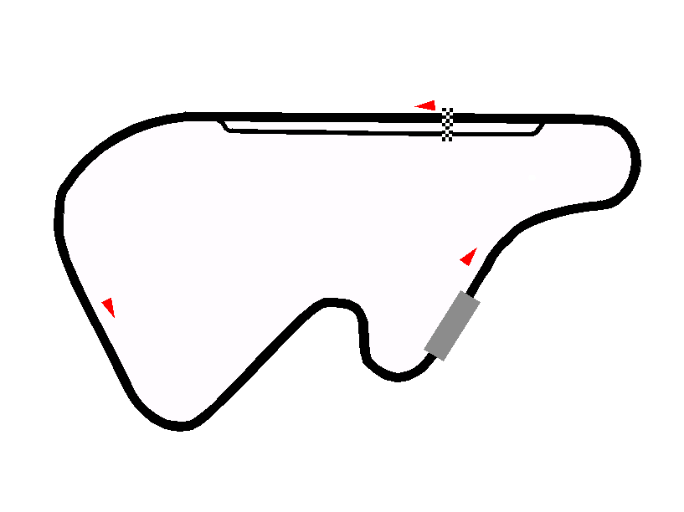
OUTLINE
Lists and Monoids
Improving Teletype performance
Teletype with Free
DLists
Codensity
Recap: Free Monads
Recovering Lists with Free

Slide 5
A MOTIVATING EXAMPLE
type Log = [String]
prog :: String
prog = last (prog' [] 20000)
where
prog' :: Log -> Int -> Log
prog' log 0 = log
prog' log n = prog' (log ++ [show n]) (n - 1)
(18.46 secs, 17,510,973,288 bytes)
(xs ++ ys) ++ zs
xs ++ (ys ++ zs)

Slide 6
MONOIDS
class Monoid a where
mempty :: a
(<>) :: a -> a -> a
-- xs <> mempty ≡ xs ≡ mempty <> xs
-- (xs <> ys) <> zs ≡ xs <> (ys <> zs)
instance Monoid [] where
mempty = []
(<>) = (++)

Slide 7
DLIST
newtype DList a = DList
{ runDList :: [a] -> [a] }
empty :: DList a
empty = DList id
singleton :: a -> DList a
singleton x = DList (x:)
append :: DList a -> DList a -> DList a
append (DList xs) (DList ys) = DList (xs . ys)

Slide 8
DLIST (CONT.)
toList :: DList a -> [a]
toList (DList xs) = xs []
instance Monoid (DList a) where
mempty = empty
(<>) = append

Slide 9
USING DLIST
{-# LANGUAGE OverloadedLists #-}
import Data.Monoid ((<>))
import qualified Data.DList as DL
type Log = DL.DList String
prog :: String
prog = last (DL.toList (prog' [] 20000))
where
prog' :: Log -> Int -> Log
prog' log 0 = log
prog' log n = prog' (log <> [show n]) (n - 1)
(0.02 secs, 10,226,320 bytes)

Slide 10
RECAP: FREE MONAD
data Free f a = Free (f (Free f a))
| Pure a
instance Functor f => Monad (Free f) where
return = pure
Pure x >>= f = f x
Free x >>= f = Free (fmap (>>= f) x)
liftF :: Functor f => f a -> Free f a
liftF = Free . fmap Pure

Slide 11
RECOVERING LIST
type List a = Free ((,) a) ()
run :: Free ((,) a) () -> [a]
run (Pure _) = []
run (Free (x, xs)) = x : run xs
empty :: List a
empty = pure ()
singleton :: a -> List a
singleton x = liftF (x, ())
append :: List a -> List a -> List a
append = (>>)

Slide 12
RECOVERING LIST
type Log = Free ((,) String) ()
prog :: String
prog = last . run $ prog' empty 20000
where
prog' :: Log -> Int -> Log
prog' log 0 = log
prog' log n =
prog' (log `append` singleton (show n)) (n - 1)
(145.32 secs, 67,530,904,088 bytes)
(xs >> ys) >> zs
xs >> (ys >> zs)

Slide 13
SUBSTITUTE / NORMALIZE
(>>=) :: Monad m => m a -> (a -> m b) -> m b
m >>= f = join (fmap f m)
-- join :: Monad m => m (m a) -> m a
-- join (Pure x) = x
-- join (Free xs) = Free (fmap join xs)

Slide 14
MONAD LAWS
return a >>= f ≡ f a
m >>= return ≡ m
(m >>= f) >>= g ≡ m >>= (\x -> f x >>= g)

Slide 15
ENTER CODENSITY
{-# LANGUAGE RankNTypes #-}
newtype Codensity m a = Codensity
{ runCodensity :: forall b. (a -> m b) -> m b }
lowerCodensity :: Monad m => Codensity m a -> m a
lowerCodensity (Codensity c) = c return

Slide 16
IT'S A MONAD!
instance Functor (Codensity f) where
fmap f (Codensity c) = Codensity (\k -> c (k . f))
instance Applicative (Codensity f) where
pure x = Codensity (\k -> k x)
Codensity f <*> Codensity x = Codensity (\k -> f (x . (k .)))
instance Monad (Codensity f) where
Codensity x >>= f =
Codensity (\k -> x (flip runCodensity k . f))

Slide 17
GENERALIZING THE MACHINERY
class (Functor f, Monad m) => MonadFree f m | m -> f where
wrap :: f (m a) -> m a
instance Functor f => MonadFree f (Free f) where
wrap = Free
instance MonadFree f m => MonadFree f (Codensity m) where
wrap x =
Codensity (\k -> wrap (fmap (flip runCodensity k) x))
liftF :: MonadFree f m => f a -> m a
liftF = wrap . fmap pure

Slide 18
RECOVERING DLIST
type List a = Codensity (Free ((,) a)) ()
run :: Free ((,) a) () -> [a]
run (Pure _) = []
run (Free (x, xs)) = x : run xs
empty :: List a
empty = pure ()
singleton :: a -> List a
singleton x = liftF (x, ())
append :: List a -> List a -> List a
append = (>>)

Slide 19
RECOVERING DLIST
type Log = Codensity (Free ((,) a)) ()
prog :: String
prog = last . run . lowerCodensity $ prog' empty 20000
where
prog' :: Log -> Int -> Log
prog' log 0 = log
prog' log n =
prog' (log `append` singleton (show n)) (n - 1)
(0.08 secs, 37,902,952 bytes)

Slide 20
TELETYPE
{-# LANGUAGE DeriveFunctor #-}
data TeletypeF k = PutChar Char k
| GetChar (Char -> k)
deriving Functor
type Teletype a = Free TeletypeF a

Slide 21
TELETYPE
{-# LANGUAGE DeriveFunctor #-}
data TeletypeF k = PutChar Char k
| GetChar (Char -> k)
deriving Functor
type Teletype a = forall m. MonadFree TeletypeF m => m a

Slide 22
TELETYPE
import Control.Monad (when)
getChar :: Teletype Char
getChar = liftF (GetChar id)
putChar :: Char -> Teletype ()
putChar c = liftF (PutChar c ())
revEcho :: Teletype ()
revEcho = do
c <- getChar
when (c /= ' ') $ do
revEcho
putChar c

Slide 23
MONAD IMPROVEMENT
improve :: Functor f
=> (forall m. MonadFree f m => m a)
-> Free f a
improve = lowerCodensity

Slide 24
FURTHER READING
Hackage: dlist, free, kan-extensions
Idris-hackers: idris-free
Janis Voigtländer: Asymptotic Improvement of Computations over Free Monads
Edward Kmett: Monads for Less

Slide 25
THANK YOU!

Slide 26
QUESTIONS?

