Slide 1


Working hard to keep things lazy
@raichoo

Slide 2
non-strictness in GHC:
What, Why, How?

Slide 3
First steps
len :: [a] -> Int
len [] = 0
len (_:xs) = 1 + len xs
main :: IO ()
main = do
let xs = [1..10000000]
print (len xs)
+RTS -s
632 MB total memory in use (0 MB lost due to fragmentation)
Productivity 30.2% of total user, 30.2% of total elapsed

Slide 4
Trying to be smarter
len' :: [a] -> Int
len' = go 0
where
go acc [] = acc
go acc (_:xs) = go (acc + 1) xs
main :: IO ()
main = do
let xs = [1..10000000]
print (len' xs)
+RTS -s
903 MB total memory in use (0 MB lost due to fragmentation)
Productivity 21.5% of total user, 21.5% of total elapsed

Slide 5
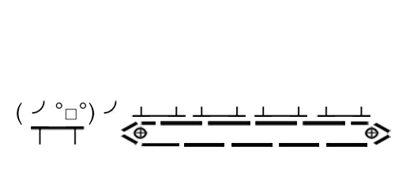

Slide 6
What?

Slide 7
Different ways to evaluate
> let f x y = x + y
> f (1 + 1) (2 + 2)

Slide 8
Applicative Order
> let f x y = x + y
> f (1 + 1) (2 + 2) => f 2 4
=> 2 + 4
=> 6
Normal Form

Slide 9
Normal Order
> let f x y = x + y
> f (1 + 1) (2 + 2)
=>(1 + 1) + (2 + 2) => 2 + 4
=> 6
Normal Form

Slide 10
Church-Rosser Theorem
If E => M and E => N then there is some Z such that M => Z and N => Z.
E
Every λ-Expression has a unique normal form (up to α-congruence).
The order of evaluation does not matter.
M
N
Z
Lambda-Calculus, Combinators, and Functional Programming - G. Revesz

Slide 11
But…
This only works as long as the reduction sequence terminates, and termination can only be determined after the fact.
Lambda-Calculus, Combinators, and Functional Programming - G. Revesz

Slide 12
Lifting Types
data Bool
= False
| True
False
True
Partial Ordering
_|_
_|_ <= _|_
_|_ <= True
_|_ <= False
True <= True
False <= False
Computation that has
not yet ended

Slide 13


Monotone Functions
Bool
f
Bool
x <= y
f x <= f y
f _|_ = True
f x = False
_|_ <= True
f _|_ <= f True
True <= False
f x = True
_|_ <= True
f _|_ <= f True
True <= True

Slide 14
Standardization Theorem
If a λ-Expression has a normal form, then normal order reduction terminates.
Lambda-Calculus, Combinators, and Functional Programming - G. Revesz

Slide 15
Hard working non-strictness
f x y = x + x + y
strict
> f (1 + 1) (2 + 2)
=> f 2 4
=> 2 + 2 + 4
=> 8
non-strict
> f (1 + 1) (2 + 2)
=> (1 + 1) + (1 + 1) + (2 + 2)
=> 2 + 2 + 4
=> 8

Slide 16
Laziness non-strictness + sharing
f x y = x + x + y
> f (1 + 1) (2 + 2)
=> let x = { THUNK: 1 + 1 }
y = { THUNK: 2 + 2 }
in x + x + y
=> let x = 2
y = 4
in x + x + y
=> 8

Slide 17
Why?

Slide 18
Modeling Problemspace
primes = filterPrime [2..]
where filterPrime (p:xs) =
p : filterPrime [x | x <- xs, x `mod` p /= 0
> take 10 primes

Slide 19
Choosing Evaluation Strategies
let solutions = map solve puzzles
Parallel and Concurrent Programming in Haskell - S. Marlow

Slide 20
Choosing Evaluation Strategies
let solutions = map solve puzzles `using` parList rseq
Parallel and Concurrent Programming in Haskell - S. Marlow

Slide 21
Reuse
foldr :: (a -> b -> b) -> b -> [a] -> b
foldr f z [] = z
foldr f z (x:xs) = f x (foldr f z xs)
any :: (a -> Bool) -> [a] -> Bool
any p = foldr False (\ x r -> p x || r)
https://augustss.blogspot.de/2011/05/more-points-for-lazy-evaluation-in.html

Slide 22
Reuse
any :: (a -> Bool) -> [a] -> Bool
any p [] = False
any p (y:ys) = y || any p ys
https://augustss.blogspot.de/2011/05/more-points-for-lazy-evaluation-in.html

Slide 23
Reuse
any :: (a -> Bool) -> [a] -> Bool
any p = or . map p
https://augustss.blogspot.de/2011/05/more-points-for-lazy-evaluation-in.html

Slide 24
I think the only serious gripe is what you call your biggest gripe, and I must say that I envy this in Haskell. As you know, in the eager world we tend to write out our own recursive functions, rather than use combinators. […] I've made my peace with this, but I agree that you have a point (ahem).
- Robert Harper in a conversation with Lennart Augustsson

Slide 25
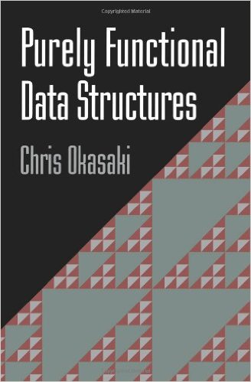
Honorable Mention

Slide 26
How?

Slide 27
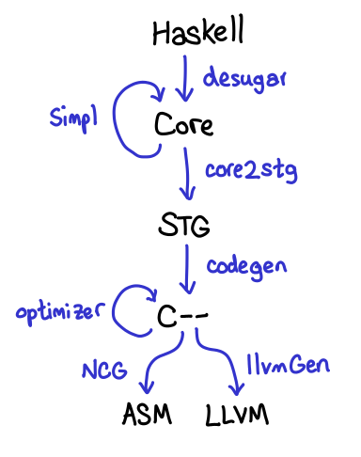
GHC Compilation Pipeline
Courtesy of Edward Z. Yang

Slide 28
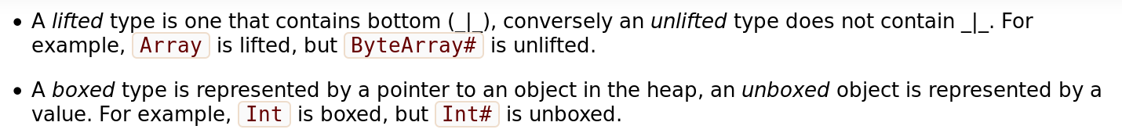
Revisiting Lifted Types
data Int = I# Int#

Slide 29
Thunk you!

