Slide 1







DATA ANALYSIS : Pizza Sales Report

Slide 2


Connect To SQL Server
PART -1
Import Data into SQL.

Slide 3
KPI’s Requirement
We need to analyze key indicators for our pizza sales data to gain insights into our business performance. We nee to calculate the following metrics:
Total Revenue : Sum of total price of all pizza orders.
Average Order Value : Average amount spent per order, calculated by dividing the total revenue by the total number of orders.
Total pizza Sold : Sum of the quantities of all the pizzas sold.
Total Orders : Total number of orders placed.
Average Pizzas Per Order : The average number of pizzas sold per order, calculated by dividing the total number of pizzas sold by the total number of orders.
PROBLEM STATEMENT

Slide 4


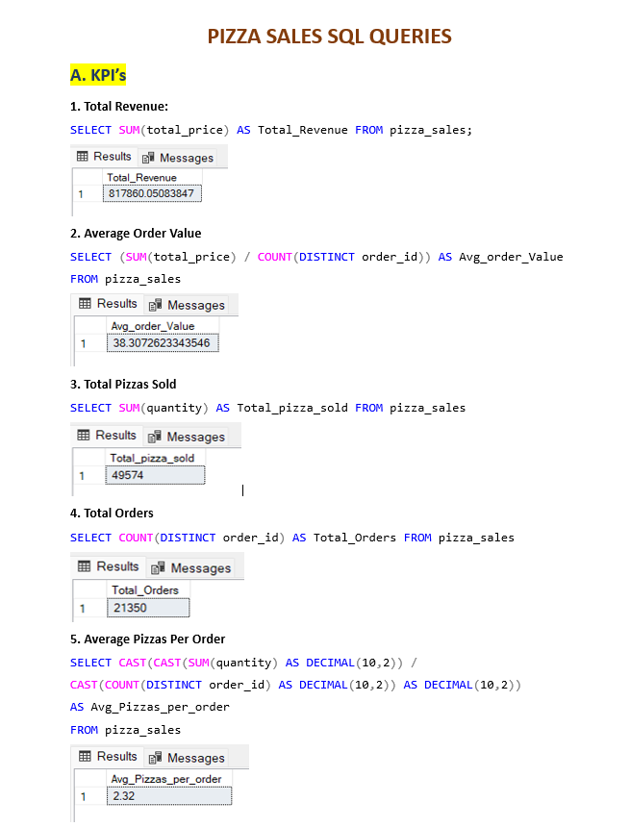

MySQL
CREATING REPORT

Slide 5

We would like to visualize various aspects of pizza sales data to gain insights and understand key trends.
Daily Trend for Total Orders
Monthly Trend for Total Orders
Percentage of Sales by Pizza Category
Percentage of Sales by Pizza Size
Total pizzas sold by Pizza Category
Top 5 Pizzas by Revenue
Bottom 5 Pizzas by Revenue
Top 5 Pizzas by Quantity
Bottom 5 Pizzas by Quantity
Top 5 Pizzas by Total Orders
Bottom 5 Pizzas by Total Orders
VISUALIZATION CHARTS

Slide 6


Connect SQL to Power BI
PART -1I
Import Data from MySQL database to Power Bi.

Slide 7
We’ve analyzed the ‘Pizza Sales’ data of a pizza shop based on entire sales performance during the year 2015, and we’ve gathered some of the insights and areas of concern from the reports and visualization :
Orders are highest on weekends, mostly on Friday and Saturday evening hour.
‘Classic category’ & ‘Large size’ Pizza contributes to maximum sales & orders.
Sundays seems to be have low order trends. So boosting sales on Sundays requires strategic planning & creative marketing. Some of the effective strategies to consider:
I. Introduce exclusive Sunday-only deals or discounts.
II. Combo Deals for Families
III. Offer free delivery or discounted delivery fees on Sundays.
Improving the ‘Avg. Order Value’ is crucial for enhancing revenue and profitability. Some of the strategies to achieve :
I. Through Upselling & Cross-selling.
II. Loyalty Programs , so that customers can redeem later.
III. Collect feedback from customers to understand their preferences.
IV. Dynamic pricing.
INSIGHTS & SUMMARY

