Slide 1
KNUST × GridCo
FROM ACADEMIC RESEARCH TO PRODUCTION IMPACT
Project Partners
DLinear+H10: Load Forecasting for Ghana's National Grid.
KNUST × GridCo
Engine
DLinear + H10 Corrector
Operational Savings
438,000 MWh/year refined
A joint project between KNUST and GridCo — bringing accurate, data-driven forecasting to the national dispatch centre. Saving fuel. Saving money. Keeping the lights on.
Data Span
Jan 2018 – May 2026
70,228 hours trained 91 MW baseline 6-fold CV 438,000 MWh/year saved

Slide 2
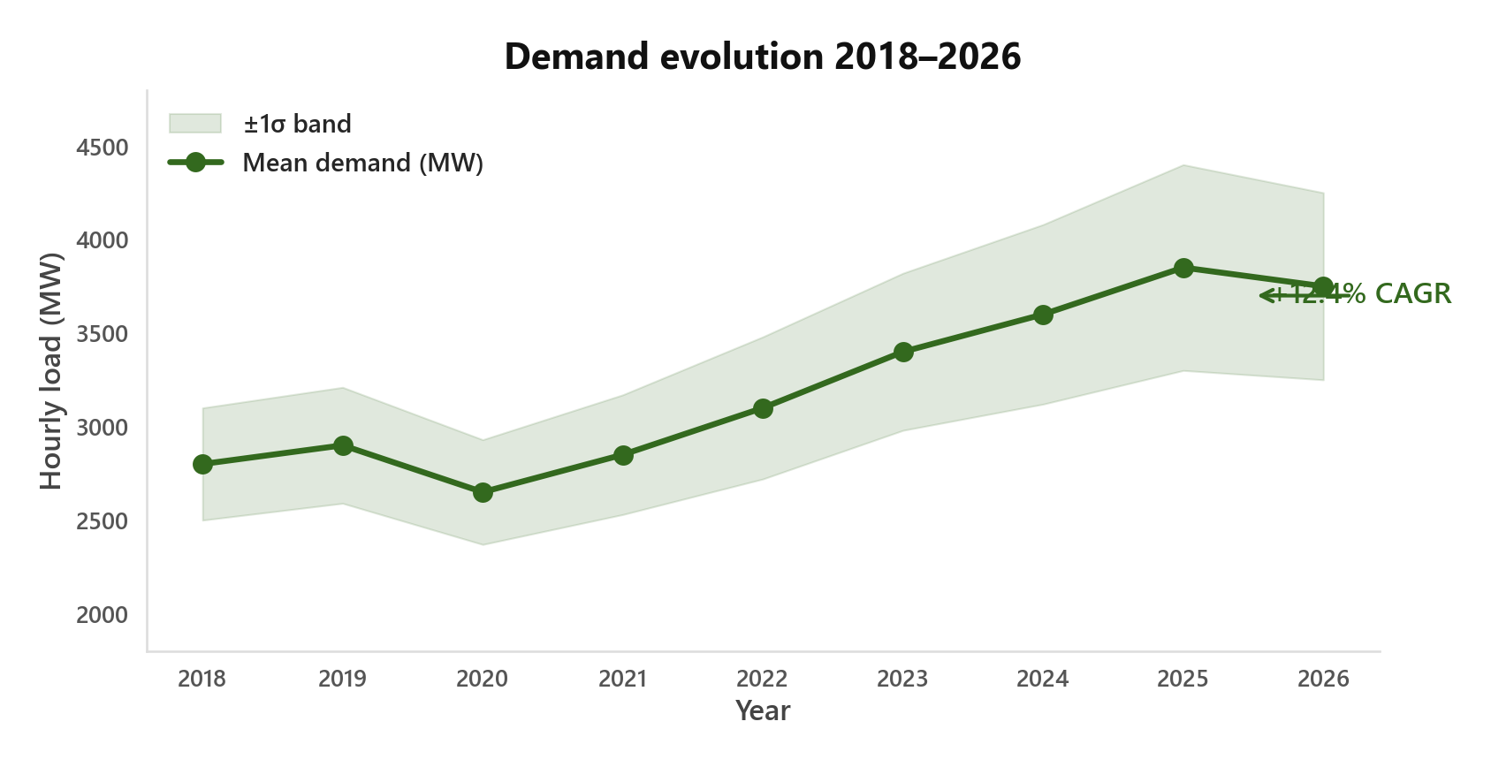
01 / The Data — 70k hours from Ghana's national grid
What the Data Tells Us About Ghana's Growing Grid.
Here's What We Found
Demand grew 2.5× in 8 years. From ~1,467 MW to ~3,750 MW. That's 12.4% annual growth. Compare this to Europe: 0–1%. A model trained on 2021 data simply won't work on 2026 data.
Accuracy has a price tag. Every MW of forecast error costs GridCo money — either fuel burned for over-generation that nobody uses, or expensive peaker plants scrambled last-minute for under-generation. A better forecast means leaner dispatch, less waste, lower costs.
What we don't know: electrification (67% → 83% rural access), GDP, urbanisation — these drive demand but we don't track them as features.
Patterns That Jumped Out
→ Daily rhythm: Morning ramp. Evening peak. Overnight trough.
→ Weekly cycle: Weekdays high. Weekends low.
→ Seasons: Dry season ≠ wet season.
→ Growth: Upward drift across all 8 years.
Features: demand_mw · temperature_c · hour · date · 3.95% filtered for sensor outages
Source: ECG SCADA · 12.4% CAGR = Compound Annual Growth Rate 2018–2026

Slide 3
02 / Aims — What we set out to achieve
Five Aims for This Academia–Industry Collaboration.
1. Accurate, Robust Forecasting
Develop a data-driven load forecasting model for Ghana's national grid that handles rapid demand growth (12.4% CAGR), distribution shifts, and limited feature availability — outperforming both operator heuristics and imported deep learning architectures.
3. Production Deployment
Package research into a web application deployed at GridCo's dispatch centre — replacing a 45-minute Excel workflow with a 1-minute automated process. Keep operators in control.
4. Sustainable AI
Prove that accurate grid forecasting does not require GPU infrastructure or massive energy budgets. A 36K-parameter CPU-trained model can beat Transformers on both accuracy and efficiency.
2. Error Correction
Go beyond raw predictions. Study residual errors to build second-stage correctors that extract an additional 20–40% accuracy gain from autocorrelated error patterns.
5. Insights for West African Grids
Draw generalisable lessons about load forecasting in rapidly developing electricity grids where stationary data assumptions fail.
KNUST Department of Electrical Engineering · GridCo National Dispatch Centre

Slide 4
03 / Current Practice — The operator's existing workflow
GridCo's Current Approach: Manual Heuristics → Data-Driven.
What They Do Today
Dispatchers use Excel. They find a similar historical day by experience, adjust for temperature, populate the schedule manually.
~45 minutes per forecast. No learning from 70k hours of data. Each forecast starts from scratch.
We Tested Their Approach
Digitised the similar-day method as a KNN model. Result: 141 MW MAE.
A simple 2-day weighted trend? 113 MW MAE. Beat the heuristic.
Conclusion: Data-driven methods outperform human heuristics when given enough history.
So What Did We Build?
A system that complements the operator — doesn't replace them.
Forecast auto-generates in ~1 minute. Fills the dispatch schedule automatically.
Operator stays in control. The forecast is a suggestion — accept, edit, or override.
Manual time
KNN baseline
Simple trend
Our system
~45 min
141 MW
113 MW
~1 min · 68.9 MW
KNN = k-Nearest Neighbours · MAE = Mean Absolute Error

Slide 5
04 / Foundations — Understanding data before modelling
We Started Simple. Here's What We Found First.
Patterns Jumped Out
→ Daily rhythm: Morning ramp. Evening peak. Overnight trough. Every day.
→ Weekly rhythm: Weekdays high. Weekends low. Predictable.
→ Seasons: Dry season ≠ wet season. Load changes with the calendar.
→ Growth: Upward drift across all 8 years. +12.4% CAGR in the raw data.
On temperature: It affects load — but it's slow-moving and already baked into hour and month features.
Resisted the Urge to Go Big
Most projects reach for deep learning first. We didn't. We asked: how far can simple methods take us?
First Try: Classical decomposition (trend + seasonality) → 3–4% MAPE
Second Try: Weighted trend (yesterday + last week) → 113 MW MAE
Lesson: Simple models already capture most of the signal. Deep learning's value must be proven — not assumed.
Our rule: Establish a strong simple baseline first. If classical decomposition hits 3–4% MAPE, don't jump to a transformer. Prove the marginal value of complexity.
MAPE = Mean Absolute Percentage Error · L1 = last 24 hours · L7 = last 7 days

Slide 6
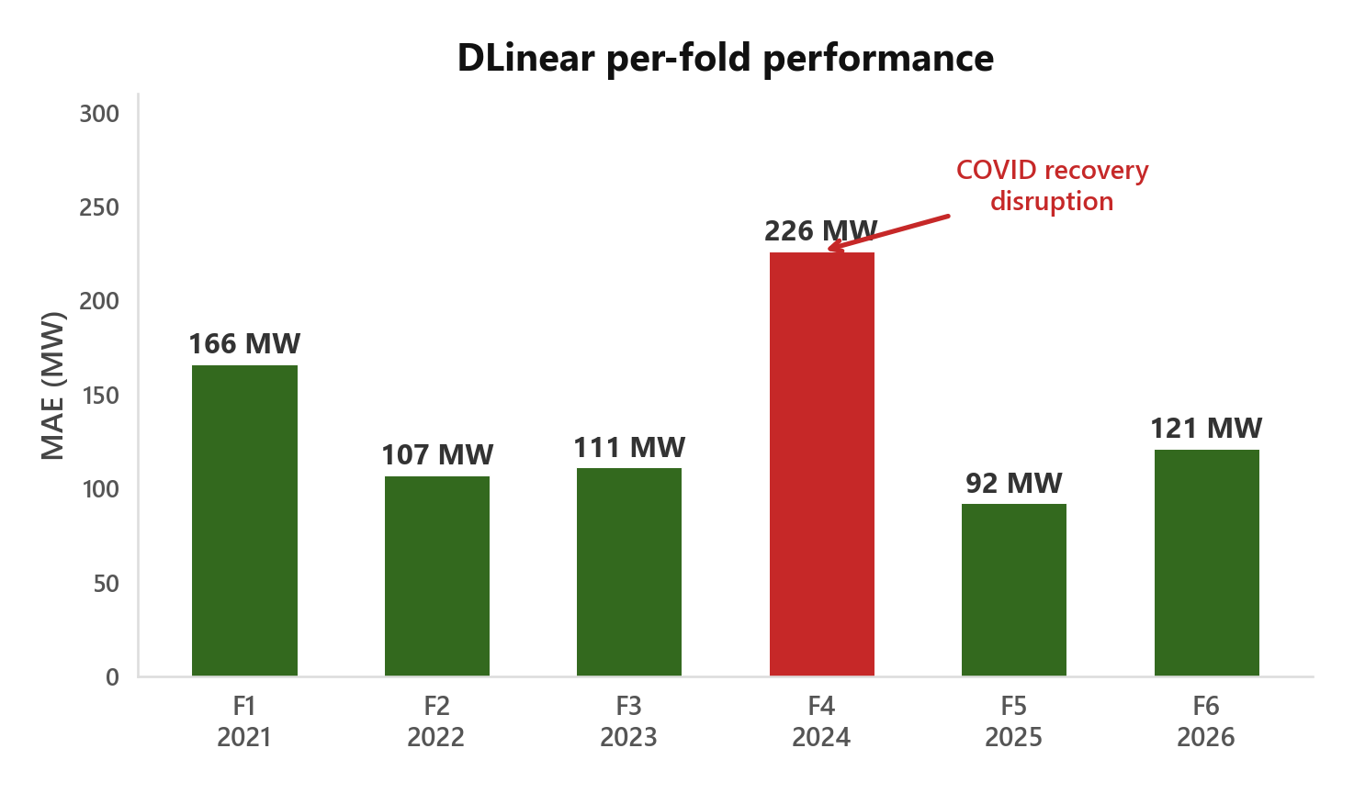
05 / Benchmarking — 6-fold expanding-window CV across 8 years
DLinear Beat Transformers, LSTMs, and CNNs — Here's How.
Model | Mean MAE | +TIDE | Gain
DLinear · 36K params | 91 MW | 67 MW | −26%
CNN (WaveNet) · 1.2M | 97 MW | 74 MW | −23%
LSTM · 840K | 102 MW | 79 MW | −23%
Transformer · 2.1M | 109 MW | 82 MW | −24%
Why DLinear Won
DLinear = Decomposition Linear. It splits load into two parts:
→ Trend — gradual direction (is demand going up or down?)
→ Seasonal — daily/weekly rhythm (morning peak, weekend dip)
Each gets a learned weight plus calendar info. They sum to the forecast. No attention. No recurrence. No convolutions.
Why it works: Load patterns aren't that complex. DLinear's 36K parameters capture the signal. The other models (1–2M params) fit noise. DLinear trains on a laptop CPU in minutes. The simplest model won — and every MW DLinear saves vs the Transformer means real fuel not burned at GridCo's dispatch.
6-fold expanding window · 8 years of data · TIDE = Trend-adjusted Iterative Debiasing Engine

Slide 7
06 / Results — Raw DLinear before any correction
DLinear's Performance Before Correction.
Horizon | MAE | MAPE
Day-Ahead (24h) | 121 MW | 4.22%
Week-Ahead (168h) | 163 MW | 5.30%
Month-Ahead (720h) | 104 MW | 3.40%
MAE vs MAPE — Why Both?
MAE: Average error in megawatts. What GridCo dispatchers feel — they dispatch in MW.
MAPE: Error as a percentage. Useful across different load levels. 121 MW is ~3.9% at peak but larger at low load.
The 2024 Spike
Fold 4 hit 226 MW — more than double the average.
COVID recovery broke the pattern. A model that worked in 2023 failed in 2024.
This is why 6-fold CV matters: one number hides regime-dependent failure.
One model handles all three horizons. 720h lower than 168h because longer horizons average out daily variation.
Fold | Test Year | MAE | Context
F1 | 2021 | 166 MW | COVID recovery disruption
F2 | 2022 | 107 MW | Stable recovery
F3 | 2023 | 111 MW | Moderate growth
F4 | 2024 | 226 MW | Growth discontinuity — spike
F5 | 2025 | 92 MW | Pattern stabilized
6-fold mean: 110 MW · Range: 92–226 MW

Slide 8
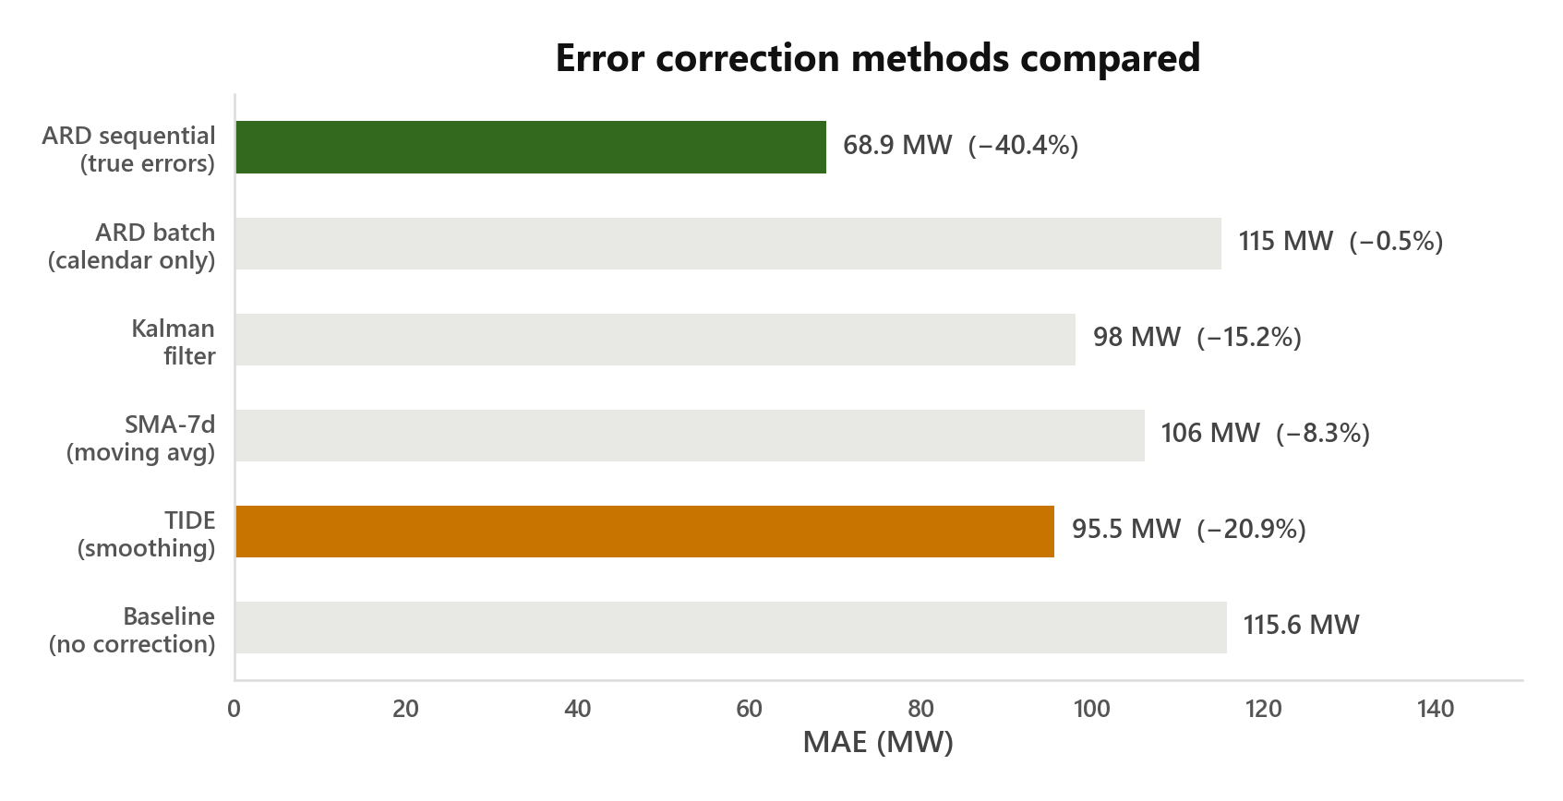
07 / Correction — Learning from prediction errors
Good Results — But Errors Told a Different Story.
Errors Are Not Random
We checked the residuals. Normally a good model's errors look like noise. Ours didn't. Correlation of 0.79 between consecutive hours. If we over-predicted hour 0, we'd over-predict hour 1 too. Errors have structure. That makes them learnable.
TIDE — A Smart Filter
Zero parameters. No training. Dampens recent errors using a weighted average. Learns how much to trust the latest mistake vs. the long-term trend.
Result: 95.5 MW (−20.9%)
ARD — Probabilistic Fix
Bayesian model that learns persistent bias: 'DLinear always over-predicts Tuesday 19h by 15 MW.' Only works with true error access (sequential mode).
Result: 68.9 MW (−40.4%)
The Critical Finding
TIDE works because it has access to recent errors. ARD without error history? Useless.
A streaming model — correcting hour-by-hour as actuals arrive — unlocks the full 40% gain. And it does so with near-zero operational cost while saving GridCo real fuel and money on dispatch.
All methods: Baseline 115.6 · TIDE 95.5 (−21%) · SMA-7d 106 · Kalman 98 · ARD batch 115 · ARD sequential 68.9 (−40%)
TIDE = Trend-adjusted Iterative Debiasing Engine · ARD = Automatic Relevance Determination

Slide 9
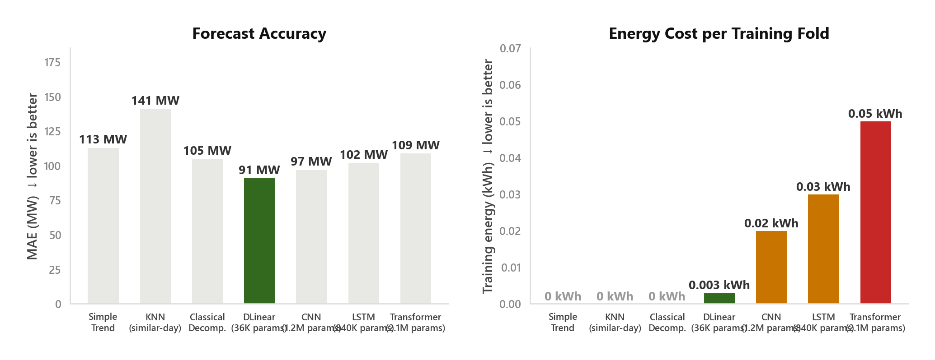
08 / Energy — How better accuracy saves real fuel and emissions
Better Forecasts Don't Just Improve Numbers — They Save Fuel.
The Fuel Story. 50 MW less error → 50 MW dispatched correctly every hour. No wasted fuel from over-generation. No expensive peaker scramble from under-generation. At ~0.4 tCO₂/MWh, that's ~20 tCO₂ saved per hour of avoided over-gen.
The Money Story. GridCo's peaker plants cost $150–300/MWh. A 50 MW under-forecast mistake can cost thousands per hour in fast-ramping generation. DLinear cuts that error by 35–50%. At 12.4% demand growth, the cost of being wrong compounds yearly.
The Annual Picture. 50 MW avg × 24h × 365d = 438,000 MWh/year of better dispatch decisions. The model trains for 0.003 kWh per fold. The operational savings — fuel, emissions, peaker avoidance — are millions of times larger.
Training energy measured with CodeCarbon · Gas turbine: ~40% efficiency, ~0.4 tCO₂/MWh · Peaker fuel ~$150/MWh

Slide 10
09 / Takeaways — What this means for West African grids
What This Work Says About West African Grids.
Industrial Impact
→ Replaced a ~45-minute manual Excel workflow with a ~1-minute automated process
→ Web application deployed at GridCo — forecast auto-fills the dispatch schedule
→ Operators stay in control: accept, edit, or override any forecast
→ Designed for semi-annual retraining as new data arrives
→ Fuel savings: 50 MW better accuracy = ~438,000 MWh/year smarter dispatch — less fuel burned, lower emissions, cheaper operations
For West African Grids
Stationary data is a myth here. European grids grow 0–1% yearly. Ours: 12.4%. Models from mature grids degrade fast.
6-fold CV is non-negotiable. Model rankings change year to year (2024's 226 MW spike). A single test year can mislead.
Accuracy is fuel efficiency. Every MW of forecast error is a MW misdispatched — wasted fuel or expensive reserves. Better forecasts = leaner, cheaper grid.
Streaming is the path forward. The 40% gain proves that error autocorrelation is our strongest signal. Batch can't use it.
Short-term
Deploy robust correctors (TIDE-style) — reliable gains without new infrastructure
Medium-term
Incorporate external drivers: electrification rates, GDP, urbanisation as model features
Long-term
Streaming DLinear with continuous real-time correction — lightweight model + live error feedback
"The grid will keep changing. Research must change with it. The simplest model won — but streaming correction unlocks what batch cannot touch."
KNUST × GridCo · DLinear+H10 · PRODUCTION READY

