Slide 1

KNUST × GRIDCO
REVOLUTIONIZING LOAD FORECASTING
From Academic Research to Production Impact for Ghana's National Grid

Slide 2

02 / Aims — What we set out to achieve
Five Aims for This Academia–Industry Collaboration.
1. Accurate, Robust Forecasting
Develop a data-driven load forecasting model for Ghana's national grid that handles rapid demand growth (12.4% CAGR), distribution shifts, and limited feature availability — outperforming both operator heuristics and imported deep learning architectures.
3. Production Deployment
Package research into a web application deployed at GridCo's dispatch centre — replacing a manual Excel workflow with automated process. Keep operators in control.
4. Sustainable AI
Prove that accurate grid forecasting does not require GPU infrastructure or massive energy budgets
Aim at energy efficient ai oriented archiectures
2. Error Correction
Go beyond raw predictions. Study residual errors to build second-stage correctors that extract an additional 20–40% accuracy gain from autocorrelated error patterns.
5. Insights for West African Grids
Draw generalisable lessons about load forecasting in rapidly developing electricity grids where stationary data assumptions fail.

Slide 3
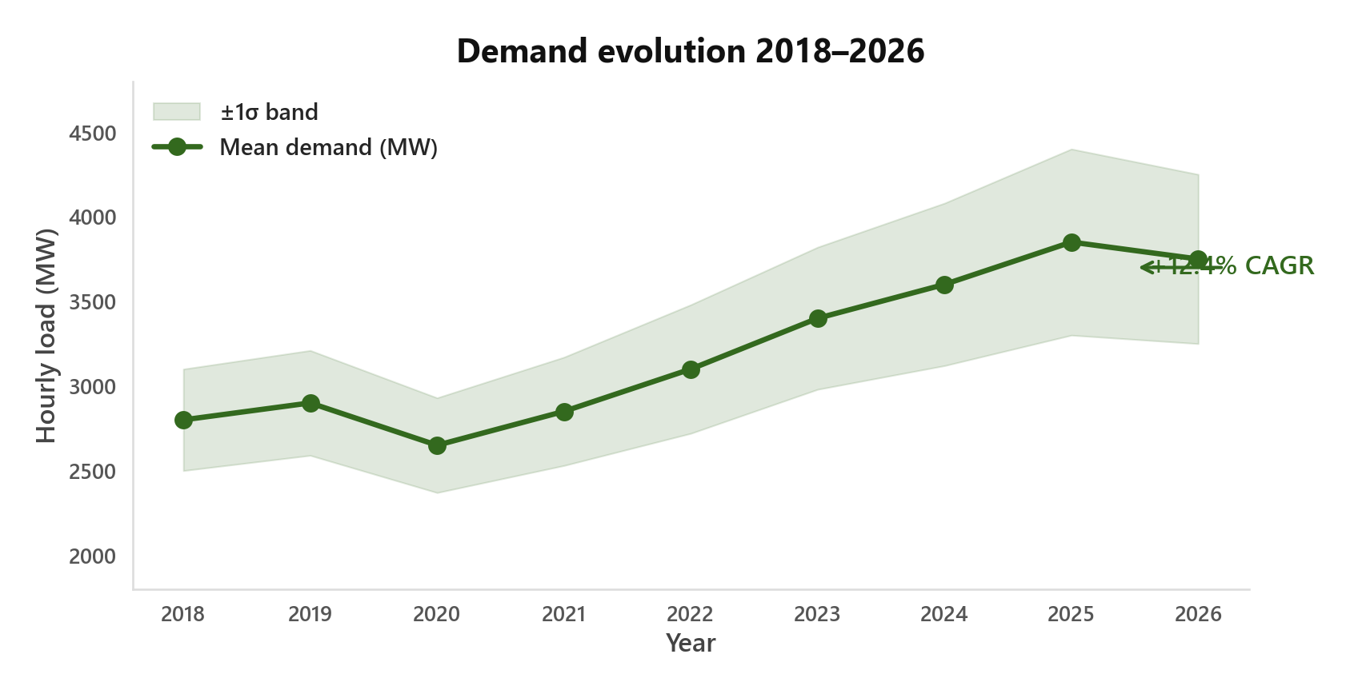
02 / The Data — 70k hours from Ghana's national grid
What the Data Tells Us About Ghana's Growing Grid.
Here's What We Found
Demand grew 2.5× in 8 years .
Applying state of the art models did not work always because of distribution shift
Online Correction gives the largest short term gains
Patterns That Jumped Out
→ Daily rhythm: Morning ramp. Evening peak. Overnight trough.
→ Weekly cycle: Weekdays high. Weekends low.
→ Seasons: Dry season ≠ wet season.
→ Growth: Upward drift across all 8 years.
Source: ECG SCADA · 12.4% CAGR = Compound Annual Growth Rate 2018–2026

Slide 4
03 / Current Practice — The operator's existing workflow
GridCo's Current Approach: Manual Heuristics
What They Do Today
Dispatchers use Excel with a similar day heuristics
No learning from 70k hours of data.
Each forecast starts from scratch.
We Tested Their Approach
Digitized the similar-day method as a KNN model.
Result: 141 MW MAE ~5% error .
Conclusion: Data-driven methods outperform human heuristics when given enough history.
So What Did We Build?
A system that complements the operator
Forecast auto-generates in ~1 minute. Fills the dispatch schedule automatically.
Operator stays in control. The forecast is a suggestion — accept, edit, or override.
KNN = k-Nearest Neighbours · MAE = Mean Absolute Error

Slide 5
03 / Foundations — Understanding data before modelling
We Started Simple. Here's What We Found First.
Patterns Jumped Out
→ Daily rhythm: Morning ramp. Evening peak. Overnight trough. Every day.
→ Weekly rhythm: Weekdays high. Weekends low. Predictable.
→ Seasons: Dry season ≠ wet season. Load changes with the calendar.
→ Growth: Upward drift across all 8 years. +12.4% CAGR in the raw data.
On temperature: It affects load — but it's slow-moving and already baked into hour and month features.
Resisted the Urge to Go Big
Most projects reach for deep learning first. We didn't. We asked: how far can simple methods take us?
First Try: Classical decomposition (trend + seasonality) → 3–4% MAPE
Second Try: Weighted trend (yesterday + last week)
MAPE = Mean Absolute Percentage Error · L1 = last 24 hours · L7 = last 7 days

Slide 6
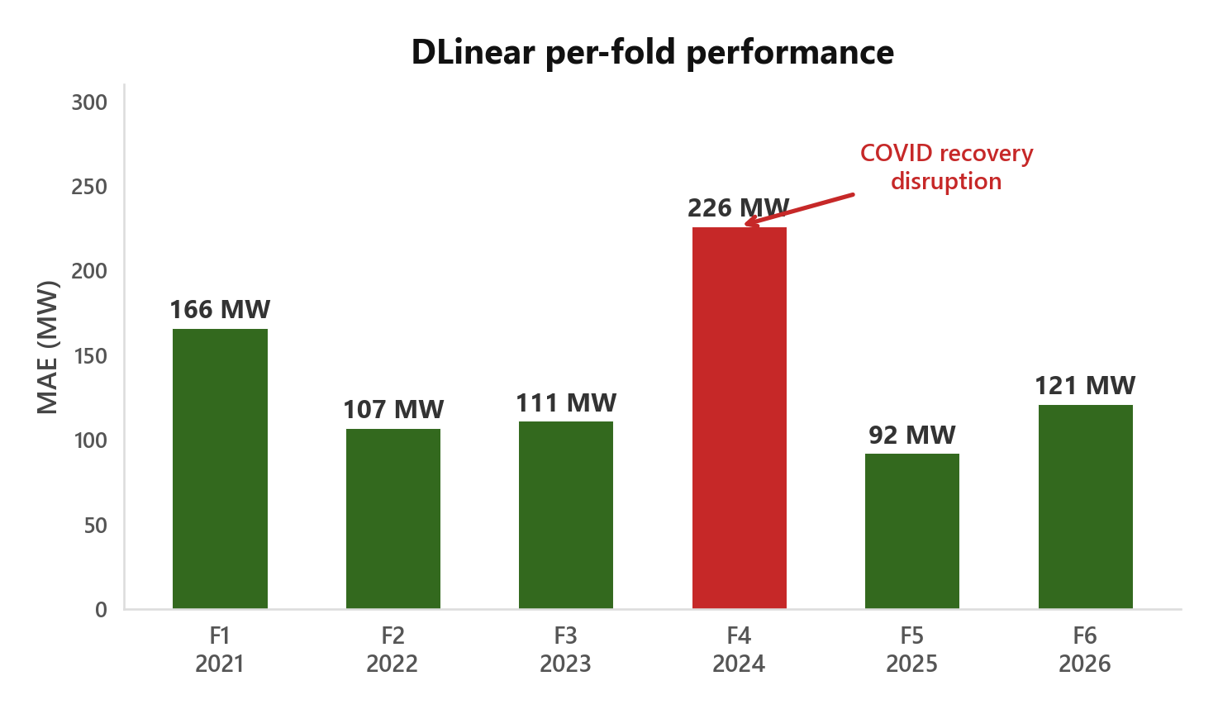
04 / Benchmarking — 6-fold expanding-window CV across 8 years
Simple Linear Decomposition(Dlinear) Beat state of the art models
Model | Average MAE(across all folds) | + correction | Gain
DLinear · 36K params | 91 MW | 67 MW | −26%
CNN (WaveNet) · 1.2M | 97 MW | 74 MW | −23%
LSTM · 840K | 102 MW | 79 MW | −23%
Transformer · 2.1M | 109 MW | 82 MW | −24%
Why DLinear Won
It splits load into two parts:
Trend — gradual direction (is demand going up or down?)
Seasonal — daily/weekly rhythm (morning peak, weekend dip)
Each gets a learned weight plus calendar info. They sum to the forecast. No attention. No recurrence. No convolutions.
Why it works: Load patterns aren't that complex.

Slide 7
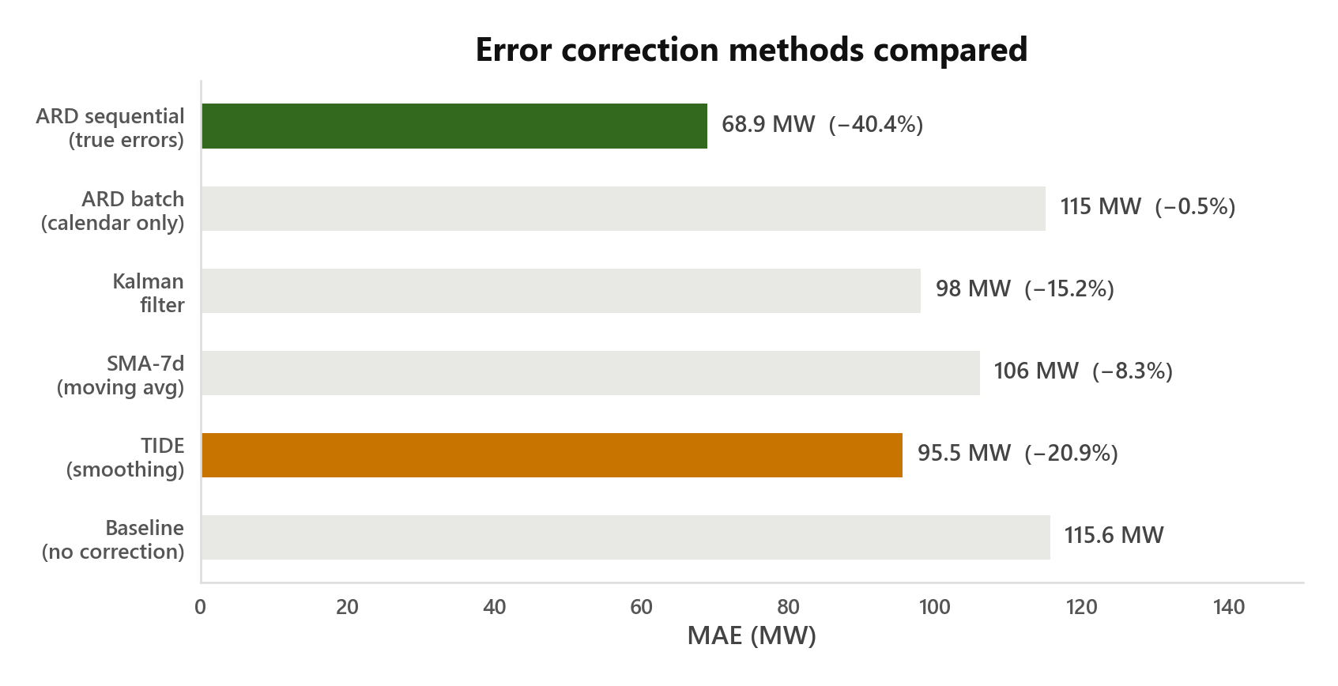
06 / Correction — Learning from prediction errors
Good Results — But Errors Told a Different Story.
Errors Are Not Random
Normally a good model's errors look like noise. Ours didn't.
Correlation of 0.79 between consecutive hours.( If we over-predicted hour 0, we'd over-predict hour 1 too ) . Errors have structure. That makes them learnable.
TIDE (Temporal integration of drift errors) — A Smart Filter
Zero parameters. No training. Dampens recent errors using a weighted average. Learns how much to trust the latest mistake vs. the long-term trend.
Result: 95.5 MW (−20.9% decrease over base dlinear model)
ARD(Automatic Relevance Determination) — Probabilistic Fix
Bayesian model that learns persistent bias: 'DLinear always over-predicts Tuesday 19h by 15 MW.' Only works with true error access (sequential mode).
Result: 68.9 MW (−40.4% over base dlinear model)

Slide 8
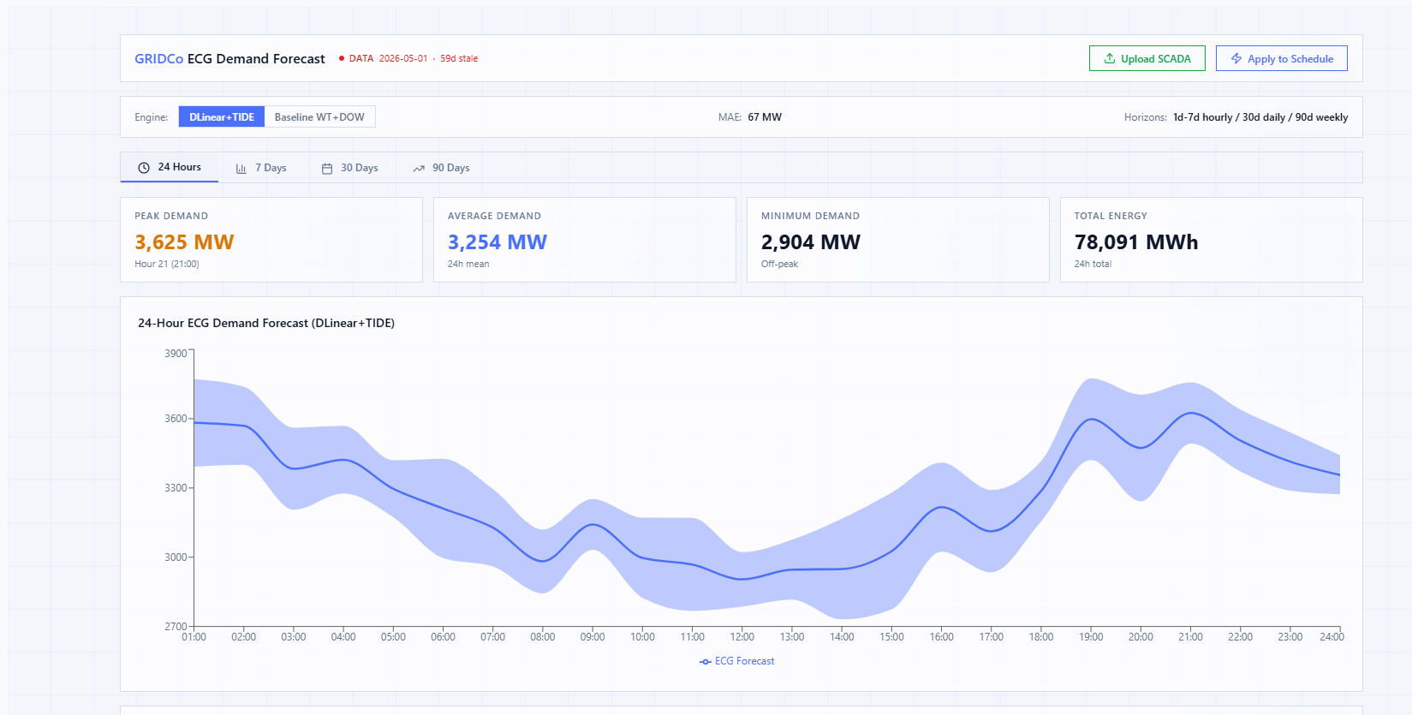
07/ Current Load forecast interface)
Current Load Forecast Interface

Slide 9
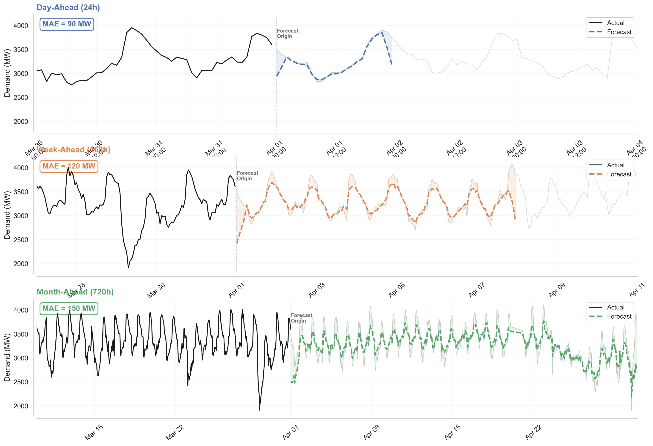
08/ Multi Horizon Performance
Multi-Horizon Performance of Deployed Model

Slide 10
09 / Energy — How better accuracy saves real fuel and emissions
Better Forecasts Don't Just Improve Numbers — They Save Fuel.
The Fuel Story. 50 MW less error → 50 MW dispatched correctly every hour. No wasted fuel from over-generation. No expensive peaker scramble from under-generation. At ~0.4 tCO₂/MWh, that's ~20 tCO₂ saved per hour of avoided over-gen.
The Money Story. Peaker plants are very expensive to run. A 50 MW under-forecast mistake can cost thousands per hour in fast-ramping generation. Machine learning integration is going to cut that error by 35–50%.
The Annual Picture. 50 MW avg × 24h × 365d = 438,000 MWh/year of better dispatch decisions. The model trains for 0.003 kWh per fold. The operational savings — fuel, emissions, peaker avoidance — are millions of times larger.

Slide 11
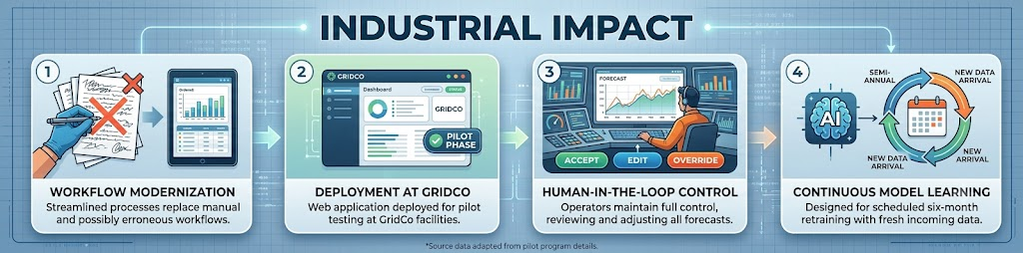
10 / Takeaways — What this means for West African grids (Undergoing rapid electrification)
Take aways and Impact of Work
For West African Grids
Stationary data is a myth here. European grids grow 0–1% yearly. Ours: 12.4%. Models from mature grids degrade fast.
CV is non-negotiable. Model rankings change year to year (2024's 226 MW spike). A single test year can mislead.
Streaming architecture is the path forward. Online correction proves that error autocorrelation is our strongest signal.
Sustainable AI is not optional. Our approach — 36K parameters, CPU-trained, 0.003 kWh per fold — proves you don't need massive compute for accurate forecasting. For developing grids, efficiency is a feature, not a trade-off.

