Slide 1
PSI & SI
By
Bhagyasri ksheerasagar

Slide 2
Agenda
• Transport streams
• packets, sections, tables, PES, demux
• DVB SimulCrypt
• architecture, synchronization, ECM, EMM, scrambling
• Standards
• MPEG, DVB, others

Slide 3
Transport streams packets and packetization

Slide 4
Standard key terms
Service / Program
• DVB term : service
• MPEG term : program
• TV channel (video and / or audio)
• data service (software download, application data)
• Signalization
• set of data structures in a transport stream
• describes the structure of transport streams and services
• Transport stream
« TS », « multiplex », « transponder »
continuous bitstream
modulated and transmitted using one given frequency
aggregate several services

Slide 5
MPEG-2 transport stream
Structure of MPEG-2 TS defined in ISO/IEC 13818-1
One operator uses several TS
TS = synchronous stream of 188-byte TS packets
• 4-byte header
• optional « adaptation field », a kind of extended header
• payload, up to 184 bytes

Slide 6
MPEG-2 transport stream
• Multiplex of up to 8192 independent elementary streams (ES)
• each ES is identified by a Packet Identifier (PID)
• each TS packet belongs to a PID, 13-bit PID in packet header
• smooth muxing is complex, demuxing is trivial
• Two types of ES content
• PES( Packetized Elementary Stream) : audio, video,
subtitles, teletext
• sections : data structures

Slide 7
MPEG-2 Transport Stream
MPEG-2 TS = multiplexing format
• For several TV channels
─ N * (Video + Audio(s) + Data) with different time bases
• Special Case: one program
─ Single Program Transport Stream (SPTS)
1 transport stream = sequence of transport packets
• Fixed size (188 bytes)
─ Helps integration with error correction tools
• Detection of data packet starts
• Synchronization after packet loss

Slide 8
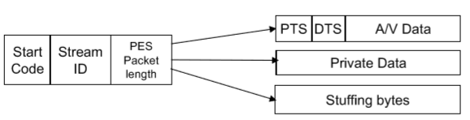
MPEG-2 Transport Stream
Two ways of transporting data
• Sections: meta data, EPG, etc…
─ Carousel
• PES Packets: audio, video
─ PTS+DTS, Clock
─ RAP, Size

Slide 9
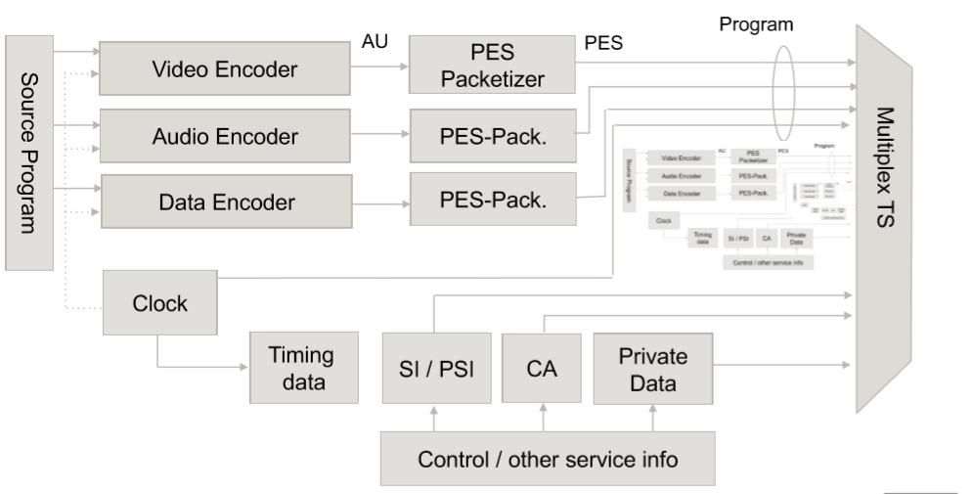
MPEG-2 Transport Stream

Slide 10
MPEG-2 transport stream
Structure of MPEG-2 TS defined in ISO/IEC 13818-1
• One operator uses several TS
• TS = synchronous stream of 188-byte TS packets
• 4-byte header
• optional « adaptation field », a kind of extended header
• payload, up to 184 bytes
• Multiplex of up to 8192 independent elementary streams (ES)
• each ES is identified by a Packet Identifier (PID)
• each TS packet belongs to a PID, 13-bit PID in packet header
• smooth muxing is complex, demuxing is trivial

Slide 11
Multiplex of elementary streams
• Two types of ES content
• PES, Packetized Elementary Stream : audio, video, subtitles, teletext
• sections : data structures
A transport stream is a multiplex of elementary streams
• elementary stream = sequence of TS packets with same PID value in header
• one set of elementary streams for global signalization
describe the TS, the network, the operator, the services, the events, EMM’s, etc.
• one set of elementary streams per service
• a service is typically a TV channel

Slide 12
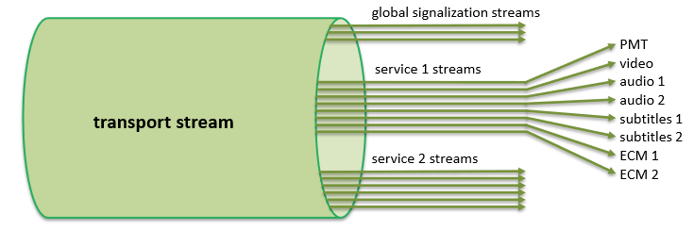
Multiplex of elementary streams

Slide 13
TS packet
4-byte header includes :
• Sync byte = 0x47
• PID : 13 bits
• Continuity counter : 4 bits
• Payload Unit Start Indicator (PUSI) : 1 bit
• Transport scrambling control : 2 bits
• Adaptation field presence : 1 bit
• Payload presence : 1 bit
Adaptation field may include :
• Program Clock Reference (PCR / OPCR)
• Private data
• Stuffing
(for PES stream padding)

Slide 14

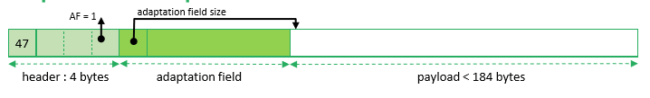
TS packet without adaptation field
TS packet with adaptation field

Slide 15
Multiplexing and demultiplexing
Elementary stream = concatenation of all payloads of all TS packets with same PID
Elementary stream transport
• packetization = cutting ES into packets payloads with same PID
• setting Payload Unit Start Indicator (PUSI) in TS header on « unit » boundary
• multiplexing = mixing with packets from other PID’s to build a complete TS
• demultiplexing = extracting all packets with same PID from TS
• depacketization = rebuilding ES from packets payloads with same PID
• using PUSI to resynchronize on « unit » boundary

Slide 16
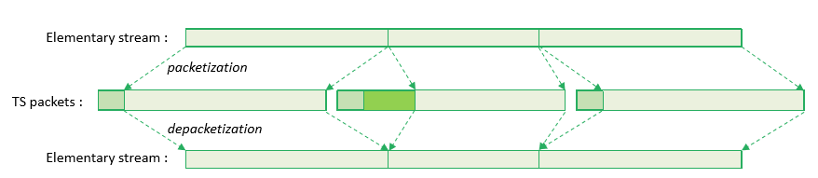

Slide 17
Packetized Elementary Stream (PES)
• A stream of PES packets
• up to 65536 bytes per PES packet
• start of PES packet identified by PUSI bit in TS header
• PES packets can contain
• video : MPEG-2 (H.262), AVC (H.264), HEVC (H.265), etc.
• audio : MPEG-2 Layer 2, AAC, HE-AAC, AC-3, DTS, DTS-HD, etc.
• DVB subtitles (text or bitmap)
• teletext (deprecated but still used)

Slide 18
Packetized Elementary Stream (PES)
One elementary stream contains one single type of content
• video
• audio for one language (with or without « audio description »)
• multi-channel audio (stereo, 5+1, etc.) within same PID
• subtitles for one language (with or without « for hard
of hearing »)
• exception : one teletext stream is a multiplex of several
text streams (« pages »)

Slide 19
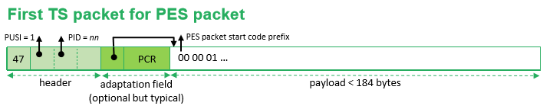

Typical PES packetization
First TS packet for PES packet
As many intermediate TS packets as required for current PES packet (multiplexed with TS packets from others PID’s)

Slide 20
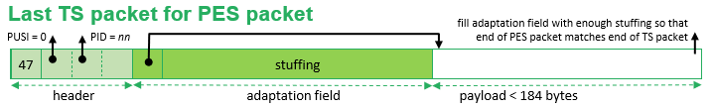
PES streams robustness
TS packet loss is tolerated in audio and video streams
• video « macro-block » effect
• audio « glitch » effect
• quality of recovery based on decoder implementation
TS packet loss detection based on continuity_counter
• 4-bit field in TS packet header
• cannot detect loss of an exact multiple of 16 TS packets
• resynchronization on next TS packet with PUSI
But video / audio decoders can resynchronize within PES packet
• video / audio bitstream formats usually contain synchronization patterns
• example : NAL unit boundary in AVC encoding

Slide 21
Sections streams
• Contain data structures named « tables »
• A table is split into one or more « sections »
• section = smallest data unit, up to 4096 bytes
• standard header and type-specific payload
• table type identified by table_id in header
• two types of section syntax : « short » and « long »
• based on 1 bit in header
• Each type of table defines its own syntax
• use long or short sections
• payload bitstream syntax

Slide 22

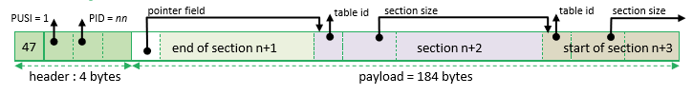

Typical section packetization
TS packet containing the start of section n+1
As many intermediate TS packets as required for section n+1 (multiplexed with TS packets from others PID’s)
Last TS packet for section n+1, start of next section

Slide 23
Tables with short section
One section per table
• section and table are equivalent
• Each table brings new information
• CAS EMM / ECM
• date and time information (TDT / TOT)
• No standard integrity check
• except section length in section header
• some table-specific mechanisms
• cryptographic integrity in EMM / ECM
• CRC32 in TOT

Slide 24
Tables with long sections
• Up to 256 sections per table
• need to receive all sections to rebuild the complete table
• Same table repeatedly cycled
• Content change notification
• version number in long section header
• each table is repeatedly broadcast with same version number
• version number changes when table content changes
• STB software sets demux filters to be notified of new tables only
• Integrity check
• CRC32 in each section
• section rejected in case of corruption, can be detected at demux level
• resynchronization on next TS packet with PUSI

Slide 25
Descriptor
• standard substructure with standard header and type-specific payload
• most tables use generic « lists of descriptors »
• Signalization: PSI / SI • PSI : Program Specific Info.
• MPEG-defined
• ISO / IEC 13818-1
• TS structure: PAT, PMT
• CA : CAT
• SI : Service Information
• DVB-defined
• ETSI EN 300 468
• private sections in MPEG terms

Slide 26
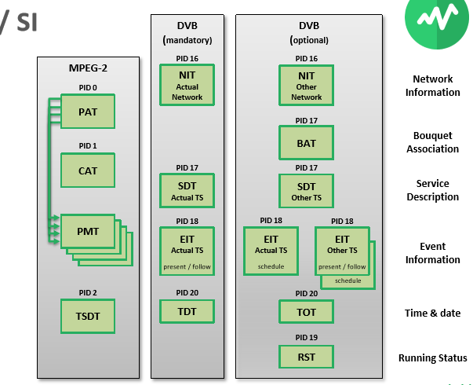

Slide 27
PSI-SI introduction
PSI & SI – what are they ?
Program Specific Information (PSI)
Defined in the MPEG-2 systems specifications
Provide information required to decrypt and display chosen event
PAT, PMT and CAT are three main tables in PSI
Service Information (SI)
Information on available services
Frequencies which carry these services
Common interest categories/groups for these services
Events in a service
Network details of service help manage revenue flow to service providers

Slide 28
Impacts of errors
Errors in Audio – Video
Cause annoyance to people watching the TV
Some glitches that users might put up with
Errors in Service Information
Improper data display (EPG, etc) could make it difficult for users to make purchasing decisions
Immediate loss of revenue for service provider

Slide 29
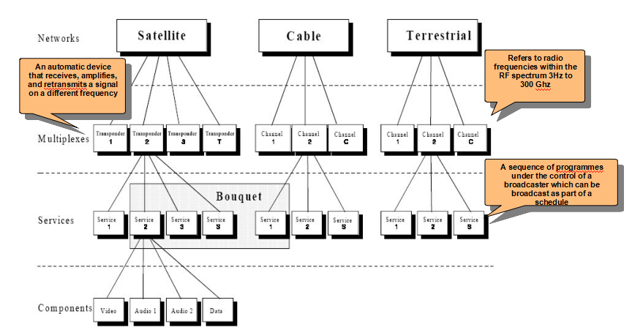
DVB Service delivery model

Slide 30
Why is PSI/SI required?
Automatic Tuning of receiver upon selection
TSID and channel number are required to tune
Program location
Program in BROADCASTING: set of elements having common start and stop times
Program in MPEG: collection of elementary streams with same PCR_PID and program number
EPG (Electronic Program Guide)
API (Application Programming Interface)
CA (Conditional Access)

Slide 31
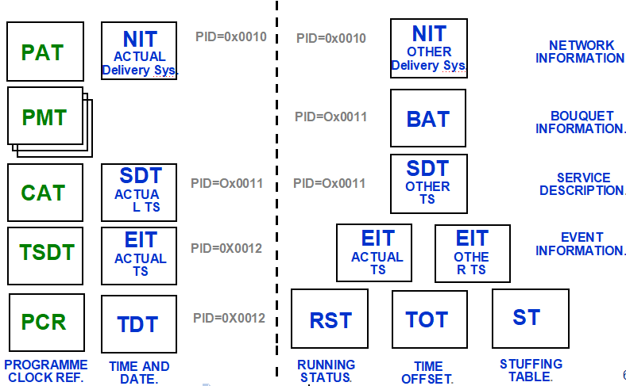
Table Structure – PSI & SI (MPEG-2 & DVB)

Slide 32
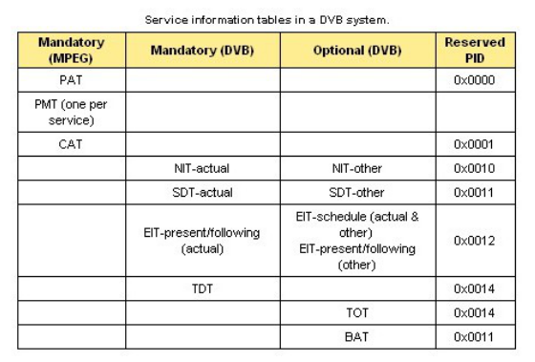
Table Structure – PSI & SI (MPEG-2 & DVB)

Slide 33
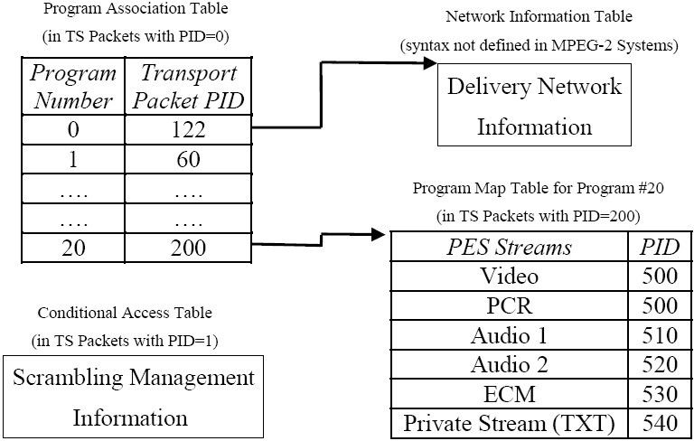
Example table associations - DVB

Slide 34
MPEG-defined PSI
PAT : Program Association Table
repeated in PID 0
list of « services » in the TS, ie. TV channels or data channels
service id and PMT PID
PMT : Program Map Table
technical description of one service
list of elementary streams in the service
PID, type (audio, video, etc.), additional info using a list of descriptors
list of ECM streams for this service
There is one PMT per service, but there may be more that one PMT on the same PID.

Slide 35
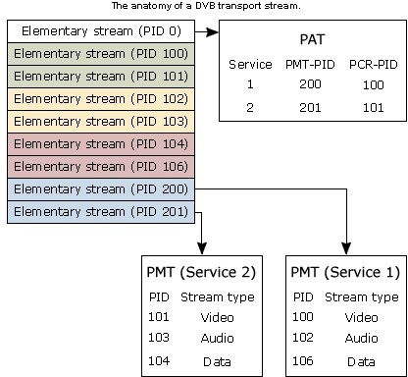
Structure of PAT and PMT tables

Slide 36
MPEG-defined PSI
CAT : Conditional Access Table
repeated in PID 1
list of EMM streams on this TS
CAT not present when no EMM on TS
This table controls the scrambling of a service.
It associates one or more CA systems with their EMM (Entitlement Management Message) stream and any other extra data that may be required.

Slide 37
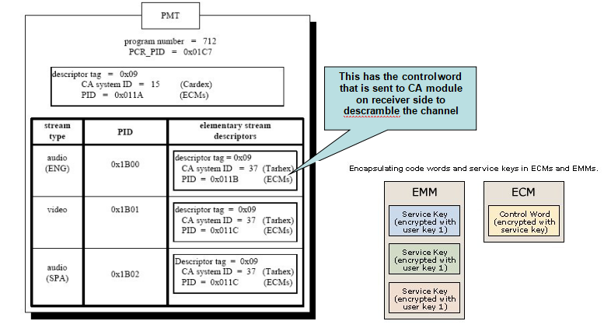
PMT with CAT information

Slide 38
DVB-defined SI
• SDT : Service Description Table
• editorial description of the services in a TS
• either in « actual » TS or « other » TS
•provides a name, language codes, running status and
country availability.
This DVB SI table describes the characteristics of available services.
It is located on PID 0x0011. Two types of SDTs are specified by DVB, the SDT Actual and the SDT Other.
The SDT Actual is a mandatory table that describes the services within the transport stream currently being accessed.
The SDT Other describes the services contained in other transport streams in they system.

Slide 39
DVB-defined SI
• BAT : Bouquet Association Table
• commercial operator description and services
• several commercial operators may sell the same services
• This DVB table describes a set of services grouped together by a broadcaster and sold as
a single entity. It is always found on PID 0x0011.
• NIT : Network Information Table
• technical description of a network
• either « actual » network or « other » network
• list of TS in this network
• usually with frequency and tuning parameters
• used for fast network scanning

Slide 40
DVB-defined SI
• list of services in each TS
• service ids and « logical channel number »
NIT:
The DVB table that contains information about a network’s orbit, transponder, etc. It is always located on PID 0x0010.
DVB specifies two types of NITs, the NIT Actual and the NIT Other.
The NIT Actual is a mandatory table containing information about the physical parameters of the network actually being accessed.
The NIT Other contains information about the physical parameters of other networks. The NIT Other is optional.

Slide 41
DVB-defined SI
EIT Event Information Table
Present/Following information allows events on a service such as classifications like “running”, “not running”, “paused”, “starts in a few seconds”.
Schedule information is arranged by table, sub-table, segment and section into 3 hours blocks within which the program guide information can be transmitted.
In general, the EIT information may be scrambled, although different countries may provide regulations which restrict this practise.

Slide 42
DVB-defined SI
• editorial description of events
• either in « actual » TS or « other » TS
• EIT « present / following »
• short description of current and next event on each service
• used to display information banner on screen
• EIT « schedule »
• long description of all events in the forthcoming days
• used to display the EPG
• optional, depends on operator’s good will and bandwidth availability
• complete 7-day EPG for a large operator uses several Mb/s
• sparse EIT schedule sections, rarely complete tables

Slide 43
DVB-defined SI
EIT Actual (DVB) :
Event Information Table. This table is part of the DVB SI. It supplies the list of events corresponding to each service and identifies the characteristics of each of these events.
Four types of EITs are defined by DVB :
1) The EIT Actual Present/Following supplies information for the present event and the next or following event of the transport stream currently being accessed. This table is mandatory and can be found on PID=0x0012.
2) The EIT Other Present/Following defines the present event and the next or following events of other transport streams in the system that are not currently being accessed by the viewer. This table is optional.
3)The EIT Actual Event Schedule supplies the detailed list of events in the form of a schedule that goes beyond what is currently or next available. This table supplies a schedule of events for the transport stream currently being accessed by the viewer.
4) The EIT Other Event Schedule supplies the detailed schedule of events that goes beyond what is currently or next available. This table supplies a schedule of events for other transport streams in the system that are not currently being accessed by the viewer. The EIT Schedule tables are optional

Slide 44
DVB-defined SI
TDT Time and Date Table
Provides UTC (Universal Time) coded as MJD (Modified Julian Date)
TOT Time Offset Table
Is used to provide time offsets to give local time.
RST Running Status Table
These are sent out only once to update the status of an event. The RST updates this information and allows timely automatic switching to events
ST Stuffing Table
Used to replace or invalidate tables.

Slide 45
DVB SimulCrypt
one network, several conditional access systems

Slide 46
Standard key terms
• CAS : Conditional Access System
• CW : Control Word
• content encryption key for video & audio
• EMM : Entitlement Management Message
• CAS-specific message to manage rights, smartcards, subscribers • sent to some identified set of subscribers, possibly only one
• ECM : Entitlement Control Message
• CAS-specific message to control a scrambled service
• sent to everyone willing to watch the service

Slide 47
DVB SimulCrypt
•Enforce coexistence of multiple CAS to protect the same content
• DVB-defined standard
• Use-cases
• one broadcast operator, multiple commercial operators
• transition between CAS generations
• Broadcast
• very simple architecture
• common scrambling
• multiple EMM and ECM streams with standard signalization
• Head-end
• complex architecture
• multiple CAS equipment
• common synchronization

Slide 48
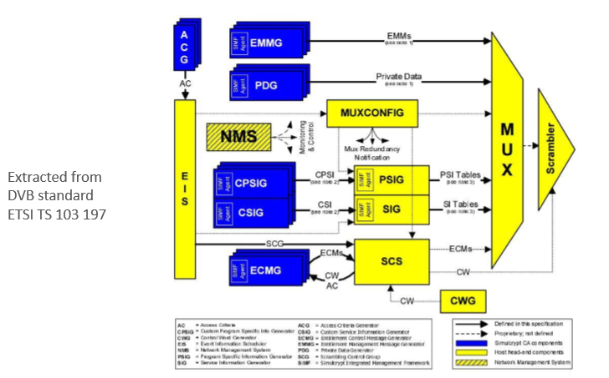
DVB SimulCrypt head-end diagram

Slide 49
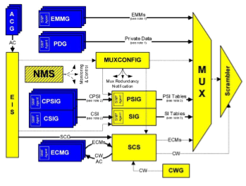
DVB SimulCrypt head-end
• Interface between two worlds
• one « MUX system » vendor
• yellow components
• multiple CAS vendors
• blue components

Slide 50
• DVB SimulCrypt protocols
• specified between components of distinct worlds
• protocols within the same world are not specified
• proprietary, vendor specific
• consistent nested tag-length-value (TLV) structures
• using logical « channels » and « streams »
• except ACG <=> EIS protocol (XML protocol)
• EIS <=> SCS protocol is specified
• so that EIS and SCS may in fact come from distinct vendors
• TSDuck plugins
• scrambler interacts with any standard ECMG
• datainject interacts with any standard EMMG or PDG

Slide 51
EMM signalization
• Using CA_descriptor in the CAT of the TS
• standard part of CA_descriptor: CA system id, EMM PID
• CA_system_id are allocated by DVB
• http://www.dvbservices.com/identifiers/ca_system_id
• private part of CA_descriptor: CAS-specific
• used by the CA software in the STB
• Number of EMM streams is CAS-specific
• for instance, one EMM stream may contain all EMM’s for
• one operator
• one EMM type (e.g. individual, group, global)
• or any other configuration
• when they exist, operator id and EMM types are CAS-specific concepts
• they are usually identified in the private part of the CA_descriptor

Slide 52
ECM broadcast
• An ECM usually transports a CW pair and access criteria
• specific to one or more audio or video streams
• specific to one CAS
• Each service (i.e. channel) has dedicated ECM streams
• per scrambling group
• per CAS
• base mechanism for DVB SimulCrypt
• Scrambling group
• a set of audio or video elementary streams scrambled with the same CW
• subtitles are usually not scrambled in practice (but could be in theory)
• usually, all audio and video streams of a service are in the same scrambling group
• in rare cases, audio and video streams are scrambled with distinct CW

Slide 53
ECM signalization
• Using CA_descriptor in the PMT of the service
• standard part of CA_descriptor : CA system id, ECM PID
• same as EMM signalization
• private part of CA_descriptor: CAS-specific
• used by the CA software in the STB
• CA_descriptor private part is usually different in CAT (EMM) and PMT (ECM)
• sample content : operator id, public subset of access criteria
• Two possible positions for CA_descriptors in PMT
• at program level
• only if one single scrambling group
• at stream level
• mandatory if different ES use different CW
• take precedence over program level if both are used for same CA_system_id

Slide 54
Scrambling synchronization
• During one crypto-period (CP) number N
• typically 10 seconds
• scrambling using same CWN
• ECMN carries CWN and CWN+1
• initial ECM broadcast delayed from start of CP (CAS specific)
• ECMN is repeated several times during CPN (typically 10 ECM/s)
• if first ECMN+1 is missed, the descrambler already knows CWN+1 anyway

Slide 55
Scrambling synchronization
• The CA software configures the descrambler with both CWN and CWN+1
• either N or N+1 is « even », the other one is « odd »
• TS packet header contains 2-bit transport_scrambling_control
• used by the descrambler to select the appropriate CW
• 00 : clear, do not descramble (MPEG-defined: ISO 13818-1)
• 10 : use even CW (DVB-defined: ETR 289)
• 11 : use odd CW (DVB-defined: ETR 289)
• Implemented in TSDuck plugin scrambler

Slide 56
Scrambling synchronization
• Based on crypto-period (CP) number
• CP numbers are sequentially allocated by SCS
• the full CP number stays on head-end
• its parity is used in TS packets and ECM’s

Slide 57
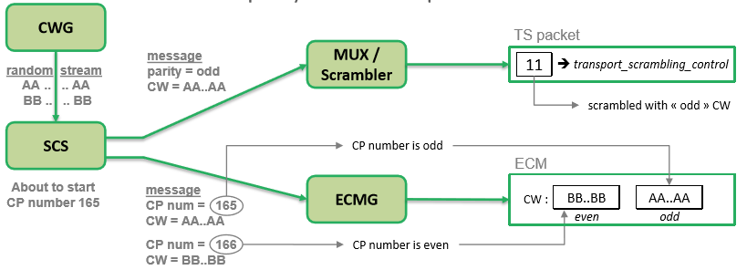
Scrambling synchronization

Slide 58
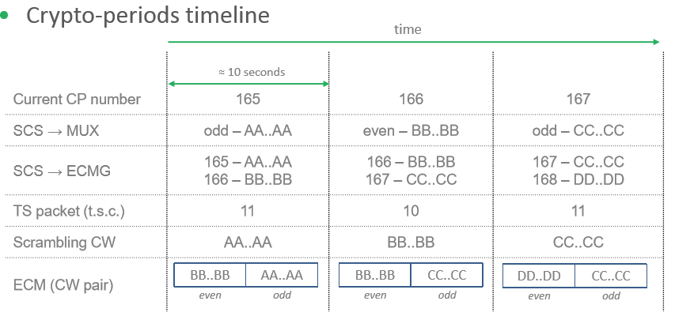
Scrambling synchronization

Slide 59
TS vs. PES scrambling
• ISO 13818-1 defines two possible levels of scrambling
• TS level
• each TS packet is scrambled individually
• clear TS header and adaptation field, scrambled TS payload
• PES level
• each demuxed PES packet is scrambled individually
• TS packet header marked as clear
• PES packet header contains similar 2-bit PES_scrambling_control
• clear PES header, scrambled PES payload

Slide 60
TS vs. PES scrambling
• In practice, only TS-level scrambling is used
• PES-level scrambling is technically much more difficult
• scrambling is performed on multiplexed TS
• ETR 289 specifies sub-scrambling of 184-byte super- blocks
• PES packet boundaries not aligned on crypto-period boundaries
• PES-level scrambling is never used in practice

Slide 61
EMM & ECM tables
• CA-private in DVB-defined range
• ETSI ETR 289 defines the range of private CA table ids
• 0x80 – 0x81 : ECM
• 0x82 – 0x8F : « CA private »
• defined as « short sections »
• no versioning
• each section is an independent new table

Slide 62
EMM & ECM tables
• Typical usage
• 0x80 and 0x81 alternating with crypto periods
• ECM table id change used as trigger by CA software
to submit ECM to smartcard or TEE
• ECM table id and CP number do not necessarily have
the same parity
• 0x82 – 0x8F used for EMM’s
• CAS-specific
• typically one table id for each EMM type, easier to filter in STB

Slide 63
Access criteria transition
• Use case : restricted event or pay-per-view event transition
• Scenario :
• the ECMG of each CAS had sent its own timing requirements to SCS
• SCS synchronizes the generation of the ECM from each CAS

Slide 64
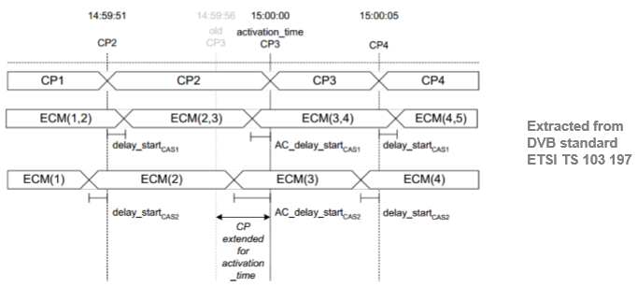
Access criteria transition

Slide 65
Clear-to-scramble transition
• Use case : Pay-TV channel with public periods in the clear
• Scenario :
• the ECMG of each CAS had sent its own timing requirements to SCS
• SCS synchronizes the generation of the ECM from each CAS

Slide 66
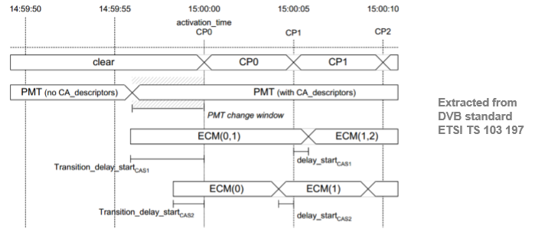
Clear-to-scramble transition

Slide 67
DVB CSA-2
• DVB Common Scrambling Algorithm
• DVB proprietary algorithm
• supposed to be « secret »
• fully described in Wikipedia
• open-source implementations online (libdvbcsa)
• Algorithm
• 64-bit key (also known as « Control Words » or CW)
• first pass : block cipher in reverse-CBC mode
• use CW as key
• block size : 64 bits
• residue ignored

Slide 68
How are the tables packed into transport streams?
Concept of Sections
Syntatic structure used to map MPEG-2 & SI tables into TS packets
Sections within each table limited to 1024 bytes, except EIT (4096b)
Elements of a section
Table ID – which table is being referred to
Table ID extension – which subtable is being referred to
Section number – applies only to sub tables
Version number – indicates newer versions of table sent earlier
Current next indicator – ‘now’ or ‘next’ – either table to be used for current event transmissions or for future!
Mapping of these tables into TS packets (ordering, stuffing, etc)

Slide 69
Service information acquisition and storage
▪Mode of transmissions and receptions
▪Data and object carousel way of transmitting schedules
▪SI parser on receiver end, which extracts PAT, PMT, SDT, EIT table information to retrieve mainly the list of services and events
▪Storage considerations
▪Embedded database to store information from these tables particularly the EIT and SDT to reproduce on EPG screen when requested by user
▪Customized databases, or choice of DBs like SQ-Lite (self-contained, serverless, zero-configuration, transactional SQL database engine)
▪Compression – any technique or using libraries such as zlib
▪Persistency of the DB cache into flash in file format

Slide 70
Table Sections
Pointer
Name | Number of bits | Description
Pointer field | 8 | Present at the start of the TS packet payload signaled by the payload_unit_start_indicator bit in the TS header. Used to set packet alignment bytes or content before the start of tabled payload data.
Pointer filler bytes | N*8 | When the pointer field is non-zero, this is the pointer field number of alignment padding bytes set to 0xFF or the end of the previous table section spanning across TS packets (electronic program guide).

Slide 71
Table header repeated until end of TS packet payload
Name | Number of bits | Description
Table ID | 8 | Table Identifier, that defines the structure of the syntax section and other contained data. As an exception, if this is the byte that immediately follow previous table section and is set to 0xFF, then it indicates that the repeat of table section end here and the rest of TS packet payload shall be stuffed with 0xFF. Consequently, the value 0xFF shall not be used for the Table Identifier
Section syntax indicator | 1 | A flag that indicates if the syntax section follows the section length. The PAT, PMT, and CAT all set this to 1.
Private bit | 1 | The PAT, PMT, and CAT all set this to 0. Other tables set this to 1.
Reserved bits | 2 | Set to 0x03 (all bits on)
Section length unused bits | 2 | Set to 0 (all bits off)
Section length | 10 | The number of bytes that follow for the syntax section (with CRC value) and/or table data. These bytes must not exceed a value of 1021.
Syntax section/Table data | data N*8 | When the section length is non-zero, this is the section length number of syntax and data bytes.

Slide 72
Table syntax section
Name | Number of bits | Description
Table ID extension | 16 | Informational only identifier. The PAT uses this for the transport stream identifier and the PMT uses this for the Program number.
Reserved bits | 2 | Set to 0x03 (all bits on)
Version number | 5 | Syntax version number. Incremented when data is changed and wrapped around on overflow for values greater than 32.
Current/next indicator | 1 | Indicates if data is current in effect or is for future use. If the bit is flagged on, then the data is to be used at the present moment.
Section number | 8 | This is an index indicating which table this is in a related sequence of tables. The first table starts from 0.
Last section number | 8 | This indicates which table is the last table in the sequence of tables.
Table data | N*8 | Data as defined by the Table Identifier.
CRC32 | 32 | A checksum of the entire table excluding the pointer field, pointer filler bytes and the trailing CRC32.

Slide 73
Descriptor
Name | Number of bits | Description
descriptor tag | 8 | the tag defines the structure of the contained data following the descriptor length.
descriptor length | 8 | The number of bytes that are to follow.
Descriptor data | N*8 | Data as defined by the Descriptor Tag.

Slide 74
MPEG-2 TS –Sections
Data Transport
• Data Blocs or « tables », of any type
• No real-time constraint
• Supports data repetition or update (carousel)
─ Version number
Table fragmentation: sections
• Maximum size: 1024 or 4096 bytes
• Current and total fragments: 8-bit
─ Max 256 sections / table
• 1 table < 256 KB or 1 MB
• Transport integrity: CRC32

Slide 75
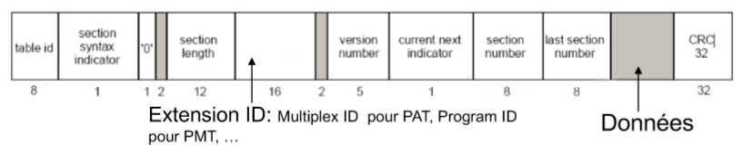
MPEG-2 TS –Sections
Table Multiplexing
• TableID
• Allows sending of different tables on a single PID

Slide 76
TS_Header_Field
Fixed packet size
188 bytes
Header 4 bytes:
• Synchronization word (1 byte): synchronization recovery when losses • Error flag: if errors are still present in the TS packet
• Packet Identifier (PID): packet destination
─ (13 bits: max 8192 destinations)
• Start flag: PES or Section first byte in this packet

Slide 77
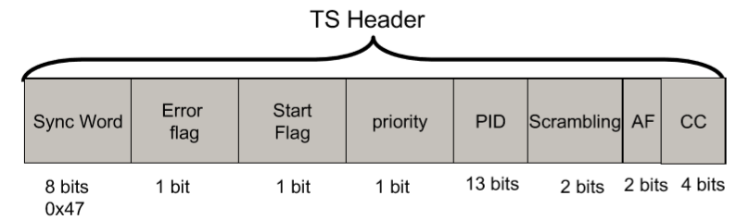
TS_Header_Field
Scrambling indicator
Adaptation Field
• For header extensions
• Random Access Point (RAP) indication
• Clock (PCR)

Slide 78
MPEG-2 TS Timing
Each program carries a clock
• Program Clock Reference (PCR)
• PES Timestamps relate to this clock
Constraints:
PCR shall be send often to compensate receiver clock drifts
─ MPEG-2 <100 ms
─ DVB: < 40 ms (i.e. once per frame @ 25 Hz)

