Slide 1
PRESENTED BY:-
Anish Paudel
Karun Sunwar
Sabin Pandey
Sarad Adhikari
PROJECT PROPOSAL
Bus Ticketing System

Slide 2
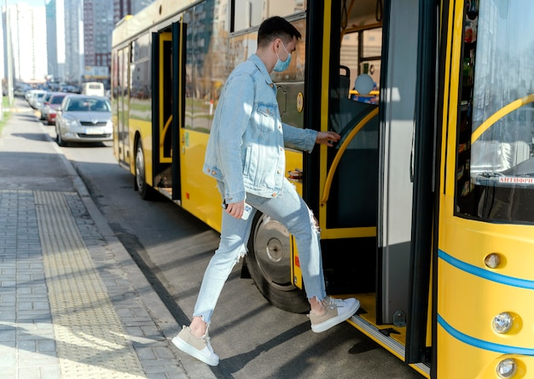
INTRODUCTION
THE BUS TICKETING SYSTEM IS:-
Web Application to manage Ticketing
Application built using Html, CSS, JS, PHP and Mysql
User-friendly
Modernize the public transportation experience

Slide 3
Problem Statement
01.
02.
03.
04.
Manual ticket booking causes human errors, overbooking, and schedule mismanagement.
Overcrowded ticket counters during peak times cause long queues and poor service.
Difficulty in handling refunds/cancellations adds to customer dissatisfaction.
Manual handwritten tickets can be easily lost, damaged, or forged.

Slide 4
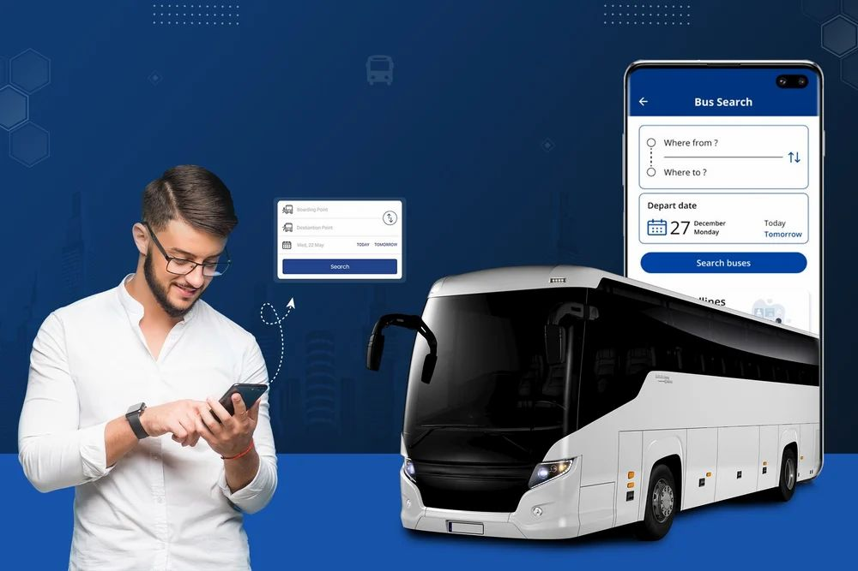
Objectives
· Enable seamless ticket booking and cancellation processes.
· Enhance route and schedule management.
· Implement robust transaction tracking and reporting.
· Ensure administrative control, role-based access, and system security.
· Ensure scalability and flexibility.

Slide 5

Gantt Chart

Slide 6
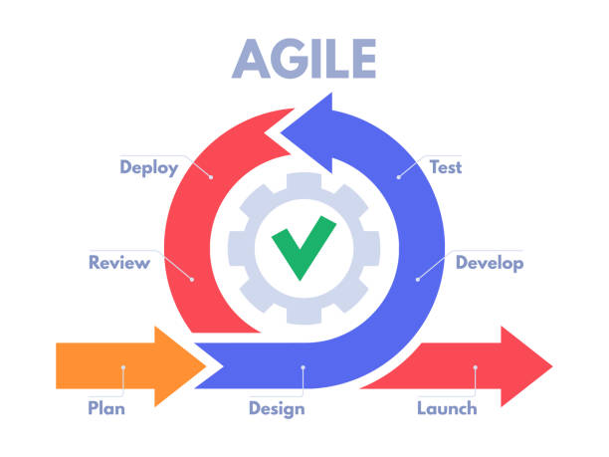
Development Methodology
Agile methodology is particularly well-suited for projects like this that require regular updates, evolving features, and client feedback. Development is broken into short cycles known as iterations or sprints (usually 1–3 weeks), where each sprint delivers usable features such as booking modules, seat selection, admin controls, or transaction tracking.

Slide 7
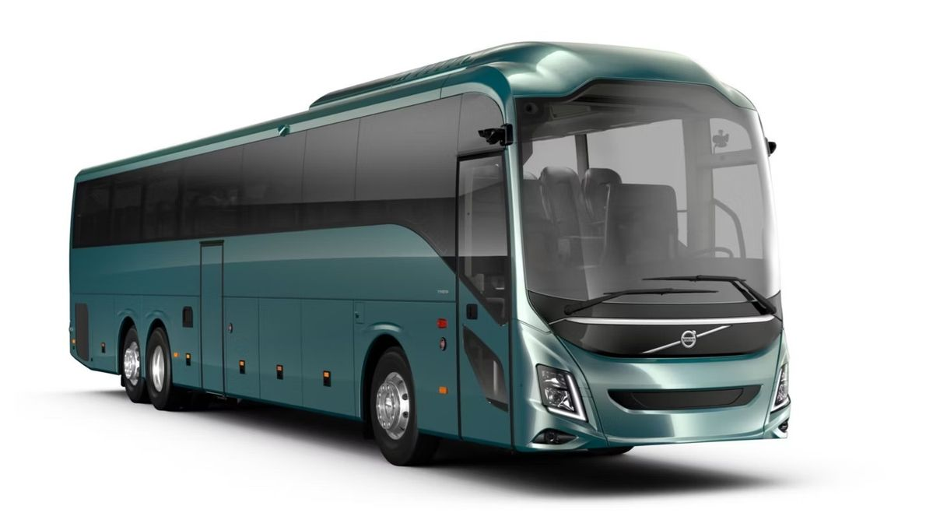
Deliverables
Software Requirements Specification (SRS) Document
Initial Prototype
Administrator Documentation
User Documentation
Test Cases and Test Reports
Training Materials

Slide 8
THANK YOU

