Slide 1
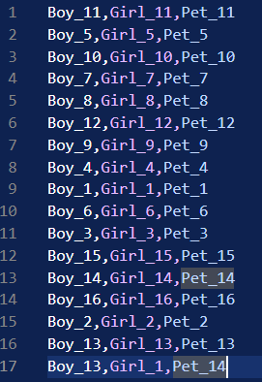
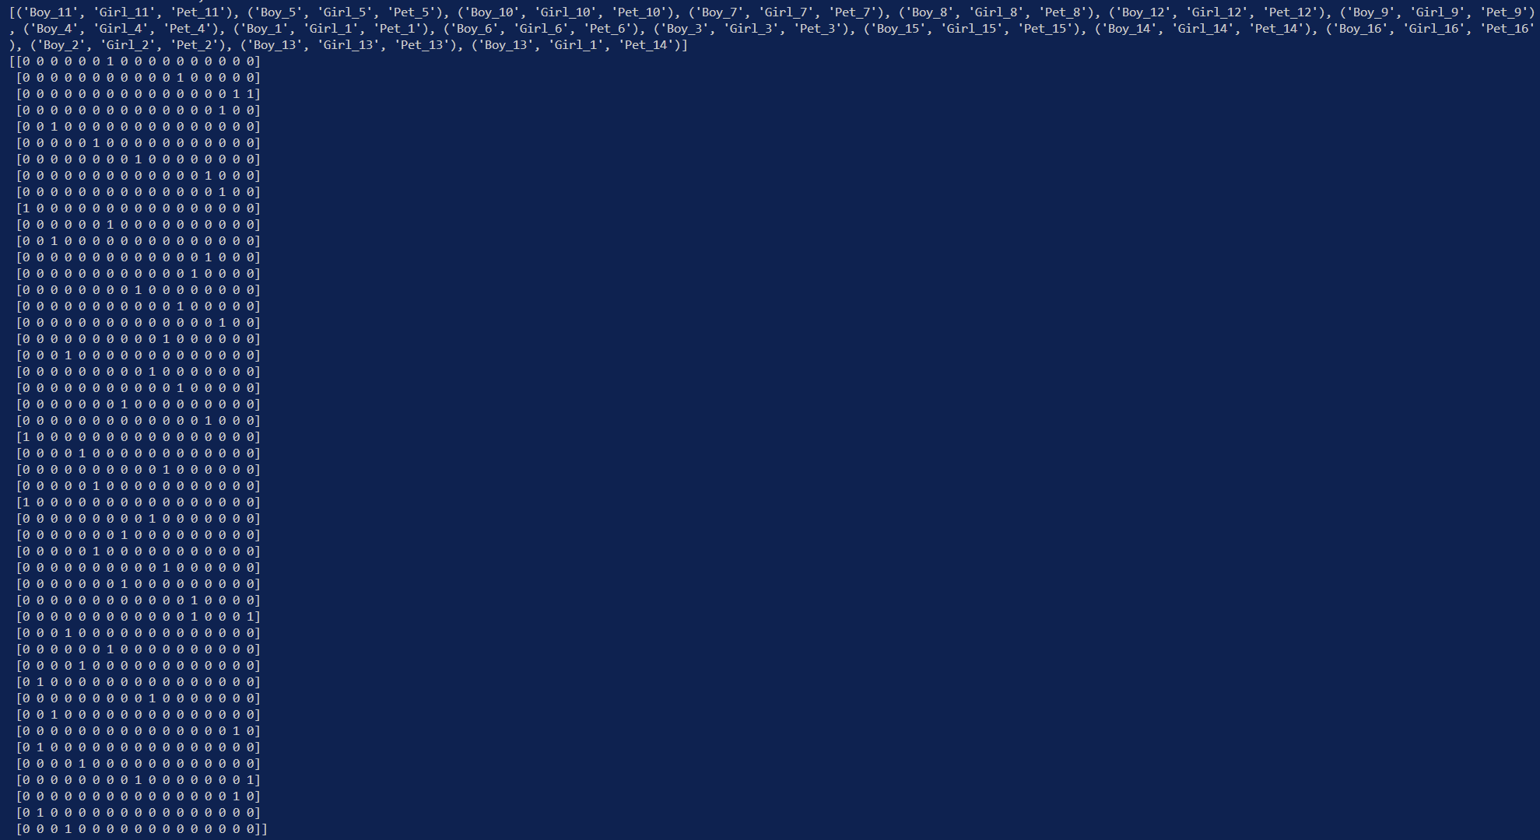
3D MATCHING TO ZOE TRANSFORMATION
Time Complexity = O(3n.|T|)
Where n = elements in each set.
|T| = size of the triples set (always ≥ n).
Thus, best case time complexity of this transformation is : O(3n.n) = O(3n²) ≈ O(n²)
Connections between 3 sets (Boys, Girls and Pets) i.e., Triples.
Converted to matrix A
Rows : all elements in sequential order of the input sets (Boys, Girl and Pets).
Columns : Triples with the element represented by the row number.
This now serves as input for ZOE, Ax=b where b ϵ {1} and x ϵ {0,1} are column vectors.

Slide 2
1. Simple Brute Force method.
To tackle this transformation, we used 2 techniques
This method continuously solves the equation Ax=b, until a x is found satisfying the equation.
Return the solution which is then represented as the solution for the original 3D Matching problem(M).
The time complexity for brute force is :
Complexity to get the matrix A : O(3n.|T|)
No. of loops in Brute Force = 2^{(|T|)} , which leads to complexity : O(2^{(|T|)} )
Complexity to multiply each value of x by A and matched with b : O(3n. |T|)
Complexity to transpose the solution of x back to 3D Matching : O(|T|)
Total Complexity = O(3n.|T|) + O(2^{(|T|)} ) + O(3n. |T|) + O(|T|)
Taking |T| = n (best case)
Total Complexity = O(3n²) + O(2^{n} ) + O(3n²) + O(n) ≈ O(2^{n} )

Slide 3
2. Multithreaded Brute Force method.
To tackle this transformation, we used 2 techniques
The iterative loop(2^{(|T|)} ) is broken down using multiple threads (t) which individually solve Ax = b, till any thread finds a solution.
Return the solution which is then represented as the solution for the original 3D Matching problem(M).
The time complexity for Multithreaded brute force is :
Complexity to get the matrix A : O(3n.|T|)
No. of loops in Brute Force = 2^{(|T|/t)} , which leads to complexity : O(2^{(|T|/t)} ) {t -> number of threads}
Complexity to multiply each value of x by A and matched with b : O(3n. (|T|)/t)
Complexity to transpose the solution of x back to 3D Matching : O(|T|)
Complexity to wait for each thread to return to the main() : O(c) {c -> some constant ≤ O(|T|/t)}
Total Complexity = O(3n.|T|) + O(2^{(|T|/t)} ) + O(3n. (|T|)/t)+ O(|T|) + O(c)
Taking |T| = n (best case) and c = O(|T|/t)
Total Complexity = O(3n²) + O(2^{n/t} ) + O(3n²) + O(n) + O(n/t) ≈ O(2^{n} ) + O(n/t)
We would assume that using multithreading we could get a solution faster. But that’s not the case, as the main() waits for each thread to ends it lifecycle and return the control.
We could kill threads as soon as any one thread returns the solution, but this would yield to potential memory faults in the system and erratic behavior of the main().

Slide 4
Pseudo-Inverse Method.
Using Relaxation {x ϵ R} (Not part of the main ZOE but a solution to 3D Matching)
This method computes the Pseudo-Inverse of A using Singular Value Decomposition of A.
Since we are using a relaxation x ϵ R we can compute x = A⁻¹b.
This gives us values closer to 1 where the triple is to be included in M and a value away from 1 where the triple can be ignored.
The time complexity for Pseudo-Inverse Method is :
Complexity to get the matrix A : O(3n.|T|)
Complexity to compute pseudo-inverse of A : O(n³)
Complexity to multiply A⁻¹b : O(|T|.3n)
Complexity to transpose the solution of x back to 3D Matching : O(|T|)
Total Complexity = O(3n.|T|) + O(n³) + O(|T|.3n) + O(|T|)
Taking |T| = n (best case)
Total Complexity = O(3n²) + O(n³) + O(3n²) + O(n) ≈ O(n³)
This method yields a much faster run time as compared to brute force method. But utilizes a relaxation which cannot be a part of ZOE.

